Slide 1
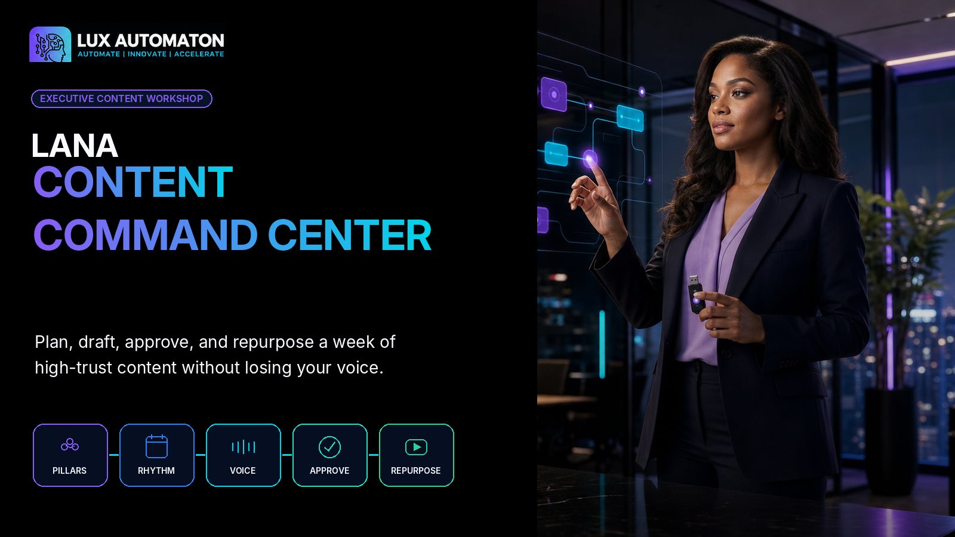

Slide 2

WORKSHOP OVERVIEW
One week. One source. One coordinated publishing system.
A practical 90-minute workshop for founders and small teams.
01
Define Your Content Pillars
02
Create a Weekly Publishing Rhythm
03
Draft Without Sounding Generic
04
Review and Approve
05
Repurpose into Video and Email
18 min Choose the recurring conversations your brand should lead, then create an evidence-rich bank of ideas inside each pillar.
18 min Give every publishing day a purpose and connect the work through one simple production board.
20 min Capture the founder's natural voice and use a structured drafting brief that gives AI real source material, boundaries, and intent.
17 min Separate drafting from approval, use a five-pass editorial review, and define the lane every asset follows before publication.
17 min Translate the approved idea into channel-native video and email while preserving the original insight and voice.
FINAL BUILD
A complete one-week Content Command Center containing a three-pillar strategy, a 15-idea bank, a weekly publishing board, one approved anchor post, a short-form video script, an email draft, and a documented review and approval workflow.
LANA CONTENT COMMAND CENTER
02

Slide 3
LEARNING FRAMEWORK
What learners will build
Every exercise creates an asset for the final Content Command Center.
✓
Define three durable content pillars tied to audience needs and business goals.
✓
Apply a repeatable human review and approval process before publication.
✓
Build a realistic weekly publishing rhythm with a clear job for each content touchpoint.
✓
Translate one approved idea into a short-form video and an email without simple copy-and-paste repetition.
✓
Create specific, evidence-rich drafts that retain the founder's natural voice.
✓
Leave with a ready-to-use one-week Content Command Center.
LANA CONTENT COMMAND CENTER
03

Slide 4
SAFETY AND PUBLISHING TRUST
Human approval stays in the loop
Protect source material, claims, rights, privacy, and audience trust.
• Do not paste confidential customer information, private conversations, contracts, credentials, health information, financial details, or unpublished strategy into a public AI tool.
• Use summaries, redacted examples, or approved enterprise/private systems when sensitive context is required.
• Verify names, dates, numbers, quotations, claims, links, and source attributions before publication.
• Keep a human approval gate for every customer-facing post, video, newsletter, or automated message.
• Do not imitate another creator's distinctive voice or reproduce protected content without permission.
• Use only photographs, music, screenshots, testimonials, and brand assets you have the right to publish.
• Avoid presenting generated examples, composite stories, or hypothetical results as real customer evidence.
• Make captions, transcripts, readable contrast, descriptive links, and alt text part of the publishing workflow.
Publish only when the source, rights, reviewer, approver, and response path are clear.
LANA CONTENT COMMAND CENTER
04

Slide 5
FACILITATION FLOW
Build as you learn
Each module advances one approved anchor idea.
1
2
3
4
5
→
→
→
→
Choose three pillars
Build a weekly rhythm
Draft from source and voice
Review and approve
Translate to video and email
FACILITATOR MOVE
Keep the learner working on one real audience, one source-backed idea, and one current week.
LANA CONTENT COMMAND CENTER
05

Slide 6
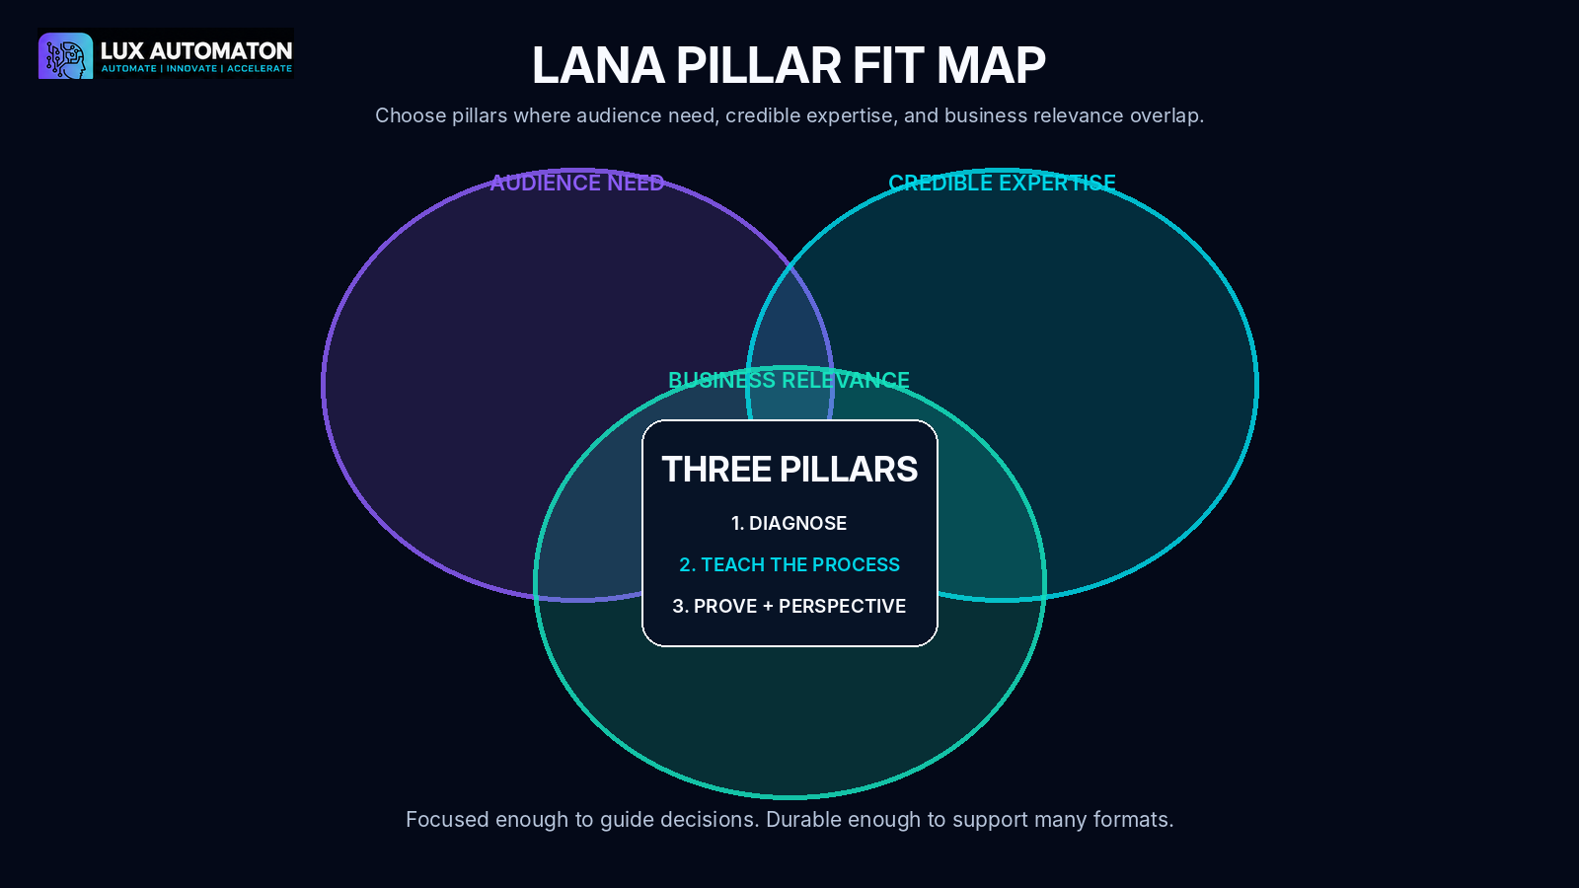
01
MODULE
DEFINE YOUR CONTENT PILLARS
A three-pillar strategy with clear purpose, boundaries, proof sources, and at least fifteen usable ideas.
FACILITATOR FOCUS
Choose durable conversations and source-backed ideas.
MODULE 01
06

Slide 7
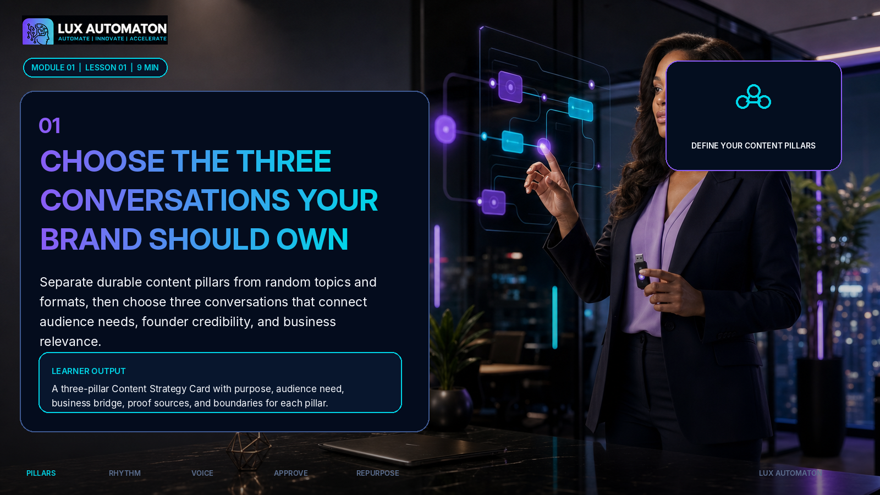
MODULE 01
07

Slide 8
LESSON 1
01
Pillar, topic, format, or campaign?
Choose a durable conversation, not a temporary container.
CONTENT PILLAR
TOPIC
A recurring conversation your audience needs and your business can credibly lead.
One specific subject inside a pillar.
FORMAT
CAMPAIGN
The delivery container: post, video, email, podcast, workshop.
A time-bound push with a start, goal, and end.
Test every pillar for audience pull + credible depth + business bridge.
LANA CONTENT COMMAND CENTER
08

Slide 9
HANDS-ON ACTIVITY
Complete the LANA Pillar Fit Map
Select three conversations and define what each includes and excludes.
1. Write the audience you want to help and the result they are trying to achieve.
2. List ten recurring questions, frustrations, decisions, or misconceptions you hear from that audience.
3. Group the items into three meaningful conversations rather than formats or platforms.
4. Score each conversation for audience pull, credible depth, and business bridge on a 1-5 scale.
5. Name the three strongest pillars and write one sentence describing what each includes and excludes.
DELIVERABLE
A three-pillar Content Strategy Card with purpose, audience need, business bridge, proof sources, and boundaries for each pillar.
LANA CONTENT COMMAND CENTER
09

Slide 10
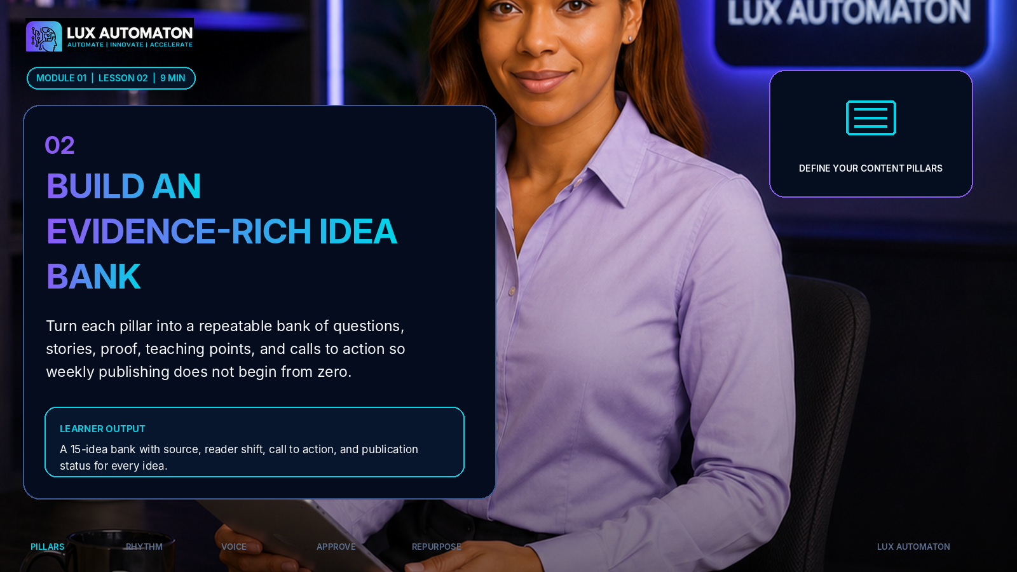
MODULE 01
10

Slide 11
LESSON 2
02
Build a 3 × 5 evidence-rich idea bank
Every idea keeps its source, reader shift, and publication status.
Question
Friction
Framework
Proof
Perspective
× 3 PILLARS
Approved source or summary
Reader shift
Possible next action
Approved / verify / private
Select one source-backed anchor idea for the rest of the workshop.
LANA CONTENT COMMAND CENTER
11

Slide 12
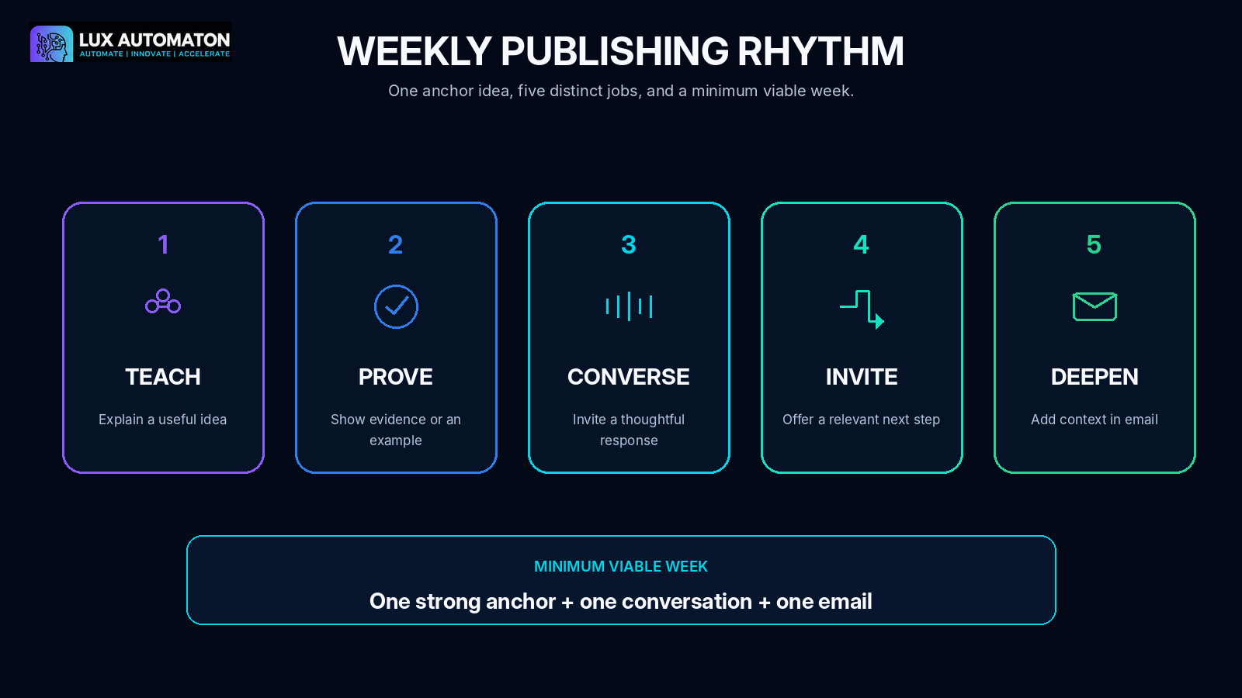
02
MODULE
CREATE A WEEKLY PUBLISHING RHYTHM
A realistic weekly rhythm and one-source production flow with owners, statuses, and deadlines.
FACILITATOR FOCUS
Make publishing capacity, roles, and next actions visible.
MODULE 02
12

Slide 13
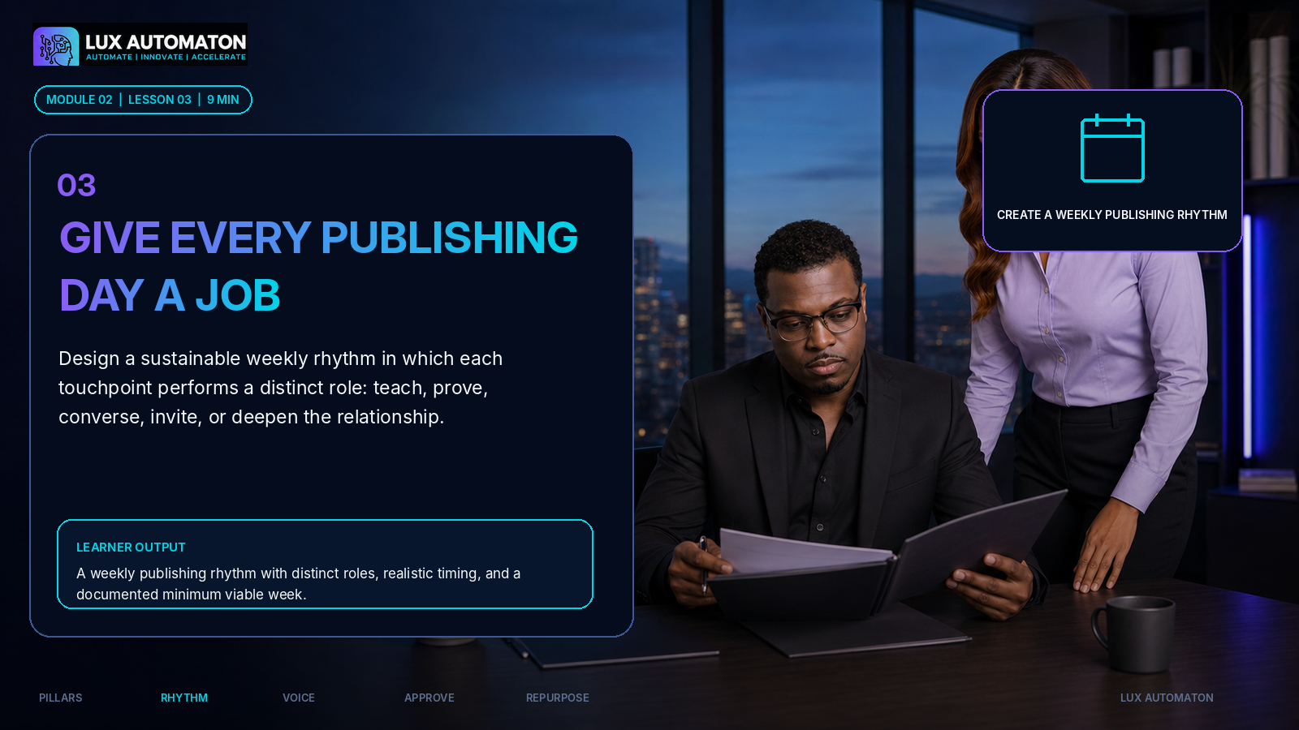
MODULE 02
13

Slide 14
LESSON 3
03
Give every touchpoint a job
Balance value, proof, conversation, invitation, and depth.
01
TEACH
02
PROVE
03
CONVERSE
04
INVITE
05
DEEPEN
Explain a useful idea or method.
Show evidence, a case, or a real example.
Invite response and learn from the audience.
Offer a relevant next step.
Add context through email, video, or a longer format.
MINIMUM VIABLE WEEK
Define what stays live when workload, approvals, or capacity tighten.
LANA CONTENT COMMAND CENTER
14

Slide 15
ACTIVITY
Map the weekly publishing rhythm
Work backward from publish date to draft, review, and approval.
• Choose a realistic three-, four-, or five-touch week.
• Name the pillar and strategic job for each touchpoint.
• Assign owner, reviewer, approval due date, and publish date.
• Leave a buffer for revision or delayed approval.
DELIVERABLE: weekly rhythm + minimum viable week
LANA CONTENT COMMAND CENTER
15

Slide 16
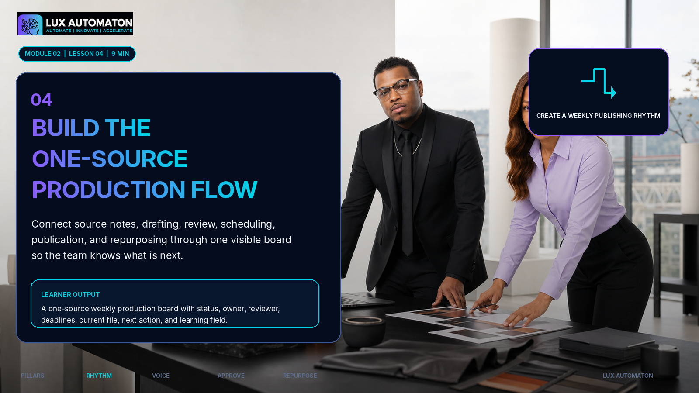
MODULE 02
16

Slide 17
LESSON 4
04
Build the one-source production flow
A board should show where the asset is, who owns it, and what happens next.
Captured
→
Drafting
→
Review
→
Approved
Scheduled
→
Published
→
Repurpose
→
Archived
Required fields: source • owner • reviewer • deadline • current file • next action • learning
LANA CONTENT COMMAND CENTER
17

Slide 18
HANDS-ON ACTIVITY
Create the weekly command board
Move the anchor through the first three statuses and assign the next action.
1. Draw the stages an asset follows from captured source to published archive.
2. Choose a short set of unambiguous status labels.
3. Define the required fields for every content record.
4. Assign an owner, reviewer, approval deadline, and next action to the selected anchor idea.
5. Add a post-publication learning field that feeds the idea bank.
ASSET
STATUS
OWNER
REVIEWER
NEXT ACTION
Anchor post
Drafting
Founder
LANA
Add proof
Short video
Captured
Founder
LANA
Translate
Email
Captured
Founder
LANA
Deepen
One current file. One owner. One next action.
LANA CONTENT COMMAND CENTER
18

Slide 19
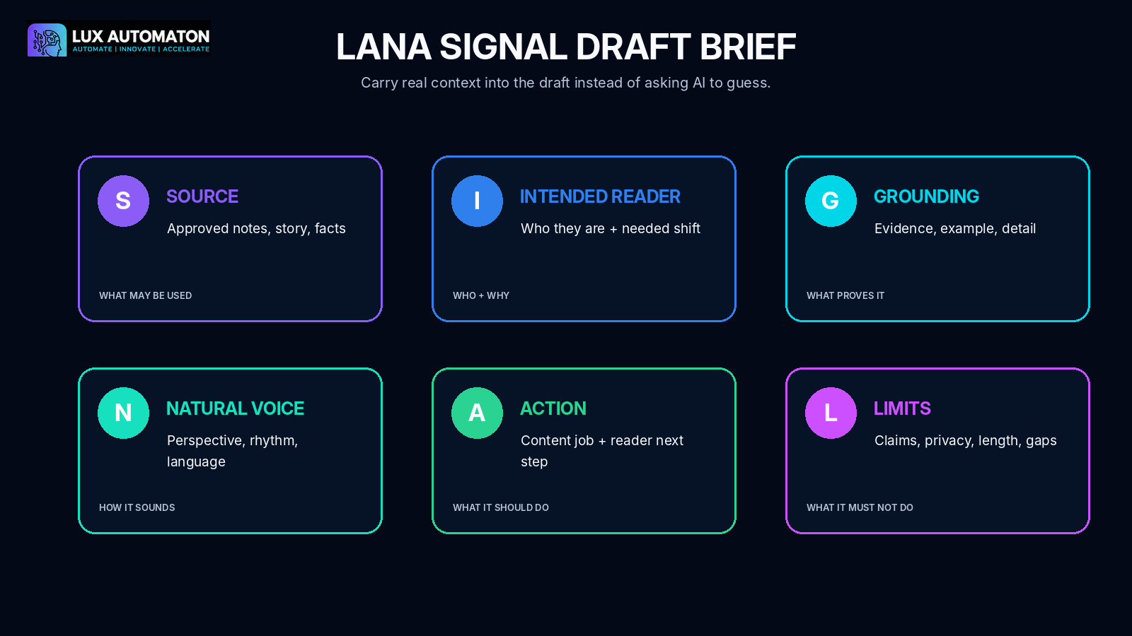
03
MODULE
DRAFT WITHOUT SOUNDING GENERIC
A reusable voice card, a SIGNAL draft brief, and one specific anchor post.
FACILITATOR FOCUS
Capture voice, source, reader, grounding, action, and limits.
MODULE 03
19

Slide 20
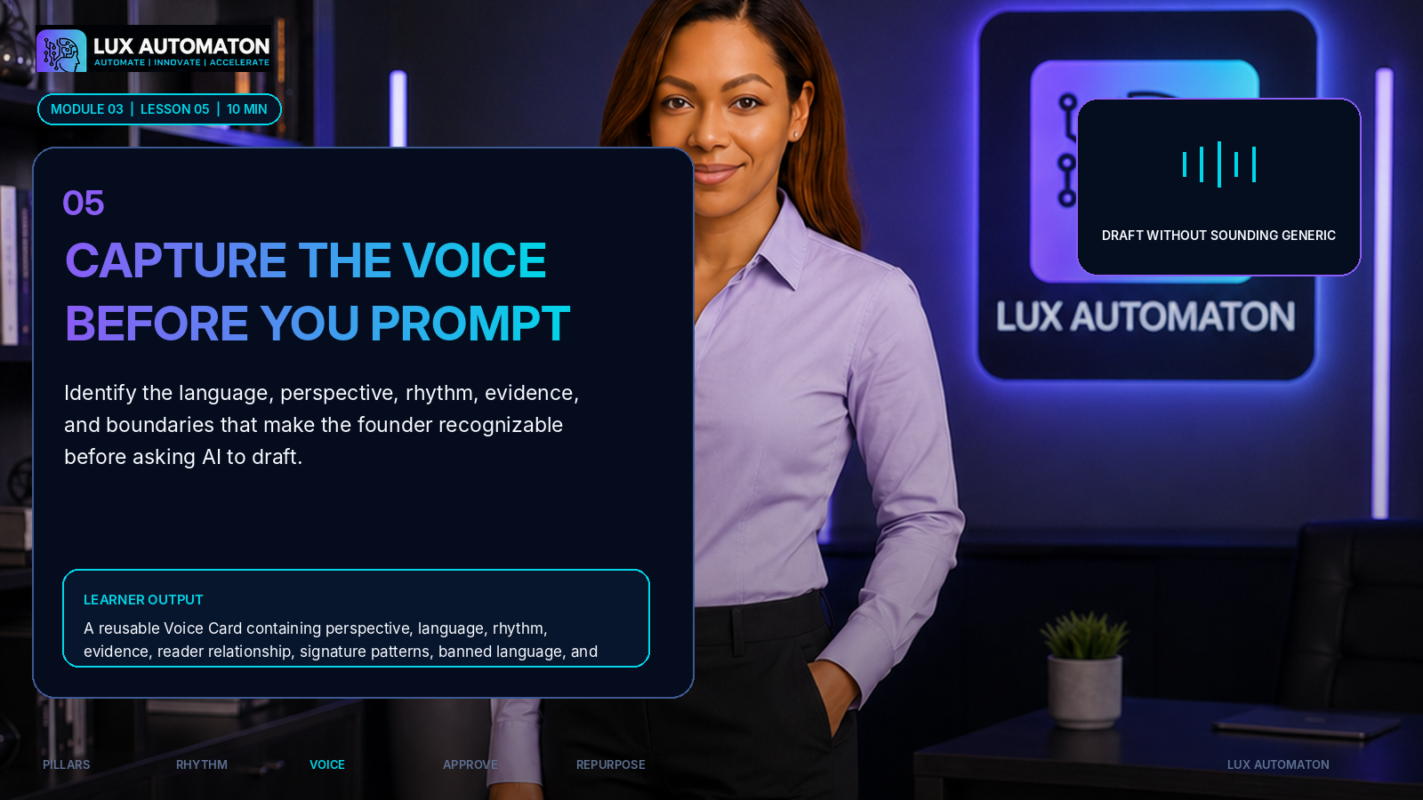
MODULE 03
20

Slide 21
LESSON 5
05
Capture the voice before you prompt
Use observable writing behaviors instead of vague personality adjectives.
PERSPECTIVE
LANGUAGE
RHYTHM
How do you interpret the problem?
What words and phrases feel natural?
How do sentences and explanations move?
EVIDENCE
RELATIONSHIP
BOUNDARIES
What examples or proof do you rely on?
How do you address the reader?
What must never be invented or exposed?
Voice rules must be specific enough that another writer can follow them.
LANA CONTENT COMMAND CENTER
21

Slide 22
HANDS-ON ACTIVITY
Build the LANA Voice Card
Extract patterns from two natural writing or speaking samples.
1. Collect two examples of writing or speaking that sound natural and credible.
2. Highlight perspective, language, rhythm, evidence, relationship, and boundaries.
3. Write five observable voice rules rather than vague adjectives.
4. Add three signature phrases or sentence patterns and three phrases to avoid.
5. State what the drafting tool must do when source information is missing.
TEST SENTENCE
“AI can help businesses create better content.”
Rewrite it with:
• Your perspective
• A concrete example
• Natural rhythm
• A clear boundary or caveat
• One reader action
LANA CONTENT COMMAND CENTER
22

Slide 23
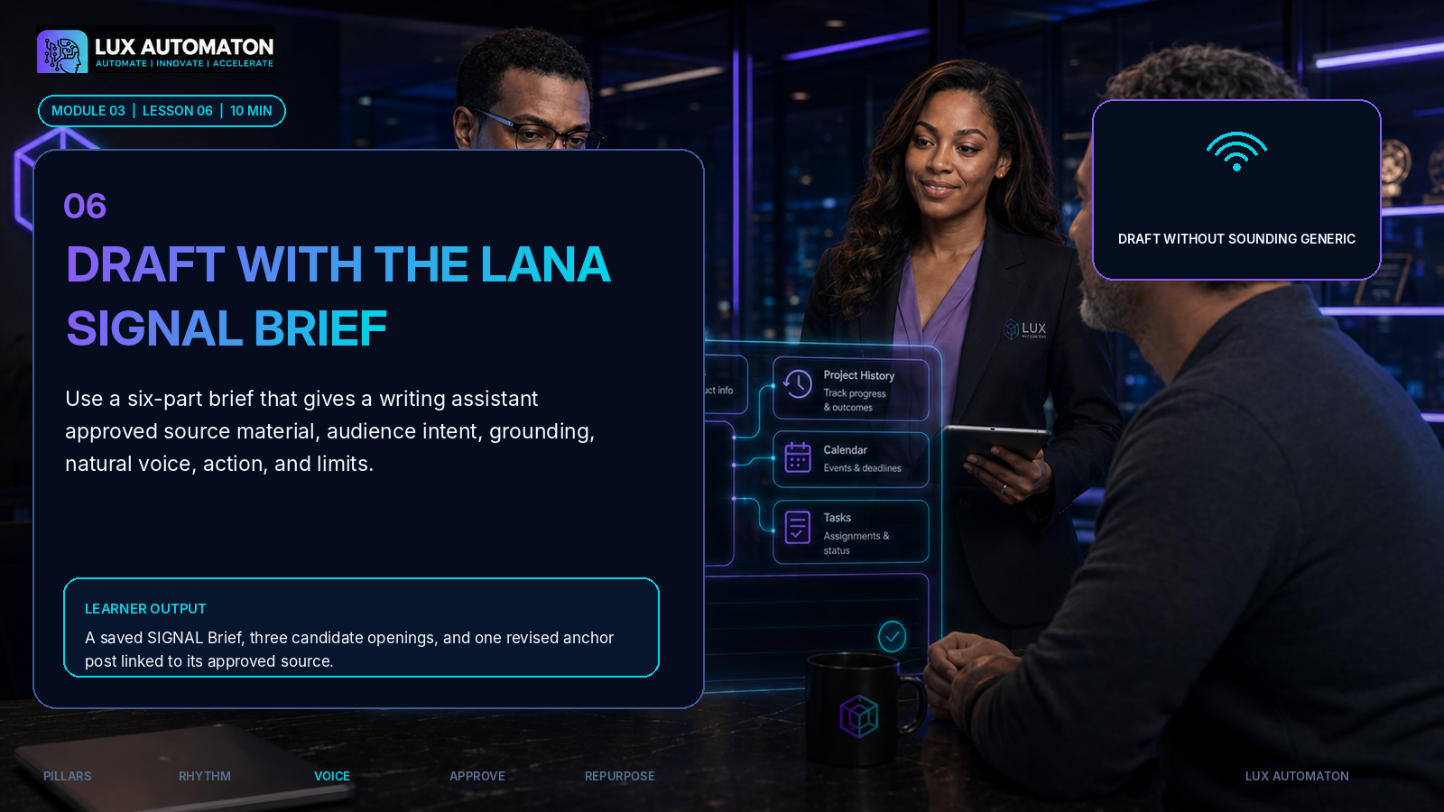
MODULE 03
23

Slide 24
LESSON 6
06
Draft with the LANA SIGNAL Brief
Ground every draft in source, reader, evidence, voice, action, and limits.
• S — Approved source
• I — Intended reader
• G — Grounding and proof
• N — Natural voice
• A — Action and reader next step
• L — Limits, claims, privacy, and format
LANA CONTENT COMMAND CENTER
24

Slide 25
DRAFTING PROTOCOL
Brief first. Draft second. Verify third.
Request three openings and an outline before the full draft.
1
2
3
4
5
SOURCE SUMMARY
→
SIGNAL BRIEF
→
OPTIONS
→
ANCHOR DRAFT
→
VERIFY
Only approved material.
Reader, proof, voice, action, limits.
Three openings + a short outline.
250–450 words or equivalent.
Mark new claims and run CLEAR.
AI may help draft. The human owns the source, decision, verification, and final approval.
LANA CONTENT COMMAND CENTER
25

Slide 26
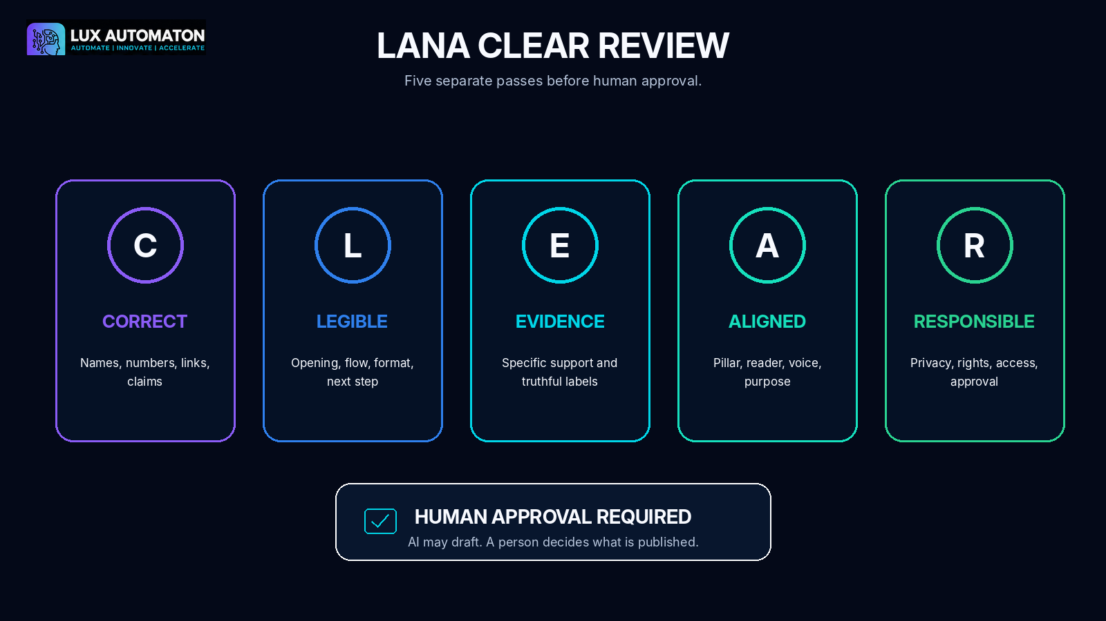
04
MODULE
REVIEW AND APPROVE
An approved anchor post and a documented review-and-approval operating procedure.
FACILITATOR FOCUS
Separate editorial review from approval and risk decisions.
MODULE 04
26

Slide 27
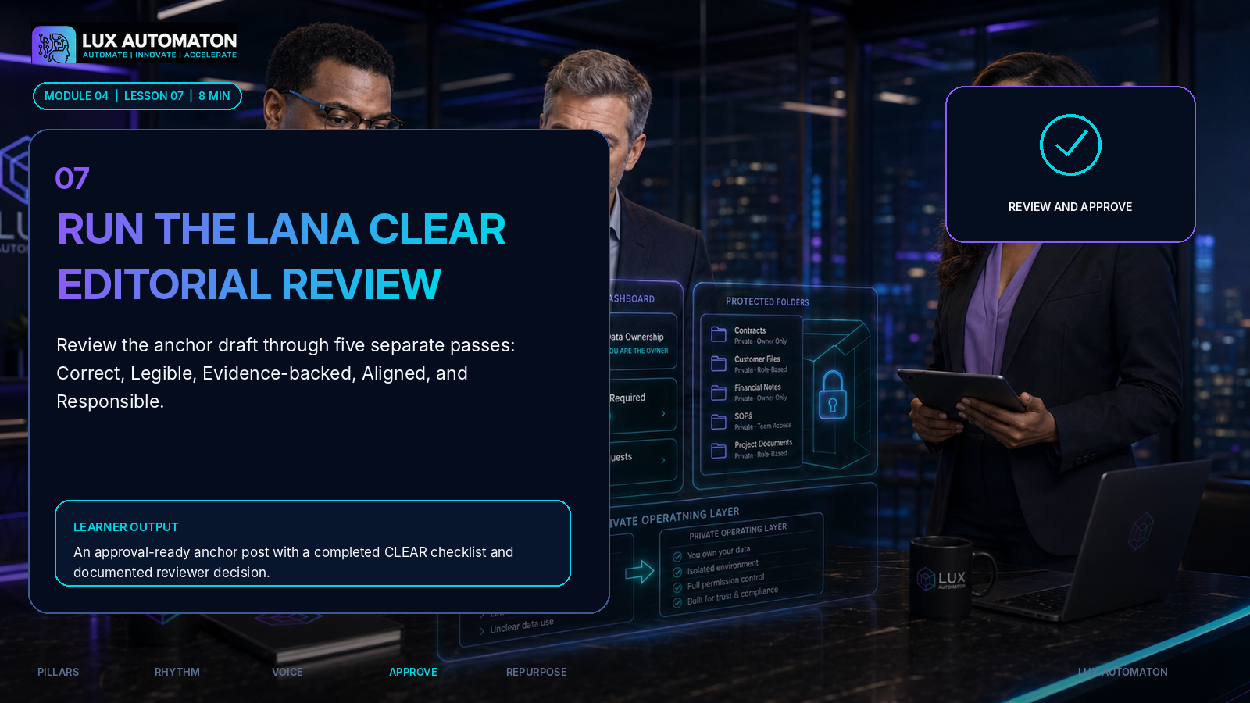
MODULE 04
27

Slide 28
LESSON 7
07
Run the LANA CLEAR editorial review
Five separate passes prevent vague, taste-based editing.
C
Correct
Names, numbers, dates, links, source match.
L
Legible
Opening, flow, structure, format, next step.
E
Evidence-backed
Claims supported; examples labeled.
A
Aligned
Pillar, audience, content job, voice, offer.
R
Responsible
Privacy, rights, access, claims, approval.
LANA CONTENT COMMAND CENTER
28

Slide 29
HANDS-ON ACTIVITY
Review the anchor in five passes
Document required changes separately from optional preferences.
1. Read the draft once without editing to identify its main idea and job.
2. Run the Correct, Legible, Evidence-backed, Aligned, and Responsible passes separately.
3. Mark each comment as required or optional.
4. Resolve required changes and recheck the source and Voice Card.
5. Record the reviewer, approval status, and date.
✓
Evidence improvement
Add a specific source, example, or label.
✓
Voice improvement
Replace generic wording with a Voice Card pattern.
✓
Reader usefulness
Make the practical move or next step clearer.
✓
Decision
Approved, revise, hold, or archive.
Record reviewer • status • date
LANA CONTENT COMMAND CENTER
29

Slide 30
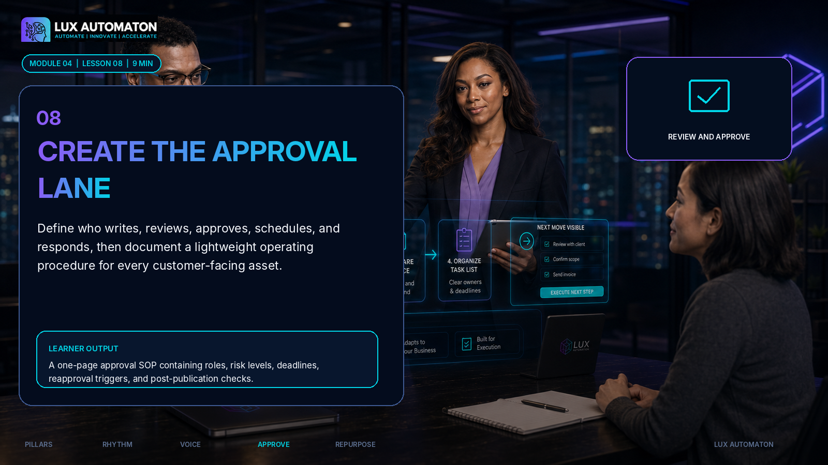
MODULE 04
30

Slide 31
LESSON 8
08
Create the approval lane
Roles and risk levels make publication decisions visible.
Source owner
Writer
Reviewer
Approver
Publisher
Response owner
Risk levels
STANDARD
SENSITIVE
URGENT
Routine teaching, approved source.
Customer, legal, health, finance, claims, privacy.
Time-sensitive correction or response.
LANA CONTENT COMMAND CENTER
31

Slide 32
HANDS-ON ACTIVITY
Write the one-page Approval Lane SOP
Define deadlines, reapproval triggers, and the correction path.
1. Name the source owner, writer, reviewer, approver, publisher, and response owner for your current team.
2. Define standard, sensitive, and urgent content categories.
3. Set the normal review window and publication cutoff.
4. List material changes that require reapproval.
5. Write the post-publication check and correction process.
WHO
Named roles + backup approver
WHAT
Standard, sensitive, and urgent categories
WHEN
Review windows + publication cutoff
REAPPROVAL
Material changes that reopen approval
AFTER
Post-publish check + correction / pause process
LANA CONTENT COMMAND CENTER
32

Slide 33
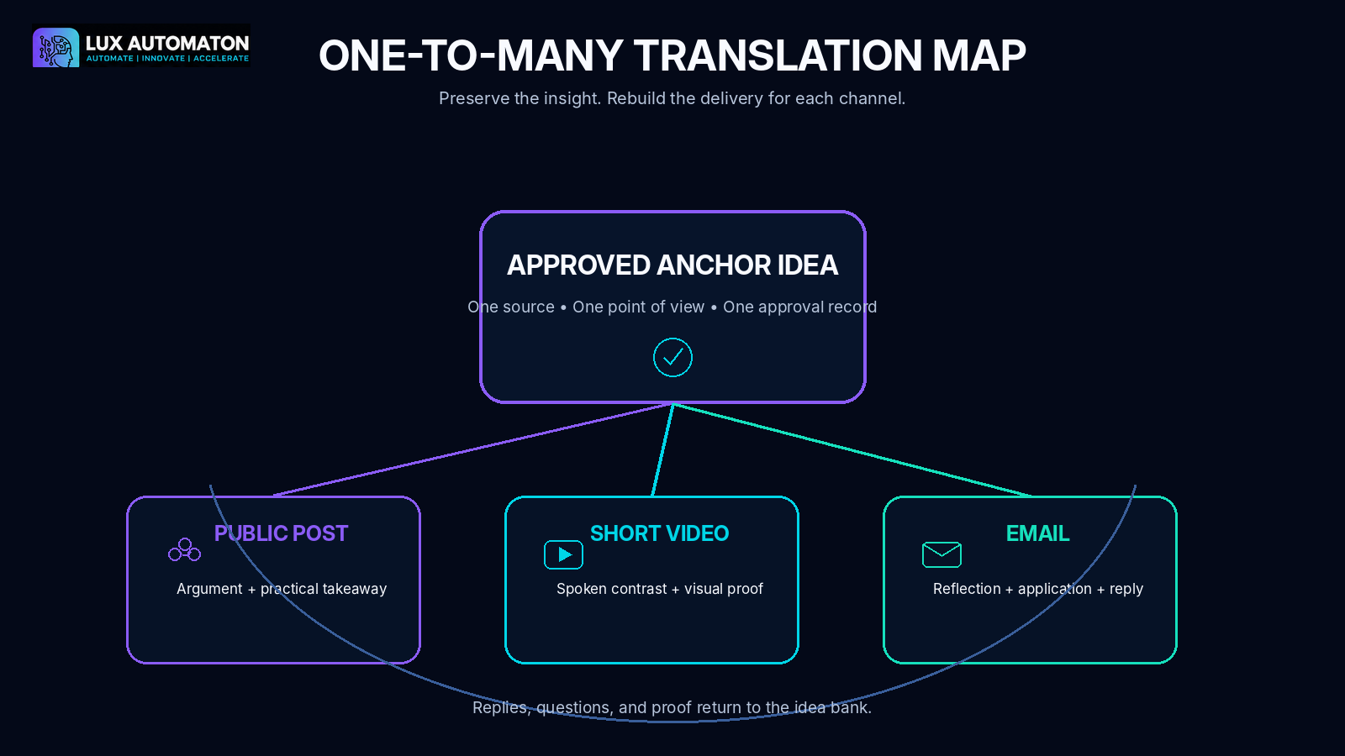
05
MODULE
REPURPOSE INTO VIDEO AND EMAIL
A short-form video script, an email draft, and a one-to-many repurposing map.
FACILITATOR FOCUS
Translate one approved insight for video and email.
MODULE 05
33

Slide 34
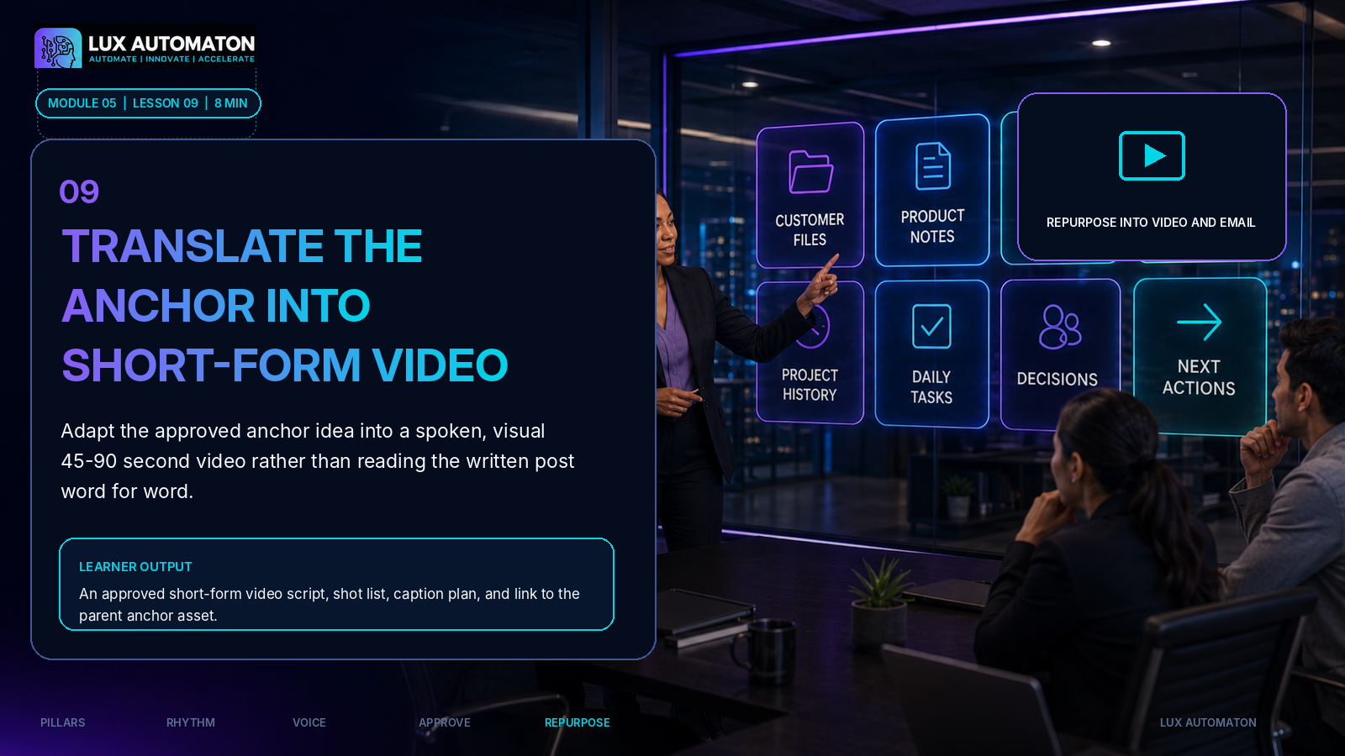
MODULE 05
34

Slide 35
LESSON 9
09
Translate the anchor into short-form video
Preserve the idea; change the delivery for spoken and visual attention.
1
2
3
4
5
HOOK
→
TENSION
→
INSIGHT
→
PROOF
→
NEXT STEP
Earn attention quickly.
Name the problem or contrast.
Deliver the one idea.
Show a detail, example, or demonstration.
Tell the viewer what to do next.
Read aloud. Time it. Cut anything that sounds written instead of spoken.
LANA CONTENT COMMAND CENTER
35

Slide 36
HANDS-ON ACTIVITY
Create the 45–90 second video plan
Write the script, shot list, caption plan, and approval check.
1. Write the one idea the viewer should remember.
2. Draft Hook, Tension, Insight, Proof, and Next Step in spoken language.
3. Read the script aloud and cut anything that sounds written rather than spoken.
4. Create a three-to-five-shot plan and caption requirement.
5. Apply the relevant CLEAR checks before recording or publishing.
SHOT
VISUAL / ACTION
SPOKEN LINE
CAPTION
RIGHTS
1
2
3
4
One idea • one next step • captions included
LANA CONTENT COMMAND CENTER
36

Slide 37
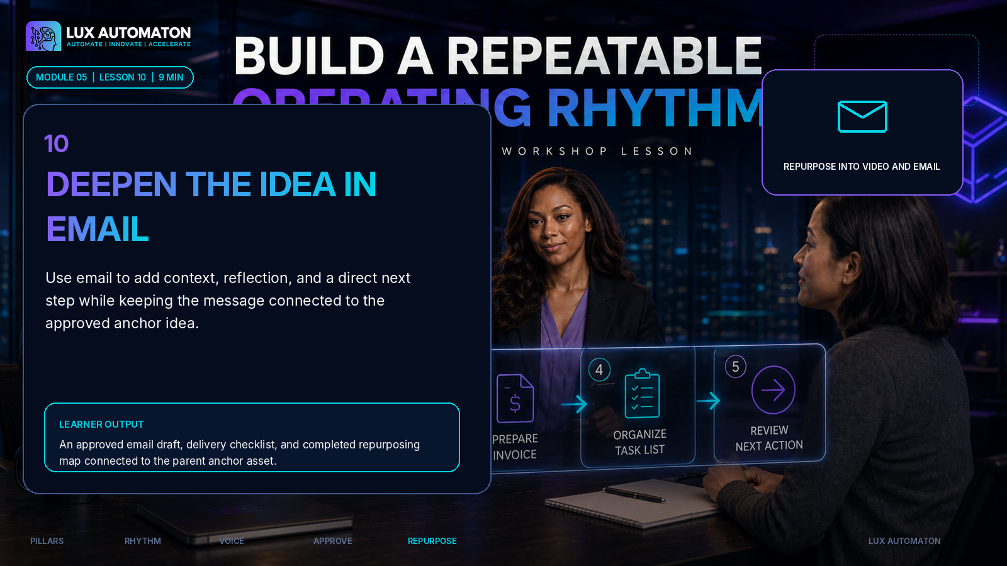
MODULE 05
37

Slide 38
LESSON 10
10
Deepen the idea in email
Use the inbox for context, reflection, and a direct relationship with the reader.
SUBJECT
PREVIEW
OPENING
ONE IDEA
Accurate before clever.
Support the promise.
Create a close reader connection.
Stay focused.
STORY / PROOF
PRACTICAL MOVE
CTA
P.S.
Add evidence or lived detail.
Give the reader something to do.
Invite one relevant next step.
Optional human afterthought.
Email should deepen the approved insight, not copy the post or narrate the video.
LANA CONTENT COMMAND CENTER
38

Slide 39
ONE-TO-MANY SYSTEM
Preserve the insight. Rebuild the delivery.
Every derivative links back to the approved parent idea.
WHAT STAYS THE SAME
• Core insight
• Approved evidence
• Audience promise
• Truth and privacy boundaries
WHAT CHANGES
• Hook and pacing
• Structure and length
• Visual or inbox context
• Channel-specific next step
LANA CONTENT COMMAND CENTER
39

Slide 40
HANDS-ON ACTIVITY
Complete the email and Translation Map
Connect the post, video, email, approvals, and live file paths.
1. Choose the deeper angle the email will add to the approved anchor idea.
2. Draft the subject, preview line, opening, one idea, proof, practical move, and call to action.
3. Compare the email with the post and video to remove unnecessary repetition.
4. Run CLEAR plus the email delivery check for links, audience, sender, reply path, and mobile view.
5. Complete the repurposing map and capture future questions from replies.
PUBLIC POST
What is concise and scrollable?
SHORT VIDEO
What is spoken and visible?
EMAIL
What is deeper and relational?
OPTIONAL
What question becomes the next asset?
Capture replies and learning back into the idea bank.
LANA CONTENT COMMAND CENTER
40

Slide 41
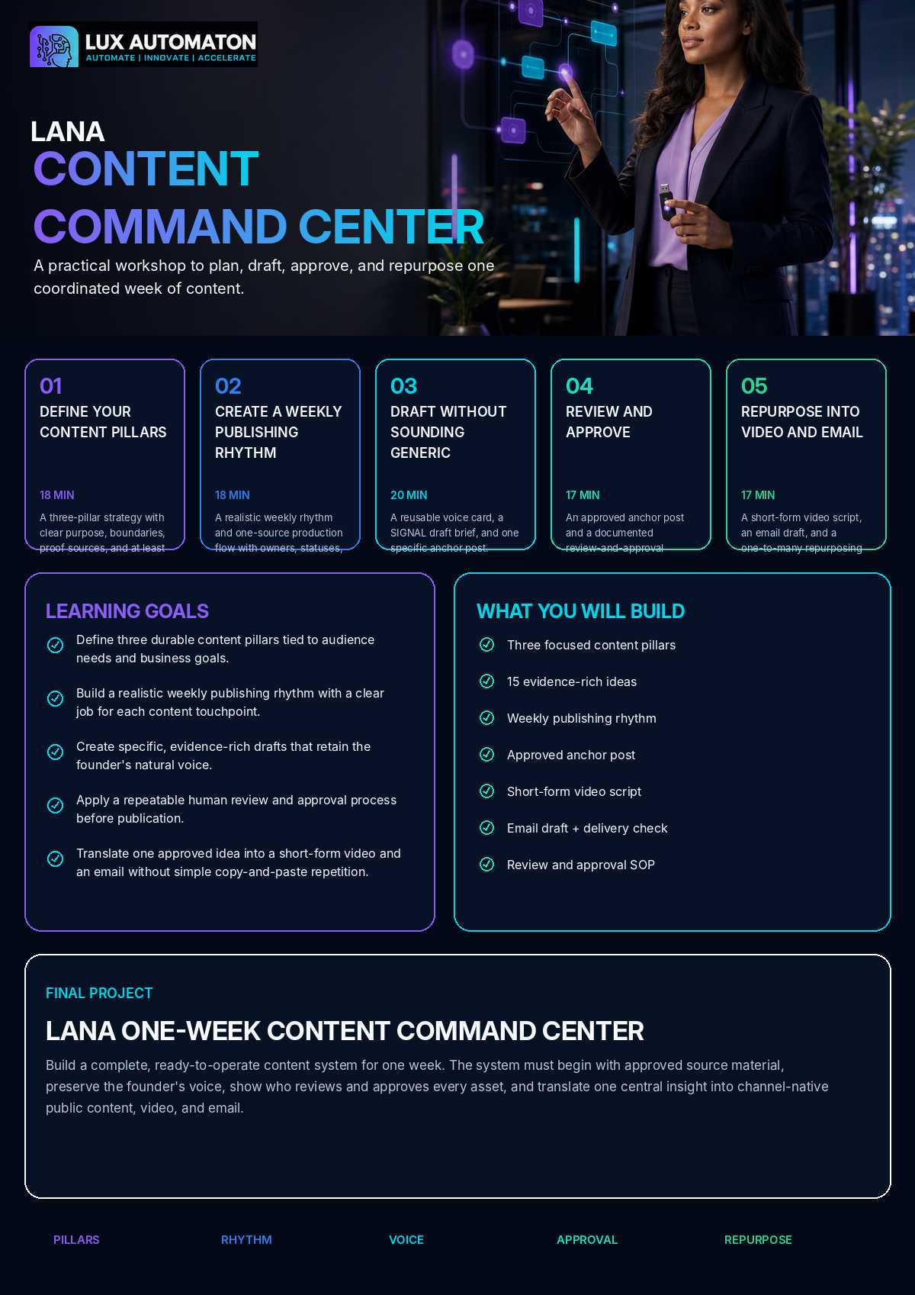
FINAL PROJECT
LANA One-Week Content Command Center
A ready-to-operate content system for one real week.
Build a complete, ready-to-operate content system for one week. The system must begin with approved source material, preserve the founder's voice, show who reviews and approves every asset, and translate one central insight into channel-native public content, video, and email.
CORE COMPONENTS
• Three-pillar Content Strategy Card
• 15-idea evidence bank
• Weekly publishing rhythm
• One-source command board
• LANA Voice Card
• SIGNAL Brief and approved anchor post
• Completed CLEAR review
• Approval Lane SOP
• Short-form video script and shot list
• Email draft and delivery check
• One-to-many Translation Map
• One-week learning and response plan
LANA CONTENT COMMAND CENTER
41

Slide 42
LAUNCH READINESS
Is the one-week system ready to operate?
Check source, workflow, voice, approval, channel fit, and learning.
☐
Every content idea belongs to one pillar and names its source.
☐
The video sounds natural when read aloud and includes a caption plan.
☐
The weekly rhythm fits actual drafting and approval capacity.
☐
The email adds value beyond the public post and has tested delivery details.
☐
The anchor post contains a specific perspective, example, and reader next step.
☐
All derivatives link to the approved parent idea.
☐
Claims, examples, customer information, links, and rights are reviewed.
☐
The command board shows the current status and next action for every asset.
☐
A named human approves each customer-facing asset.
☐
Audience replies and learning have a documented return path to the idea bank.
LANA CONTENT COMMAND CENTER
42

Slide 43
EVALUATION RUBRIC
Twenty points to launch-ready
Score 17–20 ready; 13–16 revise then launch; 0–12 rebuild key elements.
Pillar strategy and idea quality
4 PTS
Three focused pillars with useful boundaries, approved proof sources, and a strong 15-idea bank.
Weekly operating system
4 PTS
Realistic rhythm, visible statuses, owners, deadlines, next actions, and learning loop.
Voice and drafting quality
4 PTS
Voice Card and SIGNAL produce a specific, evidence-rich anchor draft that sounds natural.
Review, approval, and responsibility
4 PTS
CLEAR review, risk levels, permissions, approval, rights, privacy, and accuracy are documented.
Channel translation and readiness
4 PTS
Video and email are channel-native, linked to the parent idea, approved, and ready for production or scheduling.
LANA CONTENT COMMAND CENTER
43

Slide 44
OPTIONAL COMMAND CENTER LAB
Thirty minutes to finish and schedule
Use the extra time for build, peer review, and next actions.
0–10 MIN
10–20 MIN
Complete missing fields and files.
Peer review with CLEAR + approval lane.
20–25 MIN
25–30 MIN
Schedule, assign, or prepare production.
Name the first audience signal to capture.
Before leaving: every asset has an owner, due date, current file, approval state, and next action.
LANA CONTENT COMMAND CENTER
44

Slide 45

YOUR NEXT WEEK IS NOW VISIBLE.
One source. One rhythm. Human approval. Channel-native execution.

