Slide 1
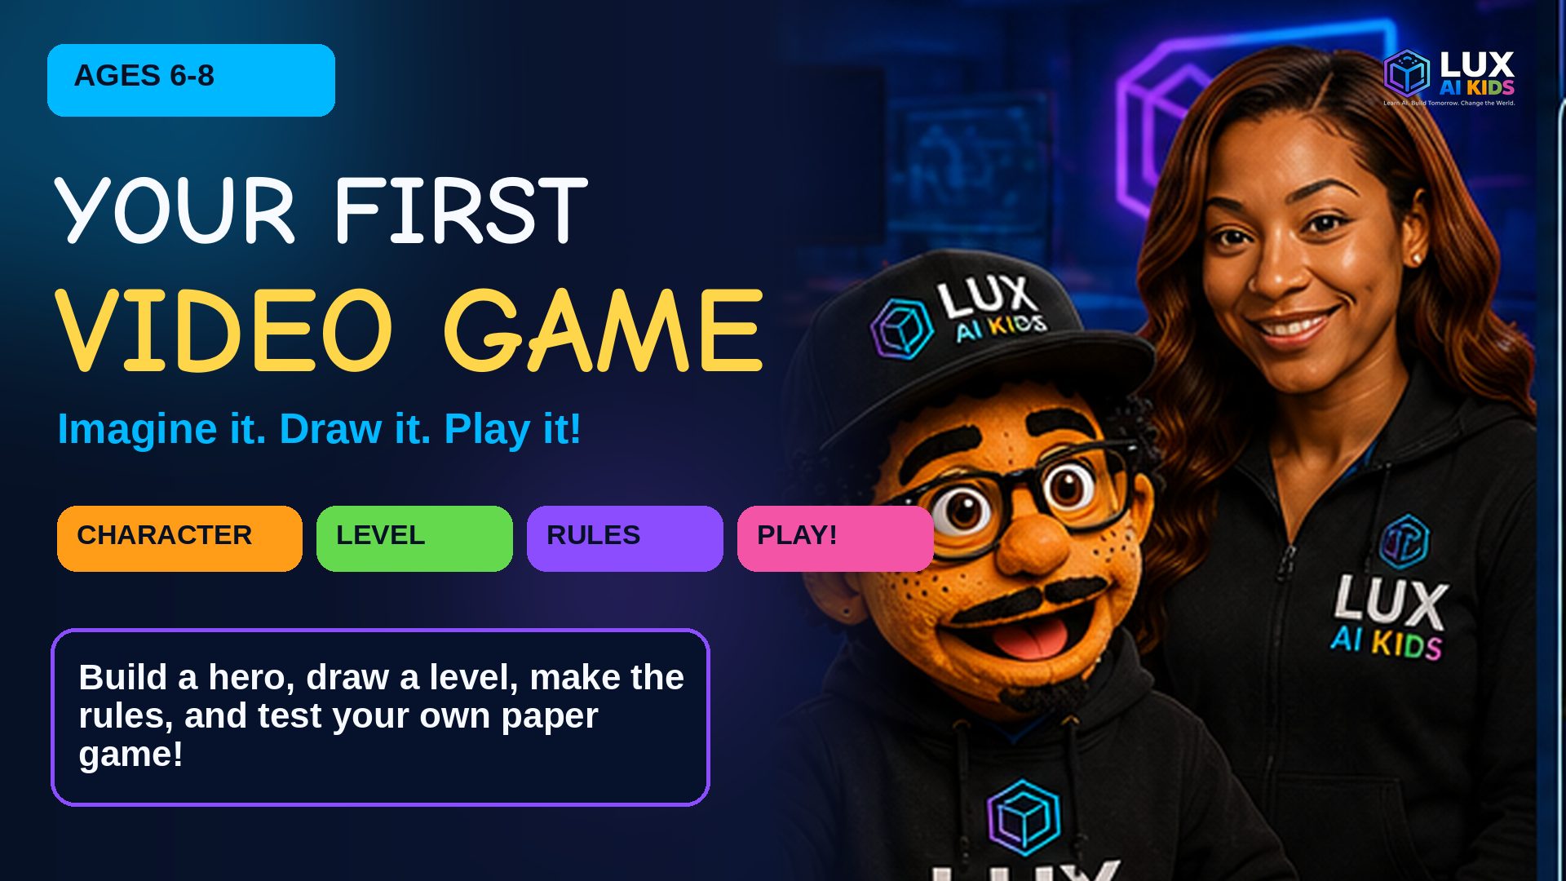

Slide 2

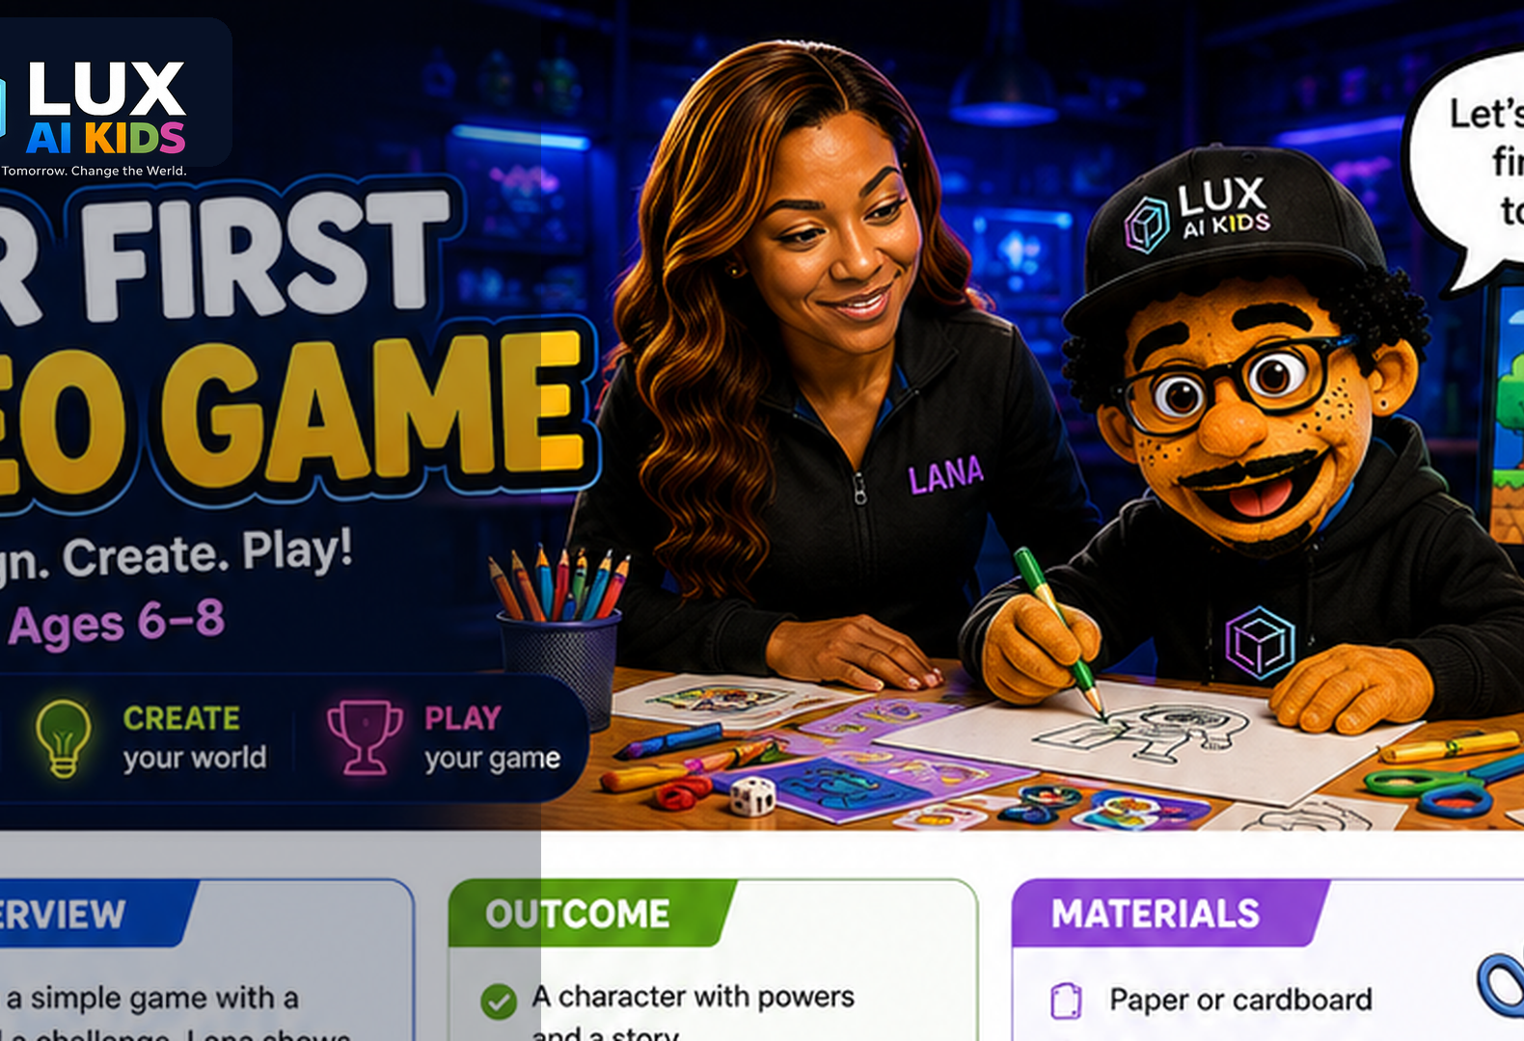
TODAY YOU BECOME A GAME DESIGNER!
You will make five cool things:
1
A game world
2
A hero
3
A level map
4
Easy rules
5
A better game after testing
AI helps. People decide. Ask a grown-up first.

Slide 3
WHAT YOU NEED
▧
Paper or cardboard
✎
Crayons and markers
✂
Child-safe scissors
▤
Index cards
★
Stickers for tokens
⌗
A ruler
AI helps. People decide. Ask a grown-up first.

Slide 4
6 FUN MISSIONS
1
What Makes a Game a Game?
2
Pick Your Theme
3
Design Your Character
20 min
15 min
20 min
Every game needs a character, a goal, a challenge, and rules.
A theme tells where the game happens and what kind of adventure it feels like.
A strong game hero has a name, a clear look, one useful power, and a reason to act.
4
Draw the Board
5
Make the Rules
6
Playtest Time!
20 min
20 min
25 min
A level is a path from START to GOAL with fun choices and challenges along the way.
Rules make the game clear, fair, and possible to play without the designer explaining every move.
Game designers learn by watching real players and changing one thing at a time.
Imagine it. Draw it. Play it. Make it better!

Slide 5
LANA'S AI HELPER PROMISE
AI can help with ideas. YOU are the game designer.
1
ASK A GROWN-UP
2
KEEP IT PRIVATE
before using an AI tool
no full name, school, address, or face photo
3
CHECK THE IDEA
4
YOU DECIDE
AI can be silly or wrong
keep, change, or skip every idea
AI helps. People decide. Ask a grown-up first.

Slide 6
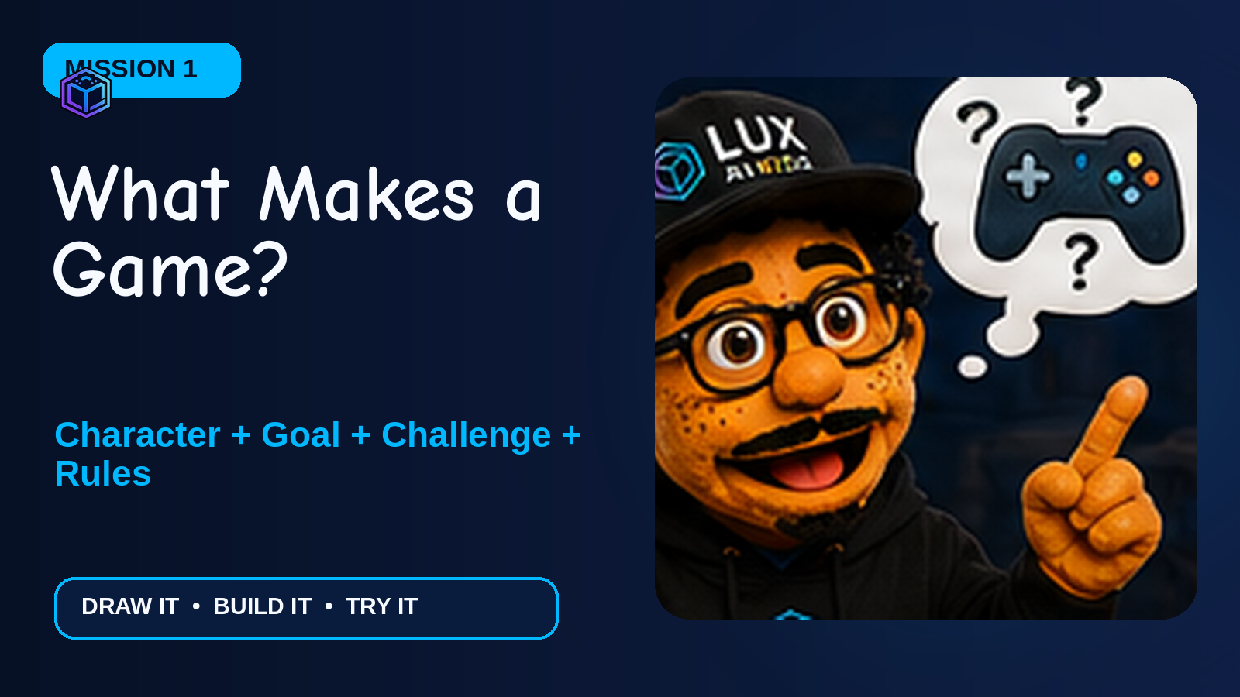

Slide 7
MISSION 1
What Makes a Game a Game?
Every game needs a character, a goal, a challenge, and rules.
ACE SAYS:
A game is a tiny world with something to do. A character tries to reach a goal. A challenge makes the trip interesting. Rules tell everyone how to play.
AI helps. People decide. Ask a grown-up first.

Slide 8
LET'S DO IT!
Game Recipe Sort: match picture cards to CHARACTER, GOAL, CHALLENGE, and RULES.
1
Show the four Game Recipe cards.
2
Say and act out each part together.
3
Use a familiar game such as tag to find the four parts.
4
Kids place or draw the four parts on their worksheet.
5
Invite two children to share their recipe.
Make: A completed four-part Game Recipe strip.

Slide 9
TRY THIS EXAMPLE
In a treasure game, the explorer is the character, the treasure chest is the goal, the river is the challenge, and “move one card each turn” is a rule.
QUICK CHECK
What tells the player how to win?
Answer: The goal.
ACE'S TIP
Use movement: pose as a hero, point to a goal, step over a pretend obstacle, then freeze for a rule.
AI helps. People decide. Ask a grown-up first.

Slide 10
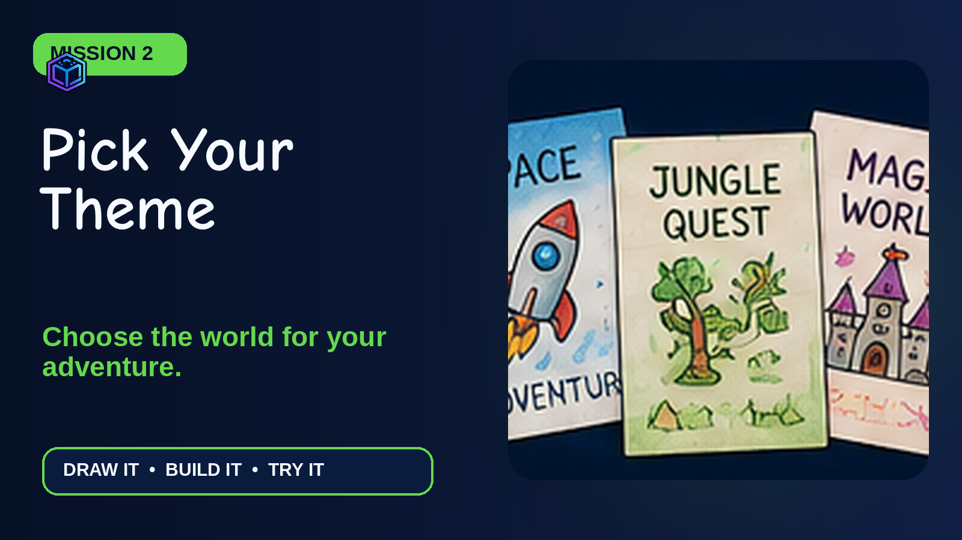

Slide 11
MISSION 2
Pick Your Theme
A theme tells where the game happens and what kind of adventure it feels like.
ACE SAYS:
A theme is the world of your game. It can be space, a jungle, the ocean, a magic castle, Dinosaur Land, Robot City, or a world you invent.
AI helps. People decide. Ask a grown-up first.

Slide 12
LET'S DO IT!
Theme Dash: choose a world card, then add one place and one mission.
1
Spread out the theme cards.
2
Let each child point to or draw a favorite world.
3
Ask: Who lives there? What could they need?
4
Complete the sentence: “In my game, the player will ___ in ___.”
5
Give the game a fun name.
Make: A theme card and one-sentence game story.

Slide 13
TRY THIS EXAMPLE
Theme: Underwater City. Mission: Help a tiny submarine collect three pearls and reach the coral gate.
QUICK CHECK
What does a theme tell us?
Answer: Where the game happens and what it feels like.
ACE'S TIP
Offer six choices, not twenty.
AI helps. People decide. Ask a grown-up first.

Slide 14
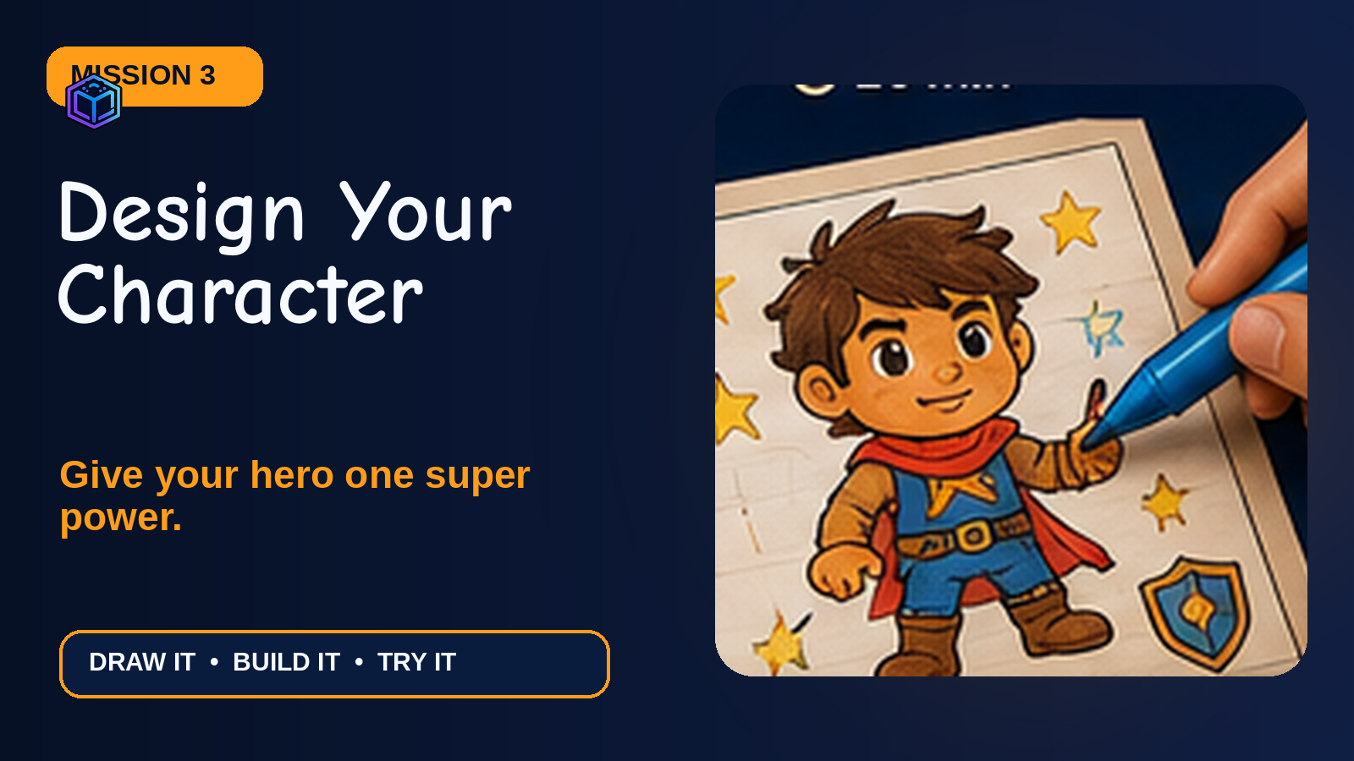

Slide 15
MISSION 3
Design Your Character
A strong game hero has a name, a clear look, one useful power, and a reason to act.
ACE SAYS:
Your character is the one the player helps. Give the hero one special power. One strong power is easier to understand than ten powers.
AI helps. People decide. Ask a grown-up first.

Slide 16
LET'S DO IT!
Create a two-sided Character Card on an index card: picture on the front, name/power/story on the back.
1
Pick a shape, animal, person, robot, or creature.
2
Draw the face and body with big simple shapes.
3
Add one color clue or special item.
4
Choose one power that helps with the game goal.
5
Finish: “My hero is ___. They can ___. They need to ___.”
Make: A finished character card with one power and a short story.

Slide 17
TRY THIS EXAMPLE
Milo Mooncat glows in dark caves. He wants to return a lost star to the sky before sunrise.
QUICK CHECK
Why should the hero have one clear power?
Answer: It is easier to understand and makes the challenge more fun.
ACE'S TIP
Start with circles, squares, and triangles.
AI helps. People decide. Ask a grown-up first.

Slide 18
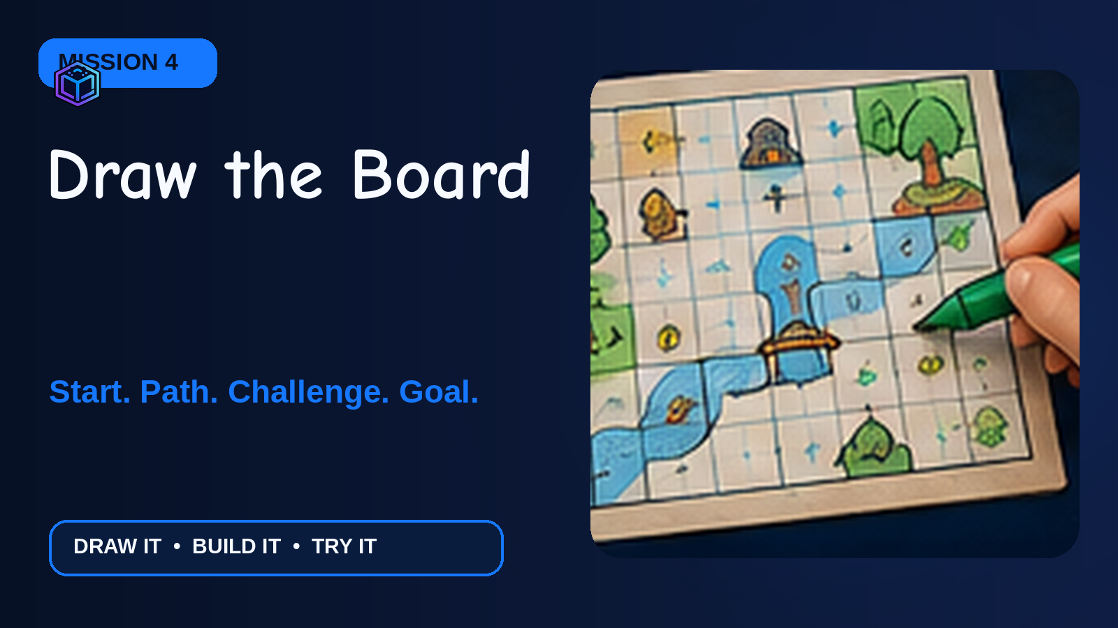

Slide 19
MISSION 4
Draw the Board
A level is a path from START to GOAL with fun choices and challenges along the way.
ACE SAYS:
Your paper board is a map of the first game level. The player needs a way to start, move, meet a challenge, and reach the goal.
AI helps. People decide. Ask a grown-up first.

Slide 20
LET'S DO IT!
Build Level 1 on paper or cardboard using a ruler, crayons, and sticker tokens.
1
Draw a large START shape.
2
Draw a winding path of 12-20 spaces.
3
Add one challenge space.
4
Add three star or bonus spaces.
5
Draw the GOAL and decorate the world after the path works.
Make: A paper game level with start, path, challenge, special spaces, and goal.

Slide 21
TRY THIS EXAMPLE
Start at the treehouse. Follow the river path. A broken bridge sends you back one space. Star spaces give another turn. The goal is the treasure cave.
QUICK CHECK
What four things belong in every level path?
Answer: Start, path, challenge, and goal.
ACE'S TIP
Draw the path lightly in pencil first.
AI helps. People decide. Ask a grown-up first.

Slide 22
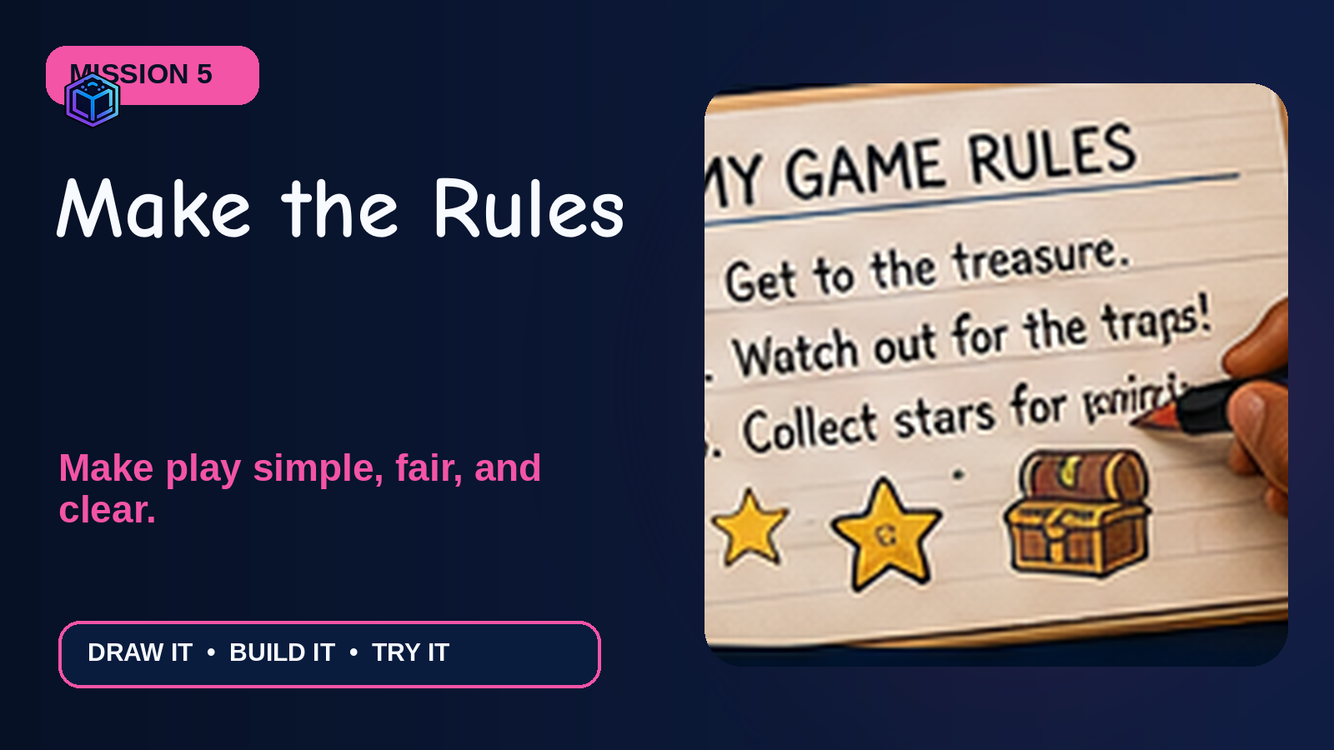

Slide 23
MISSION 5
Make the Rules
Rules make the game clear, fair, and possible to play without the designer explaining every move.
ACE SAYS:
Rules answer four questions: How do we start? What happens on a turn? What do special spaces do? How do we win?
AI helps. People decide. Ask a grown-up first.

Slide 24
LET'S DO IT!
Create a Rules Card and test the rules with a pretend turn.
1
Write or dictate the start rule.
2
Make move cards 1, 2, and 3.
3
Choose what bonus and challenge spaces do.
4
Write the winning rule.
5
Read the rules aloud and remove extra words.
6
With a grown-up, build one character-art prompt and one level-art prompt.
Make: A four-rule card, three move cards, and two paper AI prompts.

Slide 25
TRY THIS EXAMPLE
1. Put your token on START. 2. Draw a move card and move that many spaces. 3. A star gives one extra turn; a cloud sends you back one space. 4. The first player to reach the treasure wins.
QUICK CHECK
How do you know a rule is clear?
Answer: Another player can follow it without extra help.
ACE'S TIP
Use short sentences and one action at a time.
AI helps. People decide. Ask a grown-up first.

Slide 26
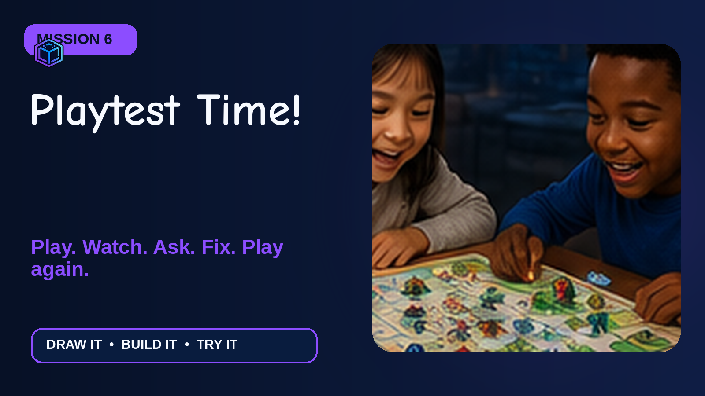

Slide 27
MISSION 6
Playtest Time!
Game designers learn by watching real players and changing one thing at a time.
ACE SAYS:
A playtest is not a test of you. It is a test of the game. If someone gets confused, that is useful information for the designer.
AI helps. People decide. Ask a grown-up first.

Slide 28
LET'S DO IT!
Play, Watch, Ask, Fix, Play Again.
1
Pair up or make groups of three.
2
Designer gives a 30-second explanation, then watches quietly.
3
Players take a few turns or finish the game.
4
Ask: Was it fun? Was it fair? Was it clear?
5
Choose one change to make.
6
Play one more quick round.
Make: A completed playtest sheet and one “Make It Better” change ticket.

Slide 29
TRY THIS EXAMPLE
A player keeps missing the bridge rule. The designer adds a bright orange arrow and changes the rule to “Bridge: go back 1.”
QUICK CHECK
What are the three playtest questions?
Answer: Was it fun, fair, and clear?
ACE'S TIP
Watch where players pause or ask questions.
AI helps. People decide. Ask a grown-up first.

Slide 30
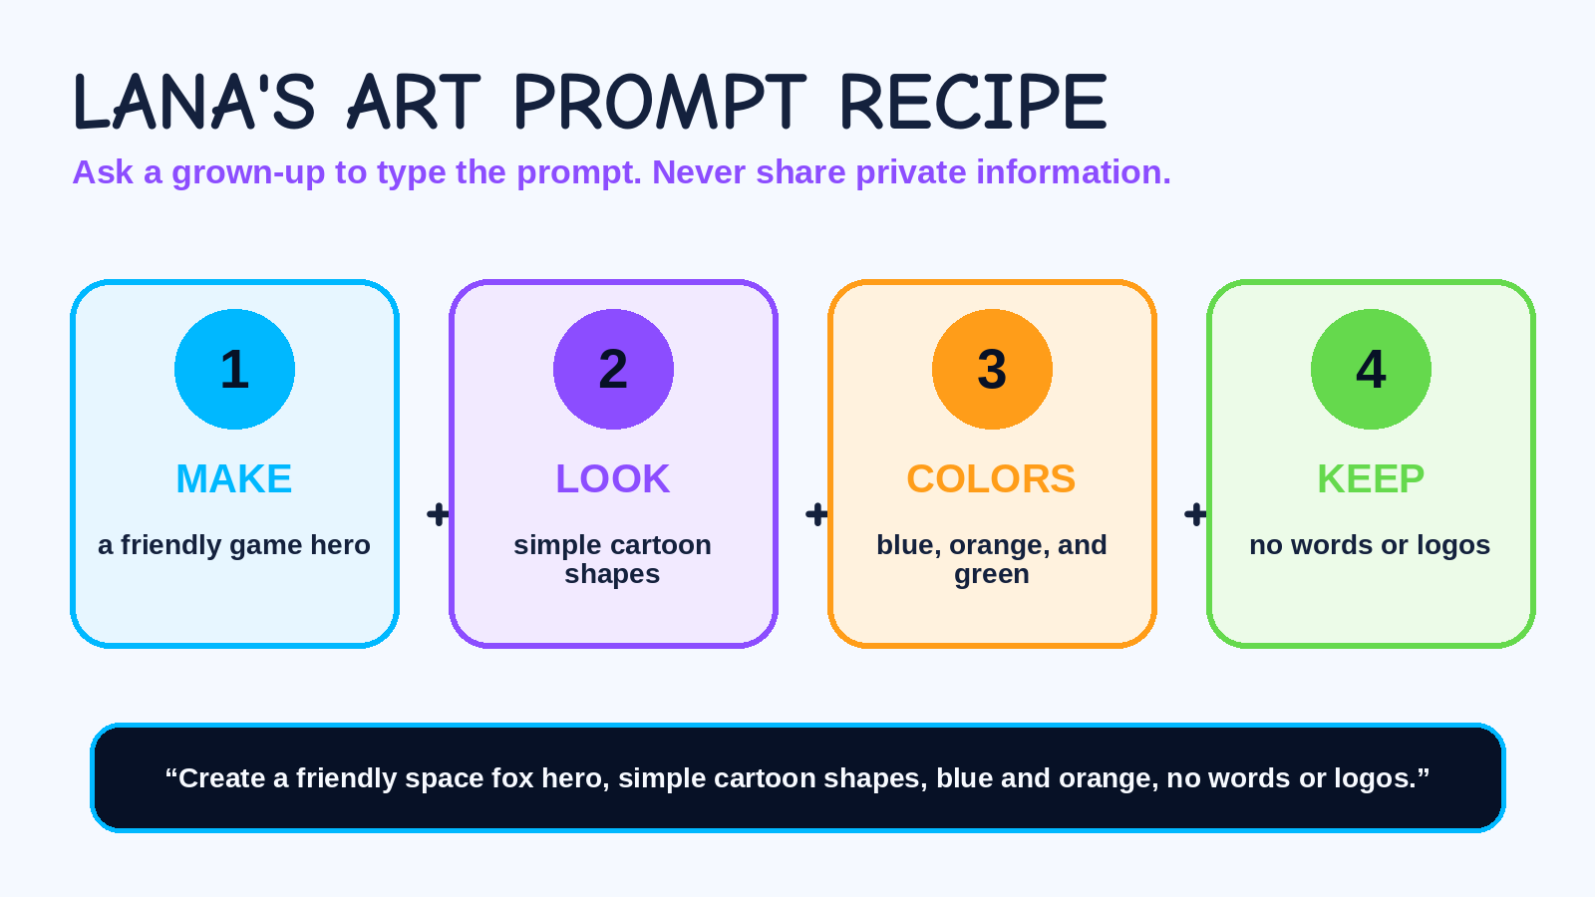
AI helps. People decide. Ask a grown-up first.

Slide 31
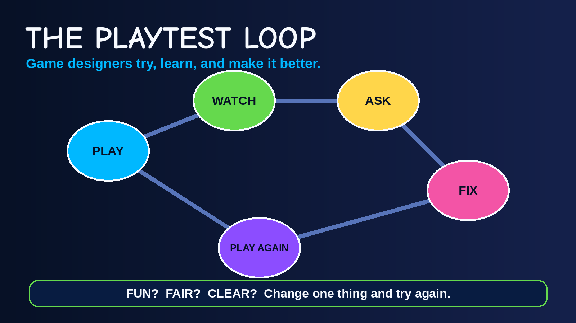
AI helps. People decide. Ask a grown-up first.

Slide 32
FINAL BUILD: MY FIRST GAME PACK
1
Theme and game name
2
Character card with one power and story
3
Level 1 board with start, path, challenge, and goal
4
Four-rule card and move cards 1-3
5
Two safe AI art prompts written on paper
6
Playtest sheet with one improvement
7
30-second game pitch
You made a real game prototype. That makes you a game designer!

Slide 33
SHARE YOUR GAME IN 30 SECONDS
My game is called...
The player is...
The goal is...
The challenge is...
The coolest part is...
Clap for every creator. Great games begin with brave ideas!

Slide 34
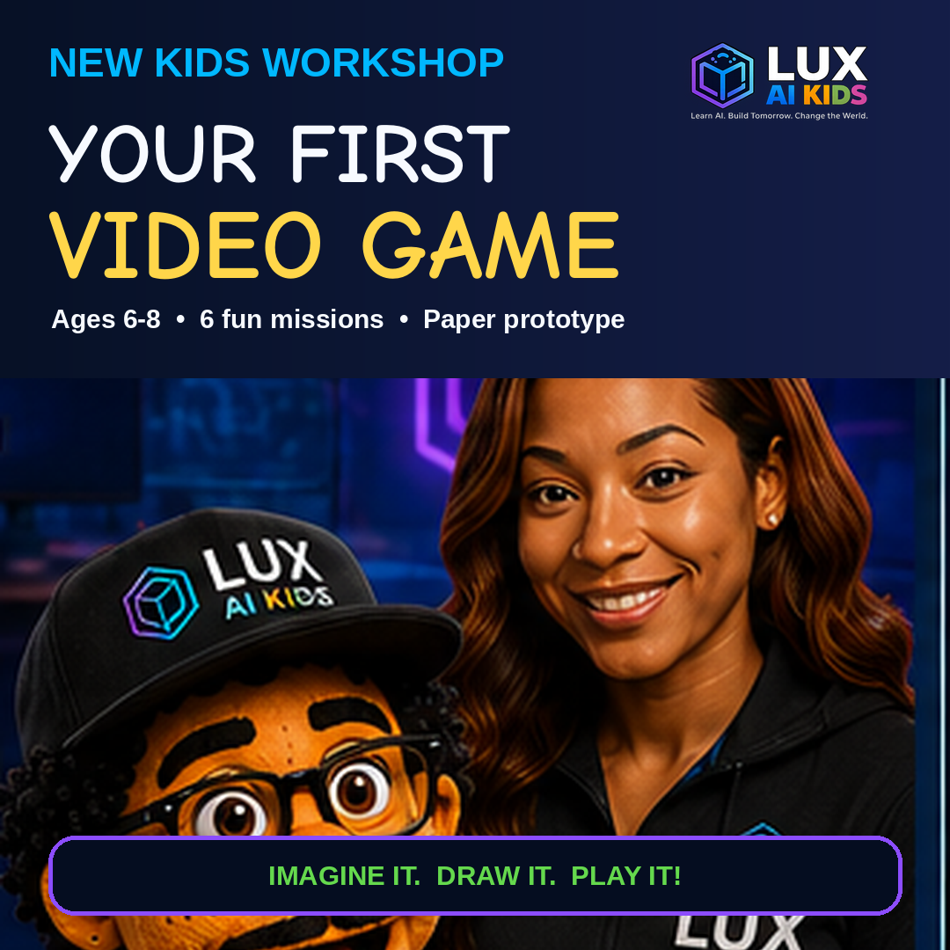
YOU DID IT!
You imagined a world. You built a hero. You made rules. You tested your game. YOU ARE A GAME DESIGNER!
LEVEL UP!

