Slide 1
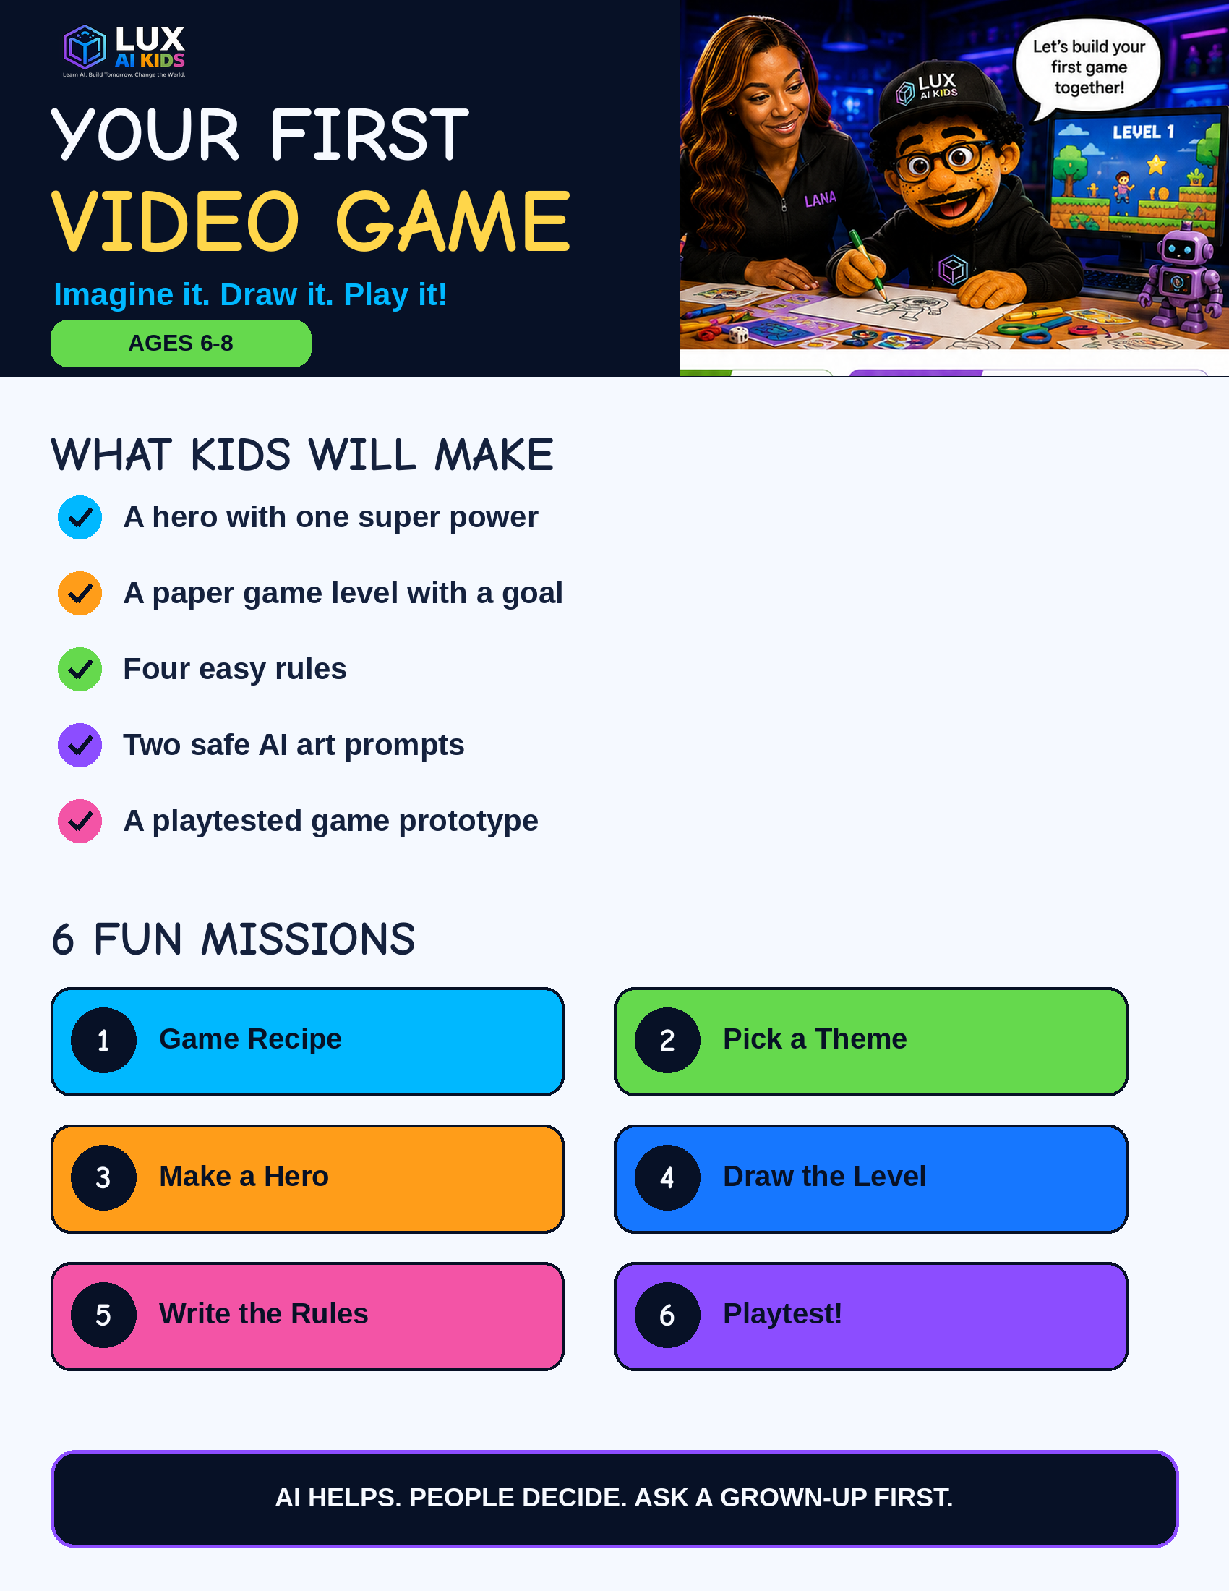

Slide 2

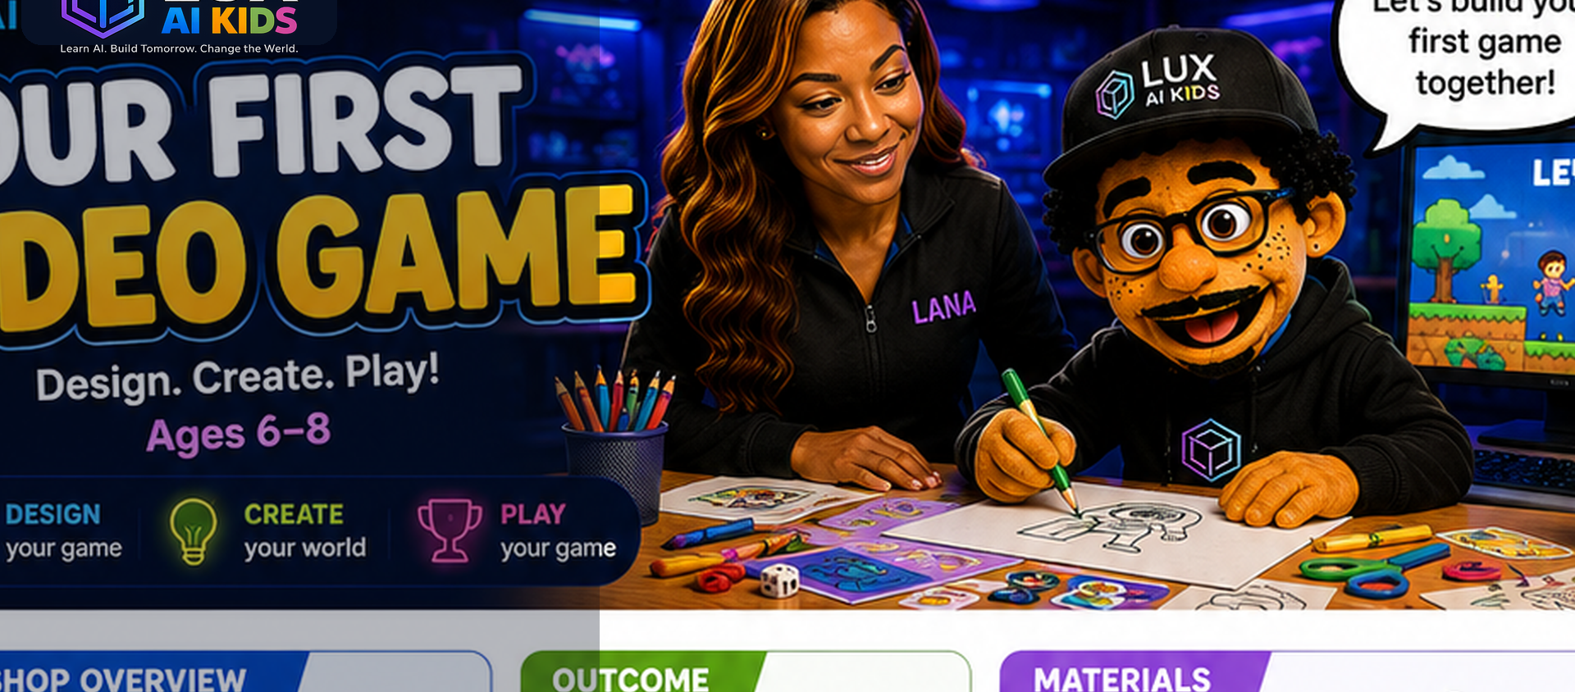
WELCOME, GAME DESIGNER!
2
This workbook belongs to:
My game-designer promise:
I will use kind ideas.
I will ask a grown-up before using AI.
I will keep private information private.
I will listen when someone tests my game.

Slide 3
GET READY TO BUILD
3
Circle what you brought today.
Paper or cardboard
Crayons and markers
Child-safe scissors
Index cards
Stickers for tokens
A ruler
LANA'S SAFE AI RULES
1
Ask a grown-up first.
2
Do not share your full name, school, address, phone number, or face photo.
3
AI gives ideas. You choose what to keep.
4
Be kind. Do not make art that hurts or embarrasses someone.

Slide 4
MY 6-MISSION GAME ADVENTURE
4
Color a star after you finish each mission!
1
What Makes a Game a Game?
☆
Every game needs a character, a goal, a challenge, and rules.
2
Pick Your Theme
☆
A theme tells where the game happens and what kind of adventure it feels like.
3
Design Your Character
☆
A strong game hero has a name, a clear look, one useful power, and a reason to act.
4
Draw the Board
☆
A level is a path from START to GOAL with fun choices and challenges along the way.
5
Make the Rules
☆
Rules make the game clear, fair, and possible to play without the designer explaining every move.
6
Playtest Time!
☆
Game designers learn by watching real players and changing one thing at a time.

Slide 5
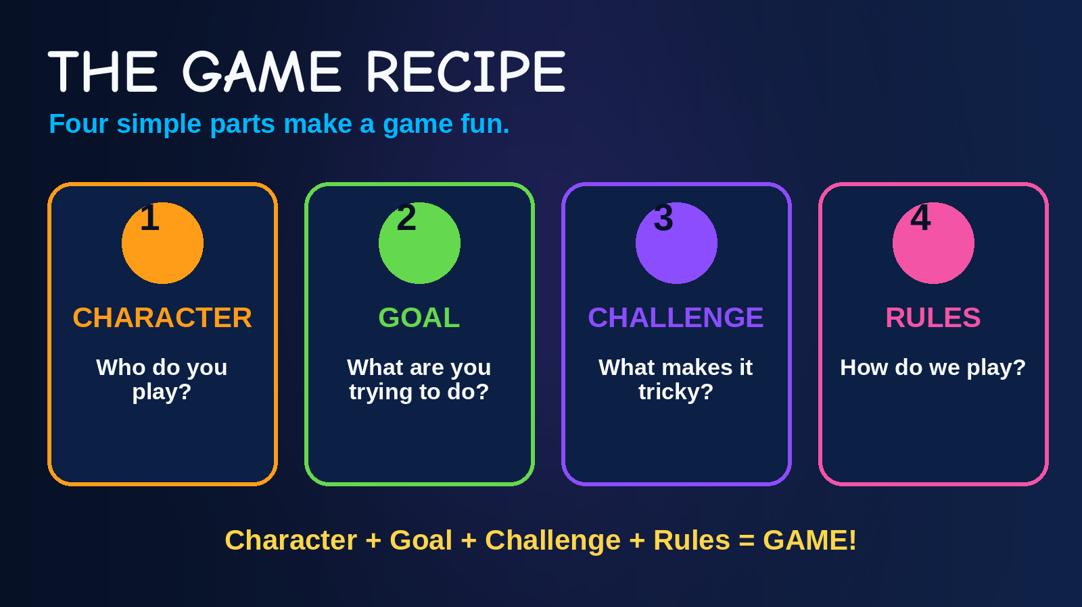
MISSION 1: THE GAME RECIPE
5
Draw one idea in each box.
CHARACTER
GOAL
Who do you play?
What do you try to do?
CHALLENGE
RULE
What makes it tricky?
How do you play?

Slide 6
MISSION 1: MATCH THE PARTS
6
Draw a line from each picture to the right word.
☺
CHARACTER
HERO
★
GOAL
TREASURE
!
CHALLENGE
ROCK
↻
RULES
TAKE TURNS

Slide 7
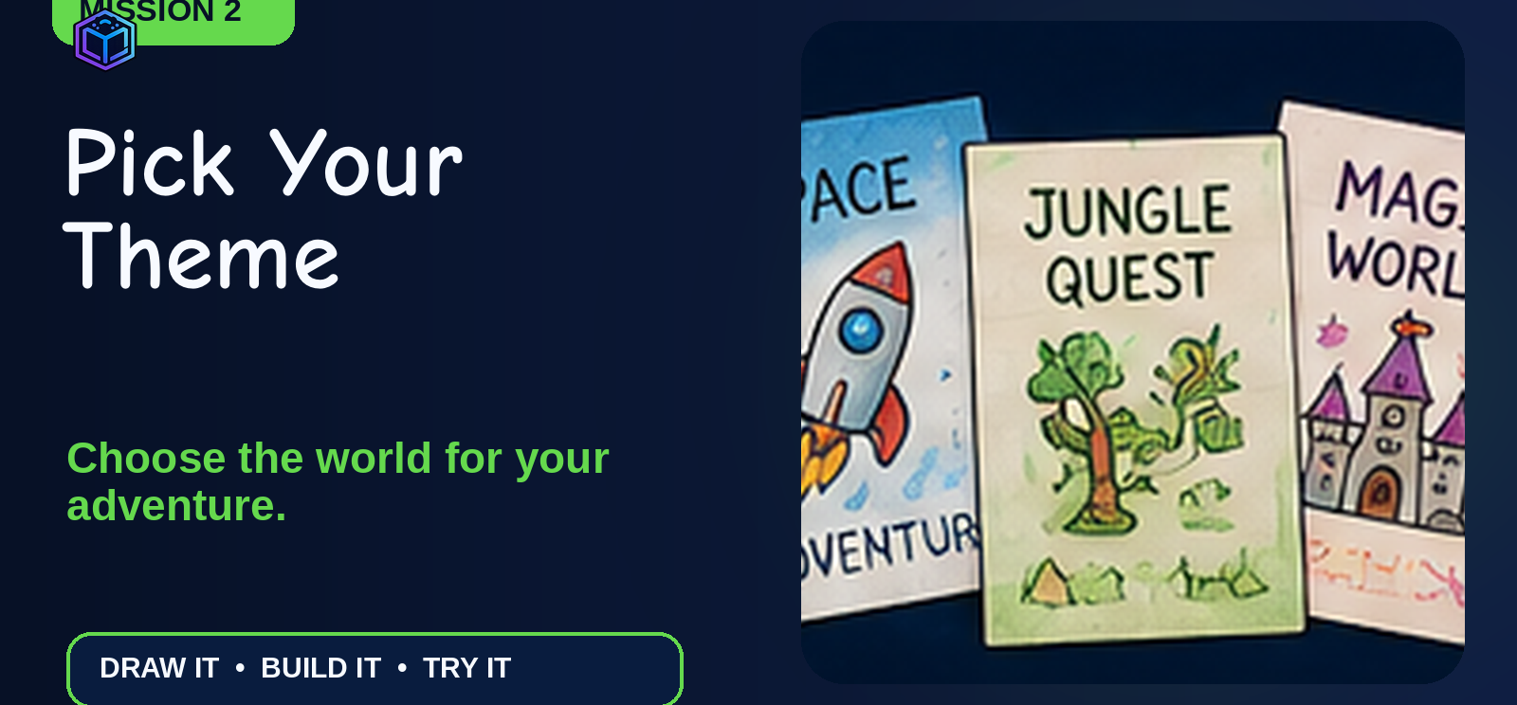
MISSION 2: PICK YOUR THEME
7
Circle one world - or draw your own!
SPACE
JUNGLE
OCEAN
MAGIC
DINOSAURS
ROBOT CITY
My world is called:
Draw one thing you would see there:

Slide 8
MISSION 2: MY GAME STORY
8
Finish the sentence. A grown-up can write your words.
In my game, the player will...
...in a world called...
My game is called:
Draw your game world:

Slide 9
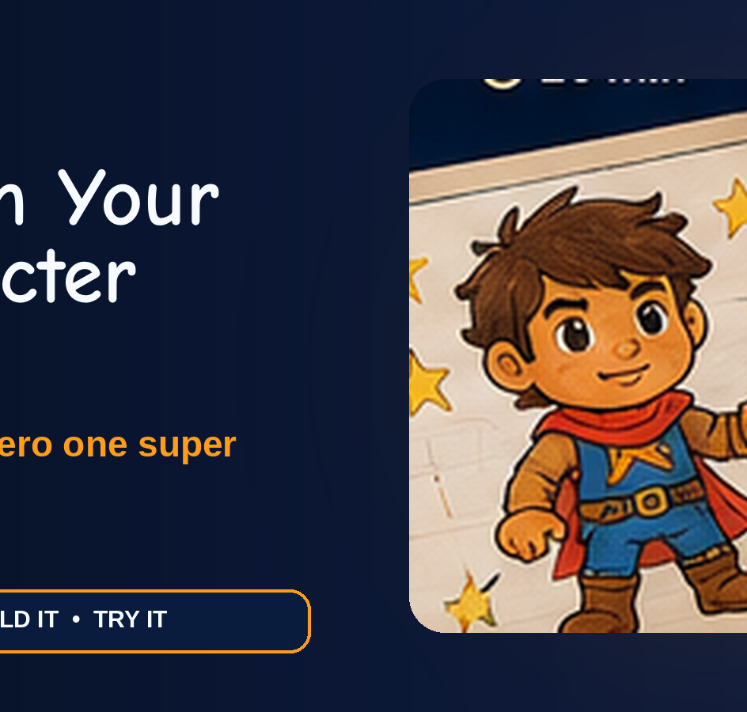
MISSION 3: DESIGN YOUR HERO
9
DRAW YOUR HERO
Name:
One power:
Colors:
Special item:
My hero helps by...

Slide 10
MISSION 3: HERO STORY
10
Use one clear power. Make the challenge still possible!
My hero is...
My hero can...
My hero needs to...
A challenge is...
ACE'S POWER TEST
Does the power help with the goal? YES / NOT YET

Slide 11
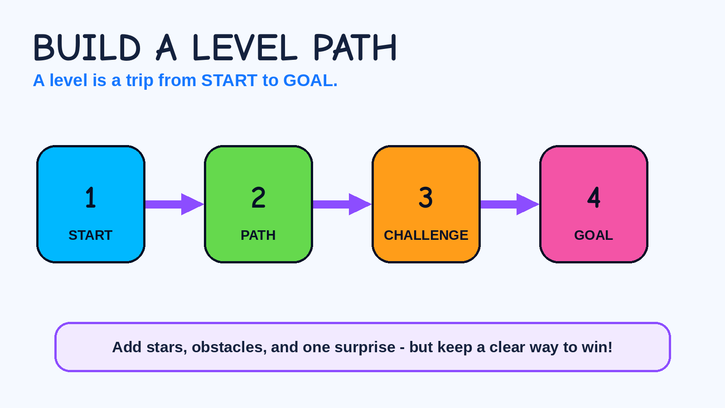
MISSION 4: PLAN LEVEL 1
11
START
PATH
Where do players begin?
How do they move?
CHALLENGE
GOAL
What slows them down?
How do they win?

Slide 12
MISSION 4: DRAW YOUR BOARD
12
Draw START, a path, one challenge, three bonus spaces, and the GOAL.
START
GOAL
Use the back if you need more room.

Slide 13
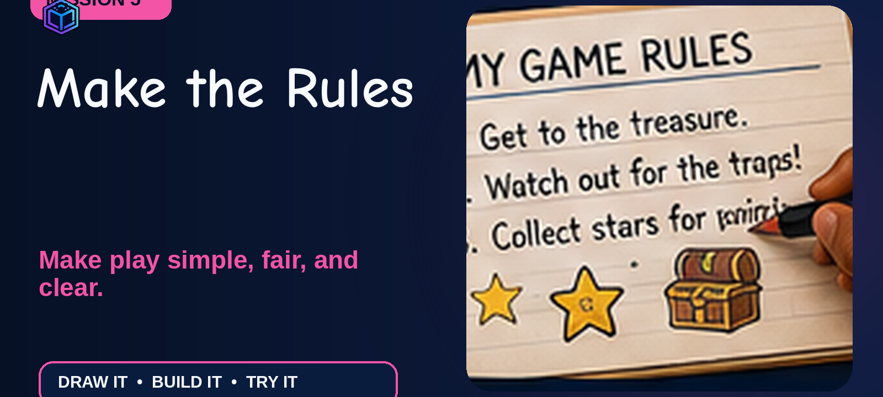
MISSION 5: MAKE THE RULES
13
1. How do we start?
2. What happens on a turn?
3. What do special spaces do?
4. How do we win?

Slide 14
MISSION 5: CUT OUT MOVE CARDS
14
Cut on the dotted lines. Mix the cards. Draw one card on each turn.
1
2
MOVE 1
MOVE 2
3
1
MOVE 3
MOVE 1
2
3
MOVE 2
MOVE 3

Slide 15
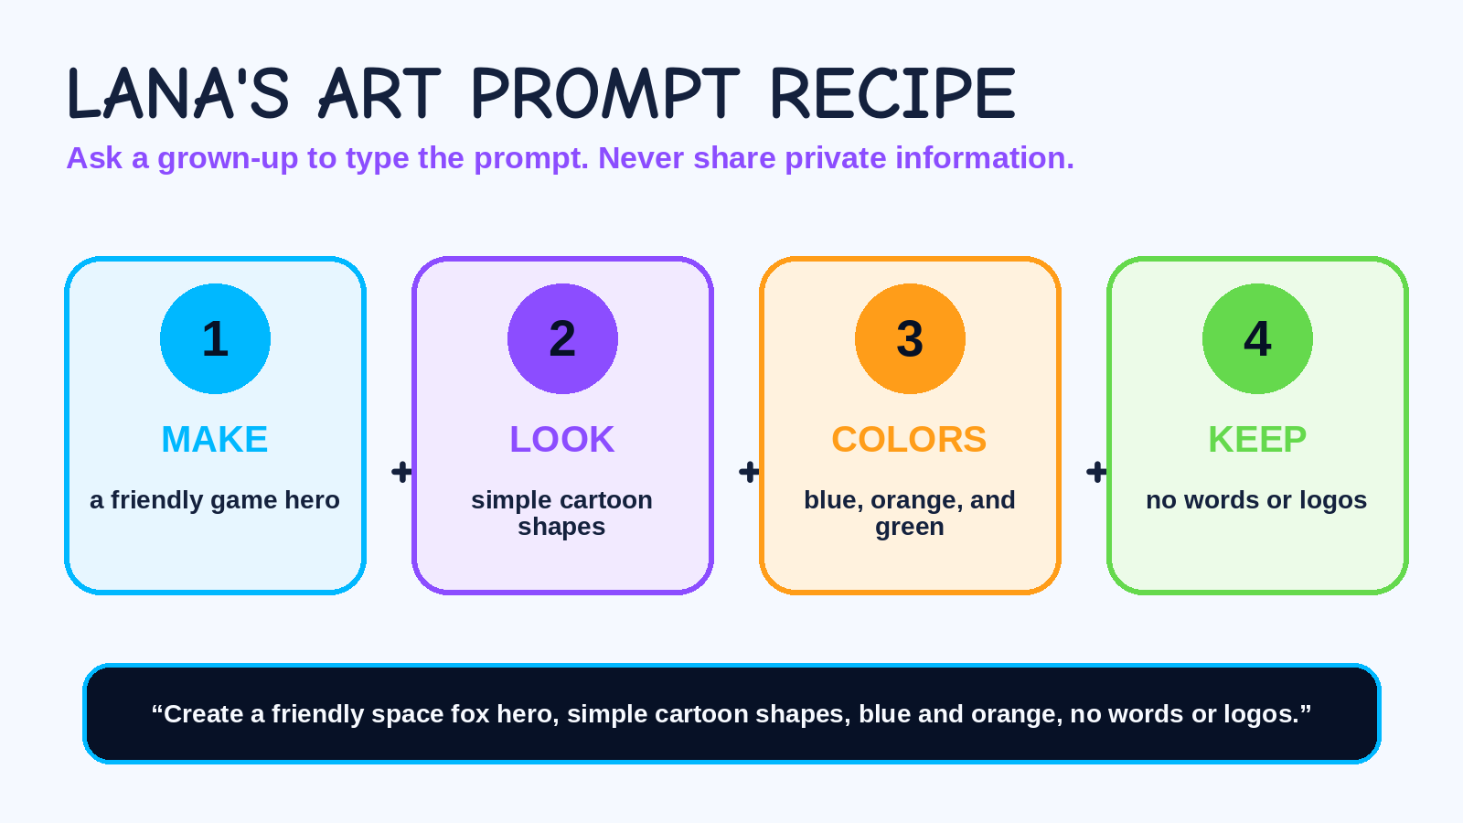
MISSION 5: GAME ART IDEAS
15
Write the prompt on paper. A grown-up can type it later.
CHARACTER ART PROMPT
LEVEL ART PROMPT
PRIVATE INFO CHECK: I did not use my full name, school, address, phone, or face photo. □

Slide 16
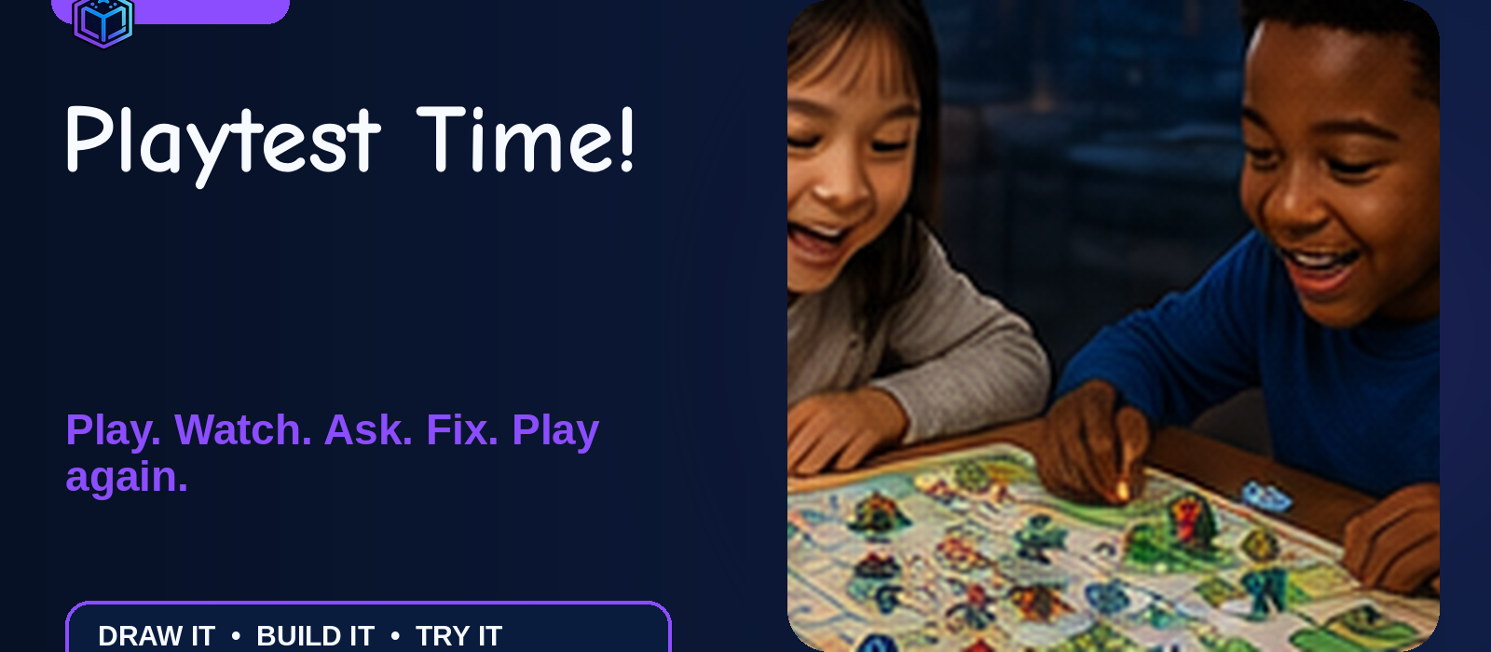
MISSION 6: PLAYTEST TIME!
16
My tester's name or nickname:
FUN
Did you want to keep playing?
YES
?
NO
FAIR
Did everyone have a chance?
YES
?
NO
CLEAR
Did the rules make sense?
YES
?
NO
One kind compliment:

Slide 17
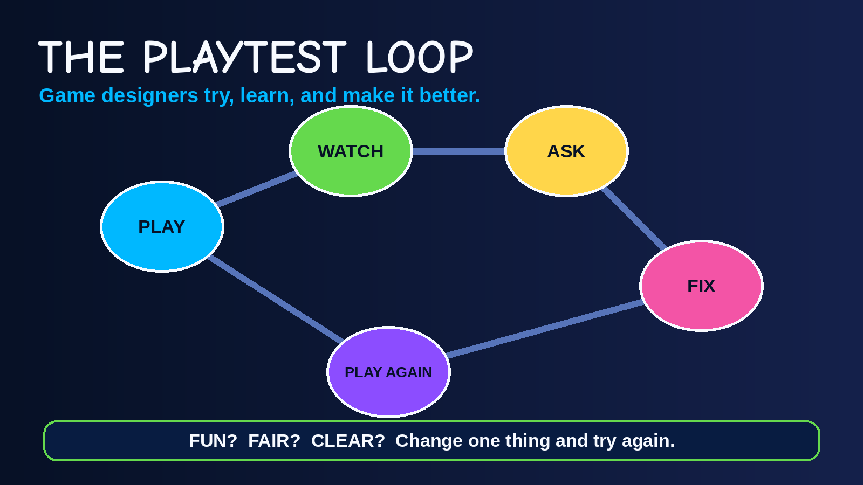
MAKE IT BETTER!
17
I noticed...
I changed...
Now my game is...
MORE FUN / MORE FAIR / MORE CLEAR

Slide 18
MY GAME CONCEPT
18
GAME NAME
THEME
HERO
GOAL
CHALLENGE
BEST PART
Draw a tiny picture of your game:
My game is ready to share! □

Slide 19
MY 30-SECOND GAME PITCH
19
My game is called...
The player is...
The goal is...
The challenge is...
The coolest part is...
Stand tall. Smile. Speak slowly. Show your game!

Slide 20

CERTIFICATE OF GAME DESIGN
This certifies that
imagined, drew, built, and playtested an original paper game!
SMART • KIND • CREATIVE GAME DESIGNER
Date
Grown-up / Teacher
IMAGINE IT. DRAW IT. PLAY IT. SHARE IT.

