Slide 1
Tachospeed Signal in Benz E200L
Startbit: | 28
Length: | 12
Message ID: | 0x98
DLC | 8
Channel | 1
Baudrate | 500kbps
Byte 3 | 31 | 30 | 29 | 28 | ? | ? | ? | ?
Byte 4 | 39 | 38 | 37 | 36 | 35 | 34 | 33 | 32
Tachospeed Signal in J1939
Startbit: | 48
Length: | 16
Message ID: | 0xCFE6C17
DLC | 8
Channel | 2
Baudrate | 250kbps
Byte 6 | 35 | 34 | 33 | 32 | 31 | 30 | 29 | 28
Byte 7 | 0 | 0 | 0 | 0 | 39 | 38 | 37 | 36

Slide 2
Byte 3 | 31 | 30 | 29 | 28 | ? | ? | ? | ?
Byte 4 | 39 | 38 | 37 | 36 | 35 | 34 | 33 | 32
This:
Byte 4 | 39 | 38 | 37 | 36 | 35 | 34 | 33 | 32
Byte 3 | 31 | 30 | 29 | 28 | ? | ? | ? | ?
&
&
0x0F | 0 | 0 | 0 | 0 | 1 | 1 | 1 | 1
0xF0 | 1 | 1 | 1 | 1 | 0 | 0 | 0 | 0
<< 4
>> 4
Byte 4 | 35 | 34 | 33 | 32 | 0 | 0 | 0 | 0
Byte 3 | 0 | 0 | 0 | 0 | 31 | 30 | 29 | 28
|
New | 35 | 34 | 33 | 32 | 31 | 30 | 29 | 28
Message.byte(6) = New
Byte 6 | 35 | 34 | 33 | 32 | 31 | 30 | 29 | 28
Message:

Slide 3
Byte 3 | 31 | 30 | 29 | 28 | ? | ? | ? | ?
Byte 4 | 39 | 38 | 37 | 36 | 35 | 34 | 33 | 32
This:
Byte 4 | 39 | 38 | 37 | 36 | 35 | 34 | 33 | 32
&
0xF0 | 1 | 1 | 1 | 1 | 0 | 0 | 0 | 0
>> 4
Byte 4 | 0 | 0 | 0 | 0 | 39 | 38 | 37 | 36
Message.byte(7) = New
Byte 7 | 0 | 0 | 0 | 0 | 39 | 38 | 37 | 36
Message:
Byte 6 | 35 | 34 | 33 | 32 | 31 | 30 | 29 | 28
Byte 7 | 0 | 0 | 0 | 0 | 39 | 38 | 37 | 36

Slide 4
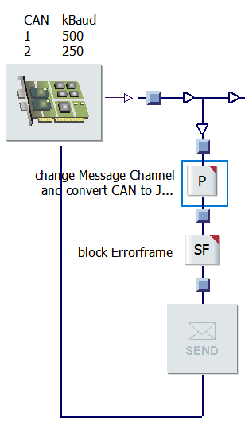
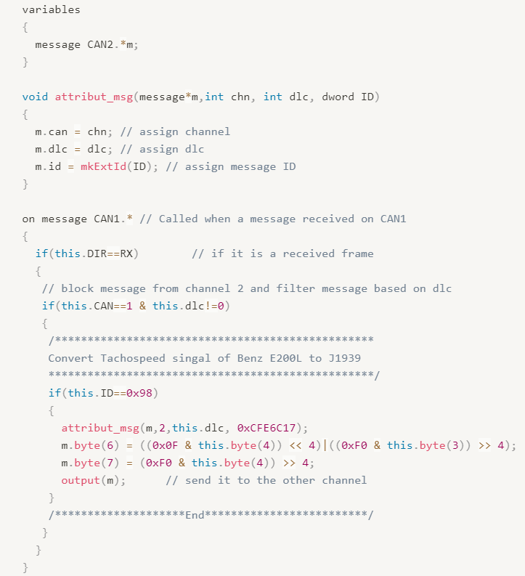
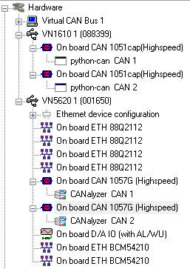
HW config
SW config
CAPL

