Slide 1




Async in Rust
Luxeria
18.03.2020
Next

Slide 2
Motivation
“async” in stable rust compiler (recently)
Interesting topic
Basic async code in Rust is fun & easy!
→ This is a short, simplified intro talk
Previous
Next

Slide 3
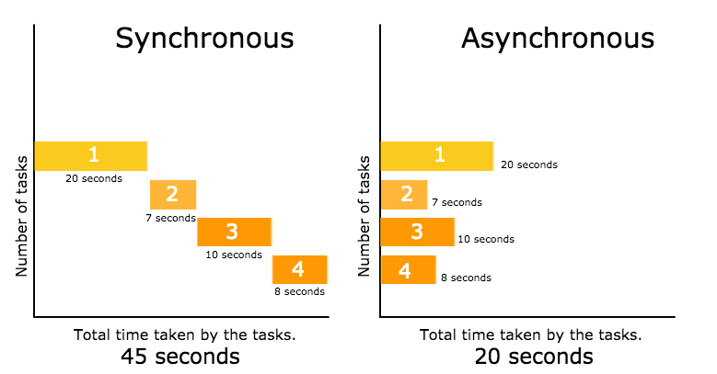
So, what does it mean?
Previous
Next

Slide 4
There is more to that
Pieces of code run at the same time
But: Not exactly the same as “parallelism”
Actually we only pretend true parallelism
Previous
Next

Slide 5
Parallel Execution
Thread / Core
Thread / Core
Thread / Core
Thread / Core
Thread / Core
Previous
Next

Slide 6
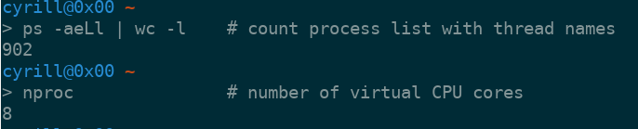
Little Problem
What if we have only one Thread / CPU Core?
What if we have 1000s of tasks?
→ How is my System not freezing all the time from long running, blocking tasks?
Previous
Next

Slide 7
Async Concepts
Futures
Executors
Poll / Wake mechanisms
Previous
Next

Slide 8
Futures
Represents something: Lets say a variable
This “future” variable will hold a value
Think of: “Somewhen, in the future, this variable will hold a value. But not yet.”
Until the variable is ready, we can just carry on executing another tasks!
→ Needs a system for scheduling this
Previous
Next

Slide 9
Executor
You feed it with futures
It uses an event loop to execute them
Rather complex logic to execute all of them the possible best way
→ No details
Previous
Next

Slide 10
Poll / Wake
Executor starts executing one task
Other tasks are not executed...
… until the execution comes across our “future” Variable
→ It then polls the future (“are you ready?”)
If it’s not ready → Yay! Start executing another task!
Also note: A future can wake up by itself
Previous
Next

Slide 11
Rust async ecosystem
Tokio
  Widely adopted, mature
  Provides runtime (executors) and many utils
Futures-rs
  Provides building blocks (and also executors)
Async-std
  Provides more building blocks
Previous
Next

Slide 12
Technically
async keyword
await keyword
futures trait
Previous
Next

Slide 13
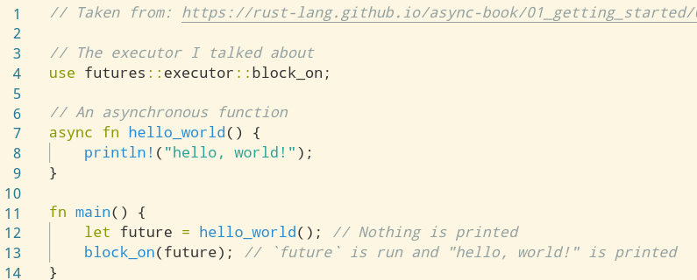
Hello, World!
Previous
Next

Slide 14
Pitfall: “cold” vs. “hot” futures
In Rust we have cold futures
Hot futures are automatically run (“awaited”) as soon as they are declared
Cold futures need to be run explicitly
Previous
Next

Slide 15

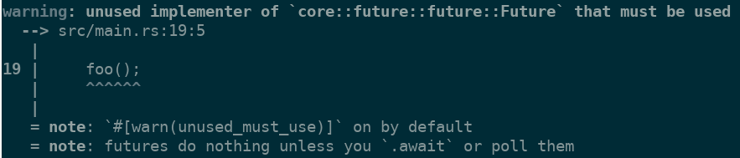
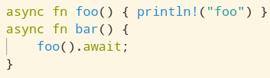
Example
Previous
Next

Slide 16
A more involved example
Async code really shines when use for heavy Input/Output or event based tasks
  JavaScript
  Linux: epoll
→ Let’s make some web requests!
Previous
Next

Slide 17
Pictures
https://book.async.rs/images/horizontal_color.svg
https://raw.githubusercontent.com/rust-lang/futures-rs/gh-pages/assets/images/futures-rs-logo.svg?sanitize=true
https://www.rust-lang.org/static/images/rust-logo-blk.svg
https://tokio.rs/img/Tokio_Mark_Large.png
https://adrianmejia.com/images/synchronous-asynchronous-javascript.png
Previous

