Slide 1
CAS CS 460/660
Introduction to Database Systems
Disks, Buffer Manager

Slide 2
DBMS architecture
Database app
Query Optimization
and Execution
Relational Operators
These layers
must consider
concurrency
control and
recovery
Access Methods
Buffer Management
Disk Space Management
Student Records stored on disk

Slide 3
Why Not Store It All in Main Memory?
Costs too much. $100 will buy you either
~100 GB of RAM or around 2000 GB (2 TB) of disk today.
  High-end Databases today can be in the Petabyte (1000TB) range.
  Approx 60% of the cost of a production system is in the disks.
Main memory is volatile. We want data to be saved between runs. (Obviously!)
Note, some specialized systems do store entire database in main memory.
  Vendors claim 10x speed up vs. traditional DBMS running in main memory.

Slide 4
The Storage Hierarchy
Main memory (RAM) for currently used data.
Disk for main database (secondary storage).
Tapes for archive, maybe
(tertiary storage).
The role of Flash (SSD)
still unclear
Registers
Small, Fast
On-chip Cache
On-Board Cache
RAM
SSD
Disk
Big, Slow
Tape

Slide 5
Economics
For $1000, you can get:
  ~400GB of RAM
  ~2.5TB of Solid State Disk
  ~30TB of Magnetic Disk
Notes:
SSD today about $100/250GB
HDDD 3TB Barracuda $90
DRAM 8GB about $20

Slide 6
Disks and Files
Today: Most data is stored on magnetic disks.
  Disks are a mechanical anachronism!
Major implications!
  No “pointer derefs”. Instead, an API:
    READ: transfer “page” of data from disk to RAM.
    WRITE: transfer “page” of data from RAM to disk.
  Both API calls expensive
    Plan carefully!
  An explicit API can be a good thing
    Minimizes the kind of pointer errors you see in C

Slide 7
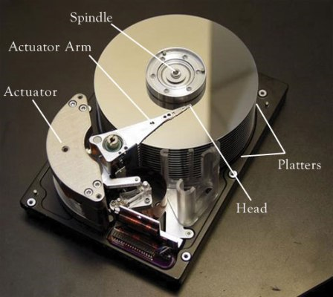


Slide 8
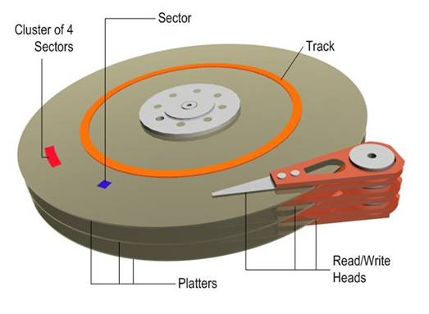
Anatomy of a Disk
The platters spin
The arm assembly is moved in or out to position a head on a desired track. Tracks under heads make a cylinder (imaginary!).
Only one head reads/writes at any one time.
Block size is a multiple of sector size (which is fixed)
Notes:
sector size: 512 bytes to new HDD 4KB (AF)
Block size: 4KB to 32KB

Slide 9
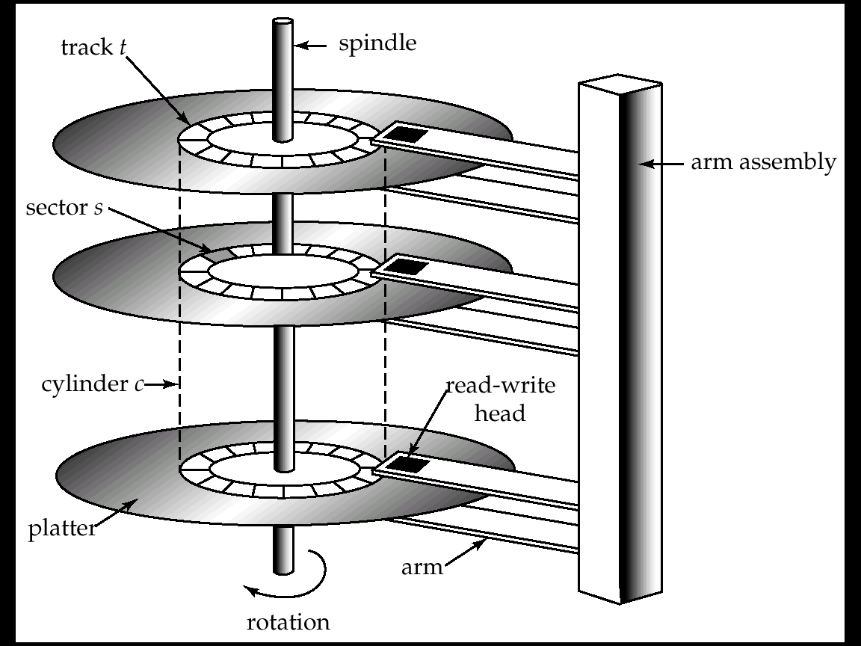

Slide 10
Accessing a Disk Page
Time to access (read/write) a disk block:
  seek time (moving arms to position disk head on track)
  rotational delay (waiting for block to rotate under head)
  transfer time (actually moving data to/from disk surface)
Seek time and rotational delay dominate.
  Seek time varies from about 1 to 15msec (full stroke)
  Rotational delay varies from 0 to 8msec (7200rpm)
  Transfer rate is < 0.1msec per 8KB block
Key to lower I/O cost:
  reduce seek/rotation delays! Hardware vs. software solutions?
Also note: For shared disks most time spent waiting in queue for access to arm/controller
Wait
Transfer
Transfer
Rotate
Rotate
Seek
Seek

Slide 11
Arranging Pages on Disk
`Next’ block concept:
  blocks on same track, followed by
  blocks on same cylinder, followed by
  blocks on adjacent cylinder
Arrange file pages sequentially on disk
  minimize seek and rotational delay.
For a sequential scan, pre-fetch
  several pages at a time!
We use Block/Page interchangeably!!

Slide 12
From the DB Administrator’s View
Modern disk structures are so complex even industry experts refer to them as “black boxes”. Today there is no alignment to physical disk sectors, no matter what we believe. Disks do not map sectors to physical regions in a way that we can understand from outside the box; the simplistic “geometry” reported by the device is an artifice.
from Microsoft’s “Disk Partition Alignment Best Practices for SQL Server”

Slide 13
Disk Space Management
Lowest layer of DBMS software manages space on disk (using OS file system or not?).
Higher levels call upon this layer to:
  allocate/de-allocate a page
  read/write a page
Best if a request for a sequence of pages is satisfied by pages stored sequentially on disk! Higher levels don’t need to know if/how this is done, or how free space is managed.

Slide 14
Notes on Flash (SSD)
Various technologies, we focus on NAND
  suited for volume data storage
  alternative: NOR Flash
Read is random access and fast
  E.g. 512 Bytes at a time
Write is coarser grained and slower
  E.g. 16-512 KBytes at a time.
  Can get slower over time
Some concern about write endurance
  100K cycle lifetimes?
Still changing quickly

Slide 15
CPU
Typical
Computer
...
...
M
C
Secondary
Storage

Slide 16
Storage Pragmatics & Trends
Many significant DBs are not that big.
  Daily weather, round the globe, 1929-2009: 20GB
  2000 US Census: 200GB
  2009 English Wikipedia: 14GB
  NYC Taxi Rides (~20GB per year)
But data sizes grow faster than Moore’s Law
What is the role of disk, flash, RAM?
  The subject of much debate/concern!

Slide 17
Buffer Management in a DBMS
Page Requests from Higher Levels
BUFFER POOL
disk page
free frame
MAIN MEMORY
choice of frame dictated
by replacement policy
DISK
DB
Data must be in RAM for DBMS to operate on it!
  The query processor refers to data using virtual memory addresses.
Buffer Mgr hides the fact that not all data is in RAM

Slide 18
Some Terminology…
Disk Page – the unit of transfer between the disk and memory
  Typically set as a config parameter for the DBMS.
  Typical value between 4 KBytes to 32 KBytes.
Frame – a unit of memory
  Typically the same size as the Disk Page Size
Buffer Pool – a collection of frames used by the DBMS to temporarily keep data for use by the query processor (CPU).
  note: We will sometime use the term “buffer” and “frame” synonymously.

Slide 19
When a Page is Requested ...
If requested page IS in the pool:
  Pin the page and return its address.
Else, if requested page IS NOT in the pool:
  If a free frame exists, choose it, Else:
    Choose a frame for replacement (only un-pinned pages are candidates)
    If chosen frame is “dirty”, write it to disk
  Read requested page into chosen frame
  Pin the page and return its address.
Q: What information about buffers and their contents must the system maintain?

Slide 20
Buffer Control Blocks (BCBs):
<frame#, pageid, pin_count, dirty>
A page may be requested many times, so
  a pin count is used.
  To pin a page, pin_count++
  A page is a candidate for replacement iff pin_count == 0 (“unpinned”)
Requestor of page must eventually unpin it.
  pin_count--
Must also indicate if page has been modified:
  dirty bit is used for this.
  Q: Why is this important?
Q: How should BCB’s be organized?

Slide 21
Additional Buffer Mgr Notes
BCB’s are hash indexed by pageID
Concurrency Control & Recovery may entail additional I/O when a frame is chosen for replacement.
(Write-Ahead Log protocol; more later.)
If requests can be predicted (e.g., sequential scans) pages can be pre-fetched several pages at a time.

Slide 22
Buffer Replacement Policy
Frame is chosen for replacement by a replacement policy:
  Least-recently-used (LRU), MRU, Clock, etc.
This policy can have big impact on the number of disk reads and writes.
  Remember, these are slooooooooooow.
BIG IDEA – throw out the page that you are least likely to need in the future.
  Q: How do you predict the future?

Slide 23
LRU Replacement Policy
Least Recently Used (LRU)
for each page in buffer pool, keep track of time last unpinned
2)Replace the frame that has the oldest (earliest) time
  Most common policy: intuitive and simple
    Based on notion of “Temporal Locality”
    Works well to keep “working set” in buffers.
  Implemented through doubly linked list of BCBs
    Requires list manipulation on unpin

Slide 24
“Clock” Replacement Policy
A(1)
An approximation of LRU
Arrange frames into a cycle, store one reference bit per frame
  Can think of this as the 2nd chance bit
When pin count reduces to 0, turn on ref. bit
When replacement necessary
do for each page in cycle {
if (pincount == 0 && ref bit is on)
turn off ref bit;
else if (pincount == 0 && ref bit is off)
choose this page for replacement;
} until a page is chosen;
B(p)
D(1)
C(1)

Slide 25
Some issues with LRU
Problem: Sequential flooding
  LRU + repeated sequential scans.
  # buffer frames < # pages in file means each page request causes an I/O. MRU much better in this situation (but not in all situations, of course).
Problem: “cold” pages can hang around a long time before they are replaced.

Slide 26
DBMS vs. OS File System
OS does disk space & buffer mgmt: why not let OS manage these tasks?
Some limitations, e.g., files can’t span disks.
  Note, this is changing --- OS File systems are getting smarter (i.e., more like databases!)
Buffer management in DBMS requires ability to:
  pin a page in buffer pool, force a page to disk & order writes (important for implementing CC & recovery)
  adjust replacement policy, and pre-fetch pages based on access patterns in typical DB operations.

