Slide 1
Week 6

Slide 2
Evaluating a learning algorithm

Slide 3
Decide what to do next
?
Get more training examples
Try smaller sets of features
Try getting additional features
Try adding polynomial features
Try decreasing learning rate
Try increasing learning rate

Slide 4
Machine learning diagnostic:
Diagnostic: A test that you can run to gain insight what is/isn’t working with a learning algorithm, and gain guidance as to how best to improve its performance.
Diagnostics can take time to implement, but doing so can be a very good use of your time.

Slide 5




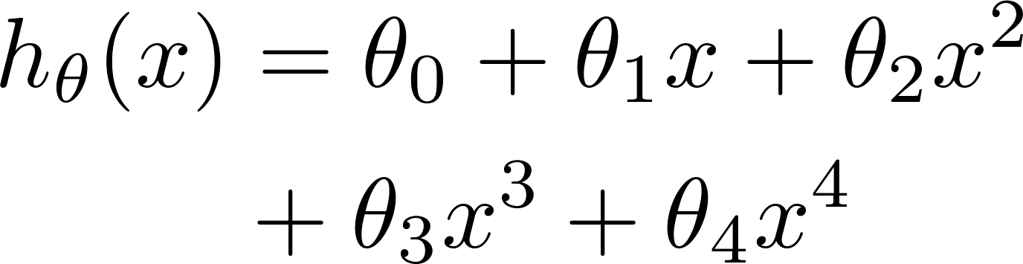


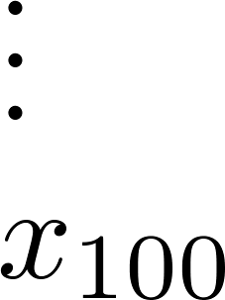
Evaluating your hypothesis
Fails to generalize to new examples not in training set.
Overfitting
price
size of house
no. of bedrooms
no. of floors
size
age of house
average income in neighborhood
kitchen size

Slide 6
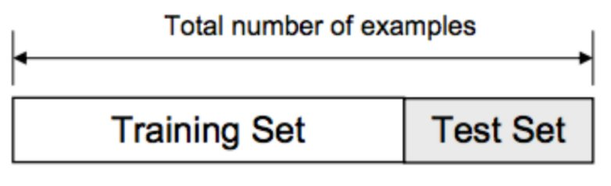
Train/Test
70%
30%

Slide 7






Train/Test
Example (Coursera):
Size | Price
2104 | 400
1600 | 330
2400 | 369
1416 | 232
3000 | 540
1985 | 300
1534 | 315
1427 | 199
1380 | 212
1494 | 243

Slide 8
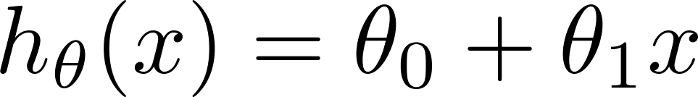
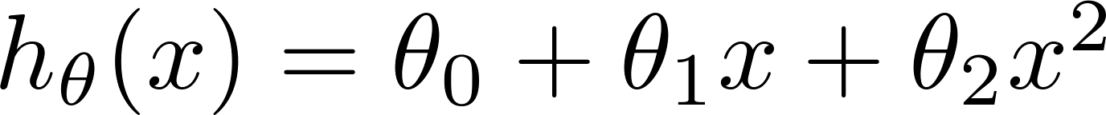
Train/Test
1.
2.
3.
10.
Train the model by data in the training set only.
Choose the degree of model which has the lowest J_test in test set
Problem: We use test set to choose model, it is likely to be an optimistic estimate of generalization error I.e. our extra parameter (d) is fit to test set

Slide 9
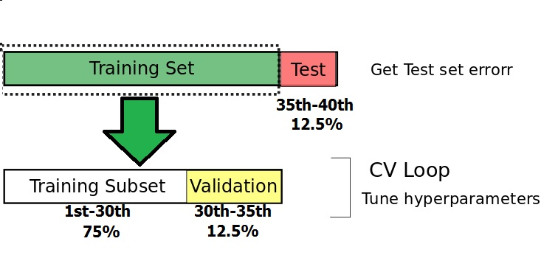
Train/Val/Test

Slide 10
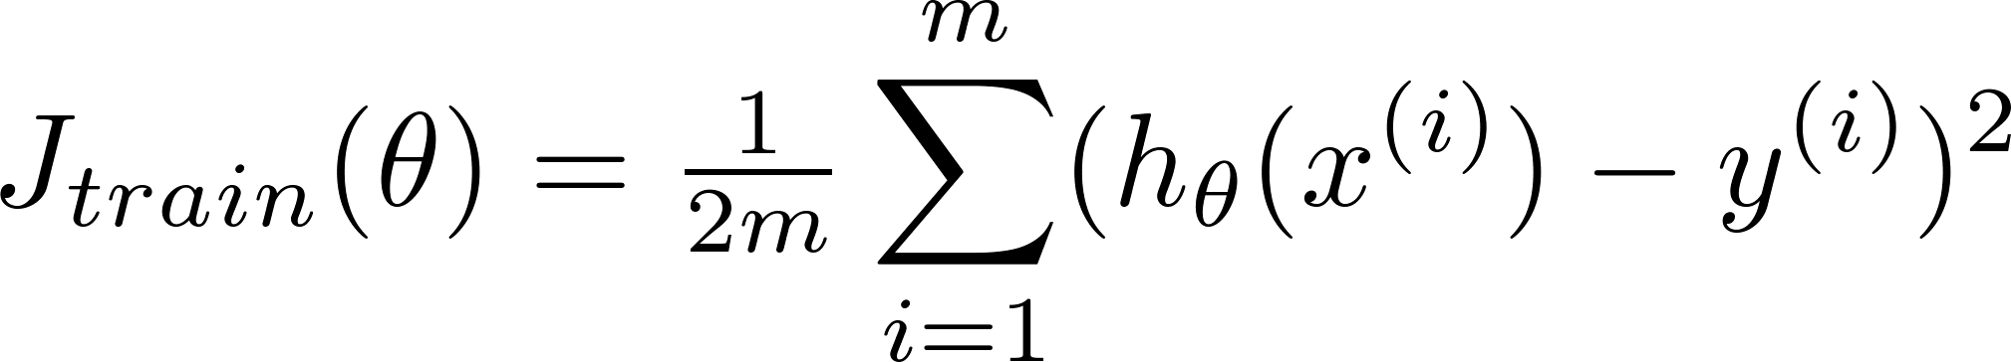
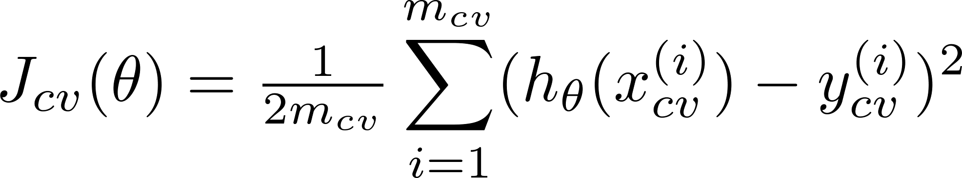
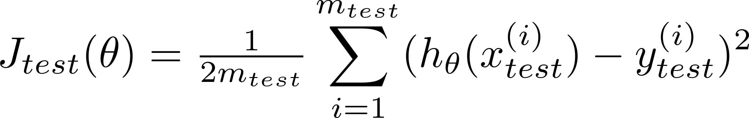
Train/validation/test
Training error:
Cross Validation error:
Test error:

Slide 11
Model selection
Evaluate some models with different degree
1.
2.
3.
10.
- Fitting model with training set
- Choose the degree of model which has the lowest loss J_valid in validation set

Slide 12
Dianosing Bias and Variance

Slide 13
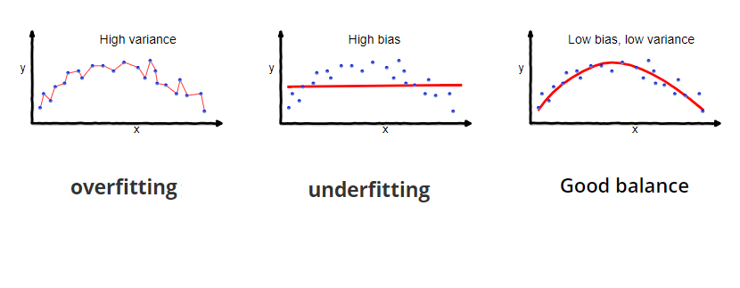
Dianosing Bias and Variance

Slide 14
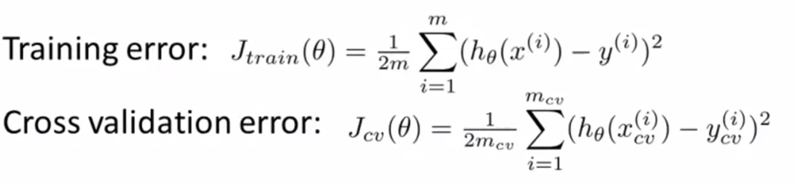
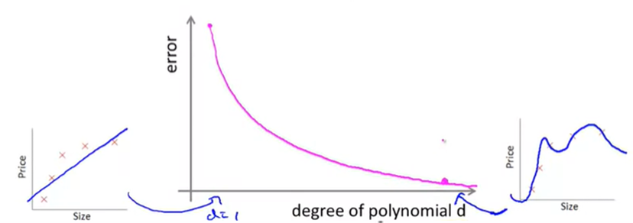

Slide 15
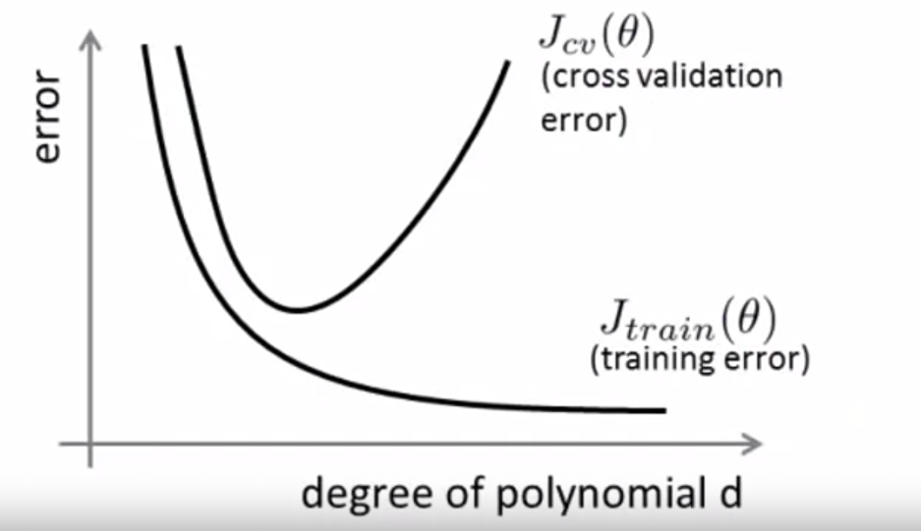
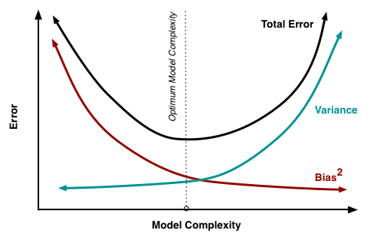
Bias (Underfitting):
High training error
High validation error
Variance (Overfitting):
Low training error
High validation Error

Slide 16
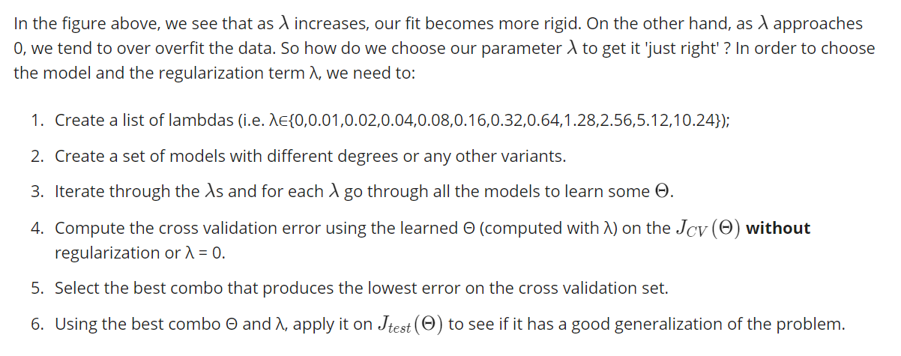

Slide 17
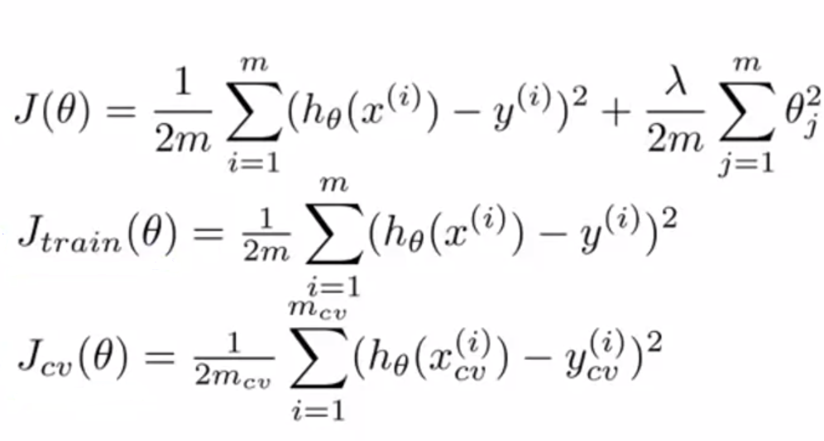
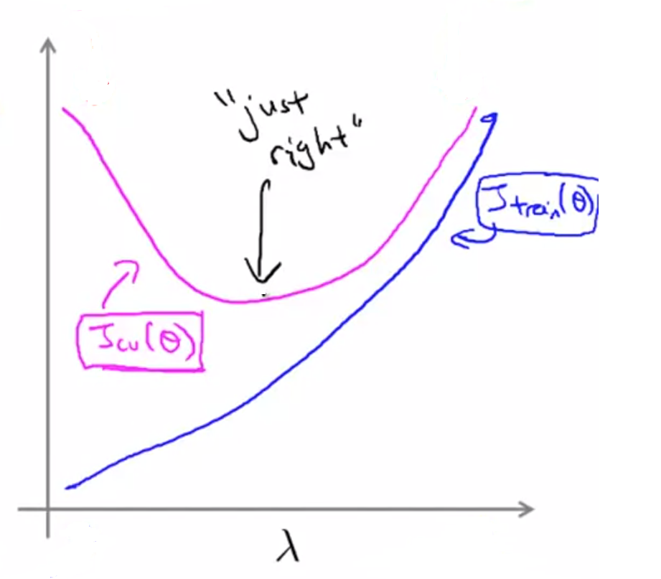

Variance
Bias
Small
Large

Slide 18
Learning Curves

Slide 19
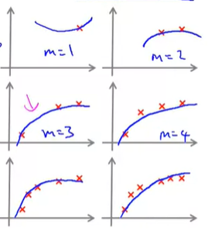
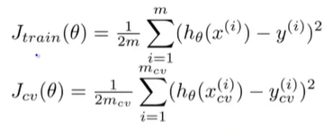
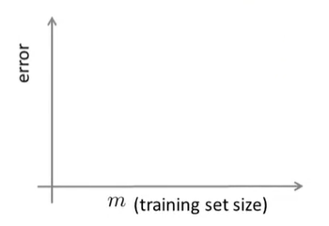


Learning Curves
Losses
More data => Harder to fit (overfit)

Slide 20
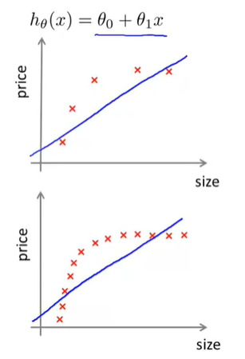
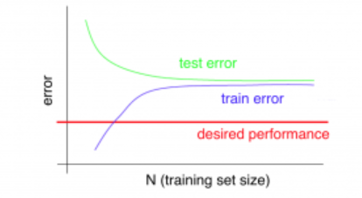
Learning Curves
High bias
More training data will not resolve high bias very much

Slide 21
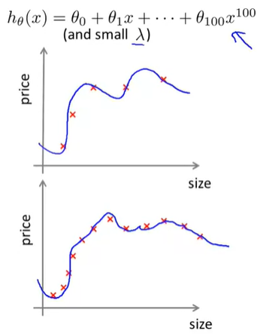
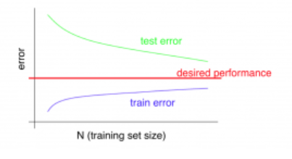
Learning Curves
High variance
Getting more training data might resolve high variance

Slide 22
Deciding what to do next revisited

Slide 23
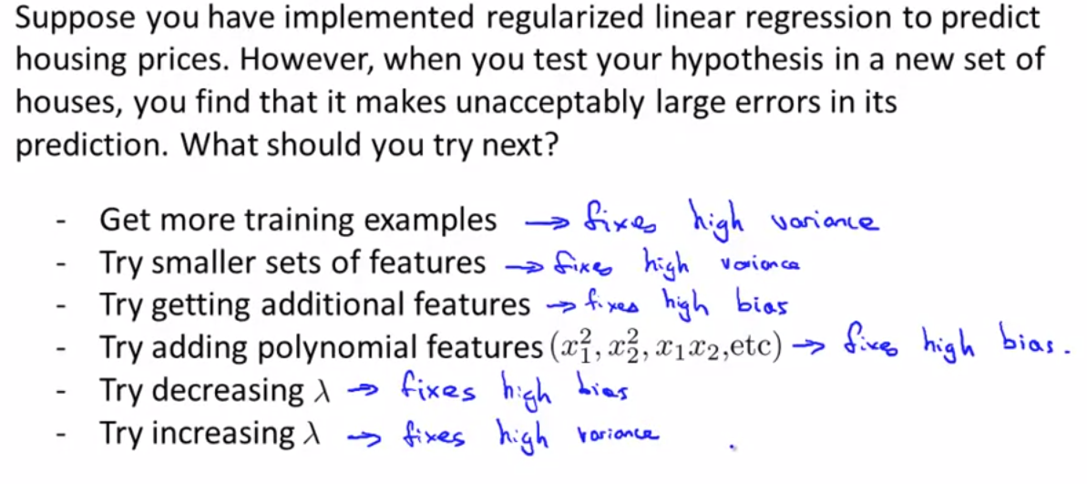
Deciding what to do next revisited

Slide 24
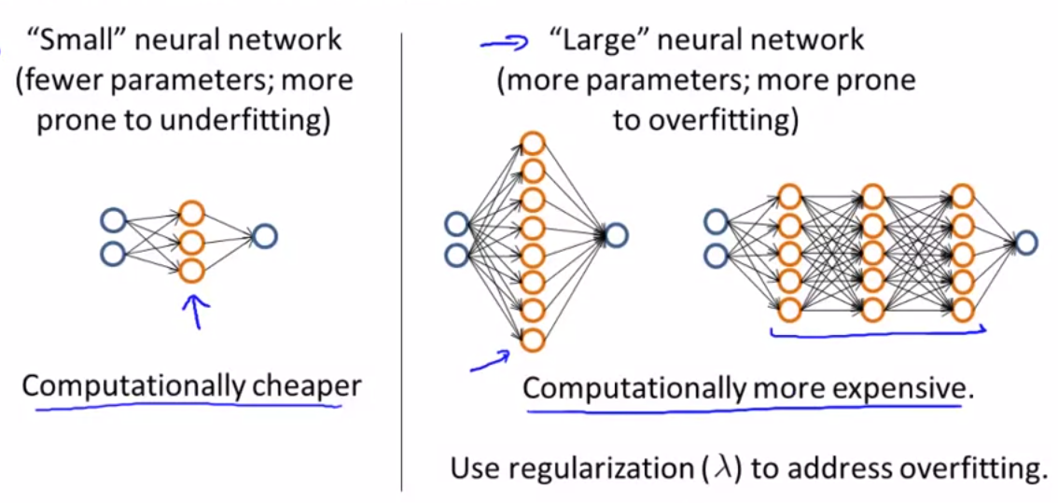
Neutral network and overfitting

