Slide 1
Reconstruction from Compressed Representation

Slide 2
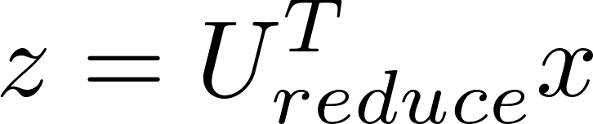

Reconstruction from compressed representation
Notes:
Make points have 0 mean on x1 and x2

Slide 3
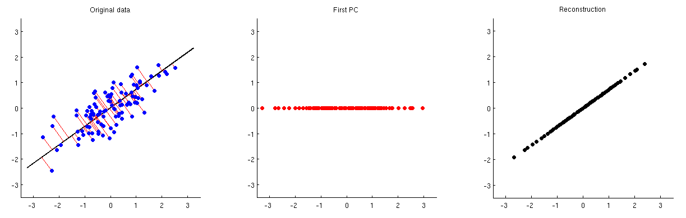
Reconstruction from compressed representation
Notes:
Make points have 0 mean on x1 and x2

Slide 4
Advice for applying PCA

Slide 5

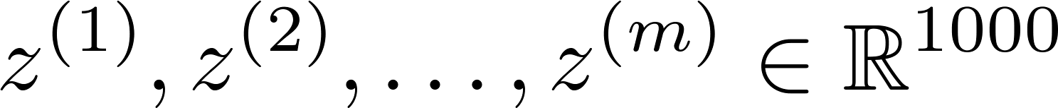
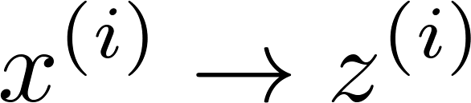
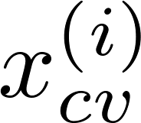
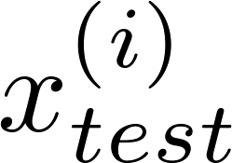
Supervised learning speedup
Expensive computation
1
Extract inputs:
Unlabeled dataset:
2
3
4
New training set:
Note: Mapping should be defined by running PCA only on the training set. This mapping can be applied as well to the examples and in the cross validation and test sets.

Slide 6
Application of PCA
Compression
Reduce memory/disk needed to store data
Speed up learning algorithm
Visualization

Slide 7
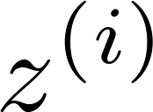
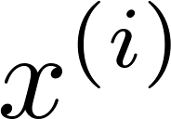

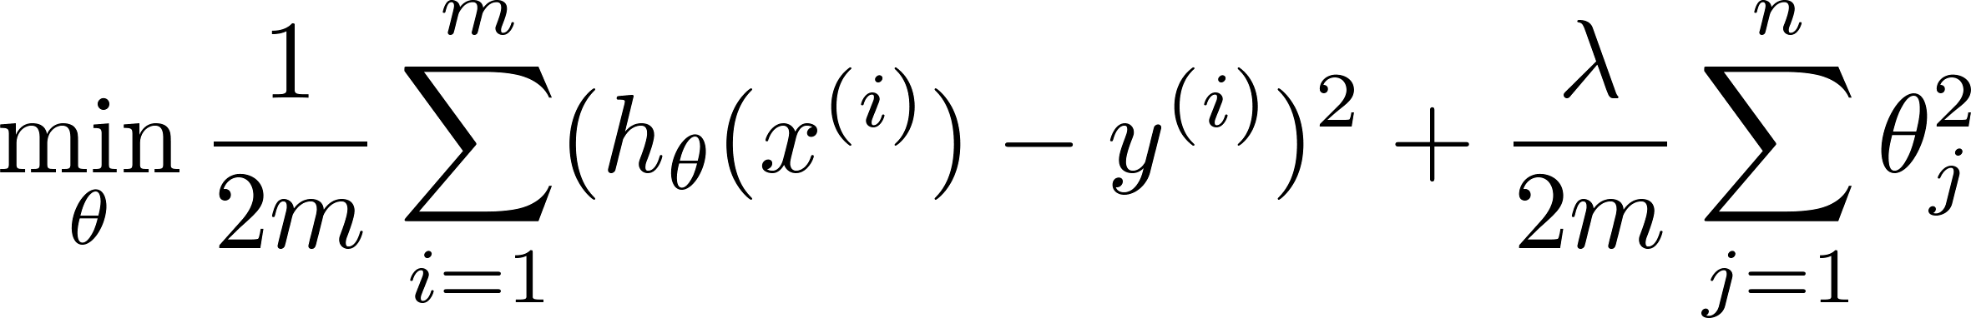
Bad use of PCA: To prevent overfitting
Use instead of to reduce the number of features to
Thus, fewer features, less likely to overfit.
BAD!!
This might work OK, but isn’t a good way to address overfitting. Use regularization instead.

Slide 8





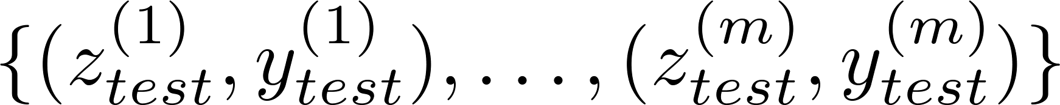
PCA is sometimes used where it shouldn’t be
Design of ML system:
Get training set
Run PCA to reduce in dimension to get
Train logistic regression on
Test on test set: Map to . Run on
How about doing the whole thing without using PCA?
Before implementing PCA, first try running whatever you want to do with the original/raw data . Only if that doesn’t do what you want, then implement PCA and consider using .

