Slide 1
Online Learning

Slide 2
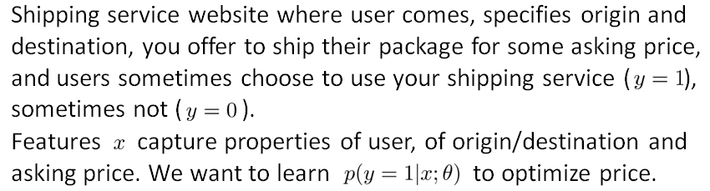
Online Learning

Slide 3
Online Learning
Repeat forever {
Get (x, y) corresponding to user
Update θ using (x, y):
θ_{i} = θ_{i} – α(h(x) - y).x_{i} (i= 0, 1, …n)
}

Slide 4



Other online learning example:
Product search (learning to search)
User searches for “Android phone 1080p camera”
Have 100 phones in store. Will return 10 results.
features of phone, how many words in user query match name of phone, how many words in query match description of phone, etc.
if user clicks on link. otherwise.
Learn .
Use to show user the 10 phones they’re most likely to click on.
Other examples: Choosing special offers to show user; customized selection of news articles; product recommendation; …
Notes:
Make points have 0 mean on x1 and x2

Slide 5
Sliding Window

Slide 6
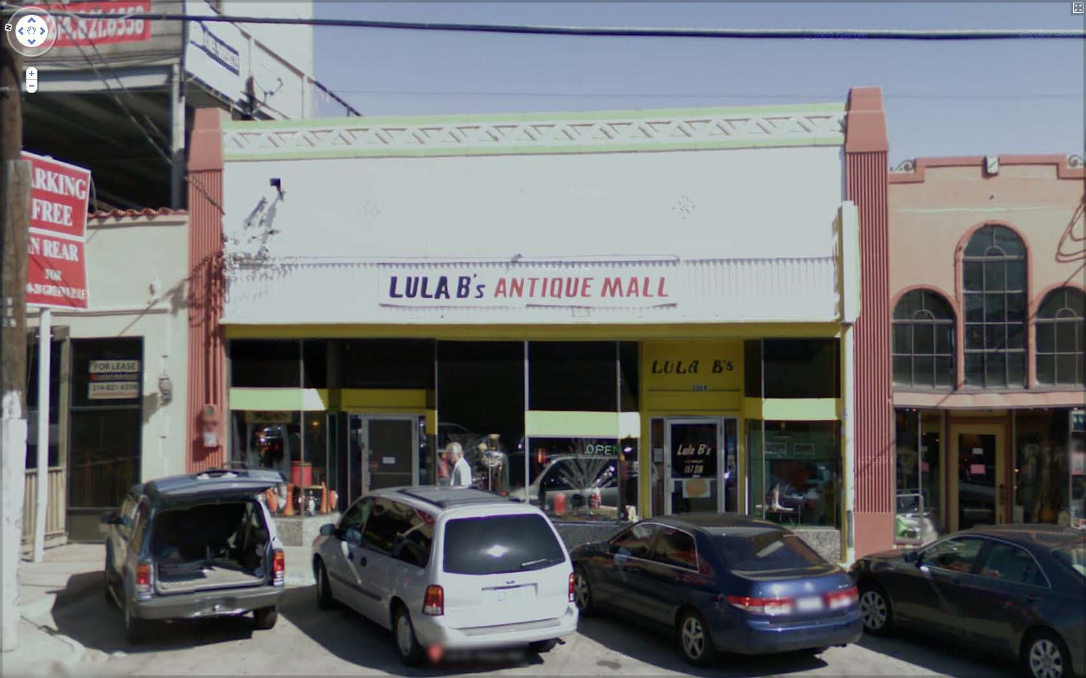
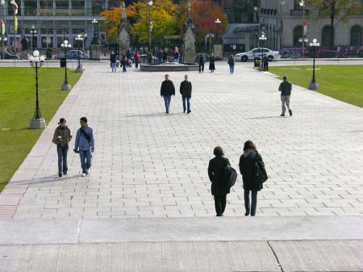
Text detection
Pedestrian detection
Aspect ratio of rectangles is different
Aspect ratio of rectangles is same

Slide 7


























Supervised learning for pedestrian detection
pixels in 82x36 image patches
Positive examples
Negative examples

Slide 8
Sliding window detection

Slide 9
Sliding window detection

Slide 10
Sliding window detection

Slide 11
Text detection

Slide 12
Text detection
Positive examples
Negative examples

Slide 13
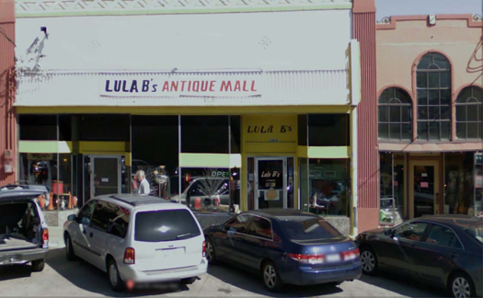


We can discard boxes who's height and width are
almost same as text should have more width
as compared to the height. But it might lead to
Skipping some text.
Text detection
[David Wu]
Notes:
Expansion
Rectangles around operator

Slide 14
1D Sliding window for character segmentation
Positive examples
Negative examples
Notes:
Change it to segmentation examples instead:

Slide 15
Photo OCR pipeline
1. Text detection
2. Character segmentation
3. Character classification
A
N
T

