Slide 1
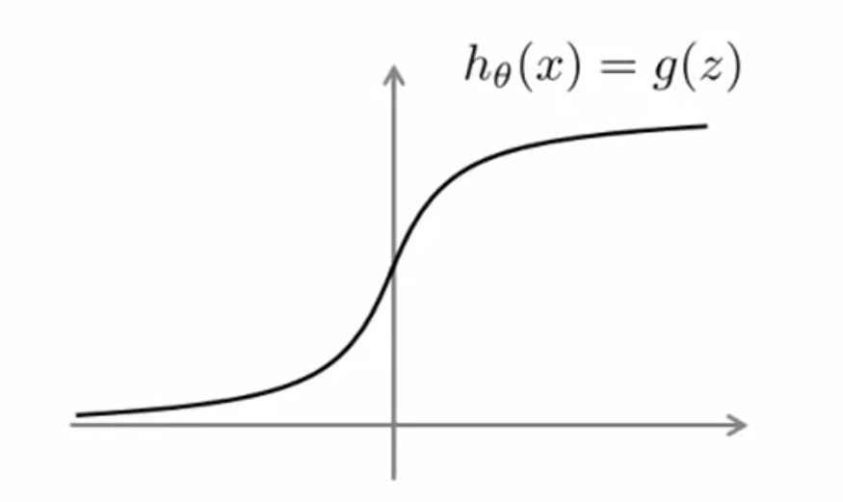

Optimization Objective
Alternative view of logistic regression

Slide 2


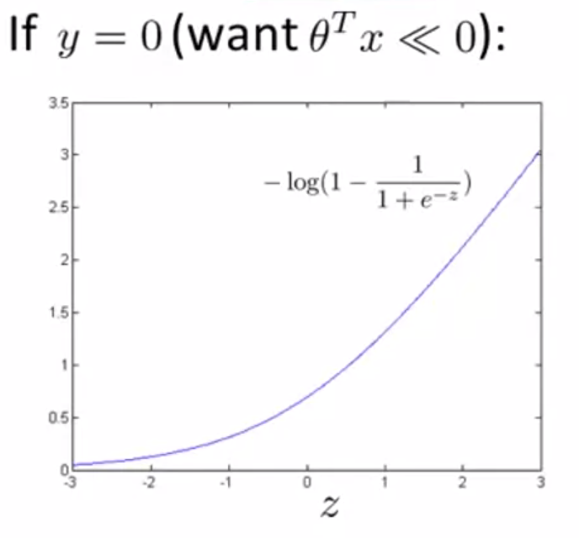
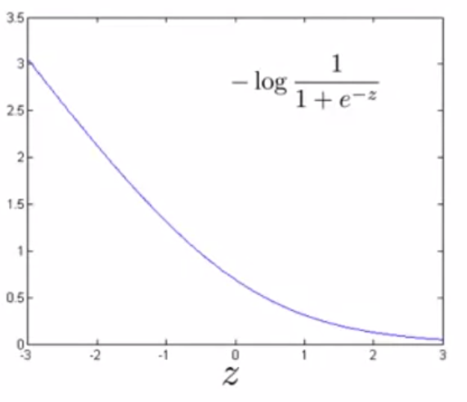

Slide 3


Hypothesis:

Slide 4
Support Vector Machines Large Margin Intuition

Slide 5


Support Vector Machine

Slide 6
Support Vector Machine

Slide 7
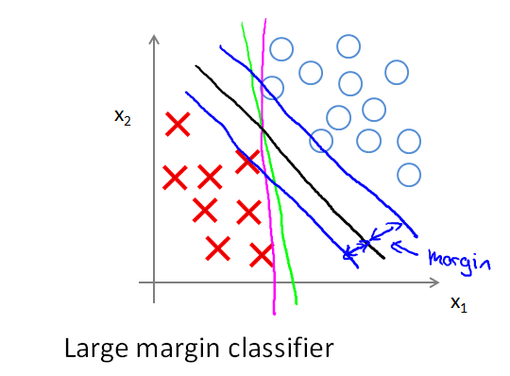
SVM Decision Boundary: Linearly separable

Slide 8
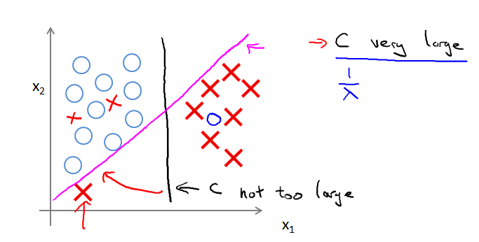
SVM Decision Boundary

