Slide 1
Neural Network: Representation

Slide 2
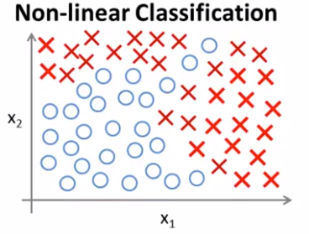

Non-linear Hypothesis
Non-linear Classification
$g(θ_{0}+θ_{1}x_{1}+θ_{2}x_{2})$

Slide 3
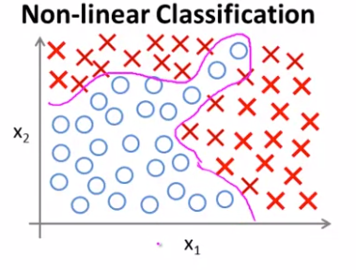
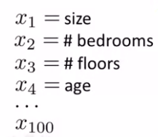

Non-linear Hypothesis
Non-linear Classification
$g(θ_{0}+θ_{1}x_{1}+θ_{2}x_{2}$
$+θ_{3}x_{1}^{2}+θ_{4}x_{2}^{2} + …)$
5000 quadratic features
160000 cubic features
……
Too many features

Slide 4
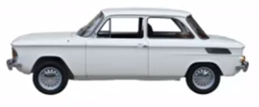
Non-linear Hypothesis
Non-linear Classification
Image Classification: Car or not Car?
300x300 color image => 270000 features

Slide 5
Neurons and the brain
Neural networks
Origin: Algorithms that try to mimic the brain
Widely used in 80s, popularity decreased in late 90s
Currently SOTA for many applications.

Slide 6
Neurons and the brain
Neural networks
Origin: Algorithms that try to mimic the brain
Widely used in 80s, popularity decreased in late 90s
Currently SOTA for many applications.

Slide 7
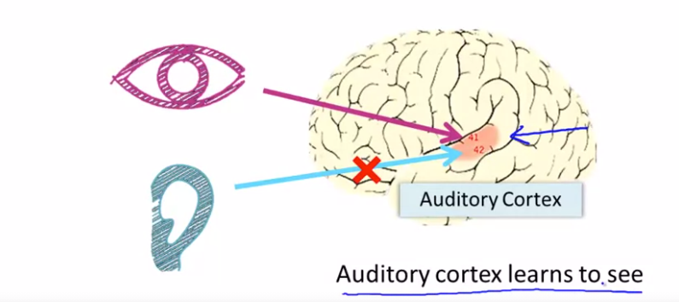
Neurons and the brain

Slide 8
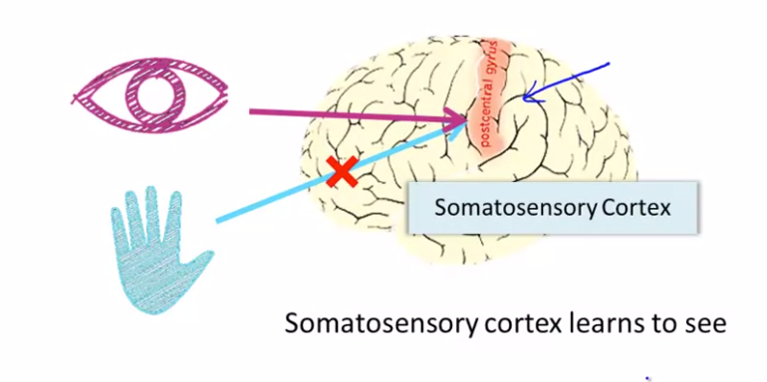
Neurons and the brain

Slide 9
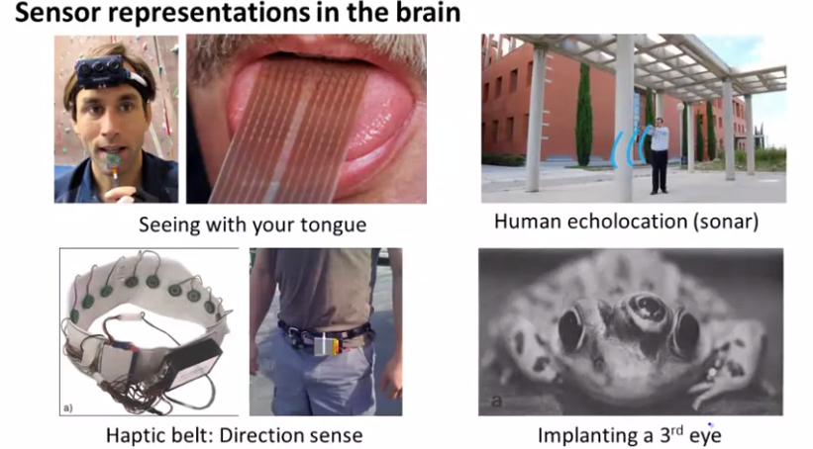
Neurons and the brain

