Slide 1
Neural Networks

Slide 2
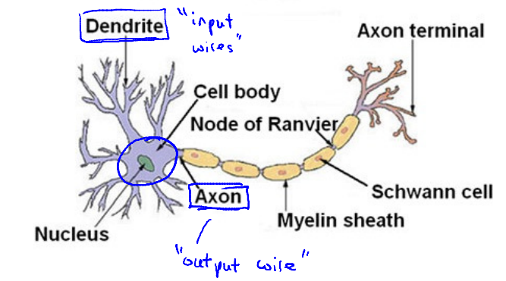
Neural in the brain
At a very simple level, neurons are basically computational units that take input (dendrites) as electrical input (called "spikes") that are channeled to outputs (axons).

Slide 3
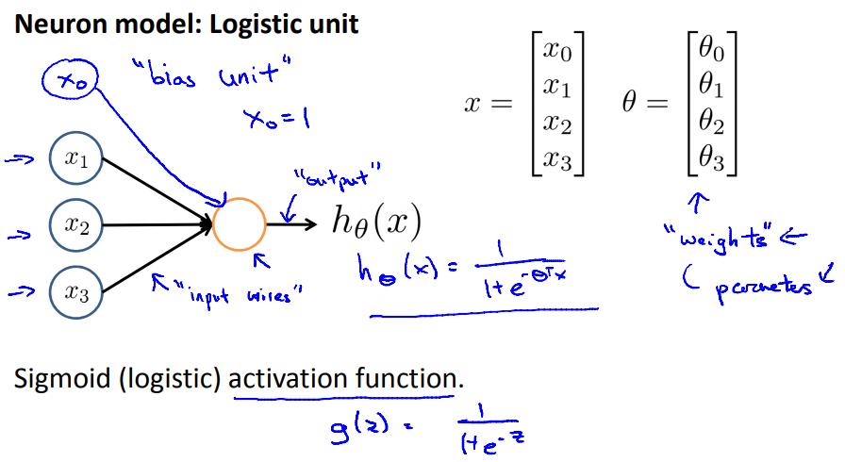
Neural model: Logistic unit

Slide 4
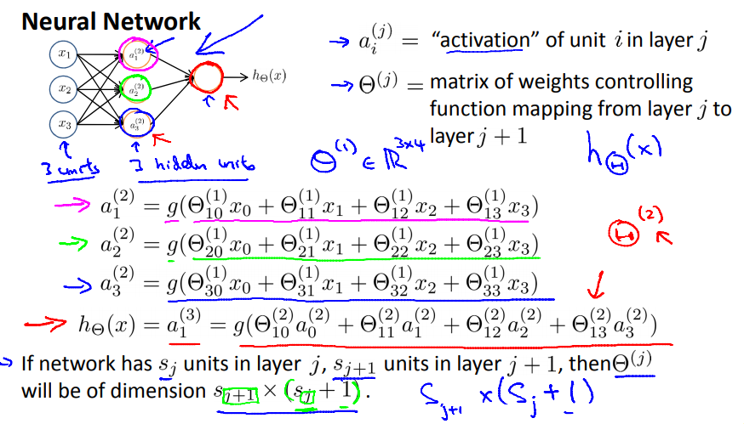
Neural network

Slide 5
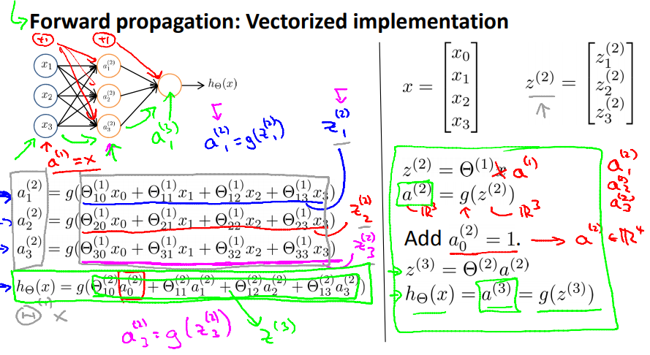
Model presentation II: Forward propagation

Slide 6
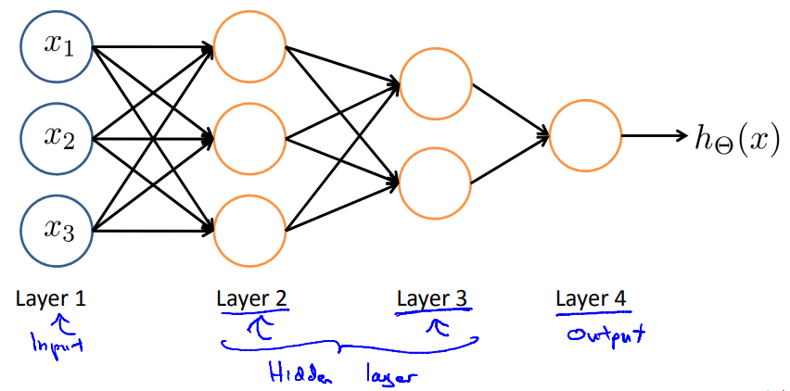
Other network architectures

