Slide 1
Putting it together

Slide 2

Training a neutral network

Slide 3


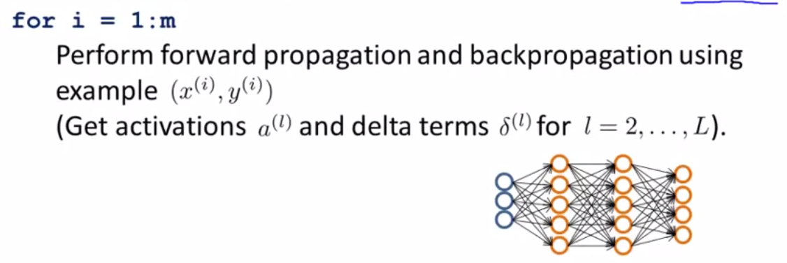
Training a neutral network

Slide 4

Training a neutral network

Slide 5
