Slide 1
Anomaly detection Choosing what features to use

Slide 2
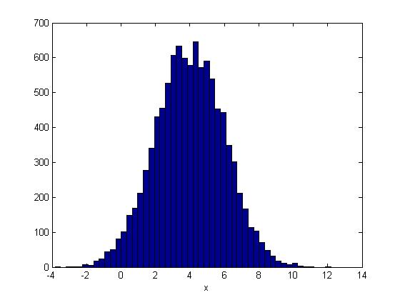
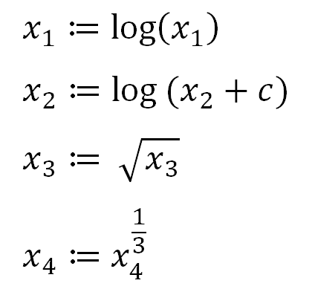
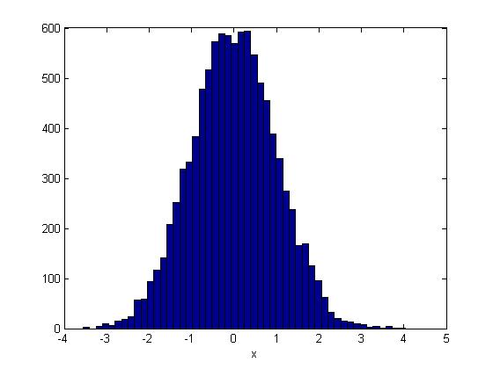
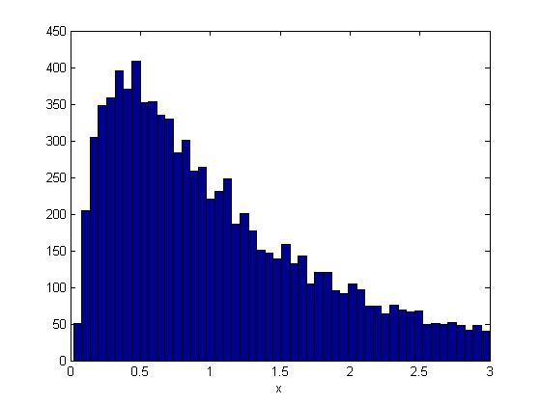
Non-gaussian features
log(x)

Slide 3
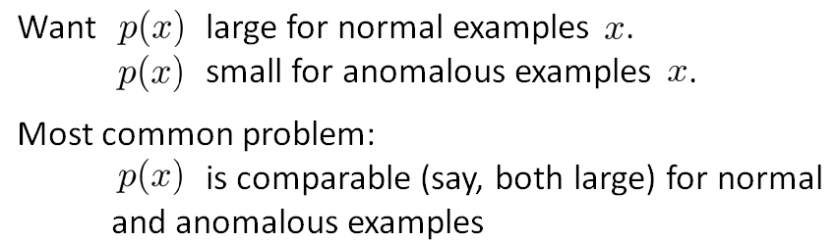
Error analysis for anomaly detection

Slide 4
Error analysis for anomaly detection
Examine the anomalous examples that are giving high probability in detail.
Choose features that might take on unusually large or small values in the event of an anomaly.

Slide 5
Multivariate Gaussian distribution

Slide 6
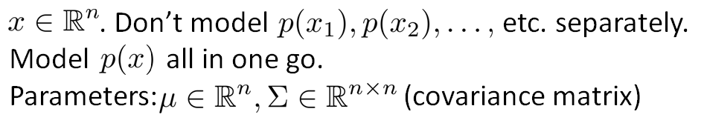
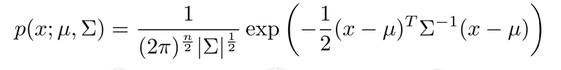
Multivariate Gaussian (Normal) distribution

Slide 7
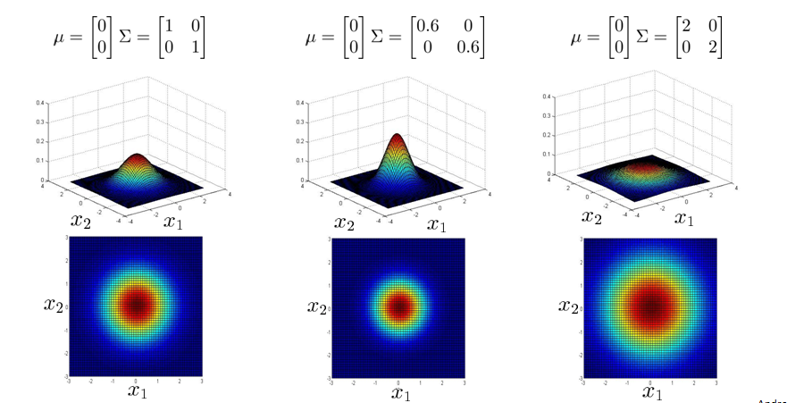
Examples

Slide 8
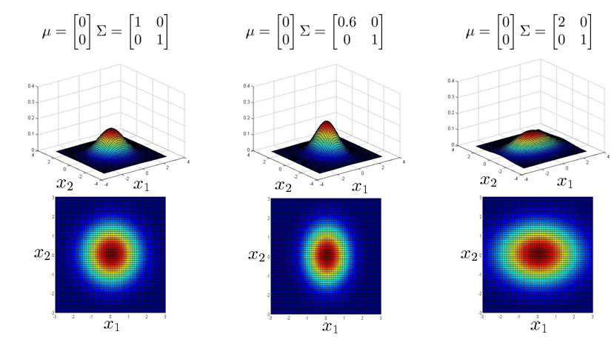
Examples

Slide 9
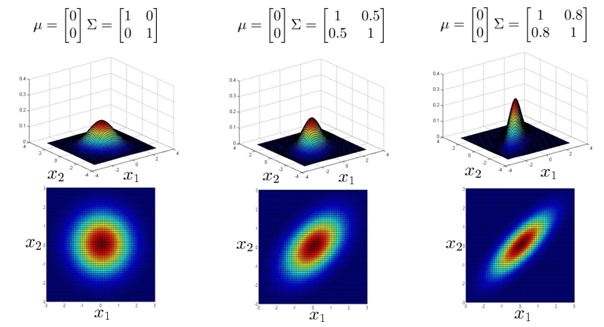
Examples

Slide 10
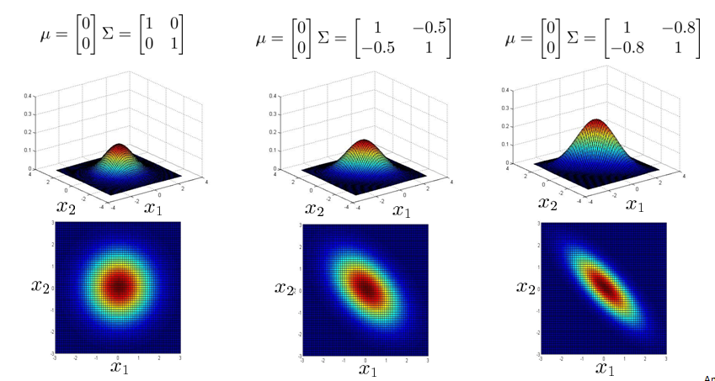
Examples

Slide 11
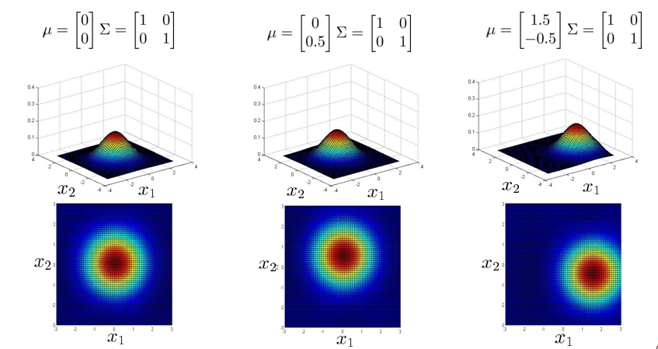
Examples

