Slide 1

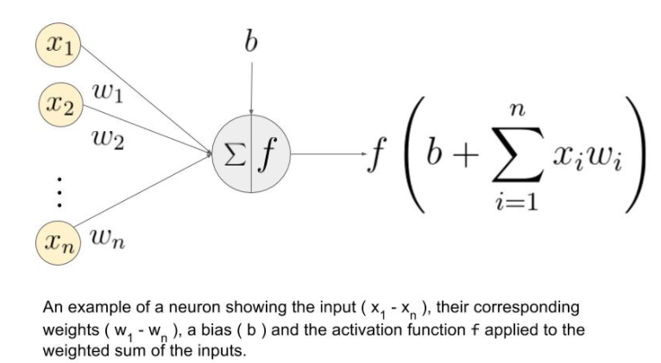
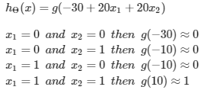
Application
A simple example of applying neural networks is by predicting x1 AND x2.

Slide 2
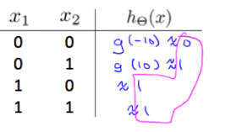
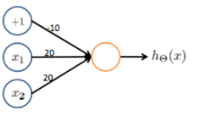
Example: OR function

Slide 3
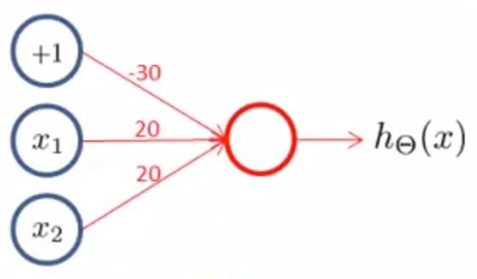
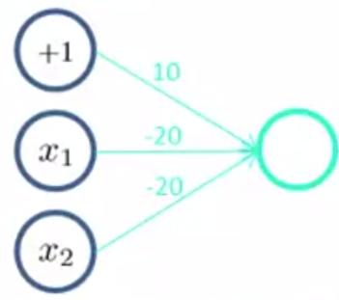
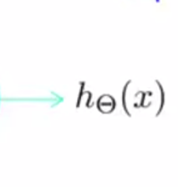
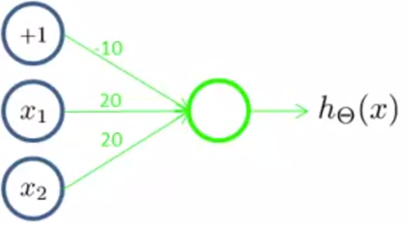



Example: XNOR function
+1
+1
x1 and x2
a(2)
1
or
a(3)
1
H(x)
x1
a(2)
2
x2
notx1 and notx2

Slide 4






Mutiple output units: One-vs-all
To classify data into multiple classes, we let our hypothesis function return a vector of values.

Slide 5
