Slide 1
Support Vector Machines: Optimization Objective

Slide 2
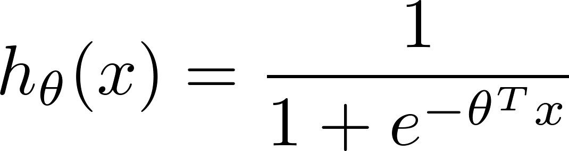
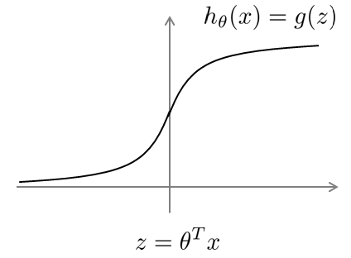
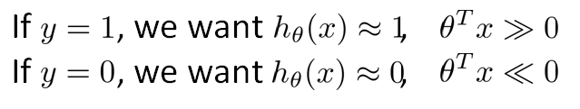
Alternative view of logistic regression

Slide 3
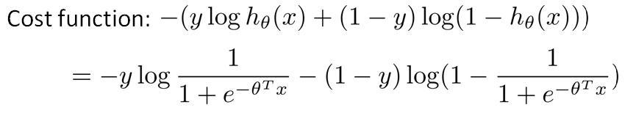
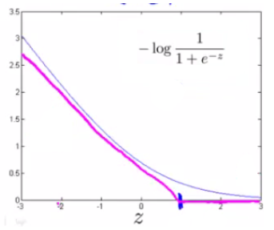
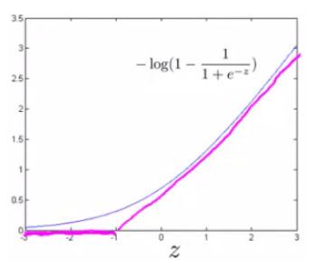
Alternative view of logistic regression

Slide 4
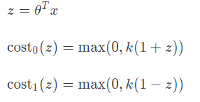
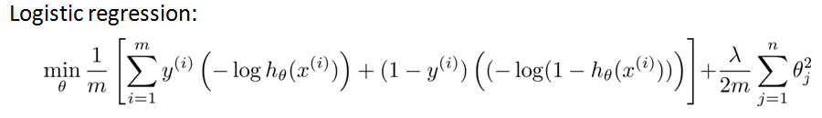
Support Vector Machine
Support vector machine:

Slide 5

SVM hypothesis
Hypothesis:

Slide 6
Support Vector Machines Large Margin Intuition

Slide 7
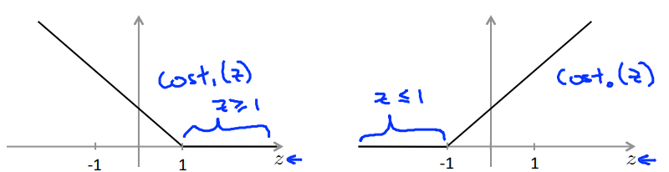

Support Vector Machine

Slide 8

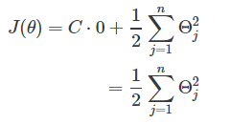
SVM Decision Boundary
If C is very large, we must choose θ such that:
➔

Slide 9
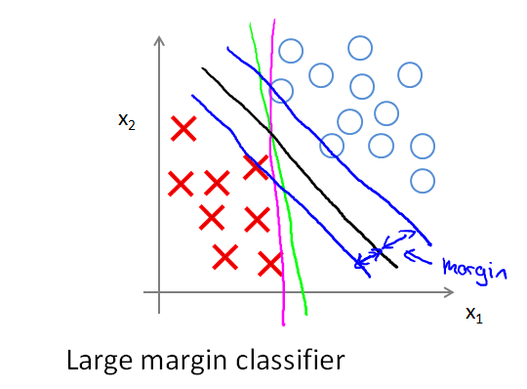
SVM Decision Boundary: Linearly separable

Slide 10
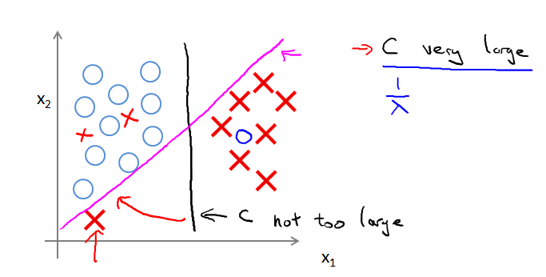
SVM Decision Boundary

