Slide 1
Clustering Optimization objective

Slide 2
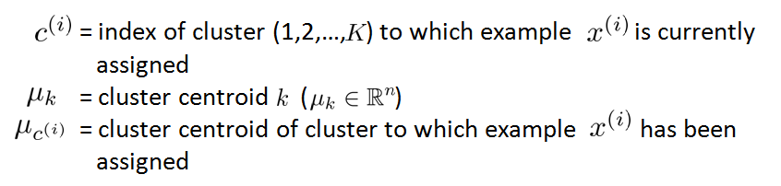
K-means optimization objective
Recall some of the parameters:

Slide 3
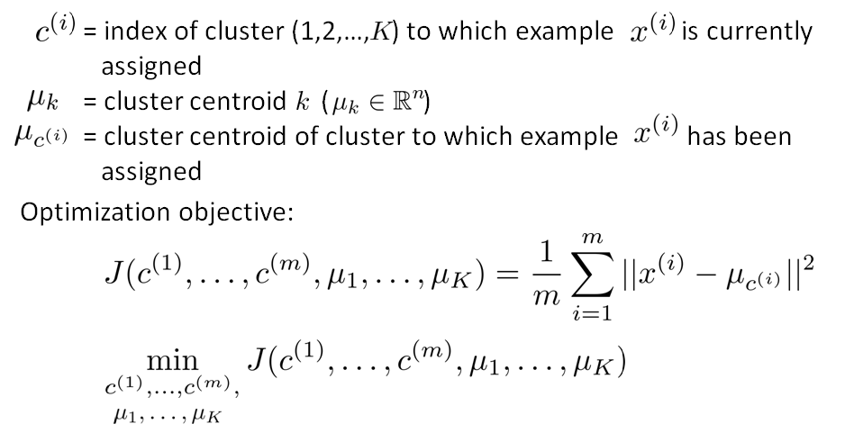
K-means optimization objective

Slide 4
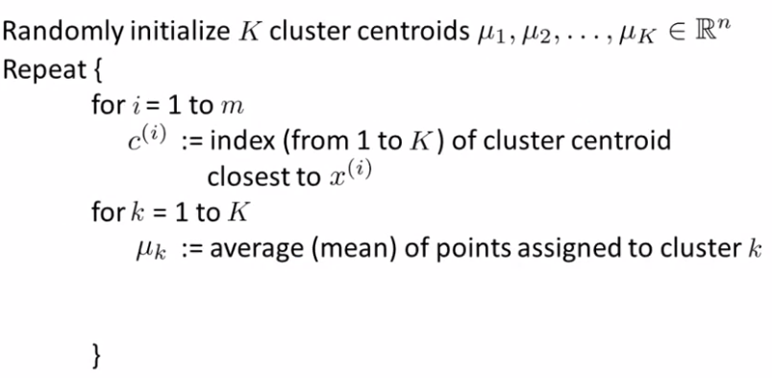
K-means algorithm
Cluster argument step
move centroid step

Slide 5
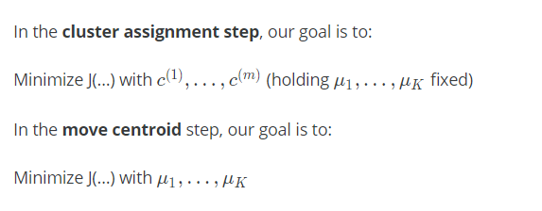
K-means algorithm

