Slide 1
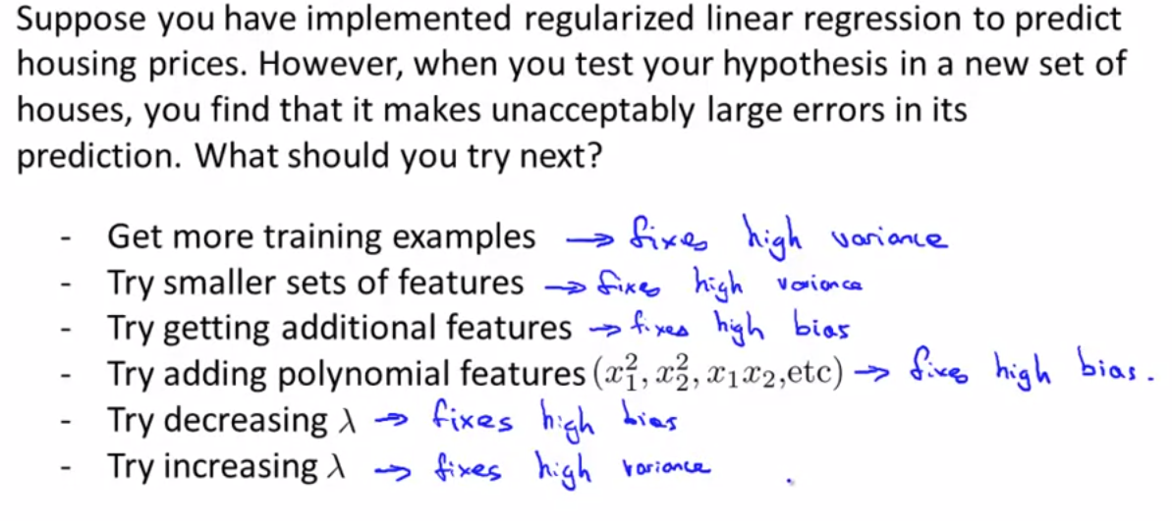
Deciding what to do next revisited

Slide 2
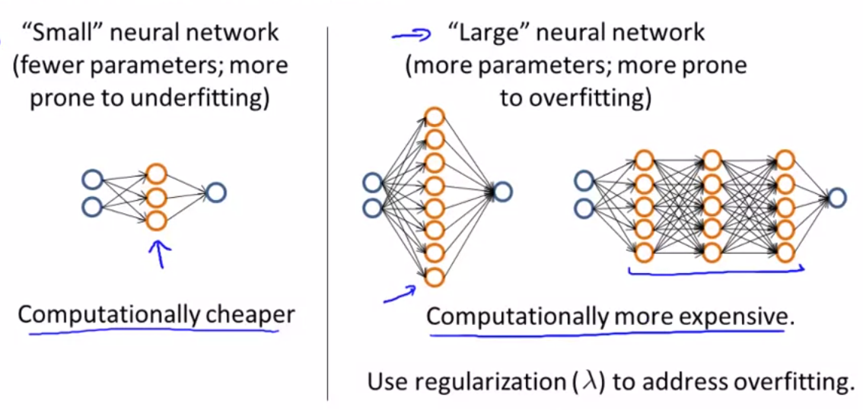
Neutral network and overfitting

