Slide 1
Regularization and Bias/Variance

Slide 2
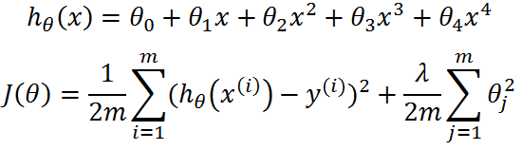
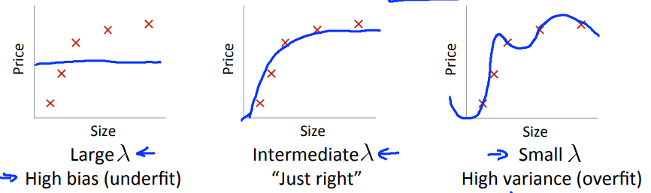
Linear regression with regularization
Model:

Slide 3


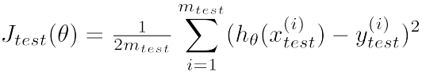
Choosing the regularization parameter λ

Slide 4
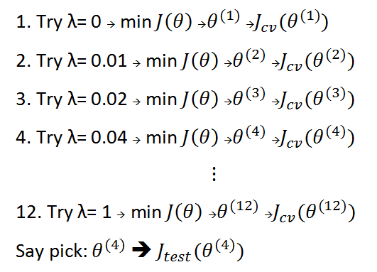
Choosing the regularization parameter λ
Model:

Slide 5
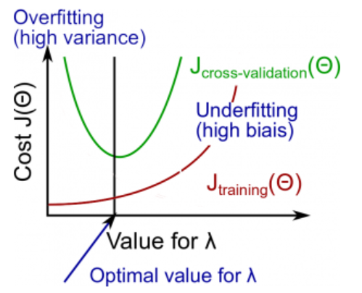
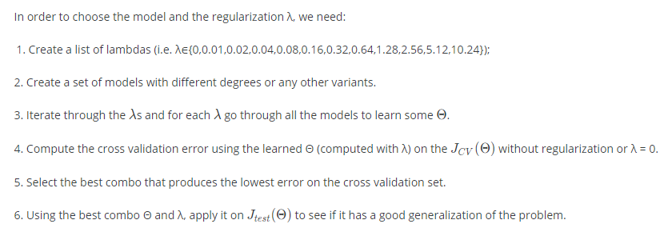
Choosing the regularization parameter λ

Slide 6
Learning Curves

Slide 7
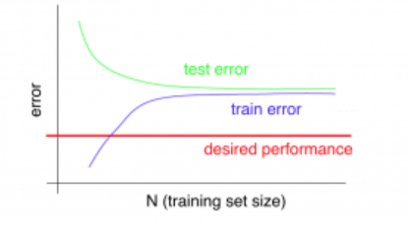
High bias
If a learning algorithm is suffering from high bias, getting more training data will not (by itself) help much.

Slide 8
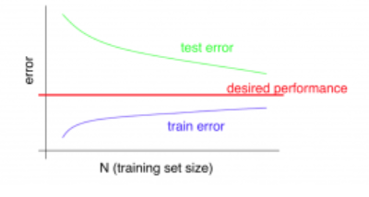
High variance
If a learning algorithm is suffering from high variance, getting more training data is likely to help.

