Slide 1

Backpropagation intuition

Slide 2
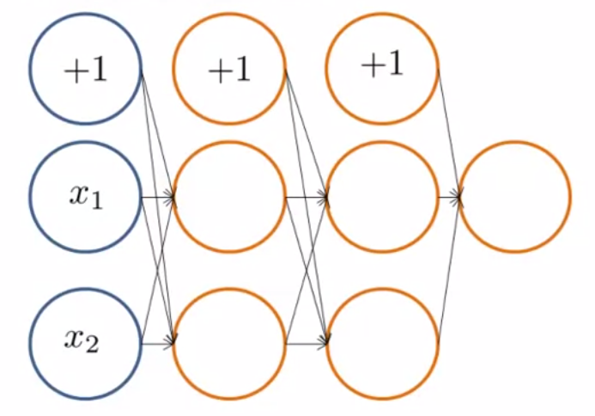
Forward Propagation

Slide 3
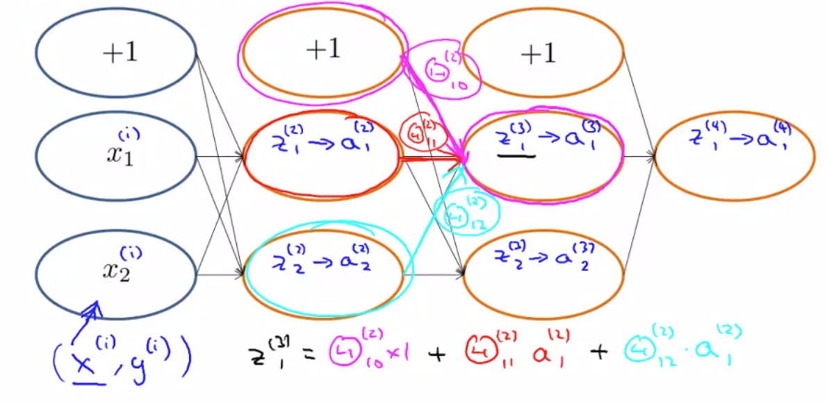

Slide 4


What is backpropagation doing

Slide 5
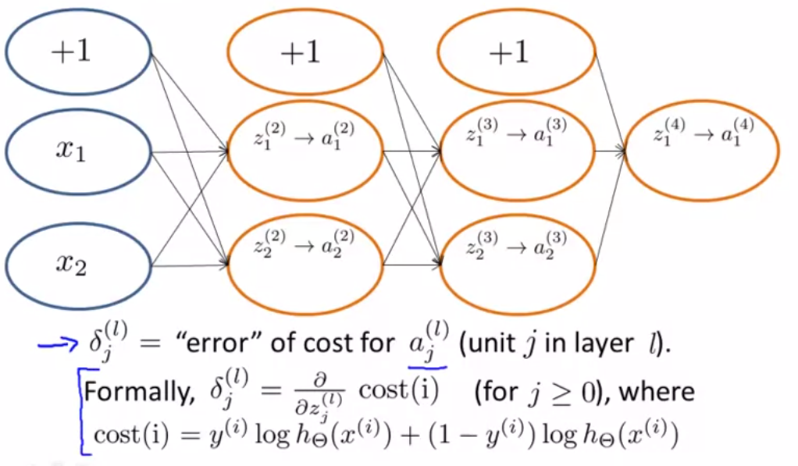
What is backpropagation doing

Slide 6


