Slide 1
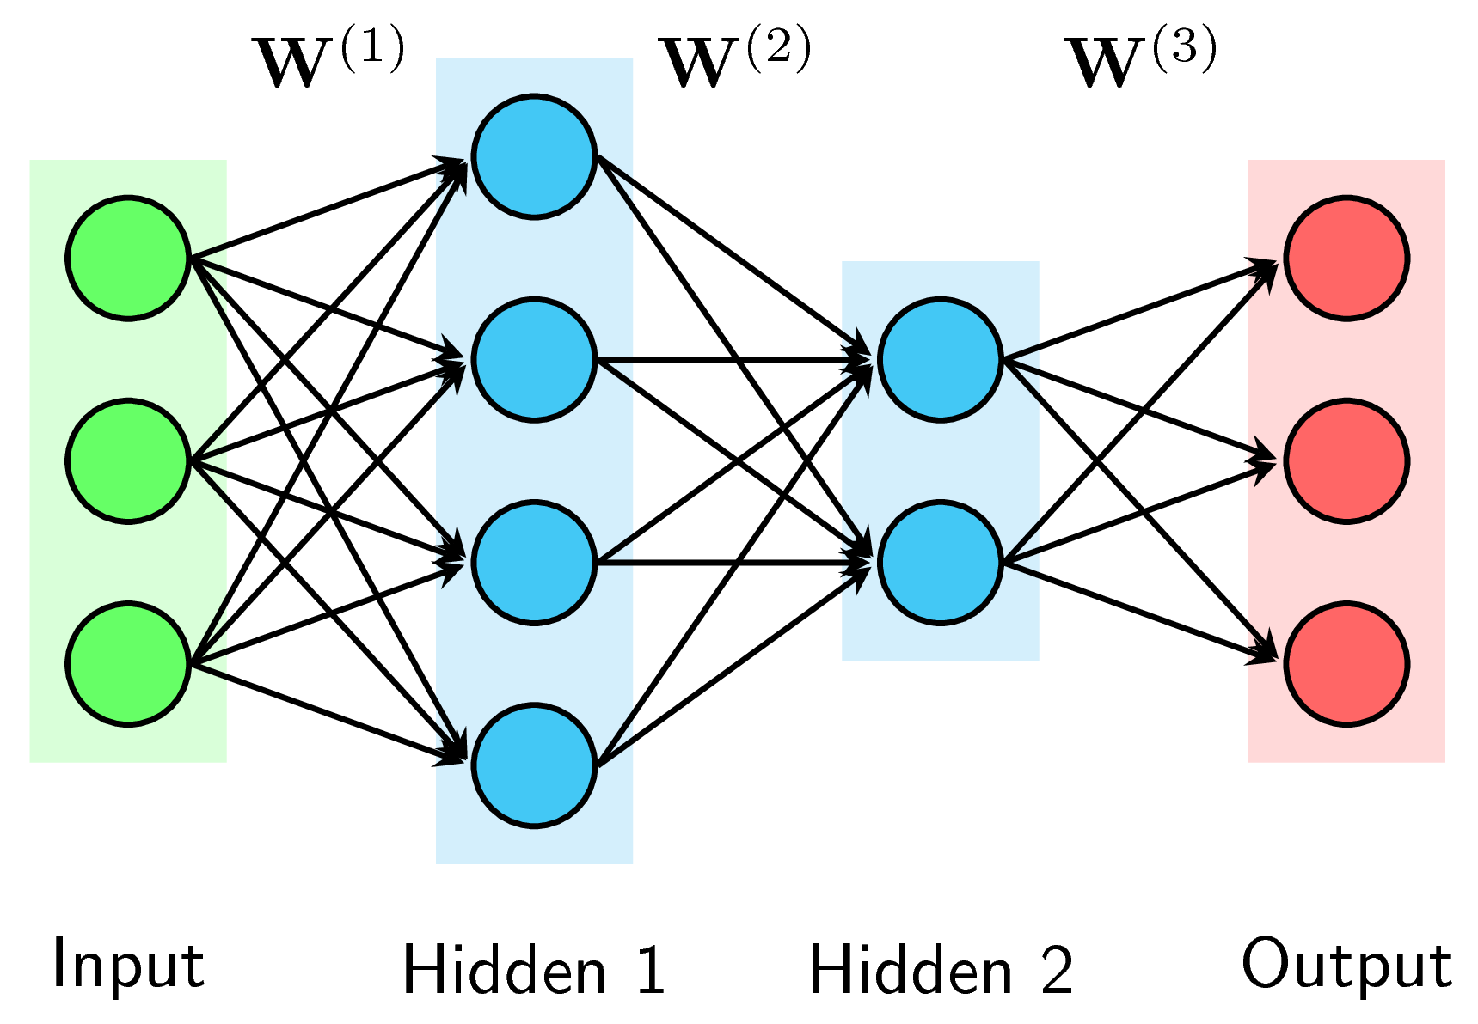


Backpropagation Algorithm

Slide 2
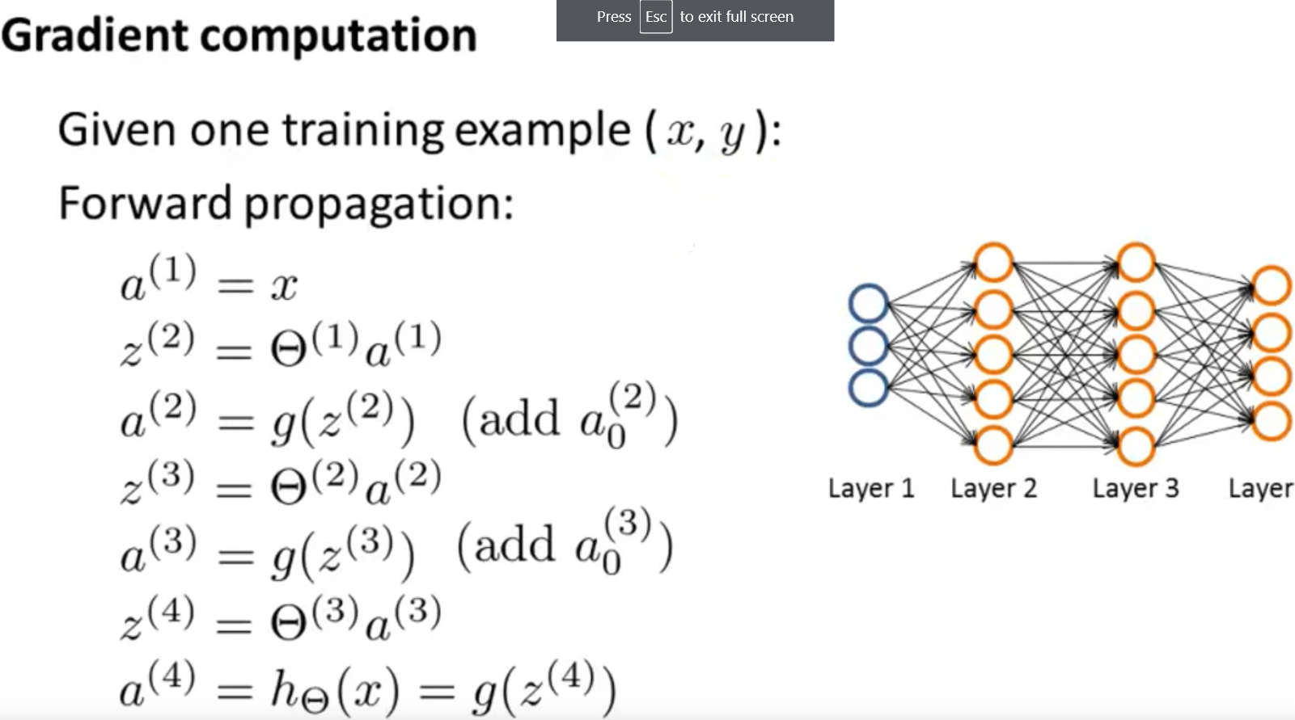




Slide 3
