Slide 1
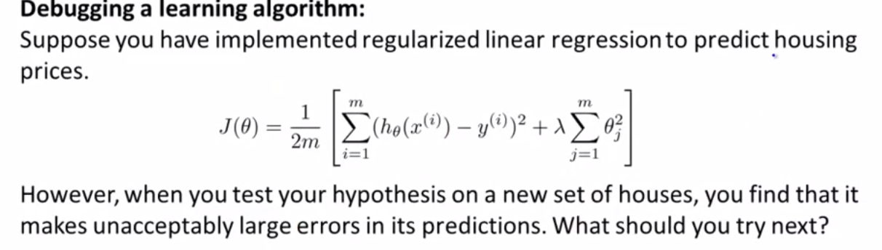
Get more training examples
Try smaller sets of features
Try getting additional features
Try adding polynomial features
Try decresing λ
Try increasing λ

Slide 2
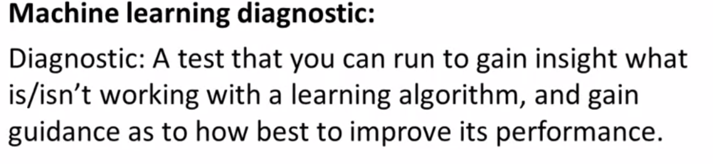
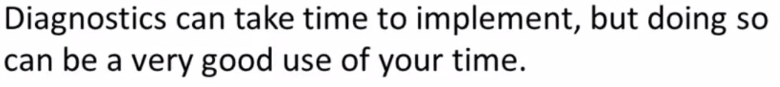

Slide 3
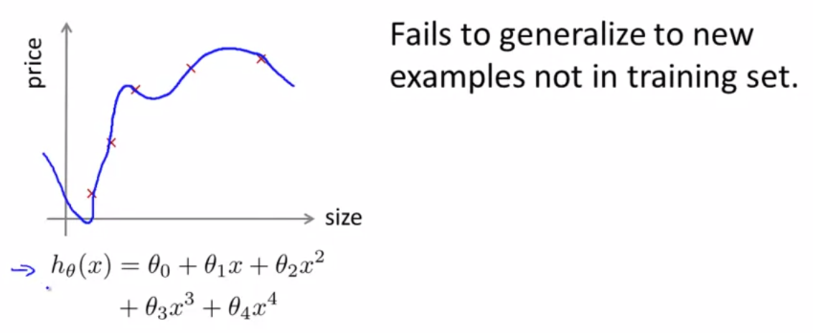
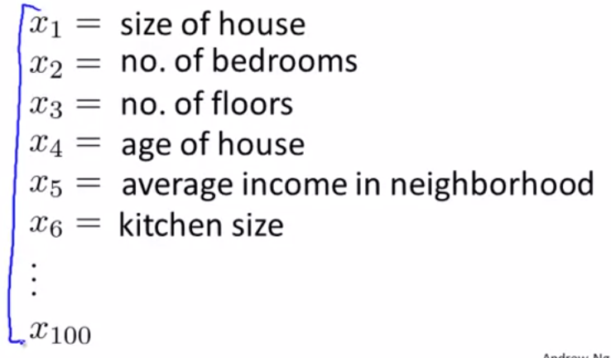
Evaluating a hypothesis

Slide 4
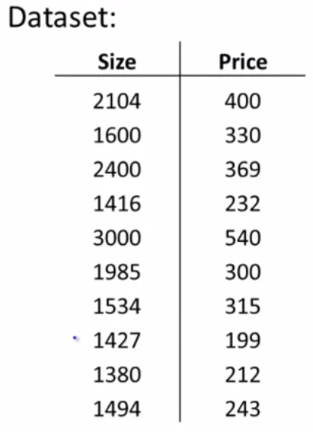
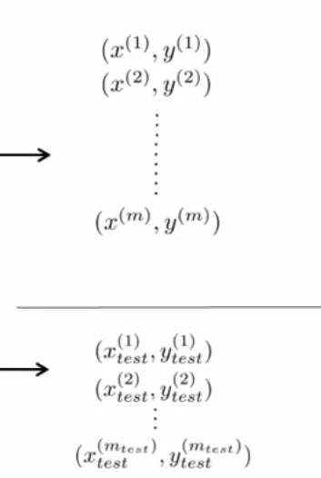
Training set
Test set

Slide 5
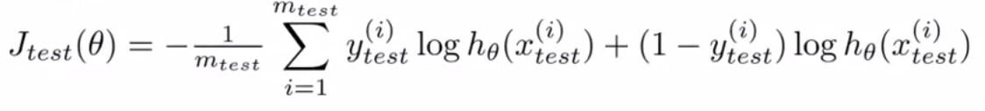
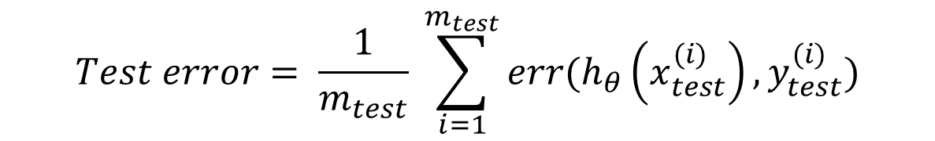
Training/testing proceduce for logistic regression
Learn parameter θ from training data
Compute test set error:
- Misclassification error (0/1 misclassification error):
Error( $h_{θ}\left(x\right),y)=\left\{\begin{aligned}1 ifh_{θ}\left(x\right)≥0,5 , y=0 or ifh_{θ}<0,5 , y=1 \\ 0 otherwise\end{aligned}\right.$
$$Test error= \frac{1}{m_{test}} \sum_{i=1}^{m_{test}}{err(h_{θ}\left(x_{test}^{(i)}\right),y_{test}^{(i)})}$$

Slide 6
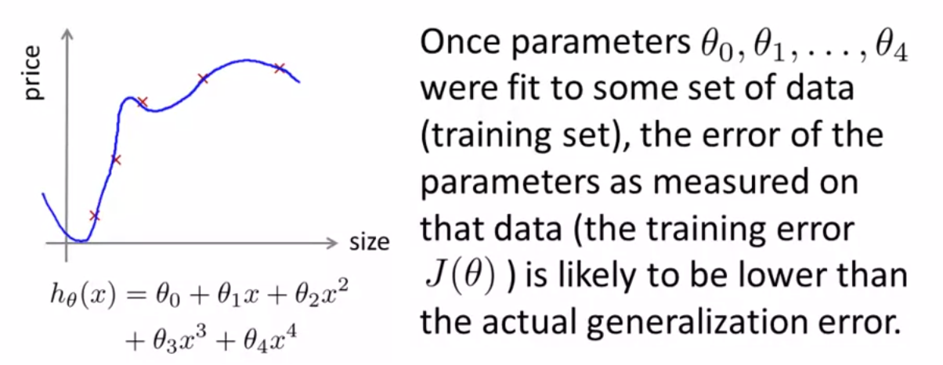
Model selection and Train/Validation/Test Sets

Slide 7
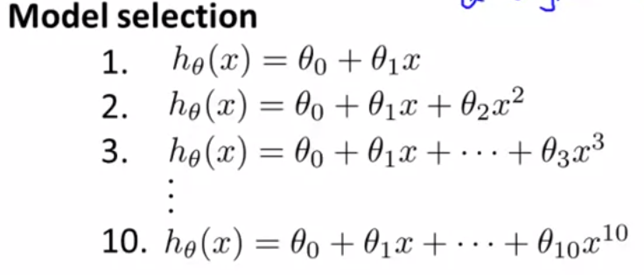
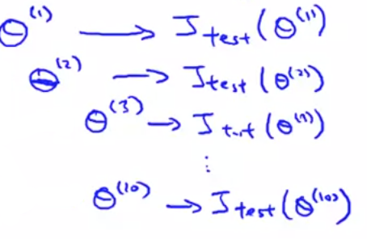

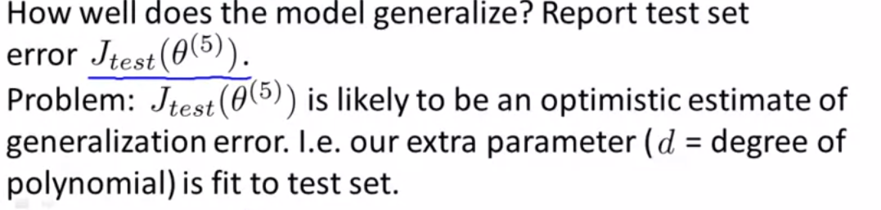

Slide 8
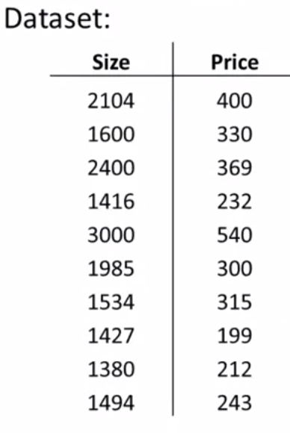
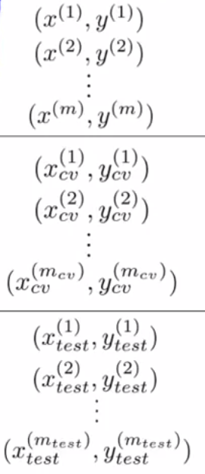
Training set
Cross validation
Test set

Slide 9
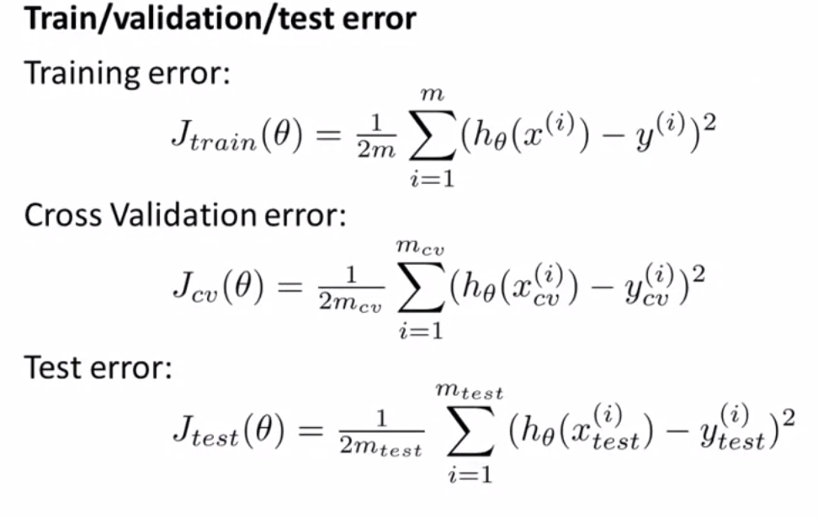

Slide 10
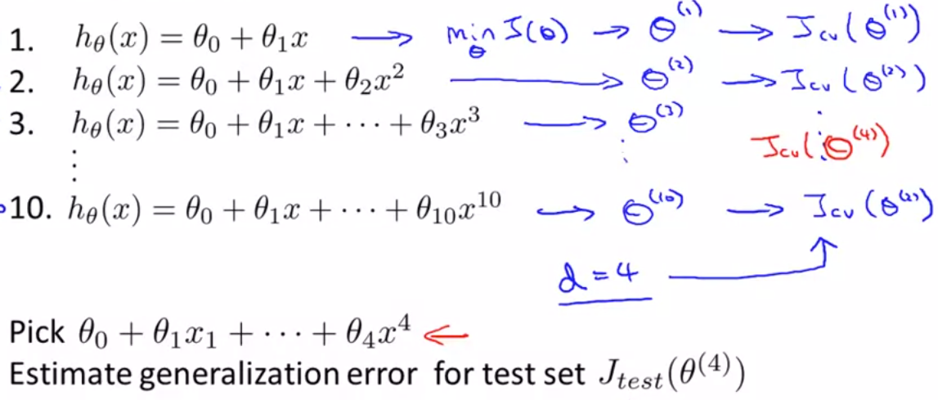
Model selection

