Slide 1
Neural Network
Thang Nguyen

Slide 2
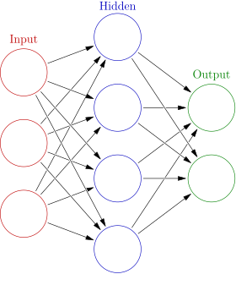
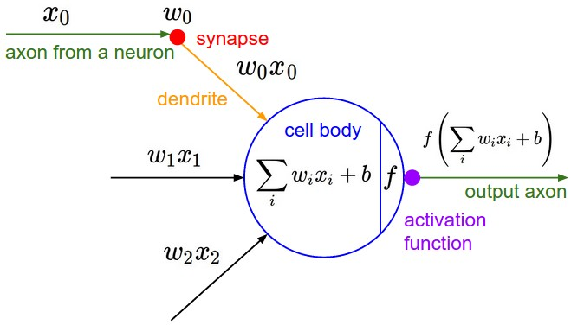
Model representation
Each node in the graph is called a neuron
Q: We know that neural network is usually used in classification tasks. But how about regression tasks?

Slide 3
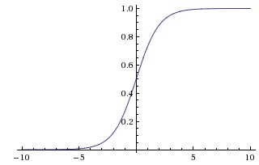
Model representation
Activation function
Problem:
Saturation
Not zero centered
Slow
Sigmoid

Slide 4
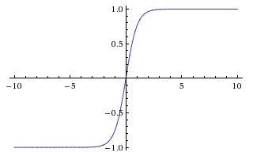
Model representation
Activation function
Always better than Sigmoid
Still having gradient saturation problem
“Tanh is a scaled sigmoid neuron”
tanh(x)=2σ(2x)−1
Tanh

Slide 5
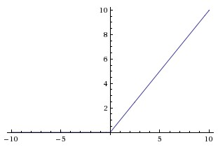
Model representation
Activation function
Most common, “default” activation function
Boost up the convergence speed
Problem: Can cause “dead neuron” problem
-> Solution: Variance of ReLU: ELU, Leaky ReLU, SELU, etc.
ReLU

Slide 6
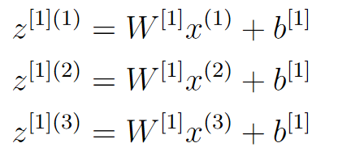
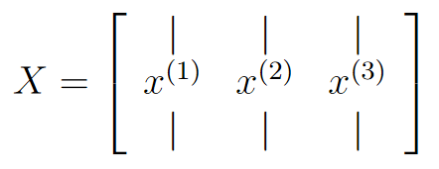
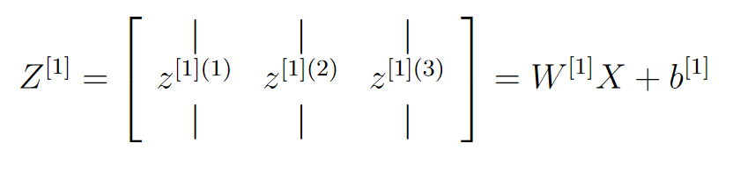
Model representation
Vecterization
For 1 layer: X is input matrix, W is weight matrix, Z is output matrix

Slide 7
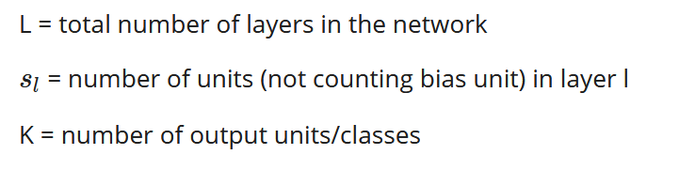
Backpropagation
Loss function
Regularization part
-> Complicated, very hard to take gradient of all variables, especially input variables.

Slide 8
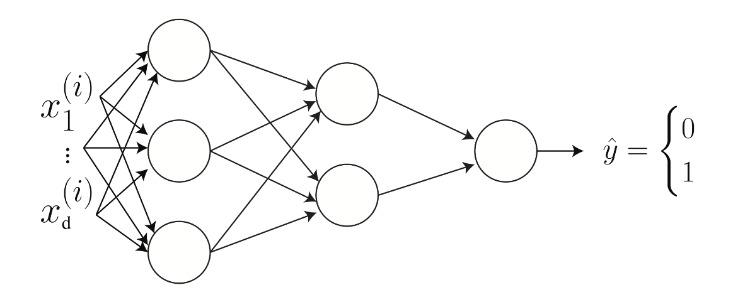
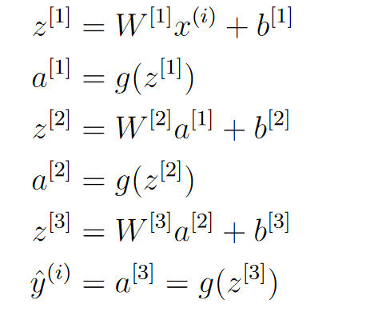
Backpropagation
Forward propagation

Slide 9
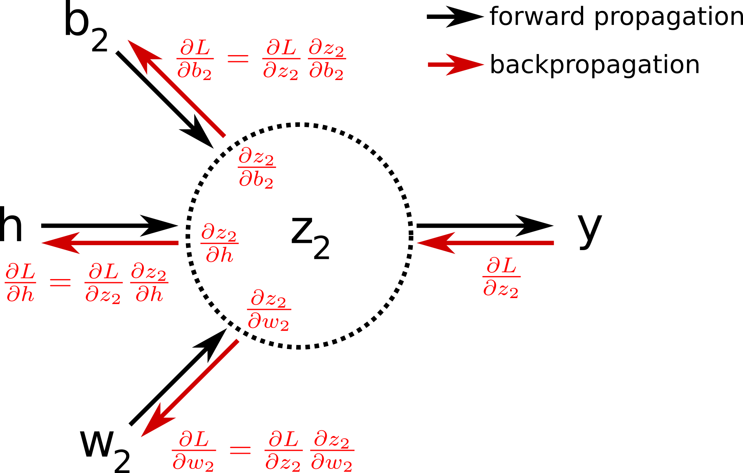
Backpropagation
Backpropagation
Uses “chain rule”:

Slide 10
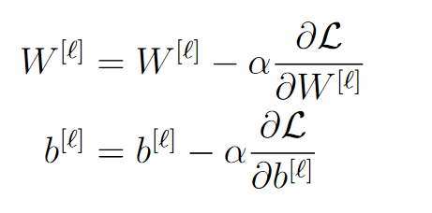
Backpropagation
Taken from “backprop”
Update rule

