Slide 1
Backpropagation Algorithm

Slide 2
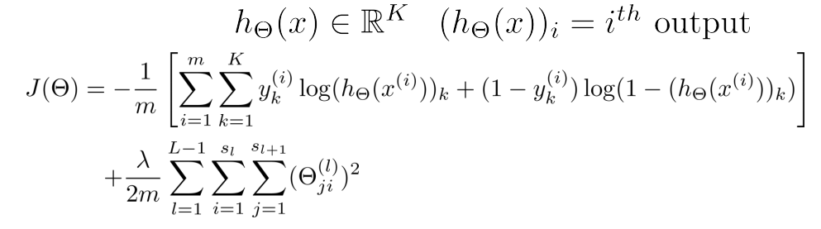

Gradient Computation
Cost Function:
Our goal: min_{Θ}J(Θ)
➔ We need compute:

Slide 3
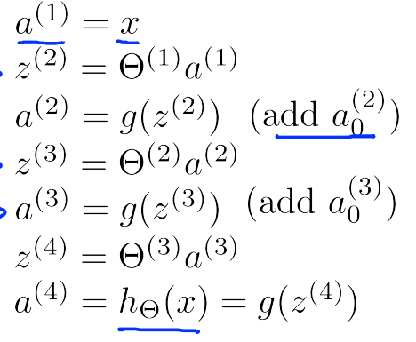
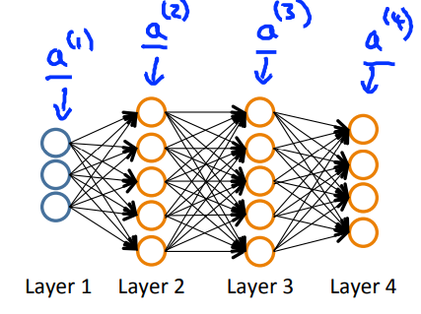
Gradient Computation: Forward propagation
Given one training example (x, y). Forward propagation:
Forward propagation:

Slide 4
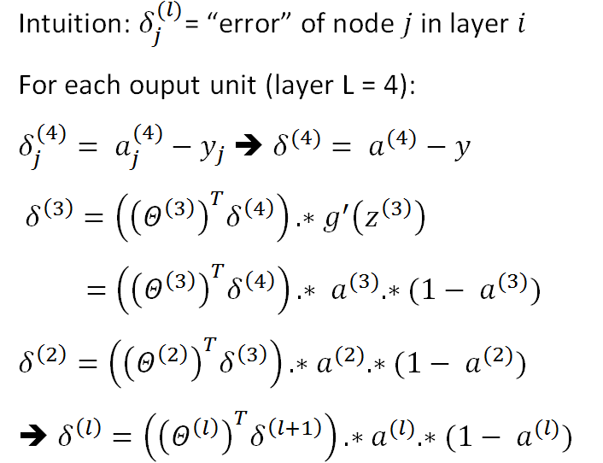
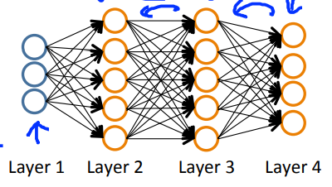
Gradient Computation: Backward propagation

Slide 5
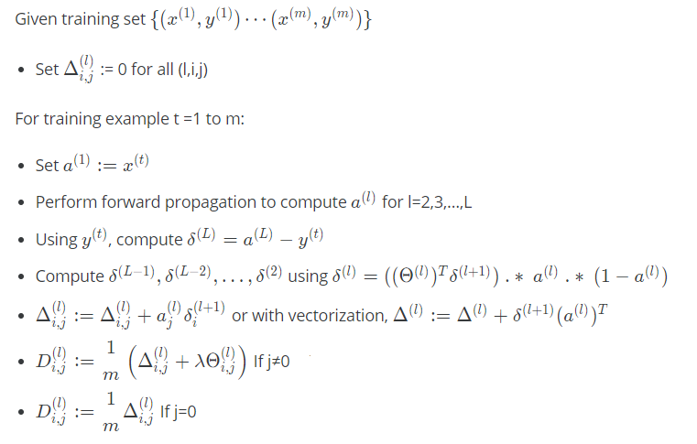

Backward propagation algorithm

