Slide 1
Building a spam classifier

Slide 2
Prioritizing What to Work On
Spam (1)
Non-spam (0)
From: cheapsales@buystufffromme.com
To: ang@cs.stanford.edu
Subject: Buy now!
Deal of the week! Buy now!
Rolex w4tchs - $100
Med1cine (any kind) - $50
Also low cost M0rgages available.
From: Alfred Ng
To: ang@cs.stanford.edu
Subject: Christmas dates?
Hey Andrew,
Was talking to Mom about plans for Xmas. When do you get off work. Meet Dec 22?
Alf

Slide 3
Prioritizing What to Work On
Spam (1)
Non-spam (0)
From: cheapsales@buystufffromme.com
To: ang@cs.stanford.edu
Subject: Buy now!
Deal of the week! Buy now!
Rolex w4tchs - $100
Med1cine (any kind) - $50
Also low cost M0rgages available.
From: Alfred Ng
To: ang@cs.stanford.edu
Subject: Christmas dates?
Hey Andrew,
Was talking to Mom about plans for Xmas. When do you get off work. Meet Dec 22?
Alf

Slide 4
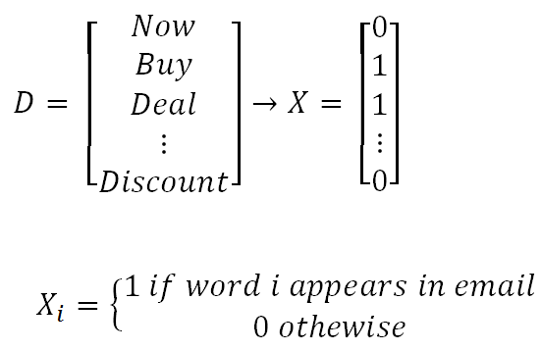
Prioritizing What to Work On
Building a spam classifier:
Supervised learning: x = features of email, y= spam (1) or not spam (0)
Feature x: Choose 100 words indicative of spam / not spam
Eg: deal, now, buy, discount, …
In practice, take most frequently occurring n words (10000 to 50000)

Slide 5
Prioritizing What to Work On
Different ways we can approach a machine learning problem:
Collect lots of data
Develop sophisticated features (for example: using email header data in spam emails)
Develop algorithms to process your input in different ways (recognizing misspellings in spam).

Slide 6
Error metrics for Skewed Classes

Slide 7
Cancer classification example
In predicting a cancer diagnoses, train logistic regression model (y= 1 if cancer, y= 0 otherwise).
Find that you got 1% error on test set.
However, only 0.5% of patients have cancer.
➔ Skewed classes

Slide 8
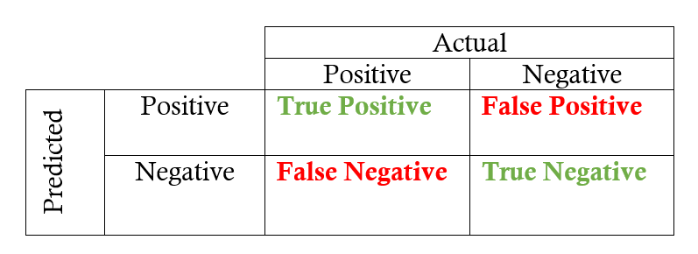
Precision/Recall

Slide 9
Precision/Recall
Precision: of all patients we predicted where y=1, what fraction actually has cancer?
Precision = True Positives / (True Positives + False positives)
Recall: Of all the patients that actually have cancer, what fraction did we correctly detect as having cancer?
Recall = True Positives​ / (True Positives​ + False negatives)
Accuracy = (True positives + True negatives) / Total population

