Slide 1
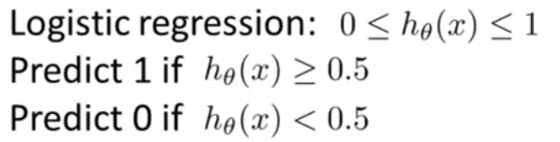
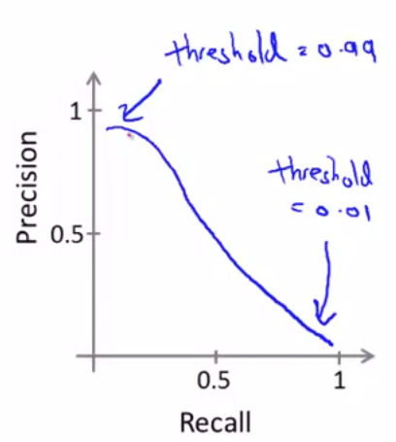


Trading off precision and recall
Precision = $\frac{true positives }{no. of predicted positive}$
Recall = $\frac{true positives }{no. of actual positive}$
Supose we want to predict y = 1 (cancer) only if very confident
➔ Higher precision, lower recall
Supose we want to avoid missing too many cases of cancer (avoid false negatives)
➔ Higher recall, lower precision
More generally: Predict 1 if $h_{θ}$(x) $≥$ threshold

Slide 2
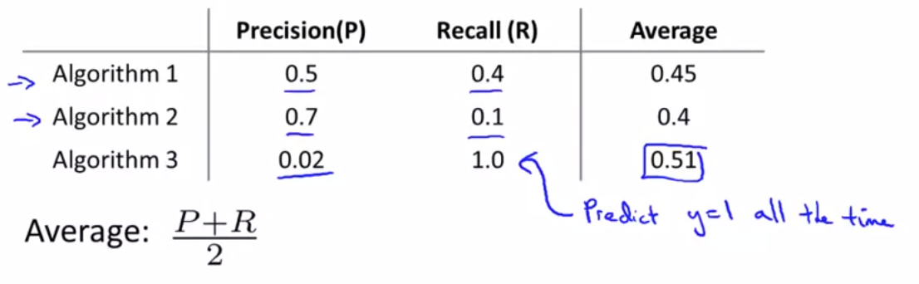
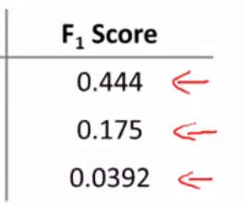
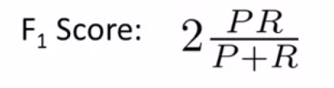
$F_{1}$score (F score)
$F_{1}$score (F score)

Slide 3
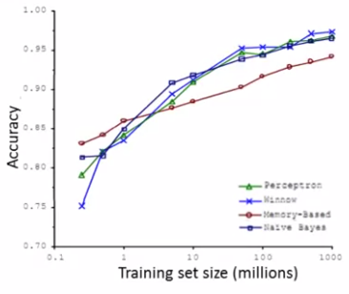
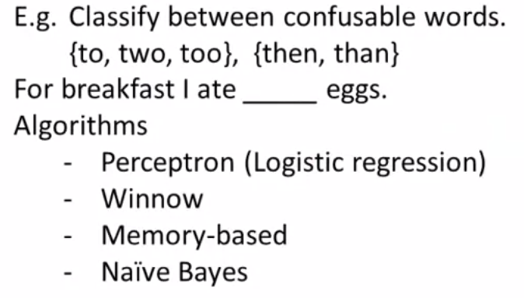
Data for machine learning
Designing a high accuracy learning system
Two

Slide 4
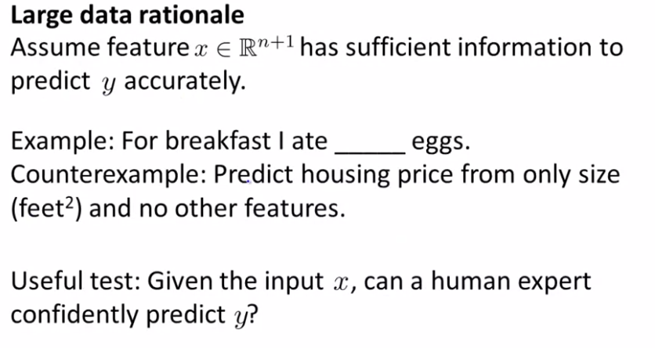

Slide 5
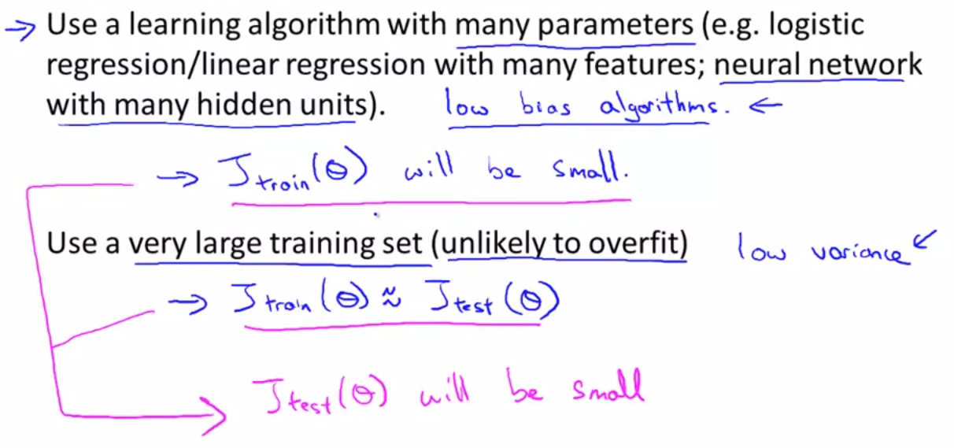
Large data rationale

