Slide 1
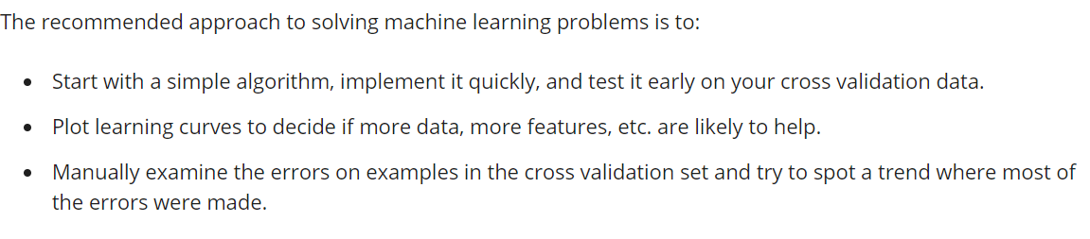
Error Analysis

Slide 2
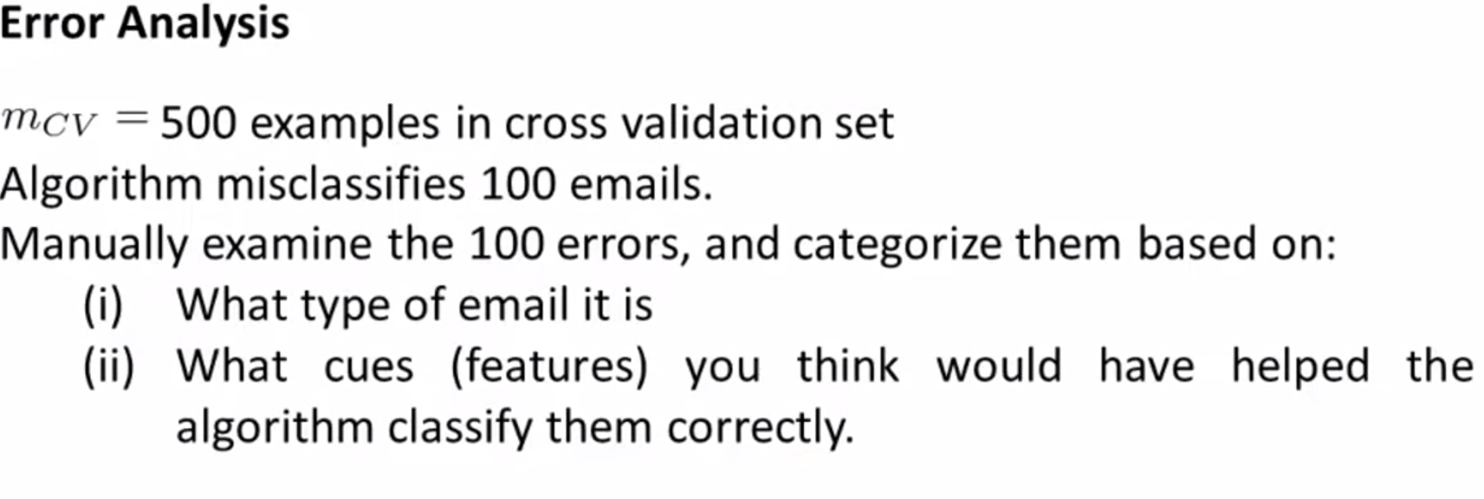
Pharma: 12
Replica/fake: 4
Steal password: 53
Other: 31
Deliberate misspellings: (m0rgage, med1cine, etc.): 5
Unusual email routing: 16
Unusual (spamming) punctuation: 32

Slide 3
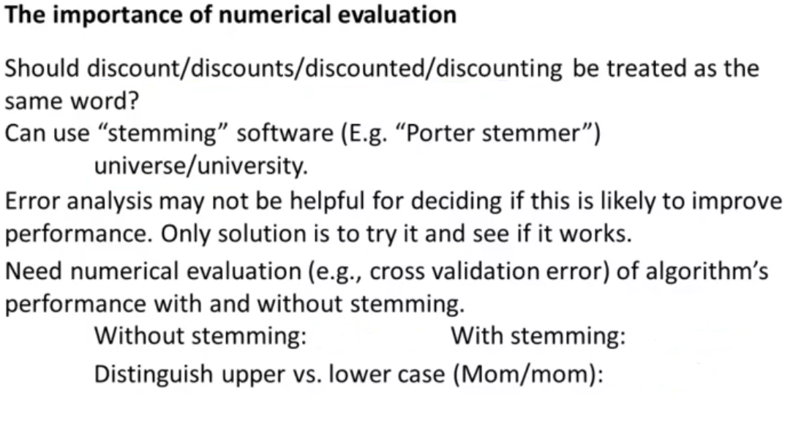
5% error
3% error
3.2% error
It is very important to get error results as a single, numerical value. Otherwise it is difficult to assess your algorithm's performance. For example if we use stemming, which is the process of treating the same word with different forms (fail/failing/failed) as one word (fail), and get a 3% error rate instead of 5%, then we should definitely add it to our model. However, if we try to distinguish between upper case and lower case letters and end up getting a 3.2% error rate instead of 3%, then we should avoid using this new feature. Hence, we should try new things, get a numerical value for our error rate, and based on our result decide whether we want to keep the new feature or not.

Slide 4
Error Metrics for Skewed Classes
Skewed classes basically refer to a dataset, wherein the number of training example belonging to one class out-numbers heavily the number of training examples beloning to the other.
Consider a binary classification, where a cancerous patient is to be detected based on some features. And say only 1 of the data provided has cancer positive. In a setting where having cancer is labelled 1 and not cancer labelled 0, if a system naively gives the prediction as all 0’s, still the prediction accuracy will be 99%.
Therefore, it can be said with conviction that the accuracy metrics or mean-squared error for skewed classes, is not a proper indicator of model performance. Hence, there is a need for a different error metric for skewed classes.

Slide 5
