Slide 1
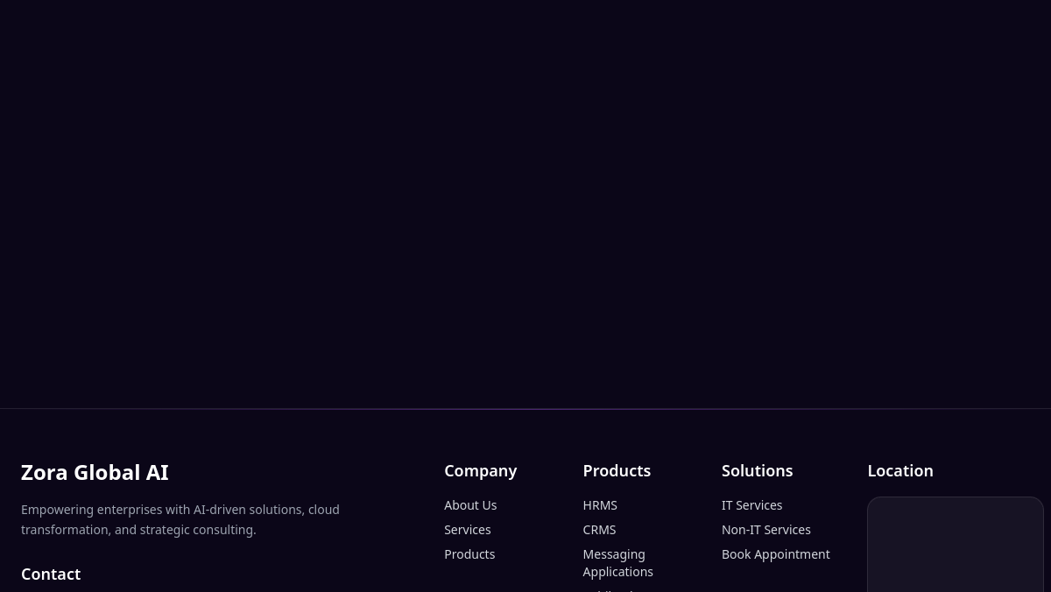

Zora Global AI Technologies
Company overview and solution portfolio
Based on content surfaced from zoraglobalai.com and the company’s public profile.
AI-driven enterprise solutions
Chennai • AI software • consulting
Notes:
[Sources] - https://www.zoraglobalai.com/ (homepage metadata and site screenshot) - https://image.thum.io/get/width/1600/noanimate/https%3A//www.zoraglobalai.com/ (homepage screenshot used as background)

Slide 2
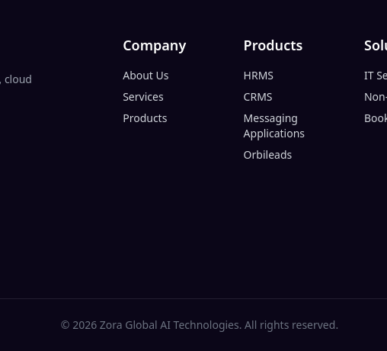
At a glance
How the brand positions itself across the website and public company profile
Brand narrative
Website footer snapshot
“Built on Trust. Powered by Intelligence.”
Enterprise AI solutions tailored to unique business challenges
AI-driven solutions, cloud transformation, and strategic consulting
Public location references point to Chennai, Tamil Nadu
Positioning themes
Bespoke AI • enterprise reliability • intelligent automation • security • predictive insight
Shows the current site navigation, product labels, solutions menu, contact details and Chennai location reference.
Notes:
[Sources] - https://www.zoraglobalai.com/ (footer content and tagline visible on site screenshot) - https://in.linkedin.com/company/zora-global-ai-technologies (public profile slogan and about text) - https://image.thum.io/get/width/1600/noanimate/https%3A//www.zoraglobalai.com/ (cropped footer image used on this slide)

Slide 3
Three solution pillars
The public profile frames Zora’s offer around service, process and growth
Explore Our Solution Areas
1
2
3
AI for Service
AI for Process
AI for Growth
Automate resolutions, coach agents in real time, and deliver consistent experiences across channels.
Identify bottlenecks, automate repetitive workflows, and continuously optimize for operational efficiency.
Unlock new revenue with predictive insights, personalized engagement, and AI-driven go-to-market strategies.
Taken together, the three pillars suggest a platform strategy that spans customer-facing operations, internal productivity, and revenue growth.
Notes:
[Sources] - https://in.linkedin.com/company/zora-global-ai-technologies (About Us section describing the three pillars and solution-area wording)

Slide 4

Portfolio signals
The site and public profile together point to two adjacent product layers
Business software on the website footer
HRMS
CRMS
Messaging Applications
Orbileads
AI engagement suite in public descriptions
AI Contact Centre • AI Ticketing
Customer Value Management • Conversational AI
These labels suggest an operations stack spanning workforce, customer management, messaging and lead generation.
Together these point to a customer-service and customer-growth layer built around automation, classification, retention and conversation.
Notes:
[Sources] - https://www.zoraglobalai.com/ (website footer product labels) - https://in.linkedin.com/company/zora-global-ai-technologies (AI Contact Centre, AI Ticketing, Customer Value Management and Conversational AI descriptions) - https://www.vads.co.id/media/4996/vads-ai-contact-center.png (illustrative contact-center image)

Slide 5
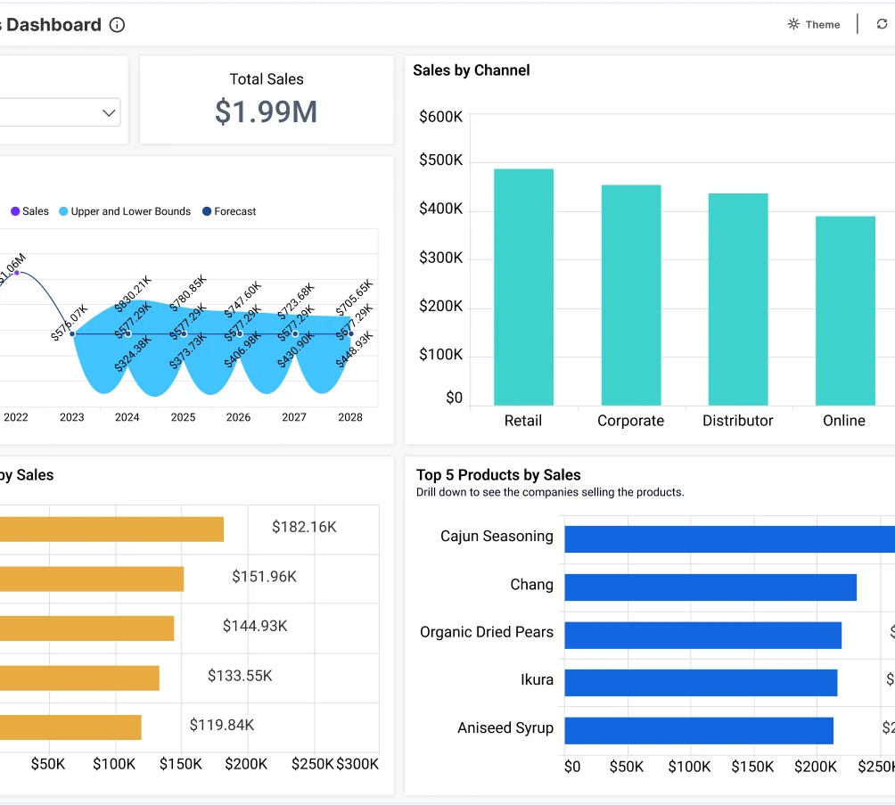
Capabilities that create business value
The public narrative repeatedly emphasizes reliability, automation, analytics and omnichannel experience
Solutions that scale
Purpose-built AI for enterprise challenges that demand precision and reliability.
Intelligent automation
Automates complex workflows and adapts to business processes.
Enterprise security
Built-in compliance and security framing for regulated environments.
Predictive analytics
Turns raw data into actionable insights with advanced models.
Omnichannel engagement
Supports a unified experience across customer touchpoints.
Why it matters: this mix aims to reduce manual work, improve decision quality, and make service delivery more consistent at scale.
Notes:
[Sources] - https://in.linkedin.com/company/zora-global-ai-technologies (About Us text listing solutions that scale, intelligent automation, enterprise security, predictive analytics and omnichannel engagement) - https://cdn.boldbi.com/wp/pages/dashboards/sales/sales-analysis-banner-v1.webp (illustrative analytics dashboard image)

Slide 6

Presentation takeaway
What an audience can retain after a quick scan of the website
Zora Global AI presents itself as a Chennai-based enterprise AI company focused on:
AI-driven software and consulting for modern enterprises
Operational products spanning HR, CRM, messaging and lead generation
Automation-led customer service and engagement solutions
A value story built on trust, intelligence and scalable business impact
zoraglobalai.com
info@zoraglobalai.com • 9087000345
Thank you
Notes:
[Sources] - https://www.zoraglobalai.com/ (website, contact details and footer product labels) - https://in.linkedin.com/company/zora-global-ai-technologies (public company profile and about text) - https://www.genesys.com/media/AdobeStock_820232504-scaled-e1718641929338.jpeg (illustrative image)

