Slide 1




I. Logo

Slide 2
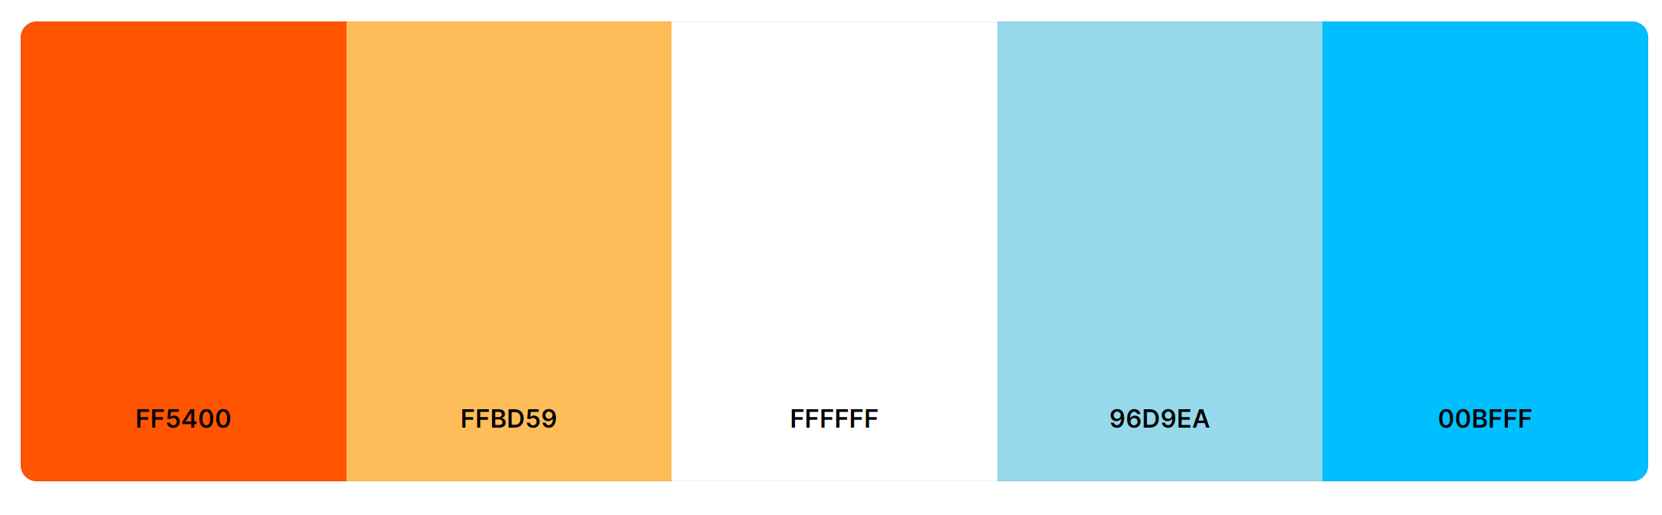
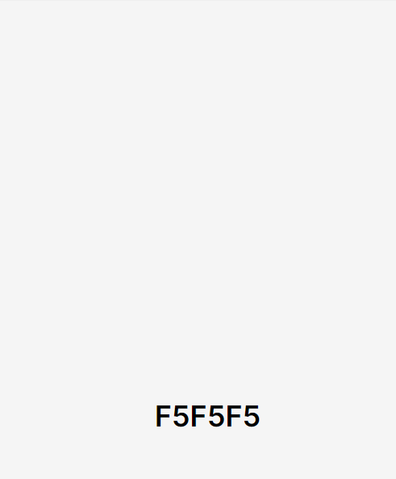
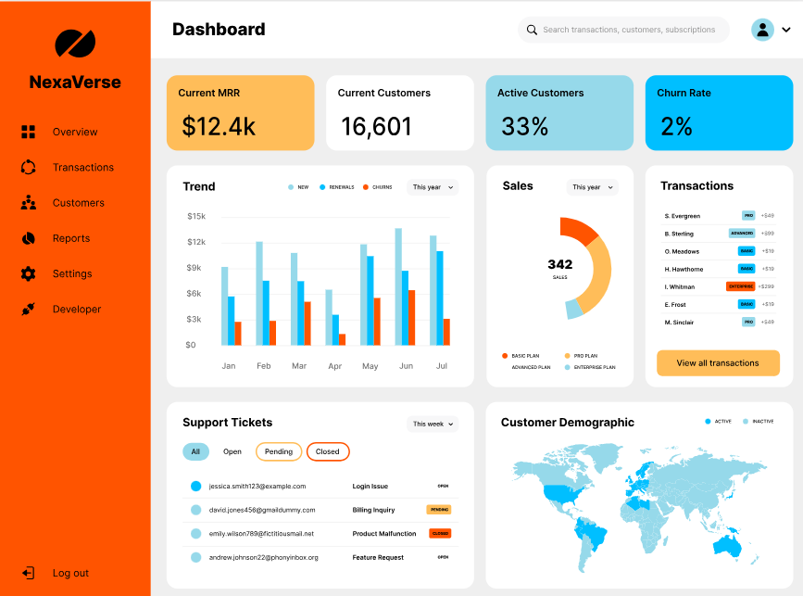
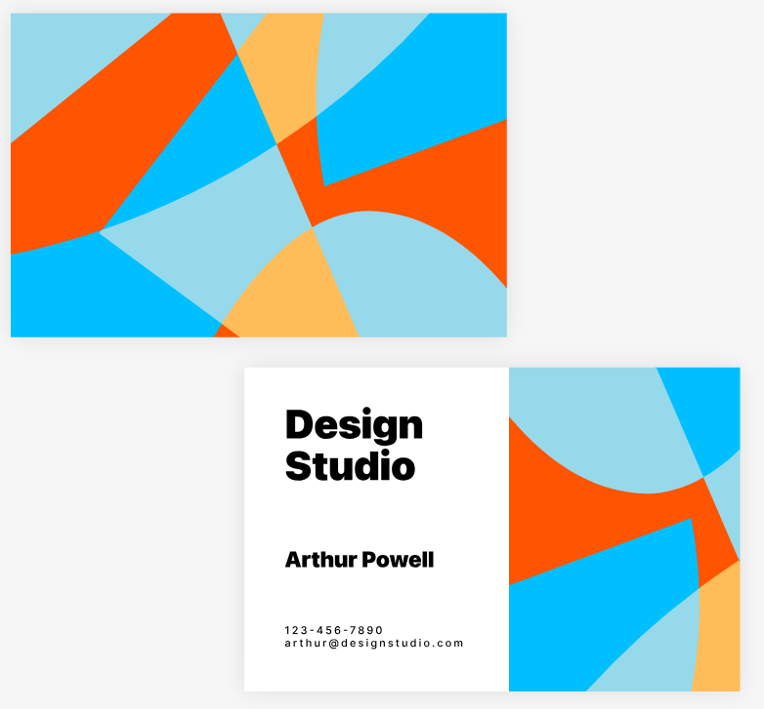

I. Brand Color Palette
https://coolors.co/palette/ff5400-ffbd59-ffffff-96d9ea-00bfff
NOTE:
I added #F5F5F5
Sample Color Combinations:

Slide 3
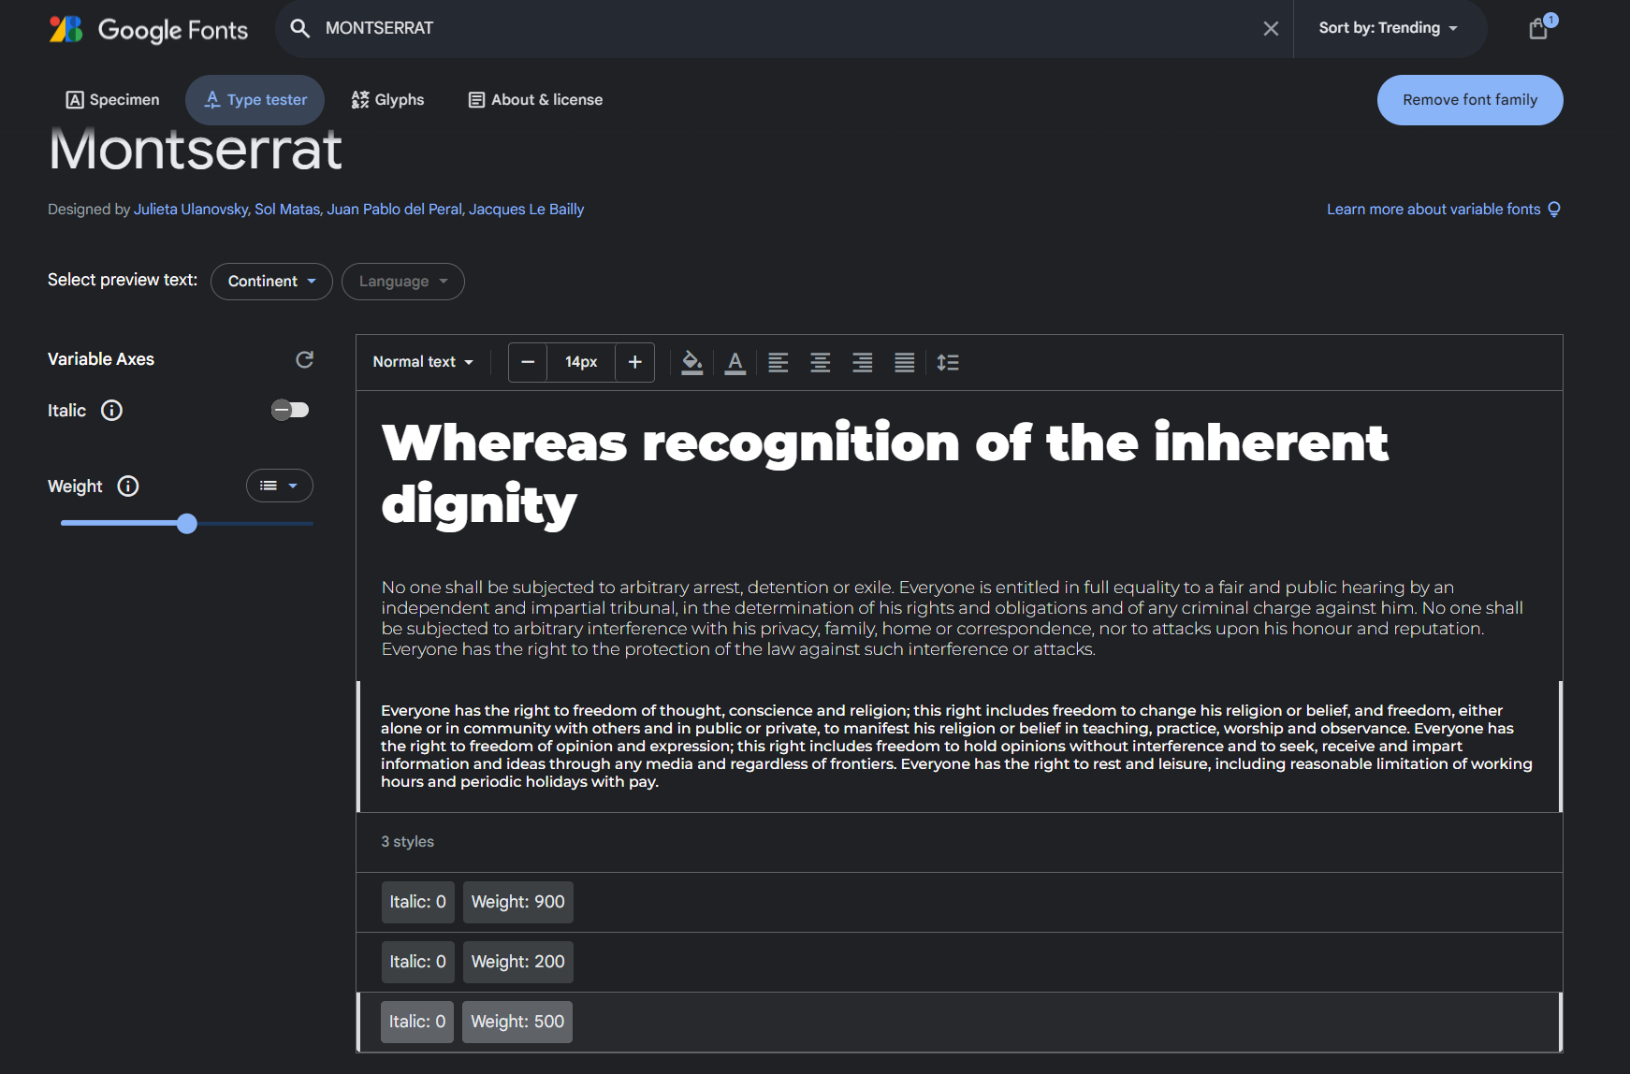
III. Brand Font
https://fonts.google.com/specimen/Montserrat/tester?query=MONTSERRAT

Slide 4
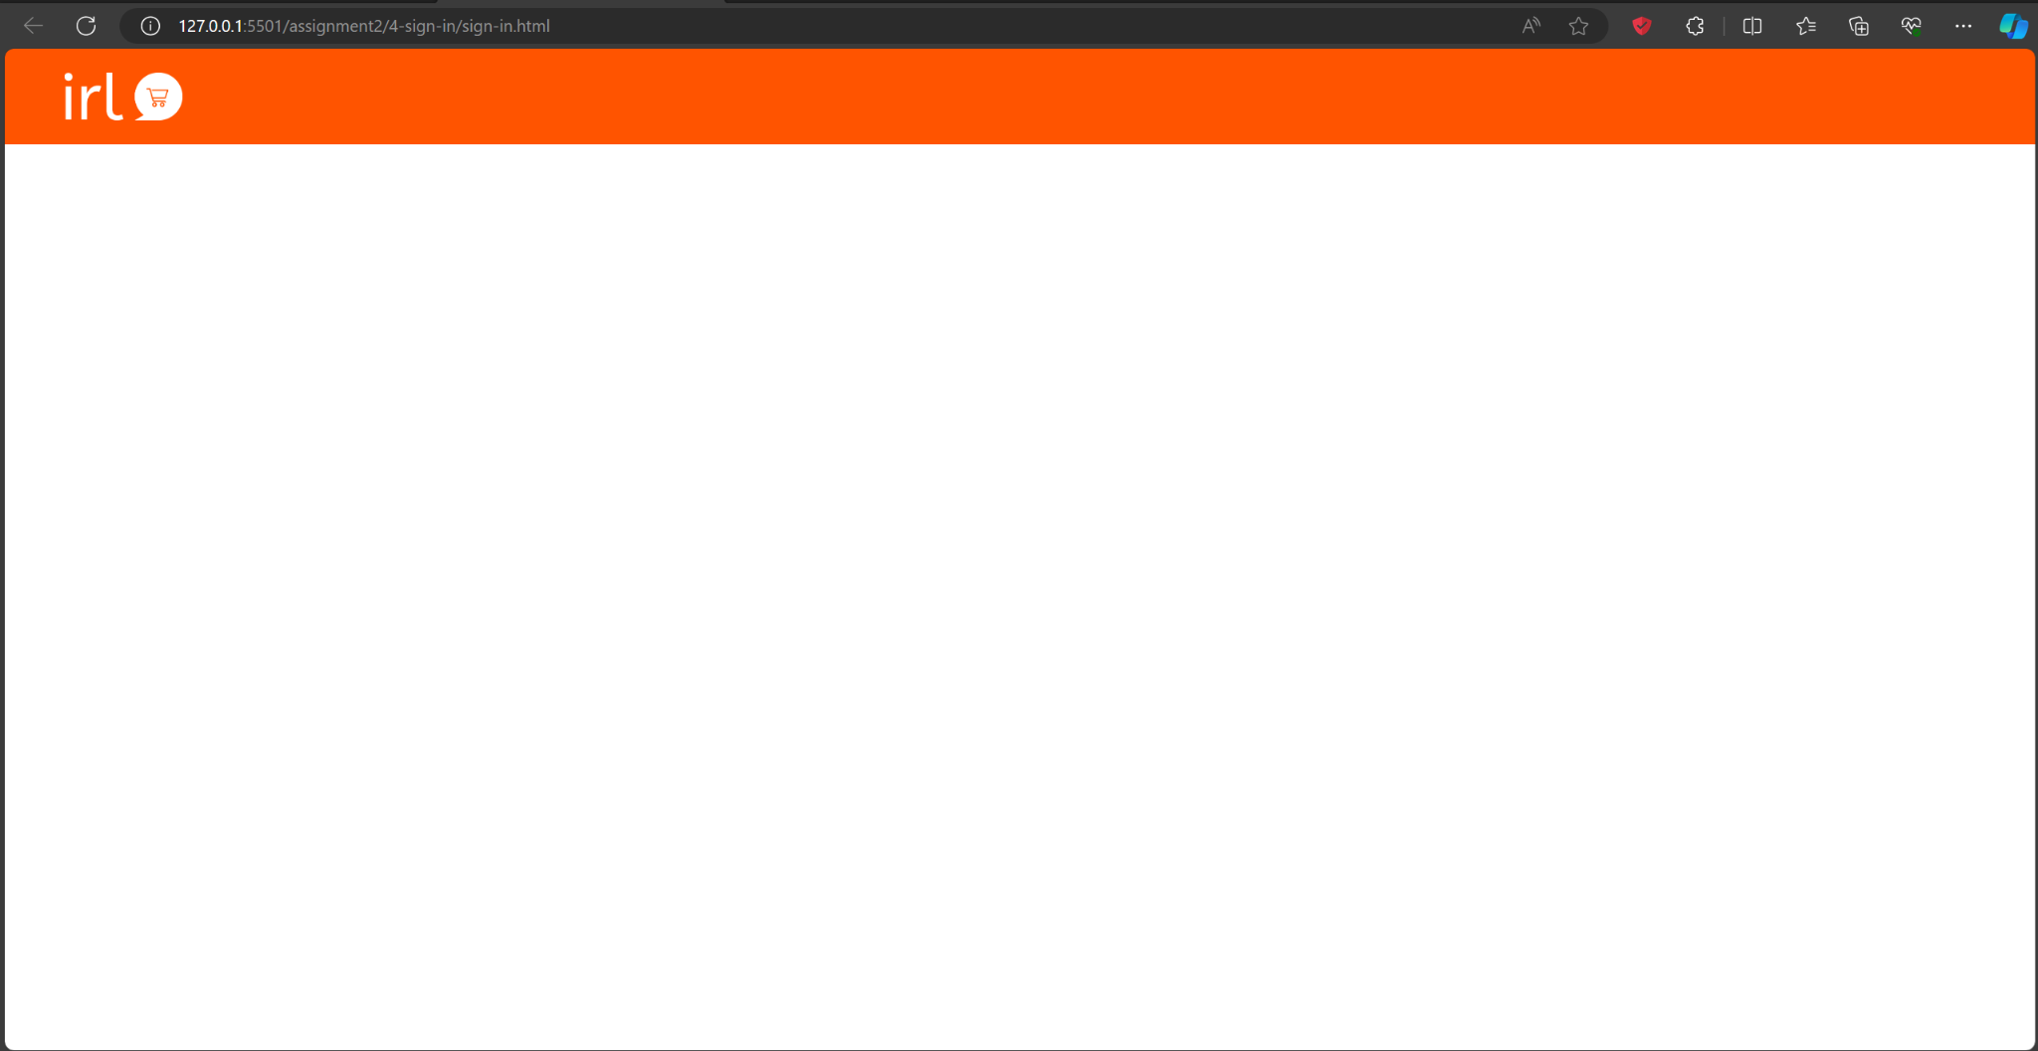
IV. Header
Header for Stand-Alone Page

