Slide 1

Data Science 100 Principles & Techniques of Data Science
?
Slides by:
Deborah Nolan
deborah_nolan@berkeley.edu

Slide 2
Announcements for Today
The class has been enlarged and the wait list is operating.
If you are a graduate student not on the waitlist, try to get on it ASAP.
Annotated slides are added after class
HW 2 will be released tonight and due 11:59 Wednesday Sep 11
Office hours are found at http://ds100.org/fa19/calendar

Slide 3
Topics for Today
How to solve probability problems
Review random variables, probability distribution, expectation and variance
Review Error, Loss, and Risk and the Relationship between the Data and the “World”
An Example

Slide 4
How do we solve probability problems?

Slide 5
Basic Approaches
Symmetry and Analogy
Counting and equally likely
Trees and conditional probability

Slide 6
Recall our group of 10 mothers
 | Number of Children
 | 1 | 2 | 3 | 4+
Count | 2 | 4 | 3 | 1
Proportion | 20% | 40% | 30% | 10%
Select a mother at random from the 10, record her #kids
Do not replace
Repeat for a total of 3 samples

Slide 7
Recall our group of 10 mothers
 | Number of Children
 | 1 | 2 | 3 | 4+
Count | 2 | 4 | 3 | 1
Proportion | 20% | 40% | 30% | 10%
What is the chance the second mom selected has 1 child?

Slide 8
Symmetry & Analogy
Urn with 10 marble one for each mother, indistinguishable except for the # written on it
Box with 10 indistinguishable tickets, except for the # on it
Deck of 10 indistinguishable cards, except for the # on the flip side

Slide 9
Symmetry & Analogy
Draw marbles from well mixed urn
Select tickets from well mixed box
Deal cards from top of well shuffled deck
Deal cards from bottom of well shuffled deck

Slide 10
Symmetry & Analogy
Chance the second draw is 1

Slide 11
Counting
10 people named A, B, C, D, E, F, G, H, I, J
With values 1, 1, 2, 2, 2, 2, 3, 3, 3, 4
Number of Combinations of first and second draws
Number of Combinations where the second draw is 1
Since each combination is equally likely, we take the ratio

Slide 12
Counting
Chance the second draw is 1

Slide 13
Tree and Conditioning
Two step process.
Only need to track whether card is 1 or not.
If you know the result of the first draw, compute the conditional chance of the second draw.

Slide 14
Tree and Conditioning
Chance the second draw is 1

Slide 15
Many approaches to figuring out probabilities
Get good at one
But be flexible and try multiple approaches
FUN PROBLEM: There are 3 cards, one has a circle on both sides, one has a square on both sides, and the third has a circle on one side and square on the other. Mix them up and place one card on the table. It displays a circle. What’s the chance there is a circle on the reverse side?

Slide 17
Working formally with Random Variables

Slide 18
0-1 Random Variables
In discussion yesterday, you worked with random variables that take on the 0 or 1 values
We will start with it as an example

Slide 19
Examples?

Slide 20
Probability Distribution

Slide 21
Expected Value and Variance

Slide 22
More Generally, Expected Value and Variance of a Discrete RV
Probability Distribution

Slide 23
More Generally

Slide 24
Sums of 0-1 Random Variables
Examples?

Slide 25
Expected Value

Slide 26
Variance
If Independent
If From a Simple Random Sample

Slide 27
Probability Distribution
Concrete: n = 4 and Y = X₁ + X₂ + X₃ + X₄ and the Xs are independent with same chance of 0 or 1 (knowing the value of X₁ doesn’t change X₂ distribution).
P(Y = 2) =

Slide 28
Probability Distribution
n independent 0-1 variables
Y = X₁ + … + X_{n}
P(X_{i} = 1) = p

Slide 29
Fun Problem Related to HW:
Roll a fair die 5 times.
N_{E} = number of evens,
N_{P} = number of primes
N₁ = number of 1s

Slide 31
Summary Statistics as Estimators of Population Parameters

Slide 32
Data Design/ Generation
Get Data from the World and Generalize Data Findings to the world
Generalization

Slide 33
The Simple Random Sample
Suppose we have a population with N subjects
We want to sample n of them
The SRS is a random sample where every unique subset of n subjects has the same chance of appearing in the sample
This means each person is equally likely to be in the sample

Slide 34
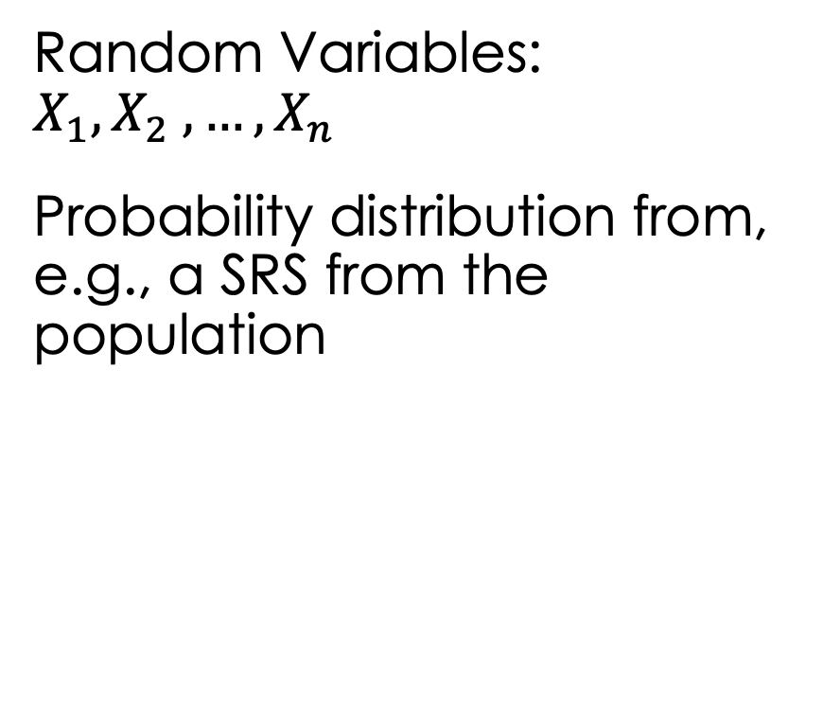

Empirical (Data)
Model (World)
DATA: $x_{1}, x_{2} , …, x_{n}$
The sample that we have to work with
Random Variables: $X_{1}, X_{2} , …, X_{n}$
Probability distribution from, e.g., a SRS from the population

Slide 35

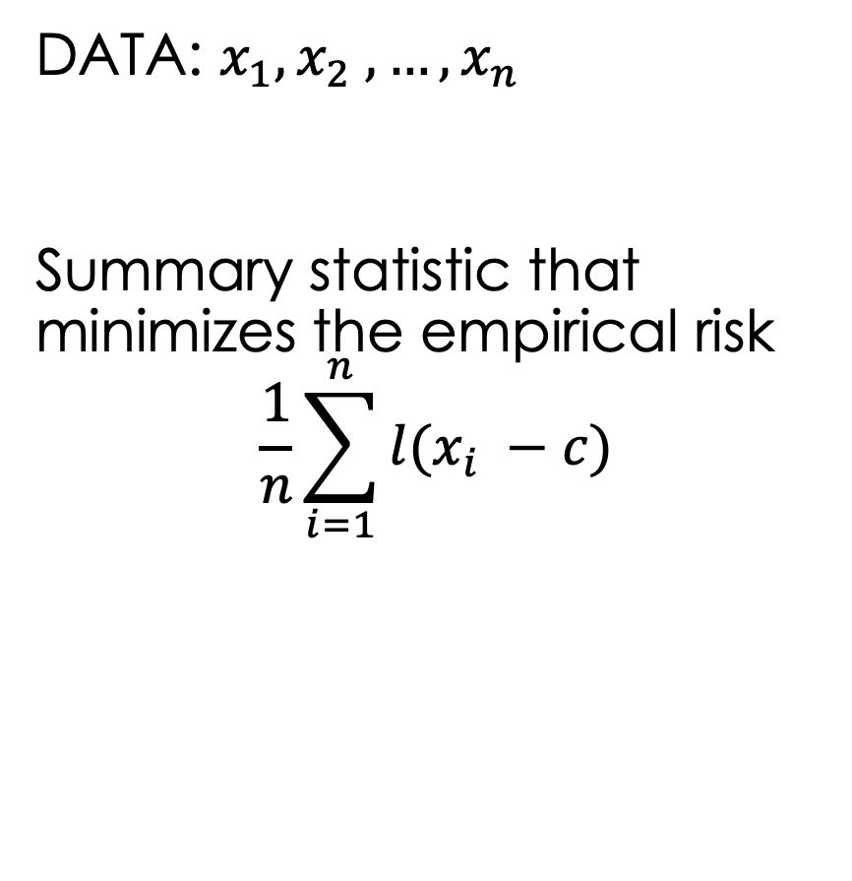
Empirical (Data)
Model (World)
DATA: $x_{1}, x_{2} , …, x_{n}$
Summary statistic that minimizes the empirical risk
$$\frac{1}{n}\sum_{i=1}^{n}{l(x_{i} −c)}$$
Random Variables: $X_{1}, X_{2} , …, X_{n}$
Probability parameter that minimizes the Risk

Slide 36
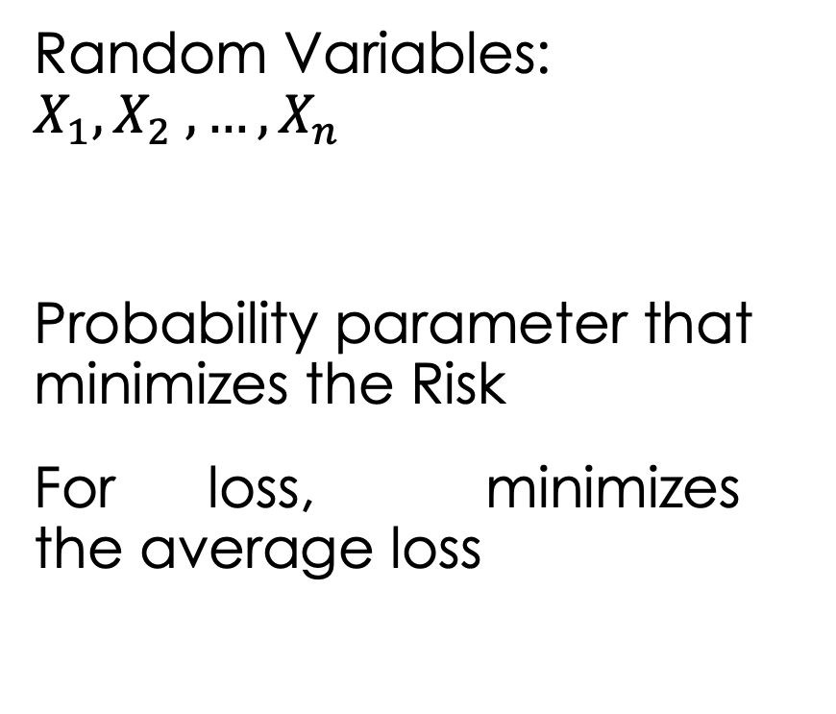
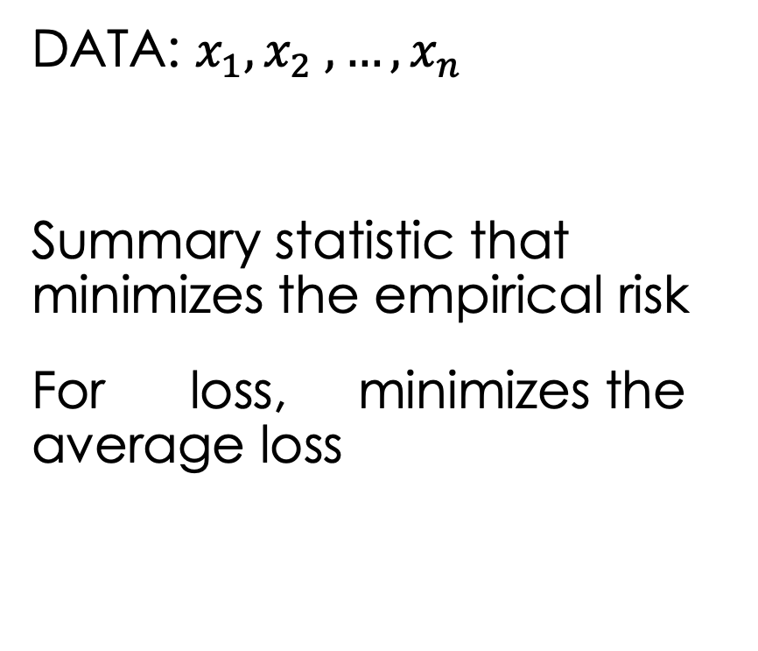
Empirical (Data)
Model (World)
DATA: $x_{1}, x_{2} , …, x_{n}$
Summary statistic that minimizes the empirical risk
For loss, minimizes the average loss
Random Variables: $X_{1}, X_{2} , …, X_{n}$
Probability parameter that minimizes the Risk
For loss, minimizes the average loss

Slide 37
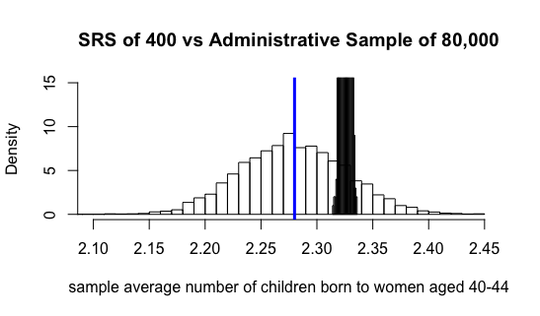
Empirical (Data)
Model (World)
Connect the sample average and expected value:
The expected value of a sample average from a SRS is unbiased
Its variability is quantifiable – the sampling error

Slide 38
Data Life Cycle
Data Design/ Generation
Probability Samples give us Representative Data where the sample average is well behaved and an accurate estimate of the population average
Generalization

Slide 39
An Example: Wait Time for a Repair

Slide 40
Data Life Cycle
?
Question
Formulation
Data Design/ Generation
Generalization
Data Analysis

Slide 41
Question
What is the typical wait time for a PG&E repair?
PG&E must report to a utilities commission about its service record.
Context

Slide 42
How might we/they focus this question?
The Question gives focus to the Population that we want to study

Slide 43
What is the Population of Interest?
SAMPLE
Sampling
Frame
What is the Sampling Frame?

Slide 44
Scenario: Administrative Data
SAMPLE
Sampling
Frame

Slide 45
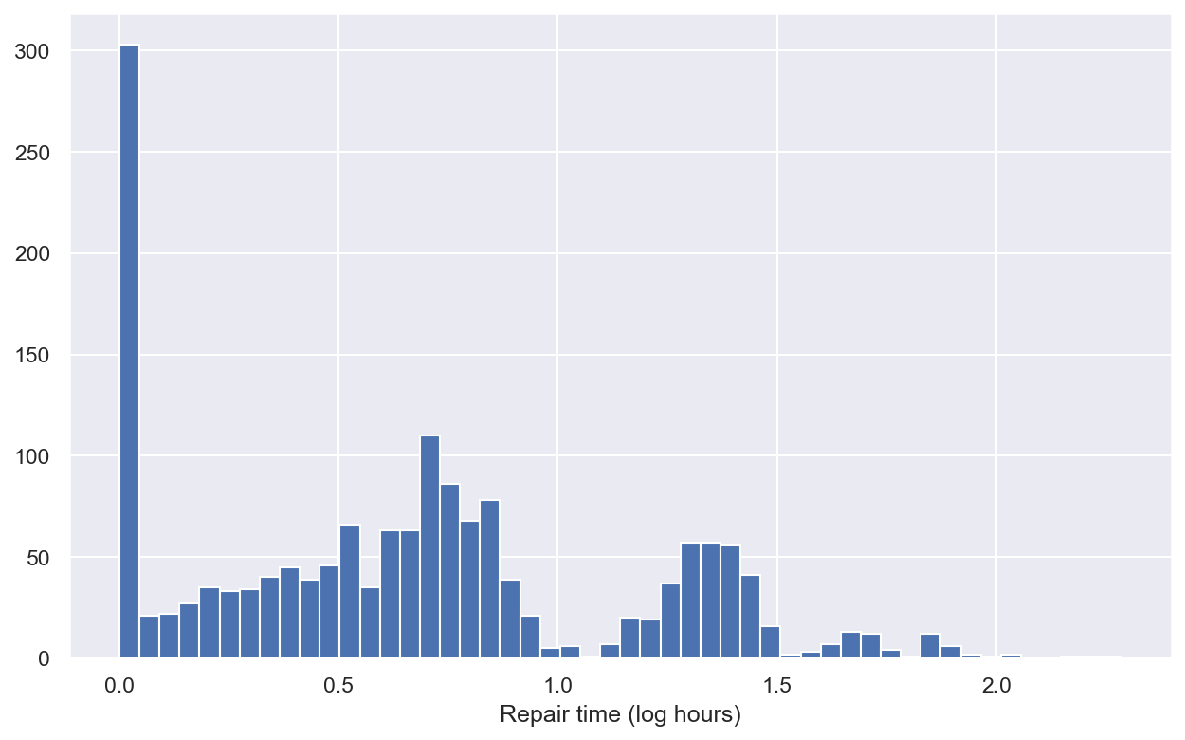

The Data
$x_{1}, x_{2} , …, x_{n}$ every wait time over a 3 month period
Can we provide a summary statistic?

Slide 46
Why is the sample median such a desirable summary?

Slide 47

Summarizing the Data
DATA: $x_{1}, x_{2} , …, x_{n} \text{where} n \text{is}\text{ 1665} \text{for} \text{our} \text{data}$
ERROR: $x_{1}−c, x_{2}−c, …, x_{n}−c$
LOSS: $l:R→R^{+}$

Slide 48
Minimize the Average L₁ Loss

Slide 49
Minimize the Average Absolute Error

Slide 50
Data Life Cycle
Data Design/ Generation
Probability Samples give us Representative Data where the sample median is a good estimate of the population
Generalization

Slide 51
Where does Probability Sampling Come into this Problem?

Slide 52
Probabilistic Behavior of the Median
Not as simple to work with as the mean
We need to make more assumptions about the underlying probability distribution of X
In many circumstances the sample median is well-behave and close to the median(X)

Slide 53
HW 2 Introduction

Slide 54
2016 Presidential Election
Outcome took many by surprise
Most polls were predicting Clinton victory was 90%
FiveThirtyEight said 70% and a couple of days before indicated that Trump had a chance to win
Now that the election has passed, we have the opportunity to see the world (voters who voted in the election)

Slide 55
Population: Pennsylvania voters
We have a record on the
# Trump votes
# Clinton votes
# Other votes
We can simulate the polls to see the sampling distribution of:
(# T votes - # C votes) / Total Votes Sampled
SAMPLE
Sampling
Frame

Slide 56
Population: Pennsylvania voters
We can introduce a little bias
Simulate the polls to see the sampling distribution of the biased sampling frame:
(# T votes - # C votes) / Total Votes Sampled
SAMPLE
Sampling
Frame

