Slide 1
Week 5 Final Project Dylan Sutcliffe CST499 Capstone for CST Instructor: Charmelia Butler December 10, 2023

Slide 2
SRS Document Requirements
Software Quality Attributes: Reliability, Availability, Performance, Usability, Security, and Maintainability
Registration with Unique ID, password, name, phone #, and email
Login with ID and password
Course registration with max students and waitlist with notifications

Slide 3
SRS Document Interfaces
User Interfaces: Registration, Login, Courses, and Notifications
Tech Stack: XAMPP
Database: MariaDB
Server: Apache 2.4.56
Language: PHP 8.2.4
Administration: phpMyAdmin 5.2.1
Bootstrap framework as thought out UX is provided which in turn helps user engagement due to important elements such as typography, colors, and layout (Whaiduzzman, 2023)

Slide 4
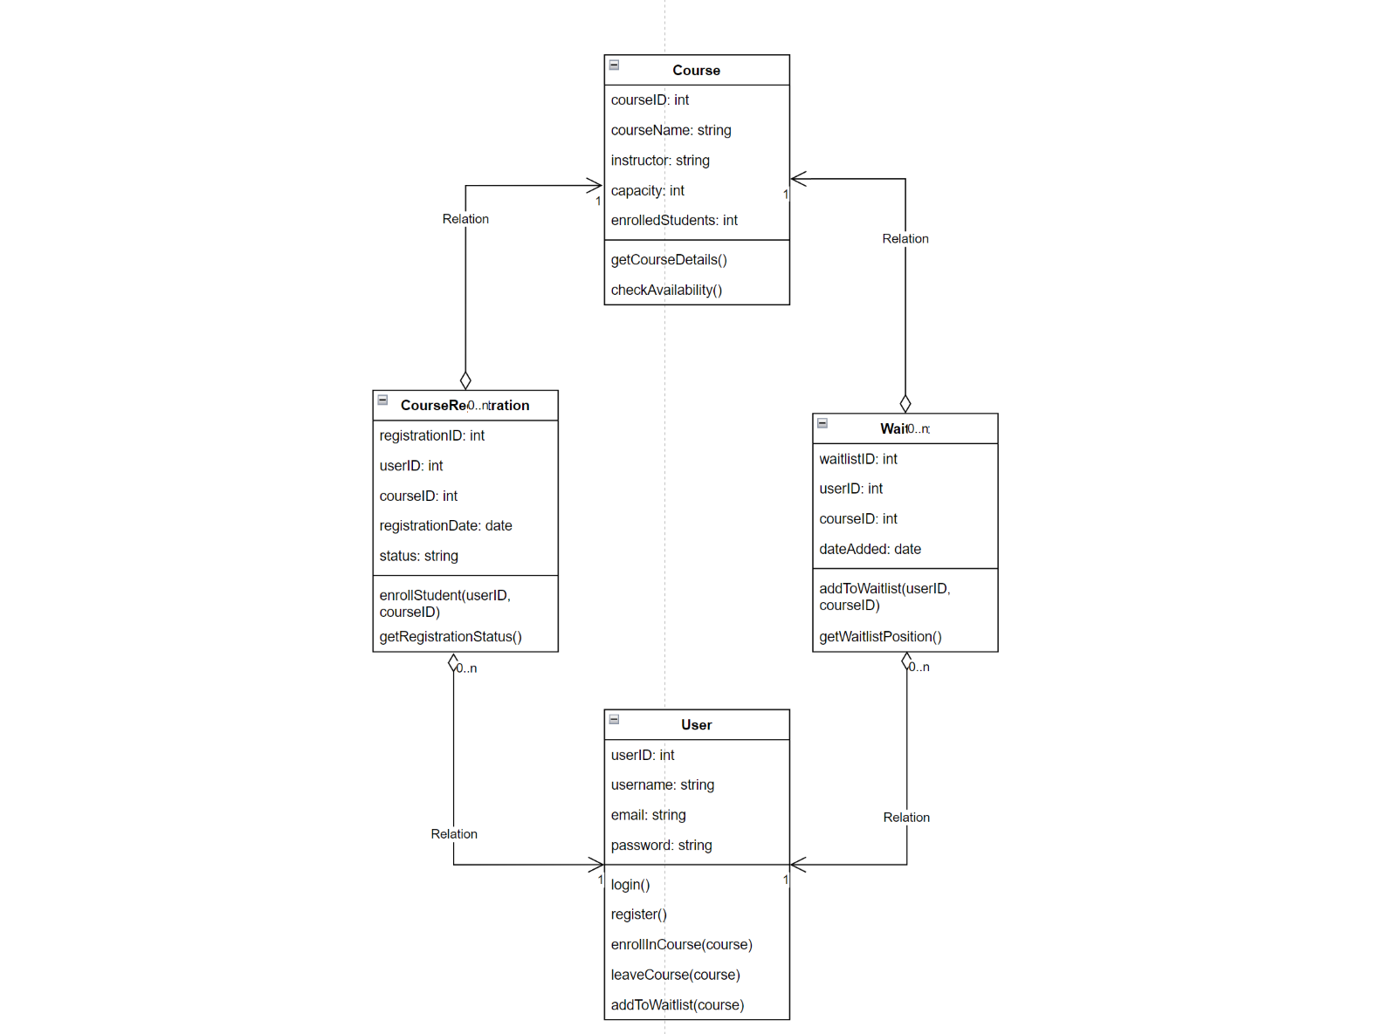
UML Model
Normalization

Slide 5
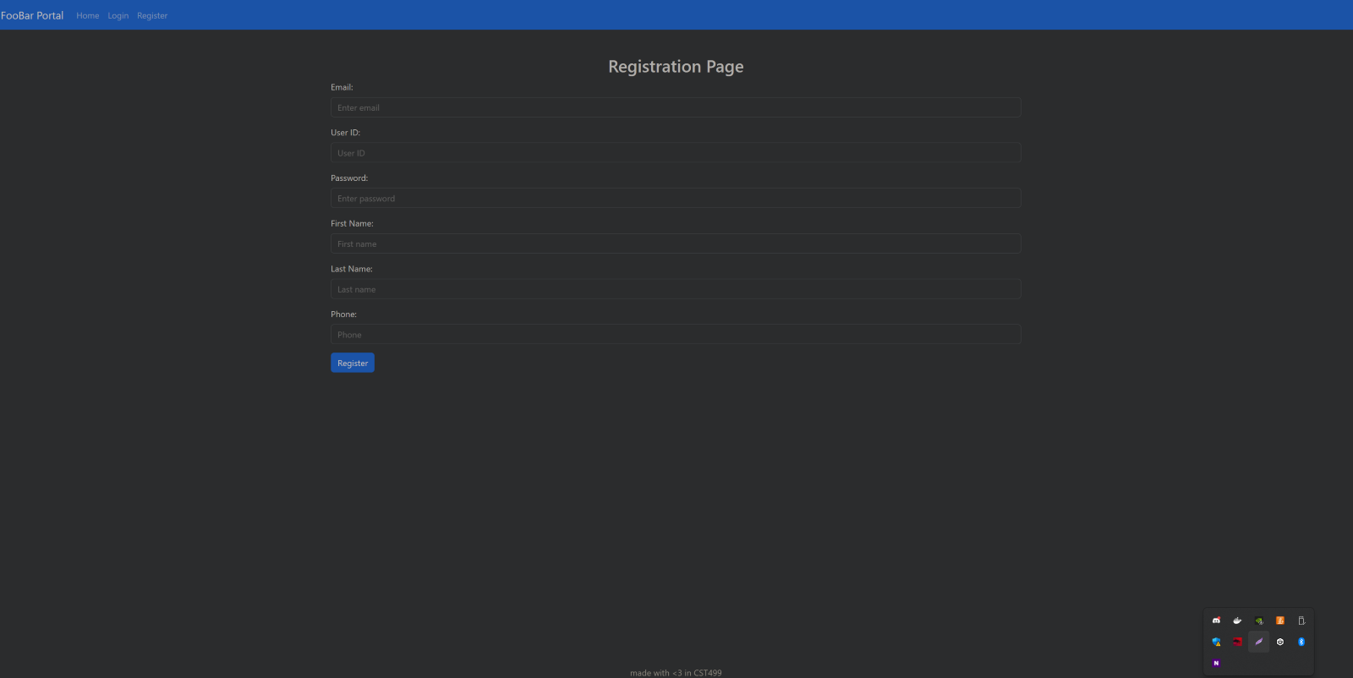
Page Design Registration
Simple form with input validation

Slide 6
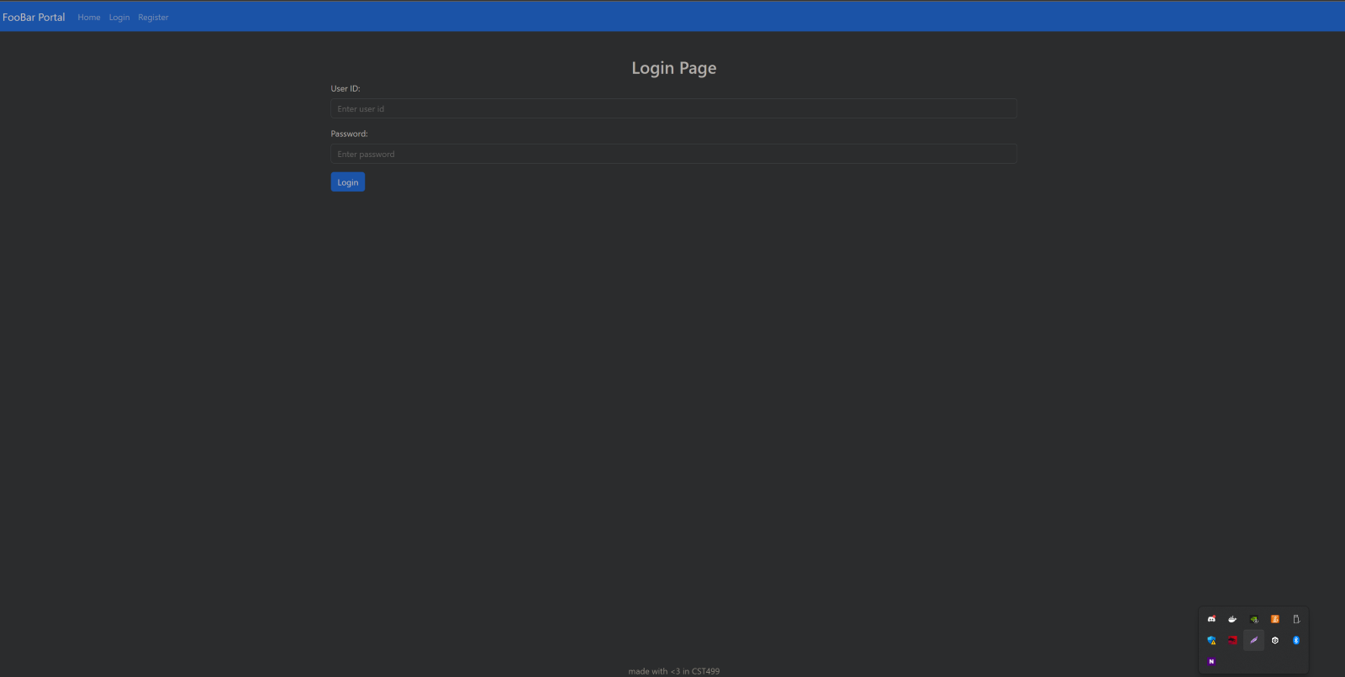
Page Design Login
Thought out errors to prevent username enumeration

Slide 7
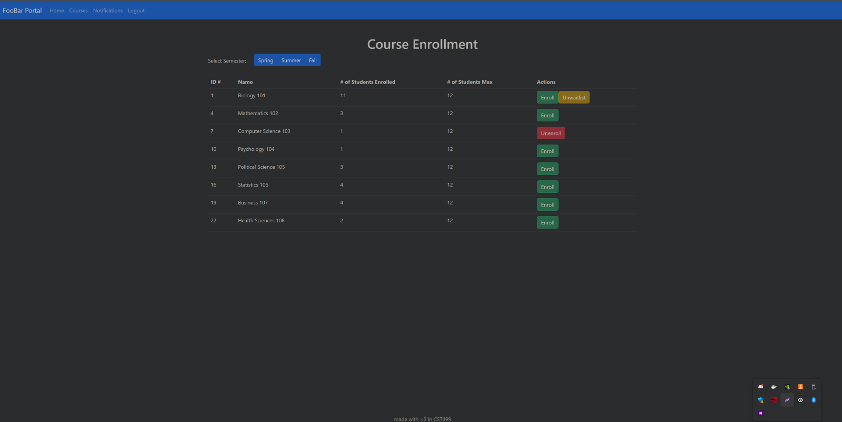
Page Design Enrollment
List of courses with max students
No enrollment on max courses (4)
Waitlist for full courses

Slide 8
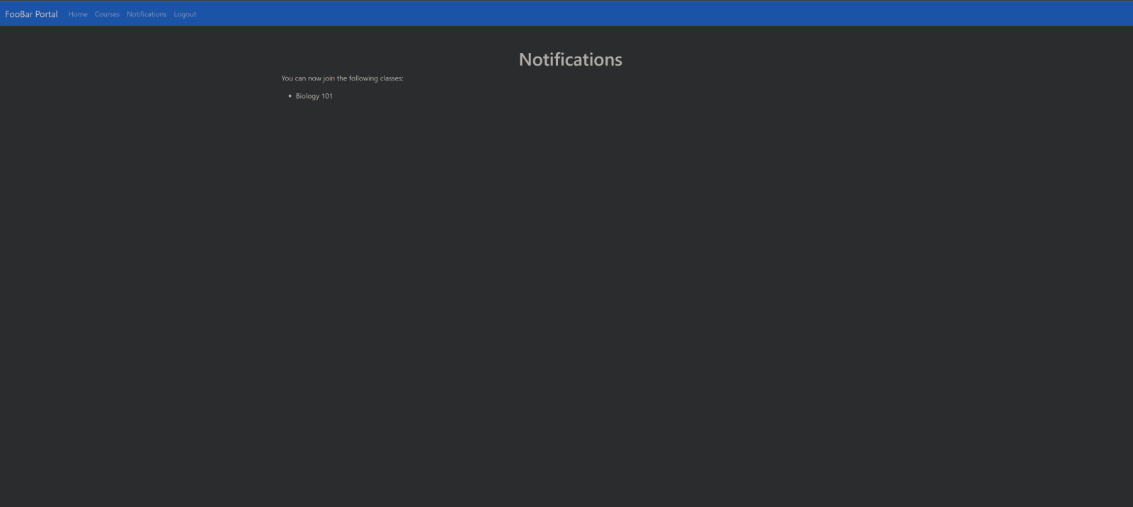
Page Design Notifications
Simple notification page listing courses that you are in line and available to enroll in

Slide 9
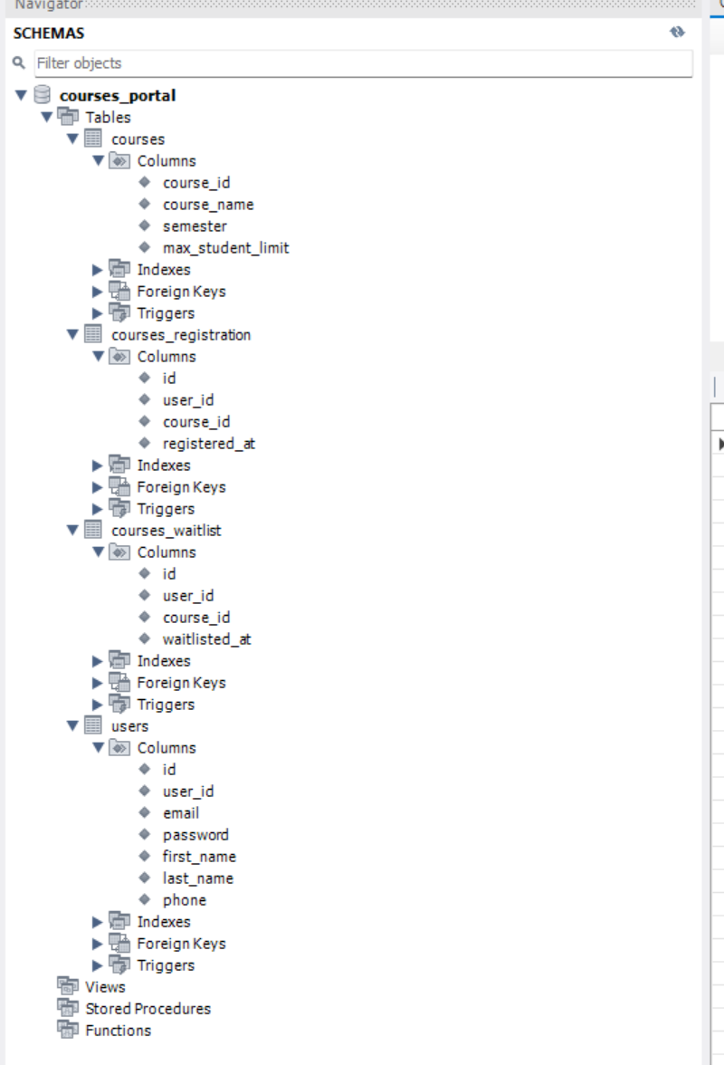
MySQL Database

Slide 10
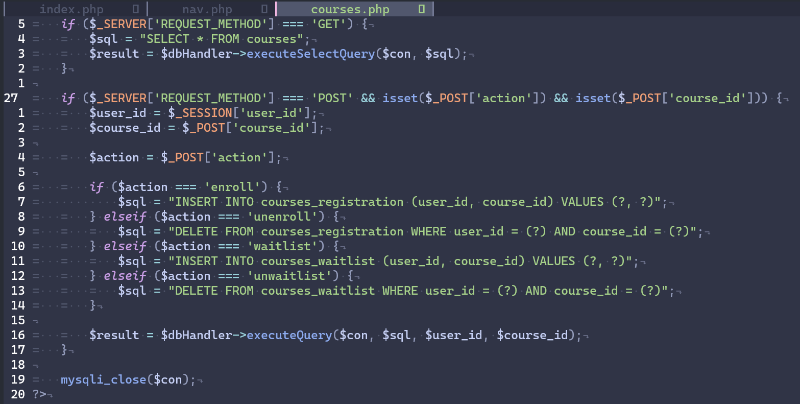
PHP Code
Easy development since PHP code goes into the htdocs directory (Kumari & Nandal, 2017)
DB handler to prevent SQL injections

Slide 11
References
Kumari, P., & Nandal, R. (2017). A Research Paper OnWebsite Development Optimization Using Xampp/PHP. International Journal of Advanced Research in Computer Science, 8(5), 1231–1235.
Whaiduzzaman, M., Sakib, A., Khan, N. J., Chaki, S., Shahrier, L., Ghosh, S., Rahman, M. S., Mahi, M. J. N., Barros, A., Fidge, C., Thompson-Whiteside, S., & Jan, T. (2023). Concept to Reality: An Integrated Approach to Testing Software User Interfaces. Applied Sciences (2076-3417), 13(21), 11997 https://doi.org/10.3390/app132111997

