Slide 1

Clarity
Smart Expense Analyzer & Financial Health Dashboard
“An honest, clear picture of your personal financial health.”
HackInMotion Hackathon · Team HIM-1043

Slide 2
THE PROBLEM
Two bad options, and a data problem
Spreadsheets with colours
Black-box AI scores
Unreadable statements
Raw rows and a pie chart. You can see what you spent never whether it was reasonable, or what to do about it.
A number appears with no derivation. Nothing to audit, nothing to argue with and it is asking you to trust it with your money.
Real Indian bank and UPI narrations are machine noise. Nothing downstream works until someone cleans them up.
UPI/DR/622450640912/MUKESH S/YESB/paytm.s22m/UPI
2
People don’t need more charts. They need a diagnosis they can check.

Slide 3
OUR APPROACH
Four principles the code actually enforces
01 Strict multi-tenant scoping
02 Computed, never hardcoded
Every route resolves the session server-side before touching the database. No client-supplied userId reaches a Prisma query — anywhere.
Scores, 50/30/20 ratios, runway and insight cards are all derived on demand from the user’s own transactions. No filler values.
03 Deterministic first, AI second
04 Resilient by default
Keyword rules run free and instantly, and store a reasoning trail. Claude handles only what rules can’t decode.
Empty datasets, malformed rows, password-locked PDFs and a missing API key all have real handled paths — not crashes.
Each principle maps to a specific mechanism in the codebase
Clarity · HackInMotion · Team HIM-1043
3

Slide 4
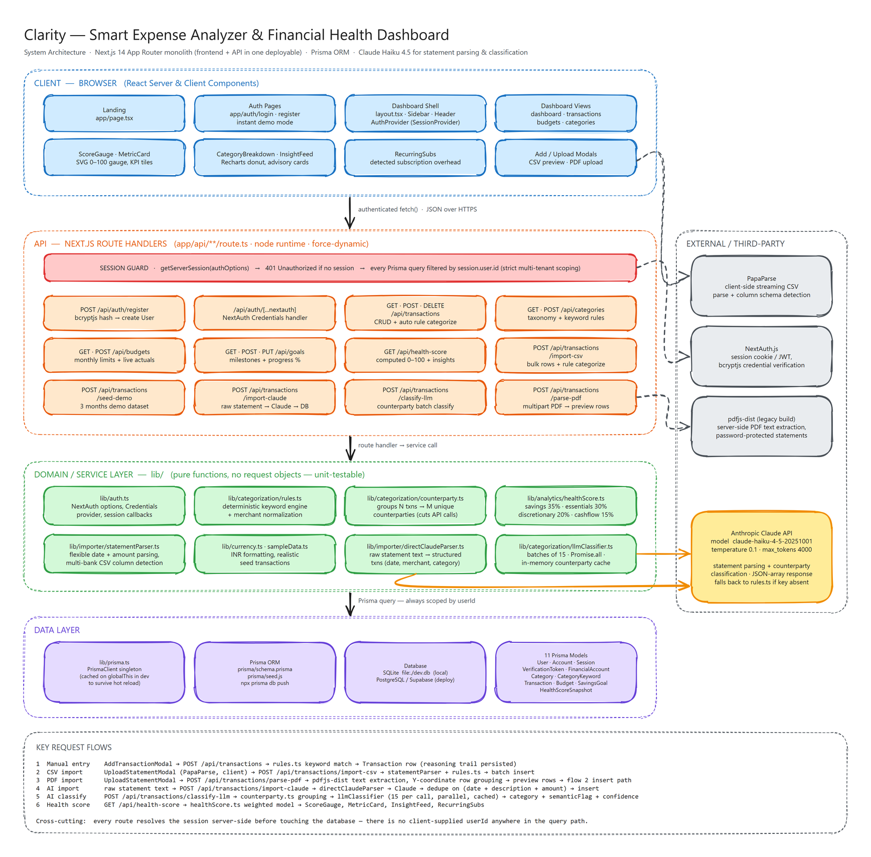
ARCHITECTURE
Full-resolution source: assets/architecture-diagram.png · editable: assets/architecture-diagram.excalidraw
Clarity · HackInMotion · Team HIM-1043
5

Slide 5
FINANCIAL HEALTH SCORE
A score you can take apart
Factor | Weight | Benchmark | Why it matters
Savings rate | 35% | ≥ 20% | The single strongest predictor of long-term resilience
Essentials (needs) | 30% | ≤ 50% | Fixed overhead you cannot cut quickly in a bad month
Discretionary (wants) | 20% | ≤ 30% | The flexible spend that is actually addressable this month
Net cash flow & runway | 15% | > ₹0 | Whether the month closes positive, and for how many months
Tiers
CRITICAL
BUILDING
STABLE
STRONG
PRISTINE
< 40
40–54
55–69
70–84
85+
Clarity · HackInMotion · Team HIM-1043
6

Slide 6
CATEGORIZATION
Deterministic first, AI only where its required
Rule engine · lib/categorization/rules.ts
Claude layer · llmClassifier.ts
Keyword matching plus merchant-name normalization across 8 life-stage categories.
• Runs in-process — no network, no cost, no latency
• Every transaction stores a reasoning string, so any label can be audited
• Users add their own categories and keyword rules
• A live sandbox on /dashboard/categories lets you paste a raw narration and watch the rules fire
For narrations no keyword list will ever decode — local vendors, UPI handles, one-off counterparties.
• Returns category, semanticFlag, isEssential, confidence and reasoning
• Semantic flags rules can’t infer: Self Transfer, Family Transfer, Reversal, Cash Withdrawal, Bank Fee
• Distinguishing a self-transfer from real spend is what keeps the score honest
Graceful degradation: with no ANTHROPIC_API_KEY set, the classifier flags items “Needs Review” and falls back to the rule engine. The app never hard-fails on a missing key.
Clarity · HackInMotion · Team HIM-1043
7

Slide 7
THE OPTIMISATION
Classify the merchant, not the transaction
Forty Swiggy orders are one decision, not forty. So we group first, then classify.
N
M
⌈M/15⌉
0
raw transactions
distinct counterparties
API calls
on a repeat run
as imported
counterparty.ts groups them
batches of 15, Promise.all
in-memory cache hit
Why it matters
Measured, not claimed
M is far smaller than N in real statements, and repeat merchants dominate. Grouping turns a per-row cost into a per-merchant cost, then batching turns that into a handful of calls.
The endpoint returns totalTransactions, distinctCounterparties, apiCallsMade, cachedHits and reductionPercentage on every call, the saving is reported from the run, not estimated in a slide.

Slide 8
STATEMENT INGESTION
Three ways in, one safe path to the database
CSV
PDF
Raw → Claude
PapaParse streams the file client-side and auto-detects column variants — Date / Posting Date, Description / Memo / Payee, Amount / Debit / Credit.
Live preview table before anything is committed.
pdfjs-dist extracts text server-side and rebuilds table rows by bucketing items on their Y-coordinate.
Password-protected statements return PASSWORD_REQUIRED so the UI can prompt and retry.
Hand the statement text straight to Claude and get back ISO dates, canonical merchant names, signed amounts and categories.
For formats no parser anticipated.
All three converge here
dedupe on (date + description + amount) → tagged with an importBatchId → batch insert, scoped to the session user
Clarity · HackInMotion · Team HIM-1043
9

Slide 9
SECURITY
Tenancy is enforced at the query, not the UI
Every request
Every query
getServerSession(authOptions) resolves the session before any database access. No session → 401, and the handler returns before a query is built.
The userId in each Prisma where clause comes from the verified session — never from the request body or a query parameter. There is no code path that accepts one.
Credentials & deletion
Scoping is also the query plan
bcryptjs salted hashes via the NextAuth Credentials provider. User relations cascade on delete; category and account links use SetNull, so removing a category never destroys transaction history.
Composite indexes on [userId, date], [userId, categoryId], [userId, accountId] and [userId, type] mean the isolation boundary is the same thing that makes reads fast.
Clarity · HackInMotion · Team HIM-1043
10

Slide 10
BUILD
Tech stack
Framework & language
Data
Auth
Next.js 14 App Router
Prisma ORM 5
NextAuth.js 4
TypeScript
SQLite (local)
Credentials provider
React 18 Server + Client Components
PostgreSQL / Supabase (deploy)
bcryptjs
UI & charts
Ingestion
AI
Tailwind CSS 3
PapaParse
@anthropic-ai/sdk
Recharts
pdfjs-dist
claude-haiku-4-5-20251001
lucide-react
react-dropzone
temperature 0.1
date-fns
11

Slide 11
Thank you
Clarity — an honest, clear picture of your personal financial health.
HackInMotion · Team HIM-1043
Clarity · HackInMotion · Team HIM-1043
14

