Slide 1
Hypotheses
Does a two-level TLB increase TLB hit rate, compared to one-level TLB?
Does supporting dynamic page size increase TLB hit rate, compared to only supporting fixed page size (4KB)?
How do TLB replacement policies impact the performance?

Slide 2
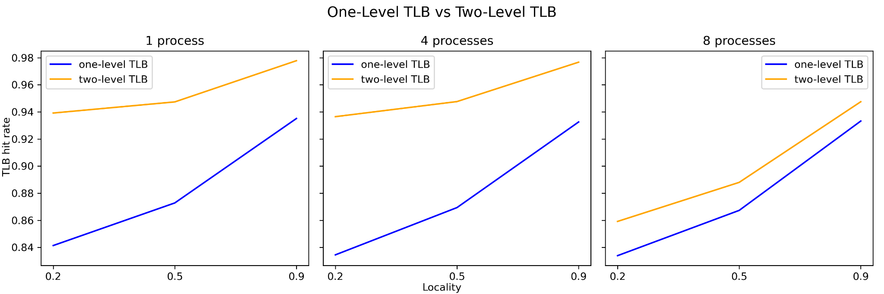
Results – two level TLB vs one level TLB

Slide 3
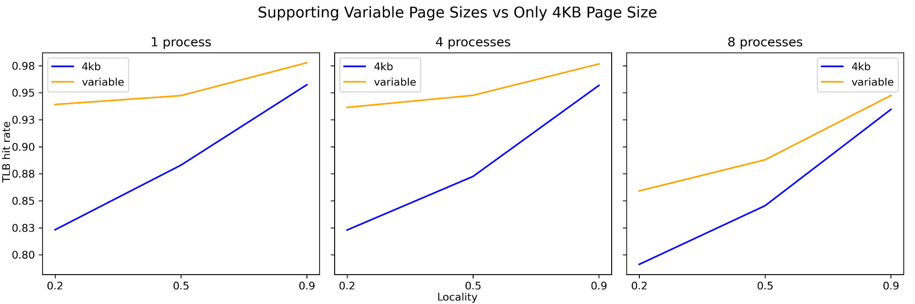
Results – dynamic vs fixed page size

Slide 4
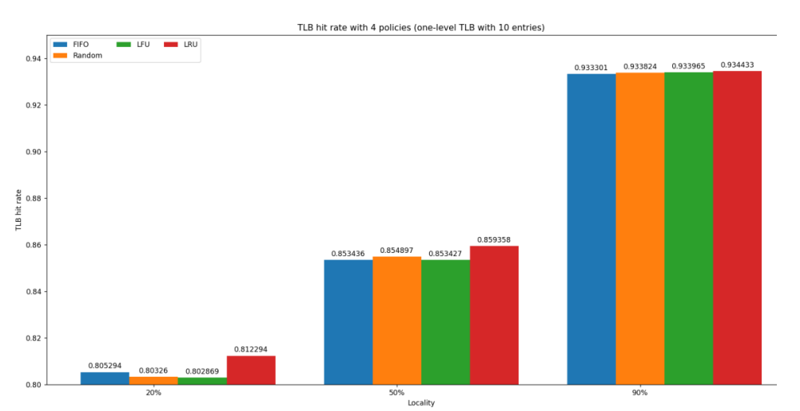
Results – 4 TLB replacement policies

