Slide 1
Sentiment and Emotion Enhanced
Rating Prediction for Hong Kong
Restaurant Reviews
Group Name: Quartet-V2
Group Member:
LU Yan 59569483
LI Jiarong 60071463
LI Qing 59447928
ZHUANG Yuchi 59983412
Date: Apr 10, 2026

Slide 2
Business Context and Motivation
Online Reviews Drive Decisions
Star Ratings Are Insufficient
Reviews heavily influence customer choices and brand reputation.
Ratings lack specific details on service, food, and value.
Scalable Interpretation Needed
Text Analytics for Improvement
Restaurants need automated analysis for large volumes of unstructured review data.
Advanced text analytics extract actionable insights on customer opinions and operational aspects.

Slide 3
Project Objectives
01
Analyze Sentiment and Emotion Patterns
Classify polarity and emotions in Hong Kong restaurant reviews using NLP.
02
Identify Descriptive Patterns
Discover patterns in ratings, categories, and business types that impact review sentiment.
03
Predict Five-Star vs Non-Five-Star Reviews
Develop a model to classify reviews as 5-star or non-5-star to simplify product focus.
04
Compare Feature Groups
Evaluate the predictive power of review text, metadata, and sentiment features on ratings
05
Derive Practical Business Implications
Provide actionable recommendations for restaurant managers and industry stakeholders.

Slide 4
Data Sources
Source Platform
TripAdvisor
16,350
Hong Kong's largest travel platform, providing authentic, user-generated restaurant reviews. The data is crawled by Python script.
Raw Reviews Collected
13,041
Geographic Scope
Cleaned Reviews for Modeling
Hong Kong Restaurants
Focuses on 302 districts, covering diverse cuisines, price ranges, and locations across Hong Kong.
Data Retention Rate
79.8%
Data Structure
Quality Assurance
Two-Level Hierarchy
Ensures accurate, non-duplicate data with reliable review text.
Restaurant-level: attributes (name, price, location, etc.).
Review-level: individual review content (rating, date, text).

Slide 5
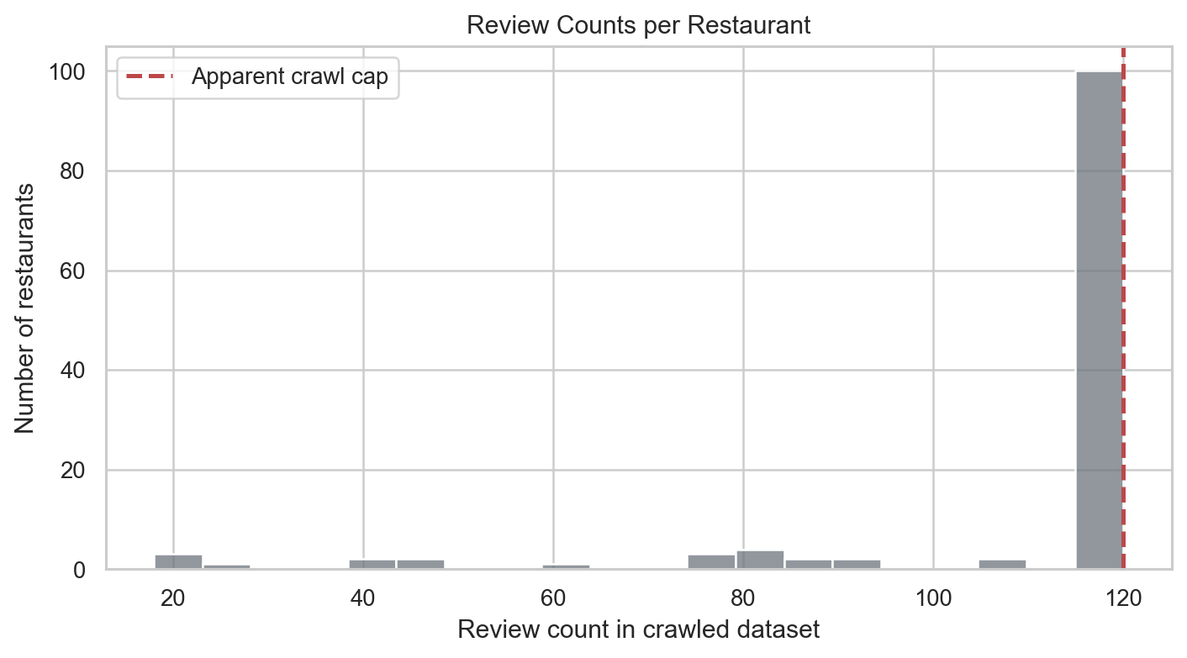
Data Quality and Challenges
Mixed-Language Text
Reviews contain English, Chinese text, and code-switching, posing challenges for sentiment analysis.
Temporal Data Issues
Time zone field exhibits patterns suggesting a function, not a month. This requires granular temporal analysis.
Class Imbalance
A strong imbalance towards 4-5 star reviews can bias models, requiring specialized techniques for minority class handling.
Review Count Caps
Review counts capped at ~120 introduce selection bias and limit review volume assessment.

Slide 6
Analytics Framework
Descriptive Analytics | Summarize review patterns, ratings, and trends
Sentiment & Emotion Analytics | Extract lexicon-based sentiment and NRC emotion features
Predictive Analytics | Classify five-star vs. non-five-star reviews
Data Collection → Cleaning → Feature Extraction → Modeling → Evaluation → Business Insights

Slide 7
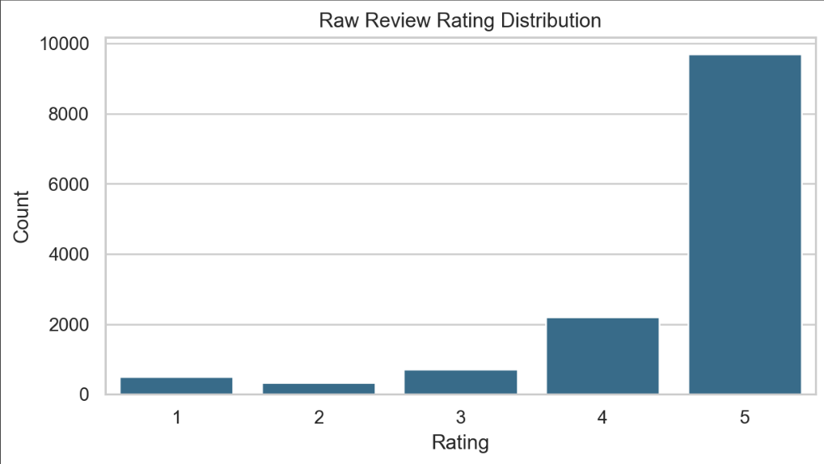
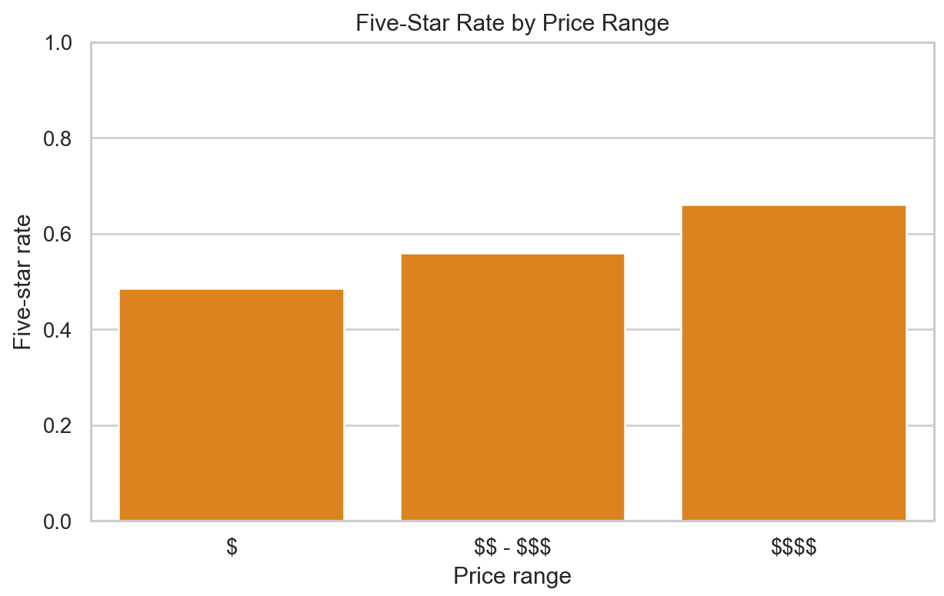
Descriptive Analytics Results
• Ratings are heavily concentrated in 5 stars
• Higher price range → higher five-star rate
• Review volume varies by year
• The dataset is useful, but not a full historical record

Slide 8
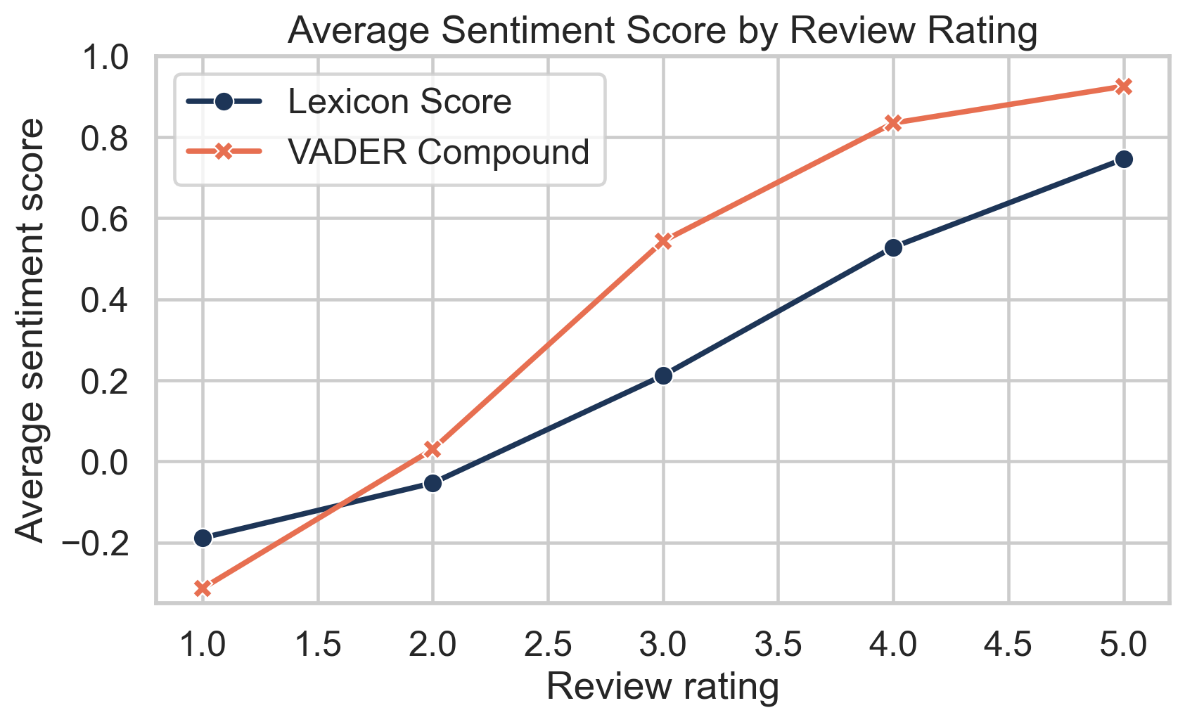
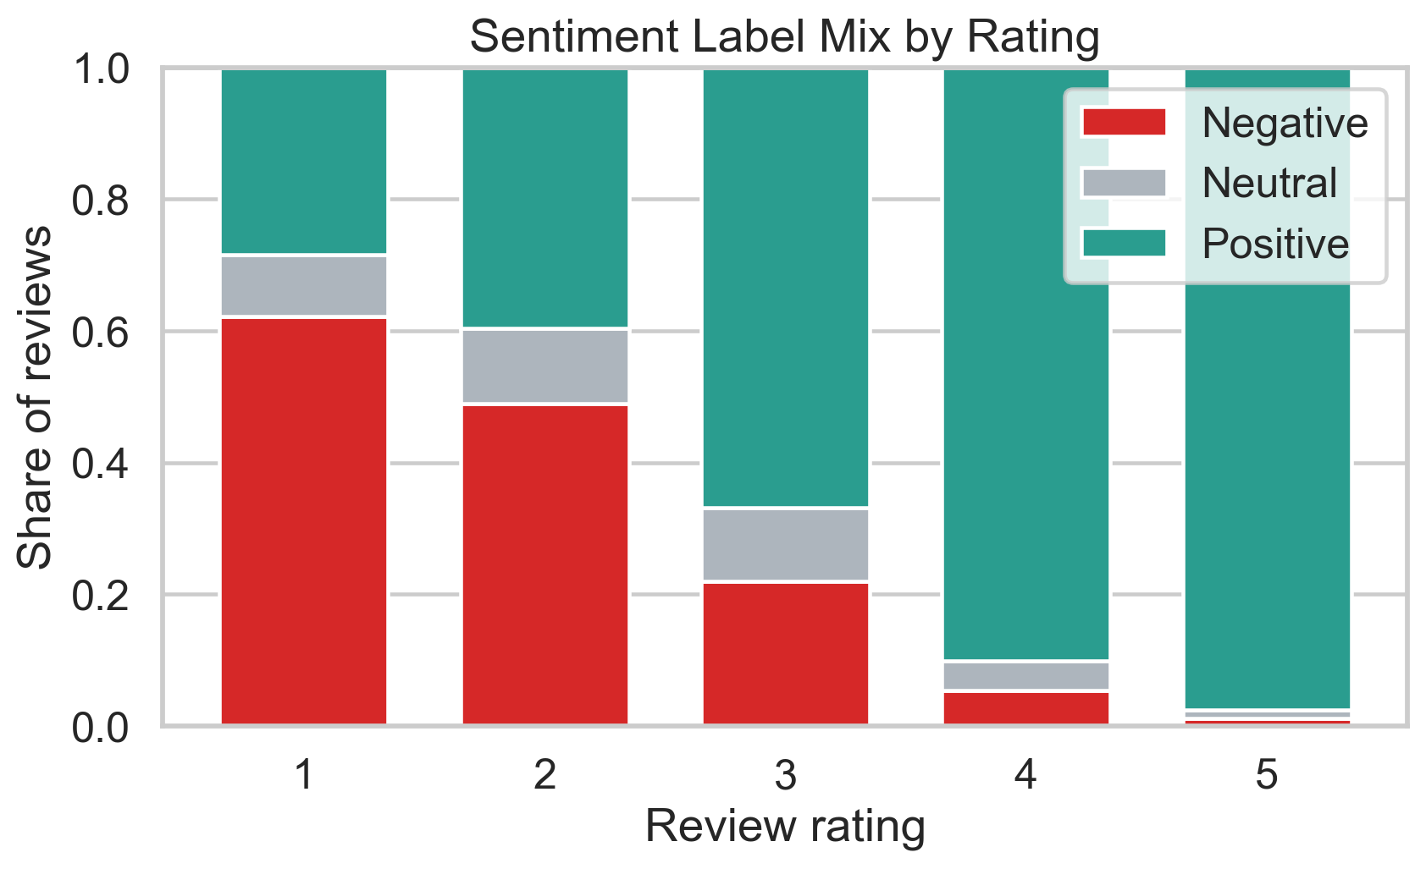
Sentiment Analysis Results
FIve-star target rating
• Sentiment score increases consistently as rating increases
• Low-rated reviews contain much more negative sentiment
• Positive sentiment dominates 4-star and 5-star reviews

Slide 9
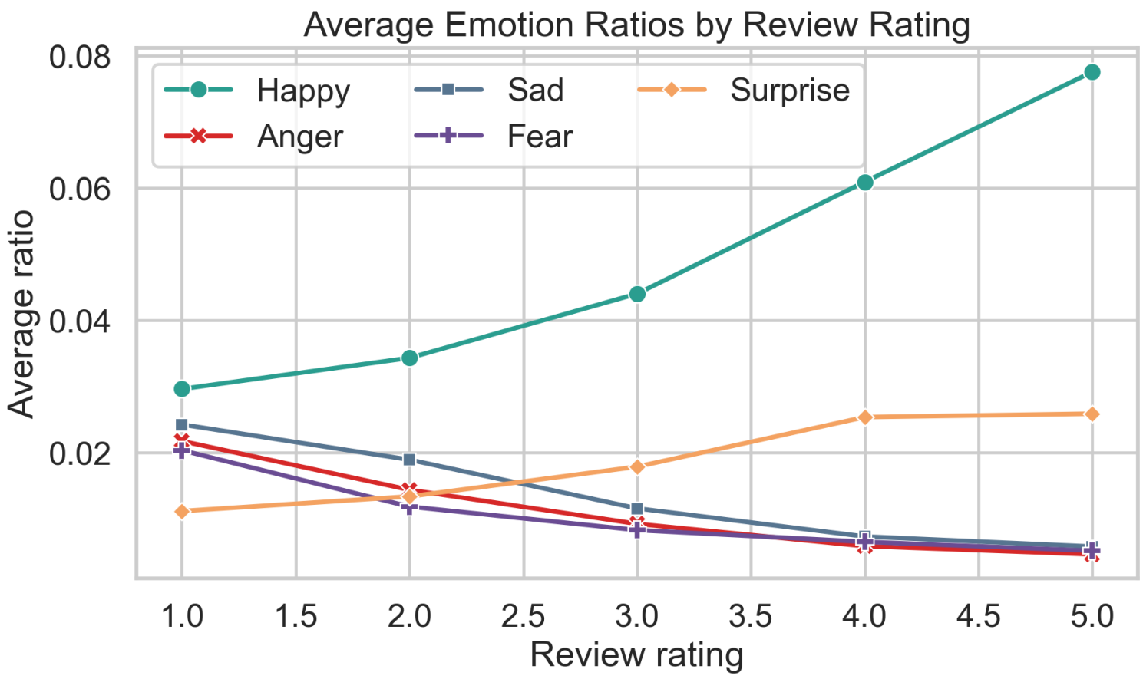
Emotion Analysis Results
• "Happy" emotion increases as rating increases
• "Anger", "Sad", and "Fear" decrease as rating increases
• Emotion features provide interpretable signals beyond polarity

Slide 10

Feature Engineering and Modeling Setup
1
2
3
Metadata Features
Text Features
Sentiment & Emotion Features
Reviewer activity, time information, price range, reservation status, and restaurant location were used as structured metadata features. These variables provide useful non-text context for rating prediction.
Cleaned review text was transformed into TF-IDF features to capture important opinion words and recurring textual patterns in customer comments.
We extracted lexicon sentiment scores, sentiment-related counts, VADER scores, and NRC emotion ratios to capture both overall polarity and finer emotional signals.
The task was defined as binary classification: five-star versus non-five-star reviews. We used an 80/20 train-test split, 5-fold cross-validation, and Macro-F1 as the main evaluation metric.

Slide 11




Models Compared
Metadata-only Baselines
Sentiment/Emotion-only Models
We first trained KNN, Random Forest, and Boosting models using only metadata features. These models provide a baseline without using review text.
We then trained the same model family using only sentiment and emotion features. This helps test whether opinion-based signals can outperform structured metadata alone.
TF-IDF-only Model
Combined Model
A TF-IDF-based KNN model was used to measure the predictive value of cleaned review text itself and compare it with curated sentiment and emotion features.
Finally, we built combined Random Forest and Boosting models using metadata, TF-IDF, sentiment, and emotion features together to test the full feature integration strategy.

Slide 12
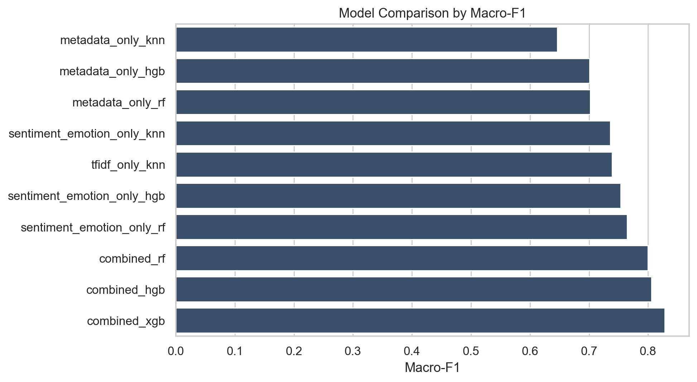

Model Performance Comparison
Sentiment/Emotion vs Metadata
Overall Comparison
Sentiment and emotion models outperformed metadata-only baselines, suggesting that customer opinion signals are more directly linked to rating outcomes.
Among all tested settings, the combined-feature models achieved the strongest overall performance, showing the value of integrating multiple feature groups.
3
4
Role of Text Features
2
TF-IDF text features also showed strong predictive ability, confirming that review text contains rich information about customer satisfaction.
Key Takeaway
The results support our main hypothesis: sentiment- and emotion-related features improve prediction, especially when combined with broader text and metadata features.
1

Slide 13
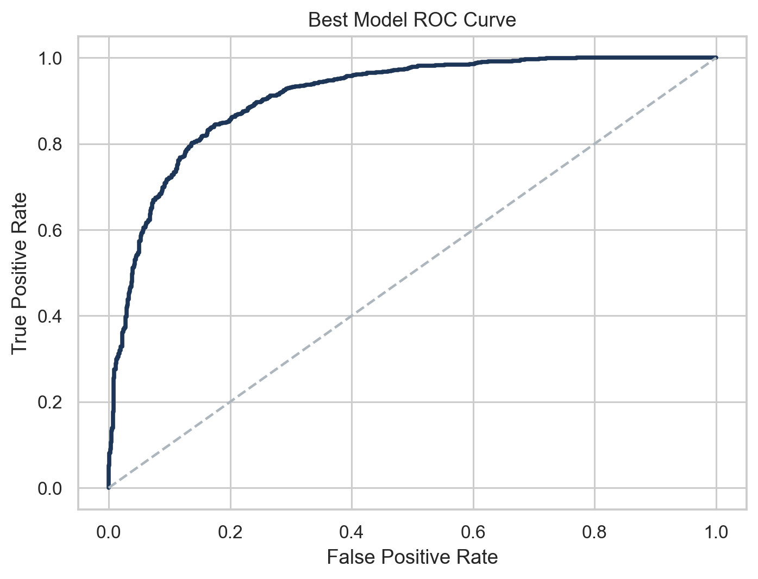
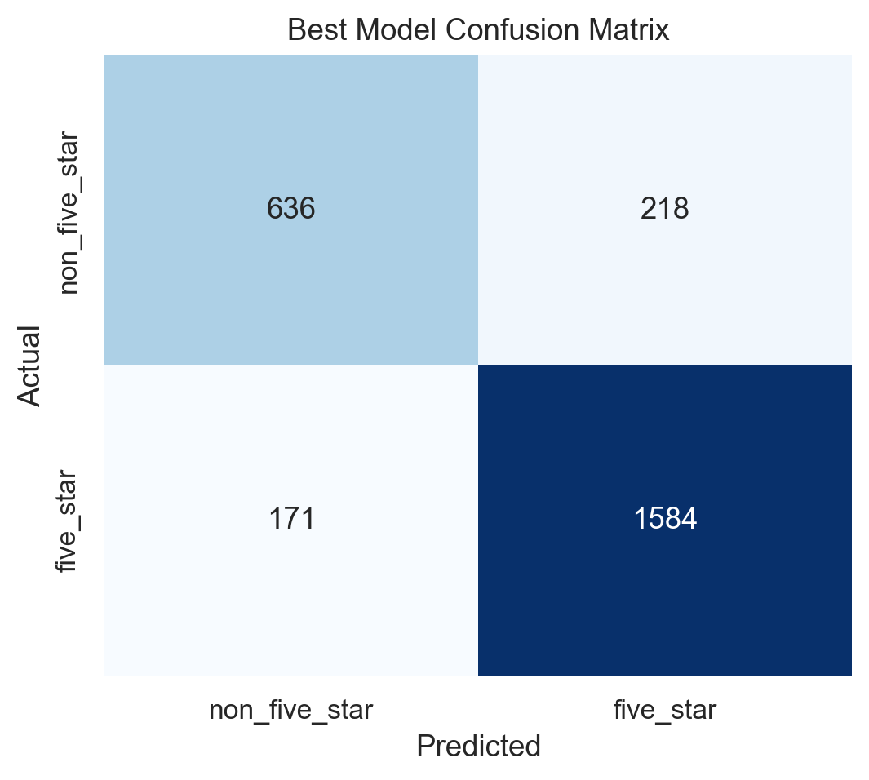
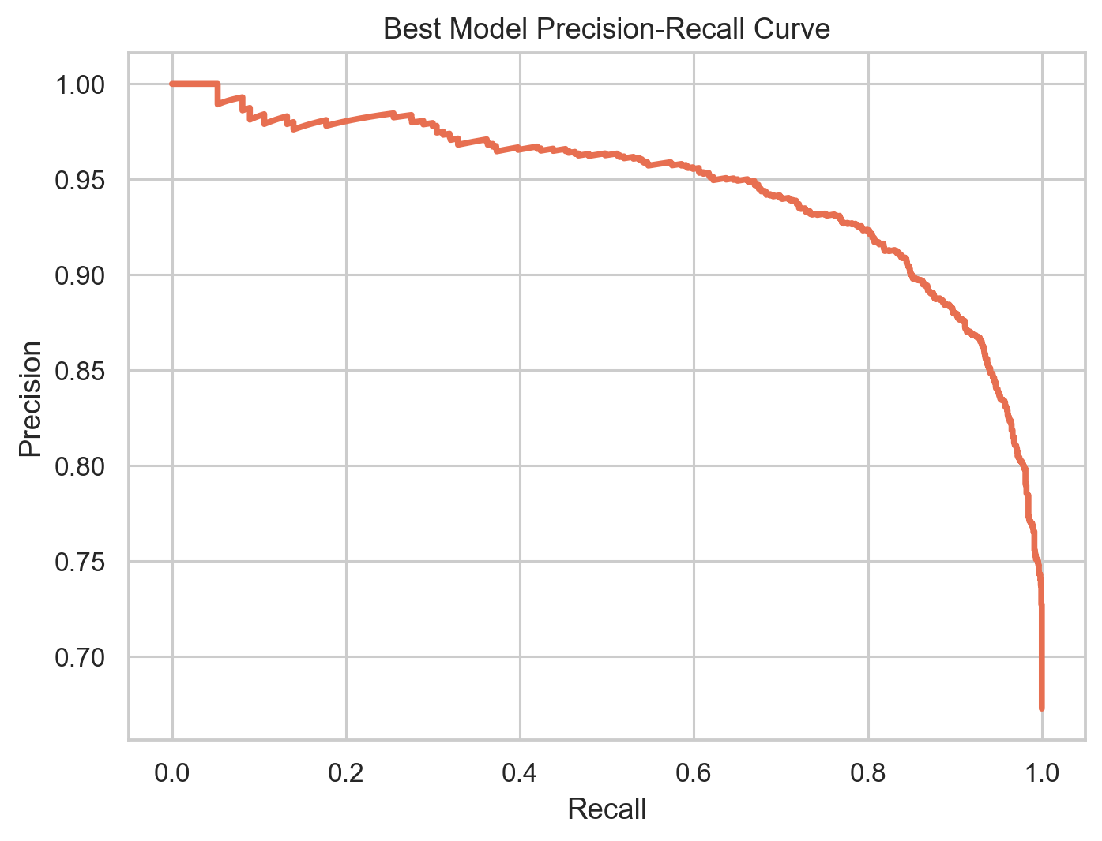
Best Model Evaluation
Best-performing Model
The best-performing model in our study was the Combined XGBoost model, which integrates metadata, TF-IDF, sentiment, and emotion features.
Main Evaluation Results
Its test Accuracy reached 0.8509, while Macro-F1 reached 0.8282, indicating strong and balanced classification performance.
Probability-based Metrics
The model also achieved ROC-AUC = 0.9093 and Average Precision = 0.9463, indicating strong ranking ability and reliable positive-class identification.
Interpretation
These results show that the combined model performed best across multiple evaluation metrics and is suitable for practical review prediction tasks.

Slide 14
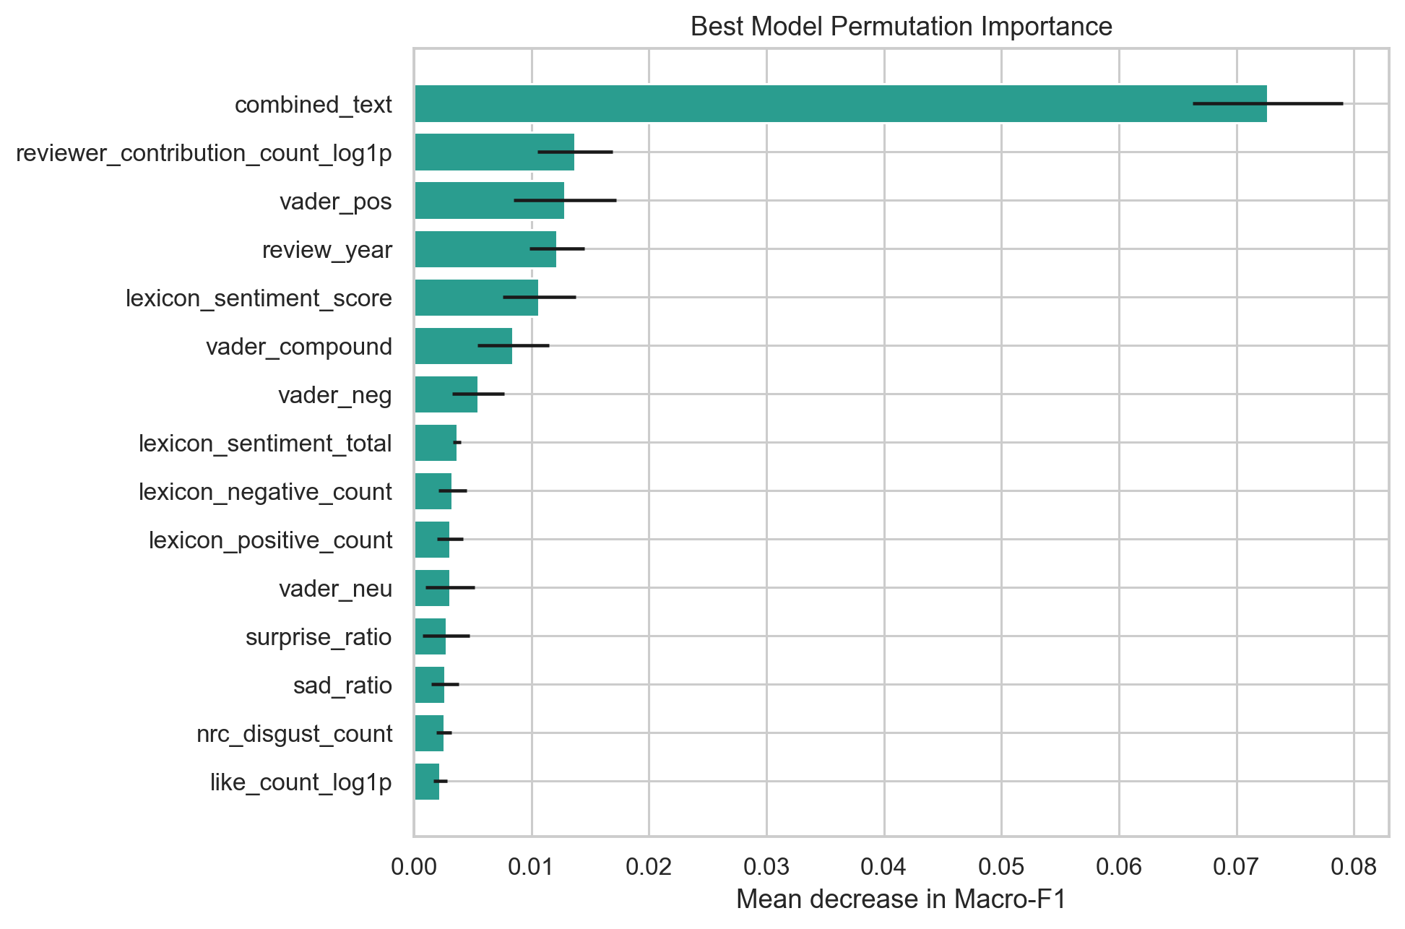
Interpreting the Best Model
01
The review text block is the strongest overall signal
02
Reviewer contribution count is also influential
03
Lexicon sentiment and VADER features contribute measurable value
04
Emotion features help enrich the representation
Notes:
To interpret the best model, we use permutation importance. The results show that the text block is the strongest predictive component, which is expected because customer experience is directly described in the review text. In addition, reviewer activity, lexicon sentiment, and VADER-based sentiment information also matter. This supports the claim that sentiment and emotion features are not only interpretable but also useful in practice.

Slide 15




Business Implications
Restaurants can monitor dissatisfaction patterns more efficiently
Sentiment and emotion offer richer signals than ratings alone
Review analytics can support service improvement and reputation management
Combined text and metadata analytics are more useful than isolated indicators
Notes:
From a business perspective, our findings suggest that restaurants should not rely only on average ratings. Sentiment and emotion signals provide richer explanations of customer experience. A practical system based on this approach could help managers monitor emerging dissatisfaction patterns, detect service issues more quickly, and better understand what drives highly positive reviews.

Slide 16
Limitations
The crawled reviews are a truncated sample
01
Raw text contains multilingual and noisy content
03
The data is imbalanced toward five-star reviews
02
Lexicon methods may miss deeper semantic nuances
04
Notes:
Our project also has limitations. The crawled reviews represent a partial sample rather than the full review history. The dataset is highly imbalanced toward five-star reviews. Some raw reviews contain multilingual or noisy content, although we cleaned the data carefully. Finally, lexicon-based methods are interpretable, but they may not capture sarcasm or more complex semantic patterns.

Slide 17
Future Work
Add deep learning models such as MLP or BERT-based classifiers
1
Increase the crawled review coverage
2
Extend to restaurant-level forecasting tasks
3
Explore aspect-based and multilingual analytics
4
Notes:
There are several natural directions for future work. We can add deep learning models such as MLP or BERT-based classifiers, increase the crawled review coverage, extend the study to restaurant-level forecasting tasks, and explore aspect-based or multilingual text analytics.

Slide 18
Thanks for Listening! Q&A

