Slide 1
INTEGER PROGRAMMING
Tuition Centre
Student-Tutor
Assignment
Optimisation
HTX xData Technical Assessment | Tan Lu Yan | 4th March 2026

Slide 2
Problem Overview
What are we solving?
Background
Assignment Requirements
A tutoring organisation admits a new batch of students every month. Each new student must be assigned to a tutor and attends a chosen tuition centre.
Tutors can teach at any centre and have indicated their top 2 preferred centres. The organisation must assign tutors to students while meeting specific operational requirements.
R1
Each student assigned to exactly one tutor
R2
Extensive students → extensive tutors only
R3
Total students assigned ≤ tutor's max overall capacity
R4
Maximise tutor centre preference where possible

Slide 3
Decision Variables
Binary variables that define the assignment
X[s,t]
Assignment Variable
Y[t]
Tutor Usage Variable
Binary variable: 1 if student s is assigned to tutor t, 0 otherwise.
One variable is created for each eligible (student, tutor) pair.
Eligible pairs: Normal students → any tutor. Extensive students → extensive tutors only.
Binary variable: 1 if tutor t receives at least one new student, 0 otherwise.
Used in Scenario (a) to count and minimise the total number of tutors used.
Linked to X[s,t] via constraints C3 — Y[t] = 1 if and only if any X[s,t] = 1.

Slide 4
Model Constraints
Constraints shared across both scenarios
C1
Assignment
Every new student must be assigned to exactly one tutor. This ensures no student is left unassigned and no student is double-assigned.
Σ X[s,t] = 1 ∀s
C2
Capacity
The sum of existing active students and newly assigned students cannot exceed the tutor's maximum overall capacity.
existing[t] + Σ X[s,t] ≤ cap[t] ∀t
C3
Linking
Links X[s,t] to Y[t]. Y[t] = 1 if and only if tutor t receives at least one new student. M is a big-M constant (= number of new students).
Σ X[s,t] ≤ M·Y[t] and Σ X[s,t] ≥ Y[t]

Slide 5
Assumptions
Modelling decisions
Active Students Only
No Scheduling Conflicts
Only active existing students count towards a tutor's load. Inactive historical records are excluded from capacity calculations.
Tutors are assumed to have no lesson clashes or can teach multiple students simultaneously at a given time.
Preference Scoring (2/1/0)
Existing students cannot be reassigned to a new tutor
Pref1 = 2, Pref2 = 1, No match = 0. Weighted 2/1 to better reflect preference strength and avoid freely substituting first-choice with second-choice.
Tutors follow their own personalized curriculum tailored to their current students, so reassigning an existing student would disrupt their learning continuity and force them to adapt to a new teaching style and pace.
Lexicographic Optimisation
Primary objective is solved first and fixed before optimising secondary. This ensures primary goals are never sacrificed for secondary gains.

Slide 6
Scenario (a) — Minimise Tutors, then Maximise Preference
Two-stage lexicographic approach
STAGE 1
Minimise Tutors Used
STAGE 2
Maximise Preference
min Σ Y[t]
max Σ score[s,t] · X[s,t]
s.t. Σ Y[t] = K*
Finds the minimum number of tutors K* needed to accommodate all 20 new students within capacity constraints.
Why should this be prioritized first?
Reducing active tutors lowers operational costs and administrative overhead for the tuition centre.
With K* fixed, maximises the total preference score.
Scoring: Pref1 match = 2, Pref2 match = 1, No match = 0.

Slide 7
Scenario (b) — Balance Workload, then Maximise Preference
Two-stage lexicographic approach with pre-processing
Pre-processing — Iterative Mean Computation
Compute mean load → identify saturated tutors (existing load ≥ mean) → exclude & recompute → repeat until stable.
Result: A005, A007 marked saturated (receive no new students). Available tutors: A001–A004, A006, A008–A010. Converged mean = 2.88.
STAGE 1
Minimise Max Total Load
STAGE 2
Maximise Preference
min L_max
s.t. existing[t] + Σ x[s,t] ≤ L_max
max Σ score[s,t] · x[s,t]
s.t. L_max = L_max*
Pushes all active tutors toward the mean μ. Balanced workload is prioritized as it prevents tutor burnout and improves retention.
Fixes the optimal max load L_max*, then maximises preference score — same 2/1 weighted scoring scheme as Scenario (a).

Slide 8
Results Summary
Key metrics from both scenarios
Scenario (a)
Scenario (b)
7
Tutors Used
2.88
Target Mean Load
(minimum possible)
(converged)
39
Preference Score
3
Max Total Load
(out of max 40)
(optimal, ≈ mean)
19 / 20
Pref 1 Matches
35
Preference Score
students at first-choice centre
16 Pref 1, 3 Pref 2, 1 no match

Slide 9
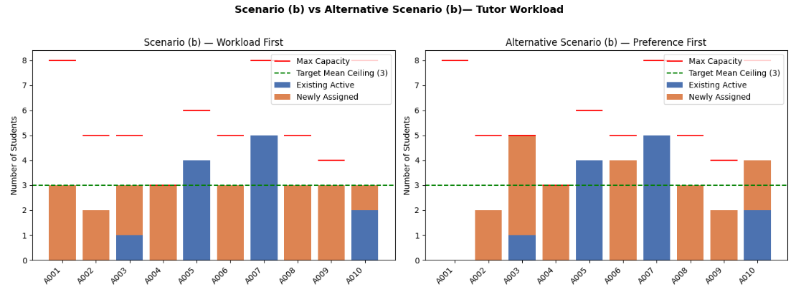
Post Analysis — Alternative Scenario (b)
What if preference was prioritised first?
Motivation
The problem statement does not explicitly state which objective takes priority in Scenario (b). The original formulation (prioritizing workload) results in 1 no-match assignment — raising the question: should preference be prioritized first instead?

Slide 10
Post Analysis — Alternative Scenario (b)
What if preference was prioritised first?
 | Original Scenario (b) Workload First | Alternative Scenario (b) Preference First
Priority | Balance workload → then preference | Maximise preference → then balance workload
Preference Score | 35 | 40
No-match Assignments | 1 | 0
Max Load for tutor | 5 | 5
Min Load for tutor | 2 | 0 (assigned nothing)
Verdict | ✓ Recommended | ✗ Not recommended
Conclusion
The alternative method does not give a desirable outcome. Despite the preference score being maximized, the workload among tutors is now heavily imbalanced, so the alternative is not recommended.

Slide 11
Thank You
HTX xData Technical Assessment | Tan Lu Yan | 4th March 2026

