Slide 1

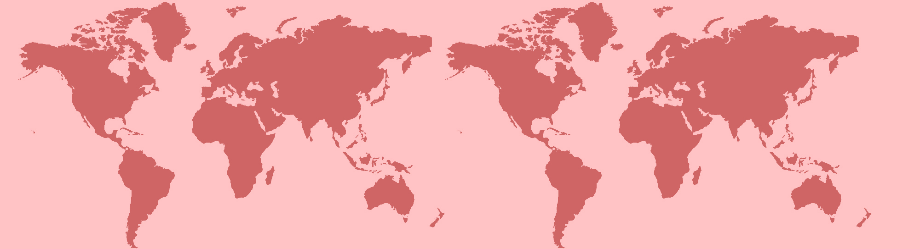
Search Engine for cc98
引
擎
8
搜
索
C
9
C

Slide 2
1
2
demo
3
prospect
4
Overview
Key points
Part One
Part Two
Part Three
Part Four

Slide 3
O
verviw

Slide 4
retrieved by title/author
there's date/space/type boundaries
'and' or 'or' to split and process queries
but...
search in range in only title or author of posts
not reaching to the content and repliers
key words mathcing search
too rigid
Current
status

Slide 5
retrieved by title/author
there's date/space/type boundaries
'and' or 'or' to split and process queries
but...
search in range in only title or author of posts
not reaching to the content and repliers
key words mathcing search
too rigid
Current
status

Slide 6
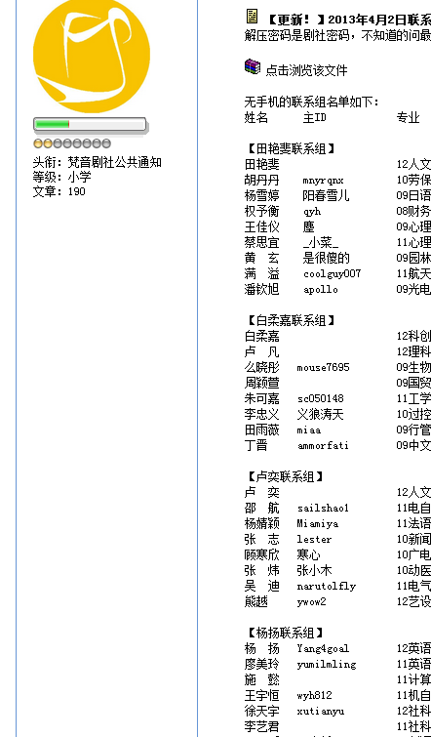
retrieved by title/author
there's date/space/type boundaries
'and' or 'or' to split and process queries
but...
search in range in only title or author of posts
not reaching to the content and repliers
key words mathcing search
too rigid
Current
status

Slide 7
Key
points

Slide 8
characters vs words
words vs phrases
和尚
no blanks in setences to split words
林建华出任浙大校长
(Latent) semantic
下雨天留客天留我不留
Chinese
tokens

Slide 9
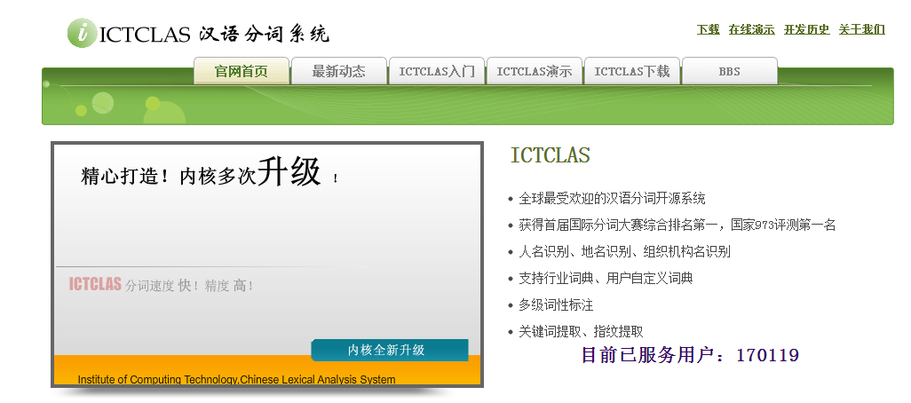
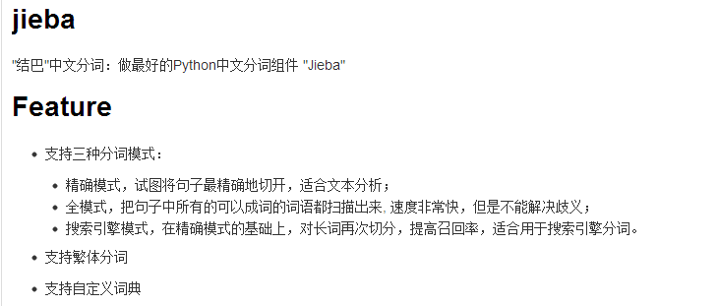
×
http://www.oschina.net/p/jieba
√
http://www.ictclas.org/

Slide 10
word segmentation
"我来到北京清华大学"
[Full Mode]: 我/ 来到/ 北京/ 清华/ 清华大学/ 华大/ 大学
[Acurate Mode]: 我/ 来到/ 北京/ 清华大学
loading user-defined dictionary
"云计算" freq
虽但厉
碉堡了
ym...
Chinese
tokens

Slide 11
two tiers:
by title; by content
1st tier:
boolean queries
2nd tier:
vector space model
rank
tf-idf
cos(q,d)
Retrieval
models

Slide 12
Queries
preprocess
combintion scheme
浙大zjg
permuing term
B tree
浙*紫金*

Slide 13
crawl
4 layers/[b] [upload] [map]...
jieba tokenize->title/content/url
4000+documents/13,000+tokens
preprocess
inverted lists
title lists
Btree
vectors
retrieve
sparse matrix
Program
structure

Slide 14
D
emo

Slide 15
P
rospect

Slide 16

ranking weight
by posting date/updating date
by essential/reserved/normal posts
query preprocessing
and or not
proximitity
...
better UI
in considering of users' habbit

Slide 17
you
listening
Thank
for
by Shy group
鲁懿帆
单才华
施懿

