Slide 1
Data Structures
Chapter 1: Basic Concepts
1-<number>

Slide 2
Bit and Data Type
bit: basic unit of information.
data type: interpretation of a bit pattern.
e.g. 0100 0001 integer 65
ASCII code ’A’
BCD 41
(binary coded decimal)
1100 0001 unsigned integer 193
1’s complement **
2’s complement **
1-<number>

Slide 3
1’s and 2’s Complements
range of 1’s complement in 8 bits
-(2⁷-1)~2⁷-1
-127~127
range of 2’s complement in 8 bits
01111111 = 127
10000001 = **
10000000 = -128
-2⁷~2⁷-1
-128~127
1-<number>

Slide 4
Data Type in Programming
data type:
  a collection of values (objects) and a set of operations on those values.
e.g. int x, y; // x, y, a, b are identifiers
float a, b;
x = x+y; // integer addition
a = a+b; // floating-point addition
Are the two additions same ?
1-<number>

Slide 5
Abstract Data Type
Native data type
  int (not realistic integer), float (real number), char
  hardware implementation
Abstract data type (ADT)
  Specifications of objects and operations are separated from the object representation and the operation implementation
  defined by existing data types
  internal object representation and operation implementation are hidden.
  by software implementation
  examples: stack, queue, set, list, ...
1-<number>

Slide 6
ADT of NaturalNumber
ADT NaturalNumber is
objects: An ordered subrange of the integers starting at zero and ending at the maximum integer (MAXINT) on the computer
functions: for all x, y ∈NaturalNumber, TRUE, FALSE ∈ Boolean and where +, −, <, ==, and = are the usual integer operations
  Nat_Num Zero() ::= 0
  Boolean IsZero(x) ::=if (x == 0) return true
  else return false
  Equal(x,y) :: == if (x == y) return true
  else return false
  Successor :: == …
  Add(x, y) :: == if (x+y <= MAXINT) Add = x + y
  else Add = MAXINT
  Subtract(x,y) :: == …
end NaturalNumber
1-<number>

Slide 7
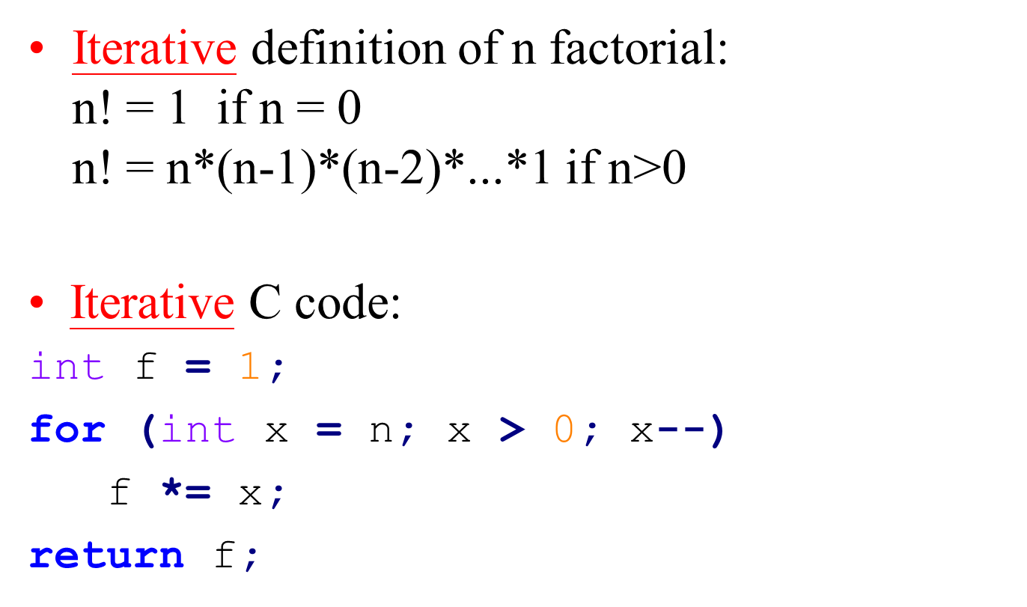
Iterative Algorithm for n Factorial
1-<number>

Slide 8
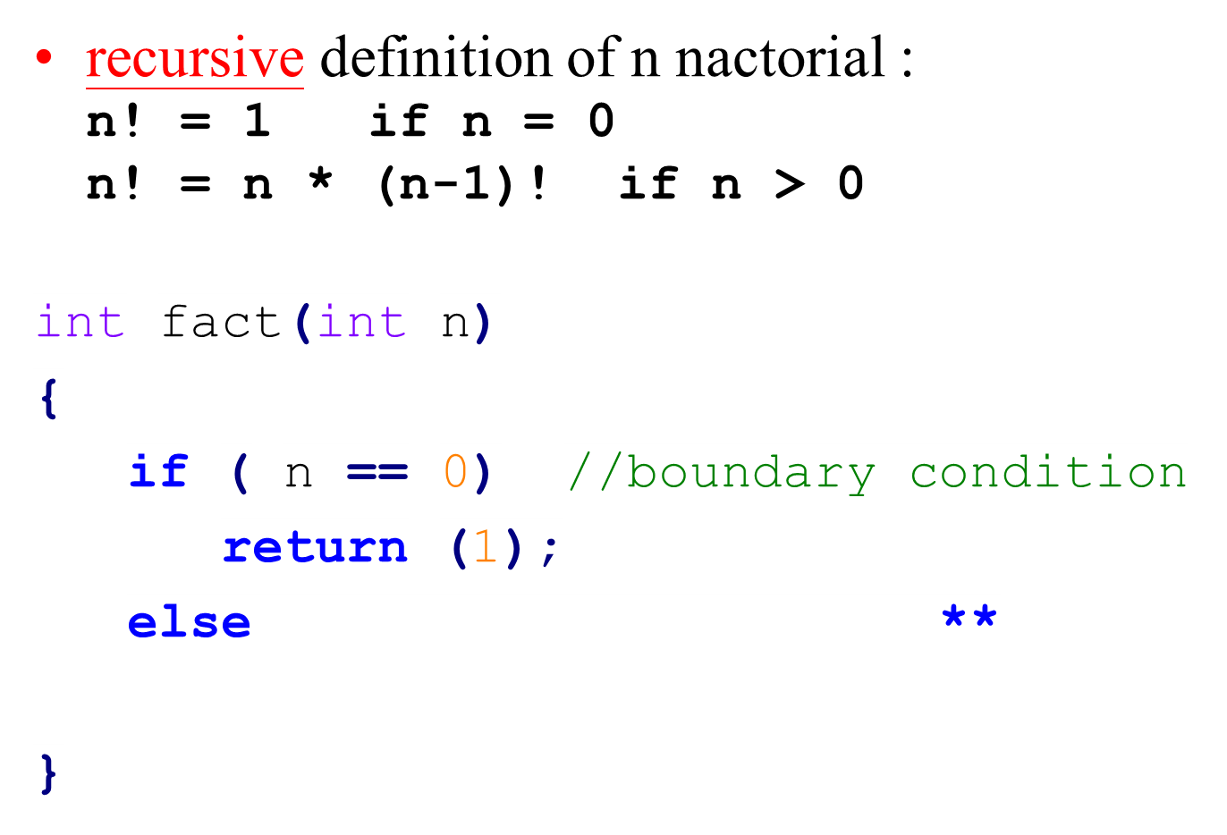
Recursion for n Factorial
1-<number>

Slide 9
An Example for Binary Search
sorted sequence : (search 9)
1 4 5 7 9 10 12 15
step 1 ↑
step 2 ↑
step 3 ↑
used only if the table is sorted and stored in an array.
Time complexity: O(logn)
1-<number>

Slide 10
Algorithm for Binary Search
Algorithm (pseudo code):
while (there are more elements) {
middle = (left + right) / 2;
if (searchnum < list[middle])
right = middle – 1;
else if (searchnum > list[middle])
left = middle + 1;
else return middle;
}
Not found;
1-<number>

Slide 11
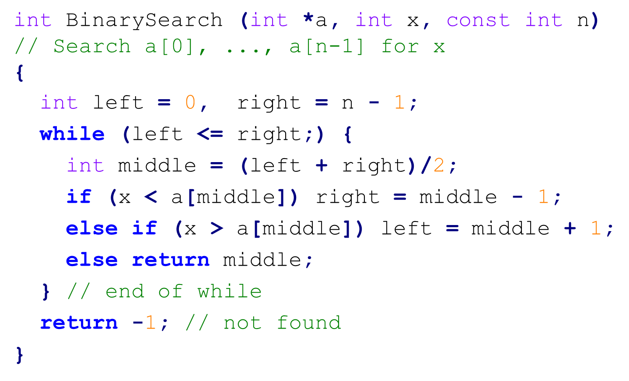
Iterative C Code for Binary Search
1-<number>

Slide 12
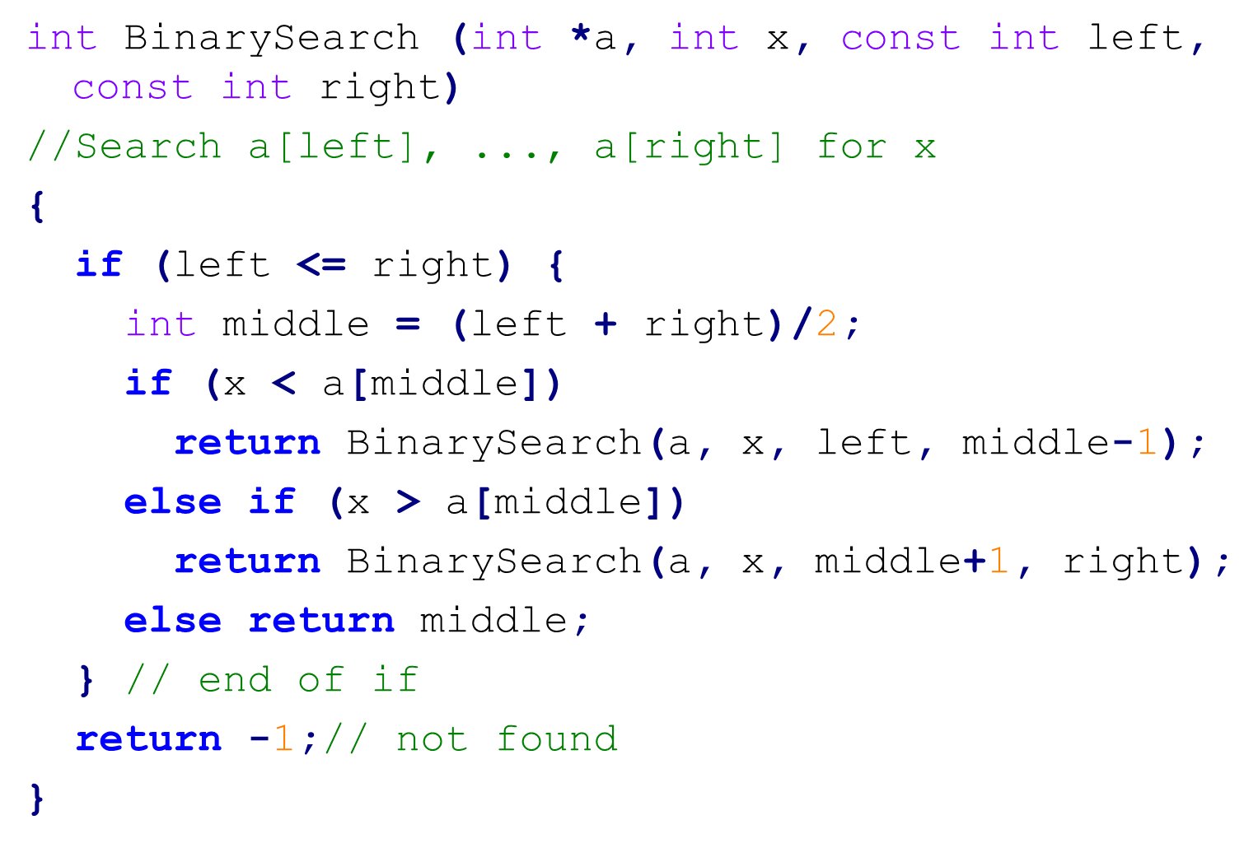
Recursion for Binary Search
1-<number>

Slide 13
Recursive Permutation Generator
Example: Print out all possible permutations of {a, b, c, d}
  We can construct the set of permutations:
    a followed by all permutations of (b, c, d)
    b followed by all permutations of (a, c, d)
    c followed by all permutations of (b, a, d)
    d followed by all permutations of (b, c, a)
  Summary
    w followed by all permutations of (x, y, z)
1-<number>

Slide 14
#include <iostream>
void Permutations (char *a, const int k, const int m)
//Generate all the permutations of a[k], ..., a[m]
{
if (k == m) { //Output permutation
for (int i = 0; i <= m; i++) cout << a[i] << " ";
cout << endl;
}
else { //a[k], ..., a[m] has more than one permutation
for (int i = k; i <= m; i++)
{
swap(a[k], a[i]); // exchange
Permutations(a, k+1, m);
swap(a[k], a[i]);
}
} // end of else
} // end of Permutations
1-<number>

Slide 15
Permutation – main() of perm.cpp
int main()
{
char b[10];
b[0] = 'a'; b[1] = 'b'; b[2] = 'c'; b[3] = 'd';
b[4] = 'e'; b[5] = 'f'; b[6] = 'g';
Permutations(b,0,2);
cout << endl
}
Output: **
1-<number>

Slide 16
The Criteria to Judge a Program
Does it do what we want it to do?
Does it work correctly according to the original specification of the task?
Is there documentation that describes how to use it and how it works?
Do we effectively use functions to create logical units?
Is the code readable?
Do we effectively use primary and secondary storage?
Is running time acceptable?
1-<number>

Slide 17
Fibonacci Sequence (1)
0,1,1,2,3,5,8,13,21,34,...
Leonardo Fibonacci (1170 -1250)
用來計算兔子的數量
每對每個月可以生產一對
兔子出生後, 隔一個月才會生產, 且永不死亡
生產 0 1 1 2 3 ...
總數 1 1 2 3 5 8 ...
http://www.mcs.surrey.ac.uk/Personal/R.Knott/Fibonacci/fibnat.html
1-<number>

Slide 18


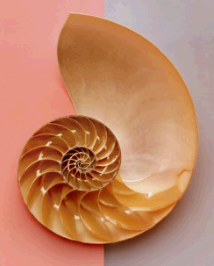
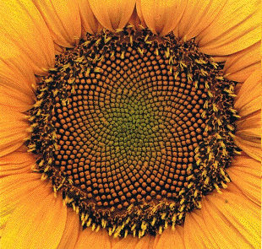
Fibonacci Sequence (2)
0,1,1,2,3,5,8,13,21,34,...
1-<number>

Slide 19
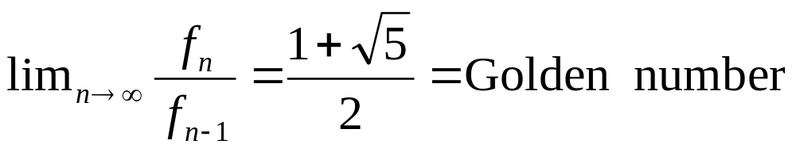
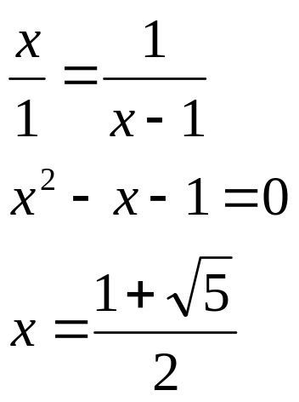
Fibonacci Sequence and Golden Number
0,1,1,2,3,5,8,13,21,34,...
f_{n} = 0 if n = 0
f_{n} = 1 if n = 1
f_{n} = f_{n-1} + f_{n-2} if n ≥ 2
1
x-1
x
1-<number>

Slide 20
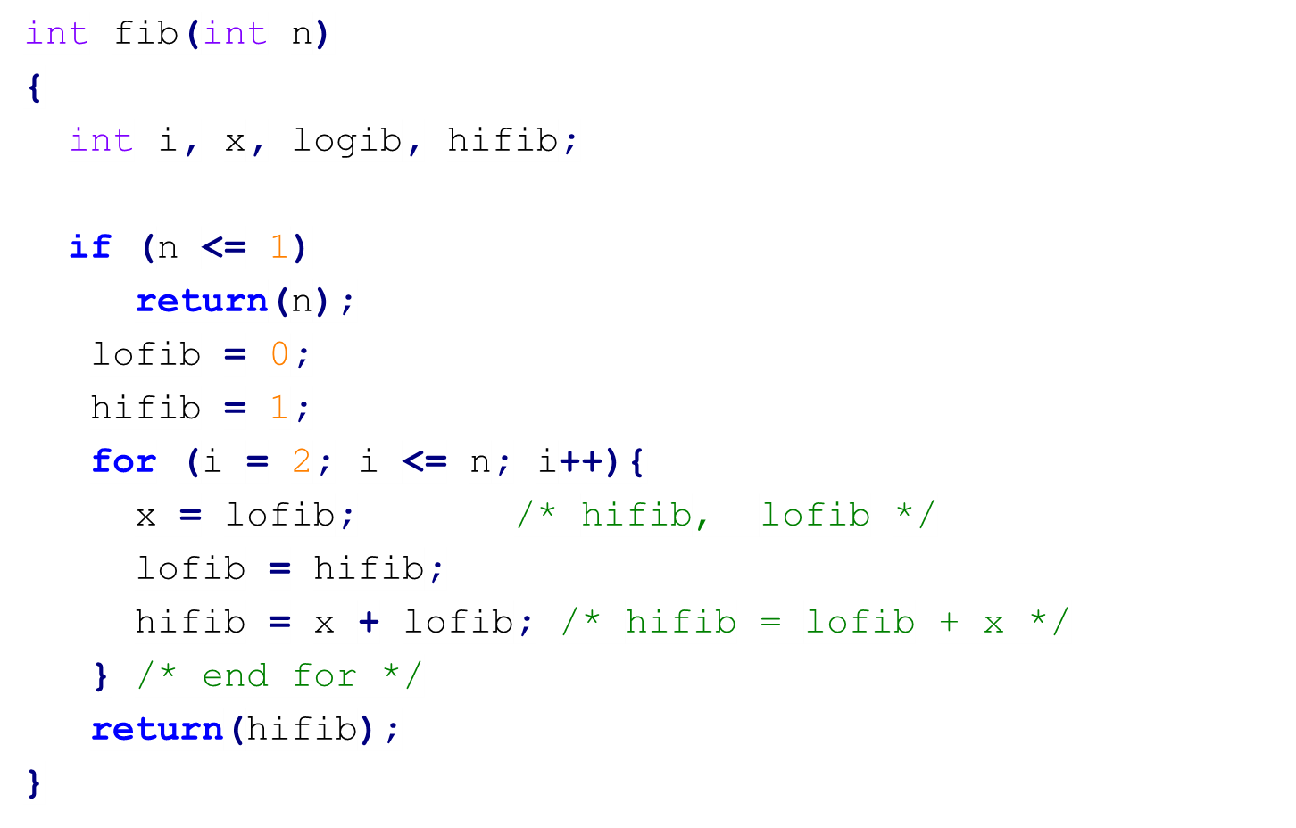
Iterative Code for Fibonacci Sequence
f_{n} = 0 if n = 0
f_{n} = 1 if n = 1
f_{n} = f_{n-1} + f_{n-2} if n ≥ 2
1-<number>

Slide 21
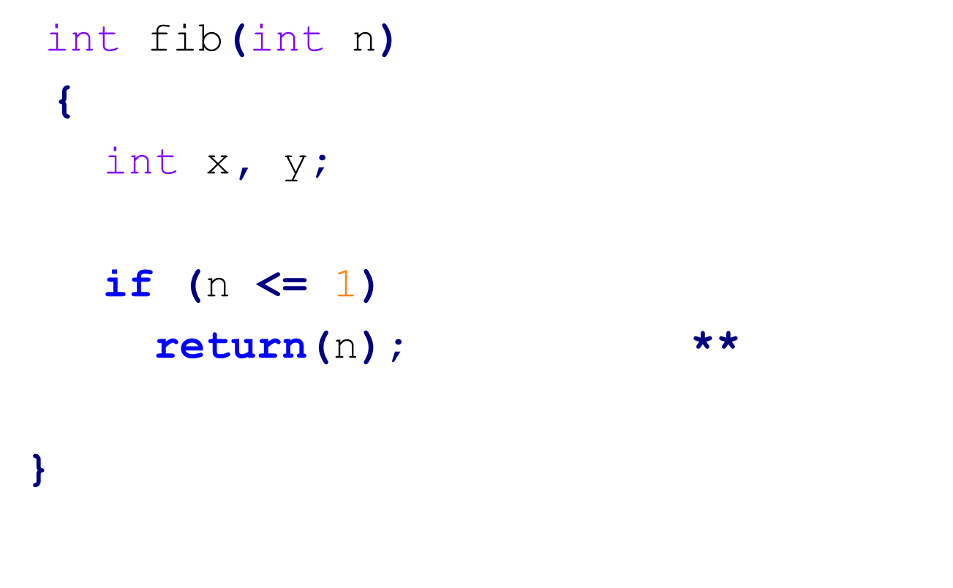
Recursion for Fibonacci Sequence
f_{n} = 0 if n = 0
f_{n} = 1 if n = 1
f_{n} = f_{n-1} + f_{n-2} if n ≥ 2
1-<number>

Slide 22
Computation Tree of Fibonacci Sequence
f5
Much computation is duplicated.
The iterative algorithm for generating Fibonacci sequence is better.
f4
f3
f3
f2
f2
f1
f2
f1
f1
f0
f1
f0
f1
f0
1-<number>

Slide 23

The Towers of Hanoi Problem
A B C
1
2
3
4
5
The initial setup of the Towers of Hanoi.
Disks are of different diameters
A larger disk must be put below a smaller disk
Object: to move the disks, one each time,
from peg A to peg C, using peg B
as auxiliary.
1-<number>

Slide 24
Strategy for Moving Disks
how to move 3 disks?
how to move n disks?
**
**
1-<number>

Slide 25
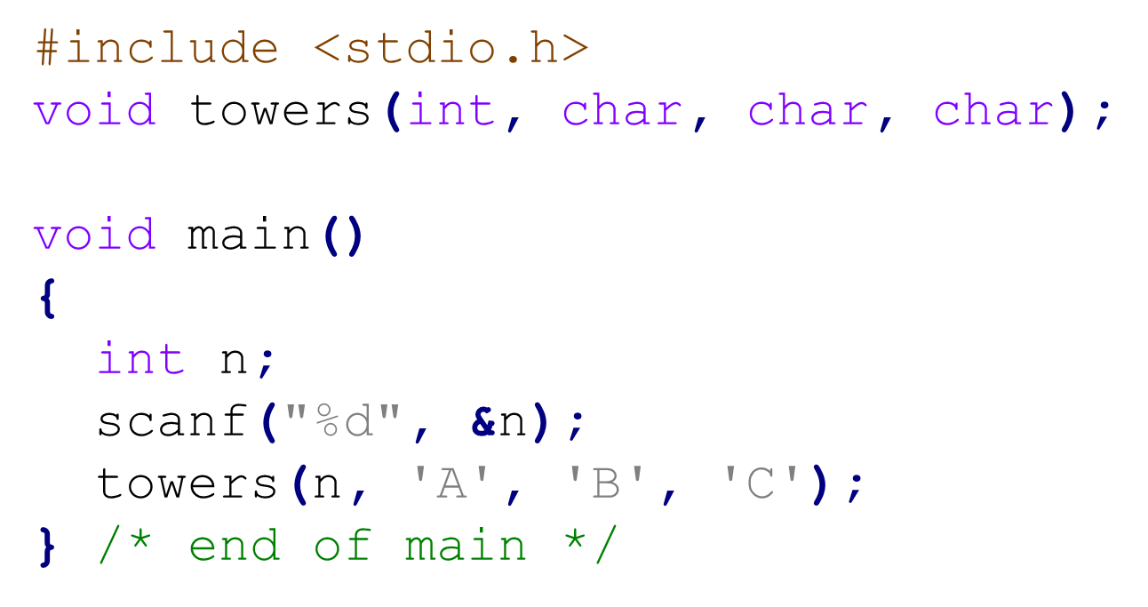
Recursive Program for the Tower of Hanoi Problem
1-<number>

Slide 26
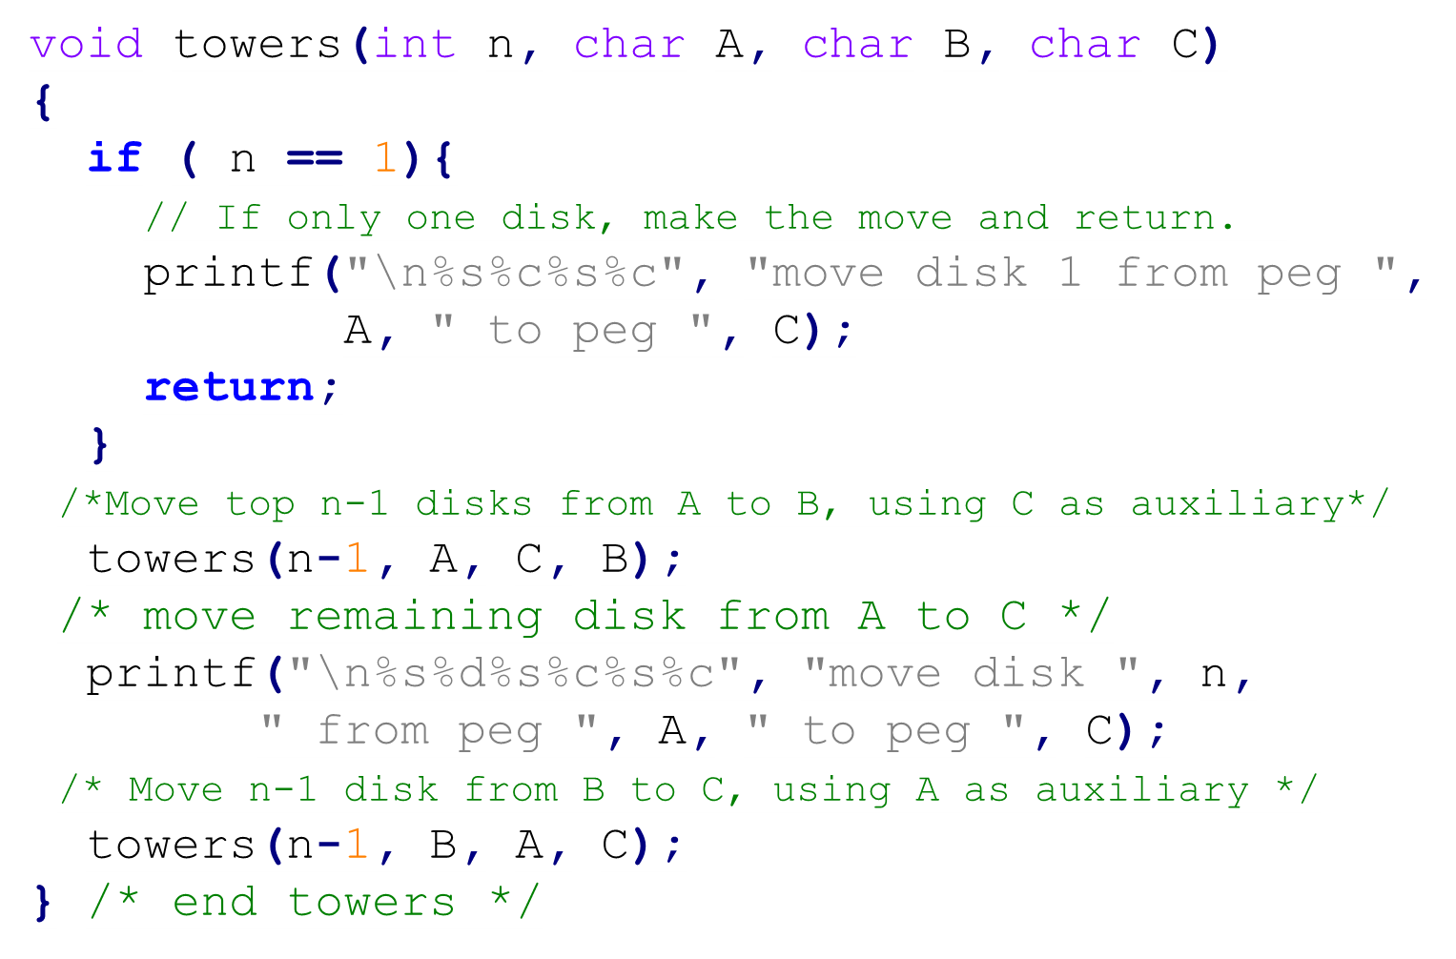
1-<number>

Slide 27
Number of Disk Movements
T(n) : # of movements with n disks
We know T(1) = 1 -- boundary condition
T(2) = 3
T(3) = 7
T(n) = T(n-1) + 1 + T(n-1)
= 2T(n-1) + 1
= 2(2T(n-2) + 1) + 1
= 4T(n-2) + 2 + 1
= 8T(n-3) + 4 + 2 + 1
= 2^{n-1} T(n-(n-1)) + 2^{n-2} + 2^{n-3} + … + 1
= 2^{n-1} T(1) + 2^{n-2} + 2^{n-3} + … + 1
= 2^{n-1} + 2^{n-2} + … + 1
= 2^{n} - 1
1-<number>

Slide 28
Asymptotic O Notation
f(n) is O(g(n)) if there exist positive integers a and b such that f(n) ≦a． g(n) for all n ≧b
e.g. 4n² + 100n = O(n²)
∵ n ≧100, 4n²+100n ≦5n²
4n² + 100n = O(n³)
∵ n ≧10, 4n²+100n ≦2n³
f(n)= c₁n^{k} + c₂n^{k-1} +…+ c_{k}n + c_{k+1}
= O(n^{k+j}), for any j ≧0
f(n)= c = O(1), c is a constant
log_{m}n = log_{m}k． log_{k}n , for some constants
m and k
log_{m}n = O(log_{k}n) = O(log n)
1-<number>

Slide 29
Values of Functions
log n | n | n log n | n² | n³ | 2^{n}
0 | 1 | 0 | 1 | 1 | 2
1 | 2 | 2 | 4 | 8 | 4
2 | 4 | 8 | 16 | 64 | 16
3 | 8 | 24 | 64 | 512 | 256
4 | 16 | 64 | 256 | 4,096 | 65,536
5 | 32 | 160 | 1,024 | 32,768 | 4,294,967,296
1-<number>

Slide 30
Time Complexity and Space Compexity
  Time Complexity: The amount of computation time required by a program
Polynomial order: O(n^{k}), for some constant k.
Exponential order: O(d^{n}), for some d >1.
NP-complete(intractable) problem:
require exponential time algorithms today.
Best sorting algorithm with comparisons: O(nlogn)
  Space complexity: The amount of memory required by a program
1-<number>

Slide 31
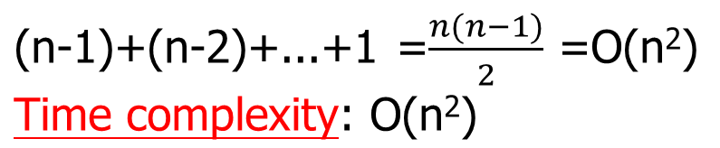
Selection Sort (1)
e.g. 由小而大 sort (nondecreasing order)
5 9 2 8 6
pass 1
2 9 5 8 6
pass 2
2 5 9 8 6
pass 3
2 5 6 8 9
pass 4
2 5 6 8 9
方法: 每次均從剩餘未 sort 部份之資料, 找出最大者(或最
小者), 然後對調至其位置
Number of comparisons (比較次數):
1-<number>

Slide 32
Selection Sort (2)
Sort a collection of n integers.
  From those integers that are currently unsorted, find the smallest and place it next in the sorted list.
The algorithm (pseudo code):
for (int i = 0; i < n ; i++)
{
/* Examine a[i] to a[n-1] and suppose
the smallest integer is at a[j]; */
//Interchange a[i] and a[j];
}
1-<number>

Slide 33
C Code for Selection Sort
void sort (int *a, int n)
{ // sort the n integers a[0]~a[n−1] into nondecreasing order
for ( int i = 0; i < n; i++)
{
int j = i; // find the smallest in a[i] to a[n−1]
for (int k = i+1; k < n; k++)
if (a[k] < a[j]) j = k;
// swap(a[i], a[j]);
int temp = a[i]; a[i] = a[j]; a[j] = temp;
}
}
1-<number>

Slide 34
Time Performance in C Code (1)
#include <time.h>
…
time_t start, stop;
…
start = time(NULL); /* # of sec since 00:00 hours, Jan 1, 1970 UTC (current unix timestamp) */
… //the program to be evaluated
stop = time(NULL);
duration = ((double) difftime(stop, start);
1-<number>

Slide 35
Time Performance in C Code (2)
#include <time.h>
…
clock_t start, stop;
…
start = clock(); /* # of clock ticks since the program begins */
… //the program to be evaluated
stop = clock();
duration = ((double) (stop - start) ) / CLOCKS_PER_SEC;
1-<number>

