Slide 1
Data Structures
Chapter 3: Stacks And Queues
3-<number>

Slide 2
Templates in C++
Template is a mechanism provided by C++ to make classes and functions more reusable.
A template can be viewed as a variable that can be instantiated (示例) to any data type, irrespective (不論) of whether this data type is a fundamental C++ type or a user-defined type.
Template function and template class
3-<number>

Slide 3
Selection Sort Template Function
template <class T>
void SelectionSort(T *a, const int n)
{ // sort a[0] to a[n-1] into nondecreasing order
for ( int i = 0; i < n; i++)
{
int j = i;
// find the smallest in a[i] to a[n-1]
for (int k = i+1; k < n; k++)
if (a[k] < a[j]) j = k;
swap(a[i], a[j]);
}
}
float farray[100];
int intarray[200];
// ...
// assume that the arrays are initialized at this point
SelectionSort(farray, 100);
SelectionSsort(intarray, 200);
3-<number>

Slide 4
Stack and Queue
Stack: Last-In-First-Out (LIFO)
Last-Come-First-Serve (LCFS)
only one end
Queue: First-In-First-Out (FIFO)
First-Come-First-Serve (FCFS)
2 ends
one for entering
the other for leaving
F
E
D
C
B
A
top
Bottom of stack
3-<number>
Stack

Slide 5
A Motion Picture of a Stack
Push(S, G)
Pop(S)
Push(S, K)
Push(S, I)
Pop(S)
F
E
D
C
B
A
G
F
E
D
C
B
A
H
G
F
E
D
C
B
A
I
H
G
F
E
D
C
B
A
J
I
H
G
F
E
D
C
B
A
I
H
G
F
E
D
C
B
A
H
G
F
E
D
C
B
A
G
F
E
D
C
B
A
F
E
D
C
B
A
E
D
C
B
A
K
E
D
C
B
A
E
D
C
B
A
D
C
B
A
C
B
A
G
C
B
A
top
(a) (b) (c) (d) (e) (f) (g) (h) (i) (j) (k) (l) (m) (n) (o)
3-<number>

Slide 6
Operations of a Stack
IsEmpty( ): check whether the stack is empty or not.
Top ( ): get the top element of the stack.
Push(i): add item i onto the top of the stack.
Pop( ): remove the top of the stack.
3-<number>

Slide 7
Parentheses Check
Check whether the parentheses are nested correctly.
7 - ( ( X * ( ( X + Y ) / ( J – 3 ) ) + Y ) / ( 4 - 5 ) )
( ( A + B )
) A + B (
**
檢查方法:
**
3-<number>

Slide 8
Checking Various Parentheses
Check whether one left parenthesis matches the corresponding right parenthesis
.
{x + (y - [a+b]) * c – [(d+e)]} / (h-j)
**
檢查方法:
**
3-<number>

Slide 9
Abstract Data Type Stack
template <class T>
class Stack
{ // A finite ordered list with zero or more elements.
public:
Stack (int stackCapacity = 10);
// Create an empty stack whose initial capacity is stackCapacity
bool IsEmpty( ) const;
// If number of elements in the stack is 0, return true(1) else return false(0)
T& Top( ) const;
// Return top element of stack.
void Push(const T& item); // (推入)
// Insert item into the top of the stack.
void Pop( ); // (彈出)
// Delete the top element of the stack.
};
3-<number>

Slide 10
Implementation of Stack by Array
a_{n-1}
a₂
a₁
a₀
a₀
a₁
a₂
a_{n-1}
Array index
0
1
2
3
n-1
3-<number>

Slide 11
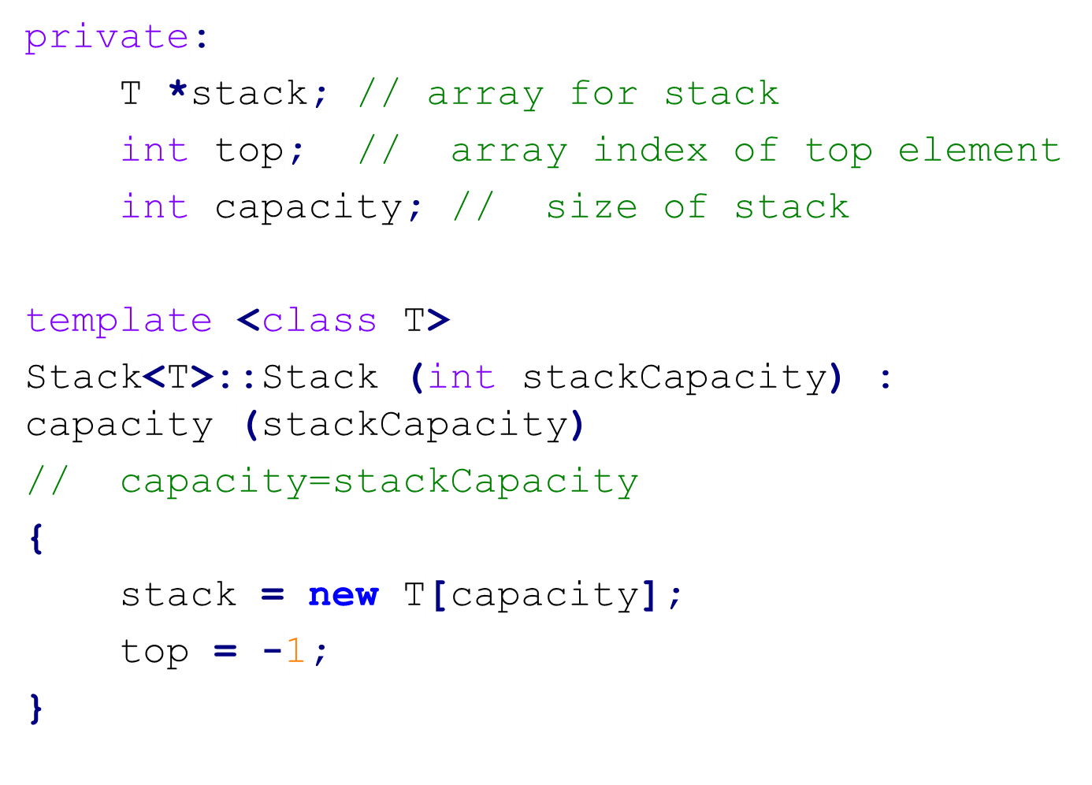
Array Implementation of Stack
3-<number>

Slide 12
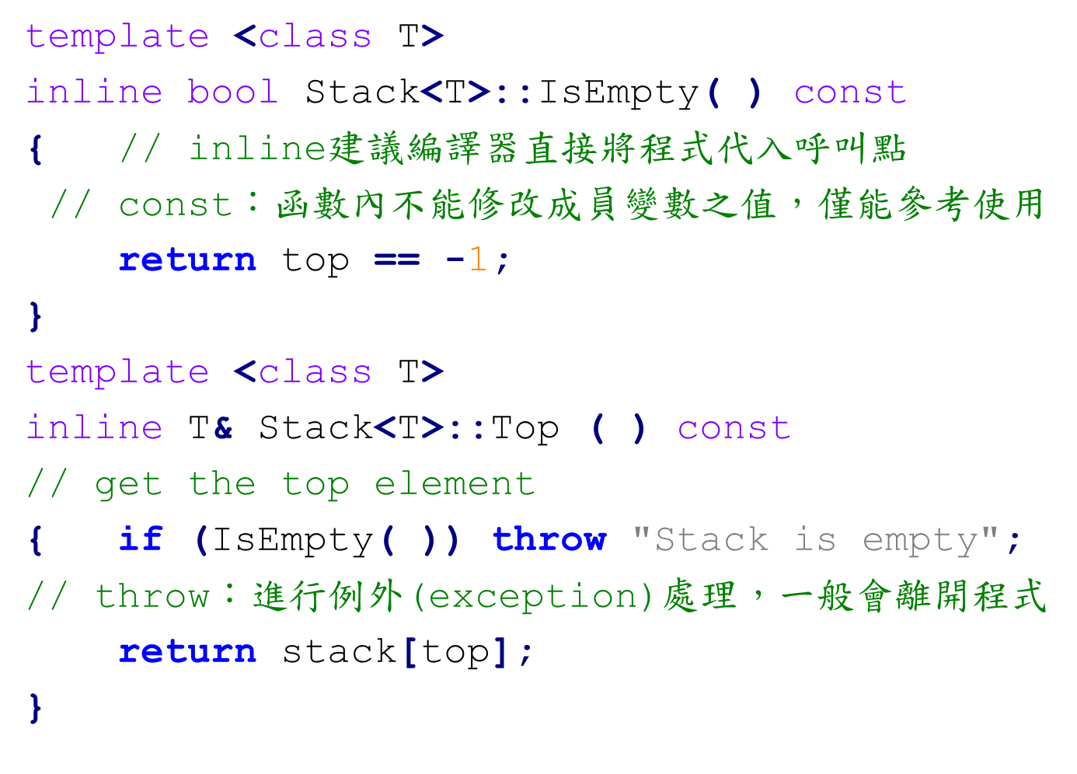
Array Implementation of Stack
3-<number>

Slide 13
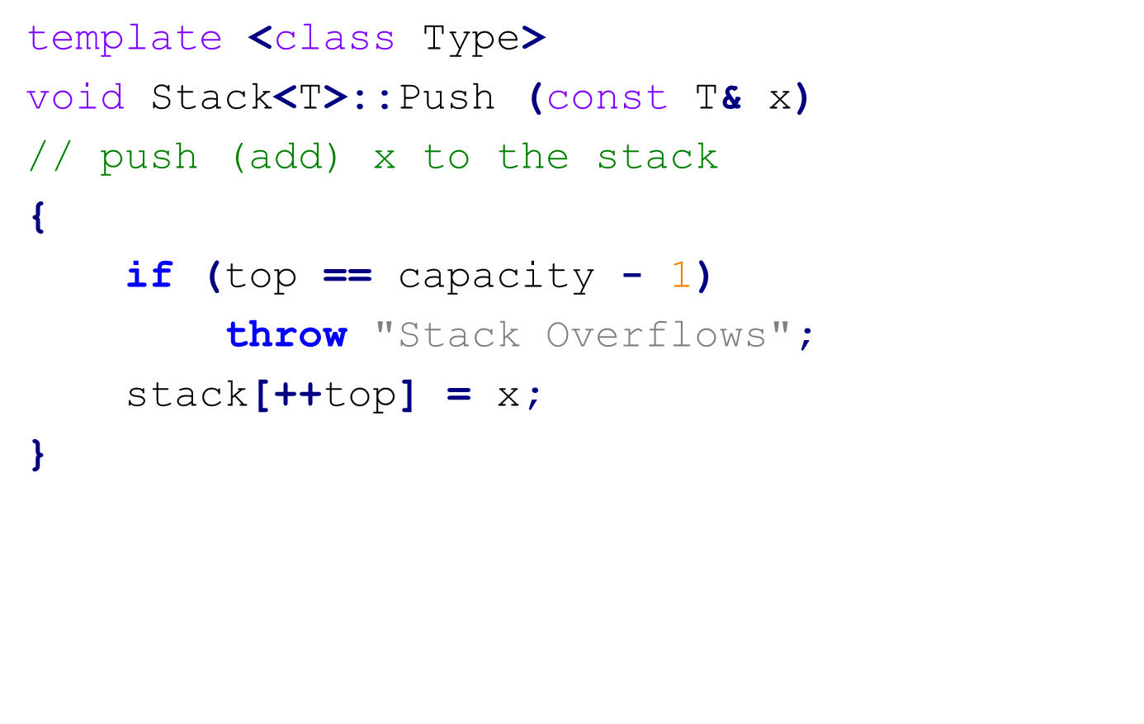
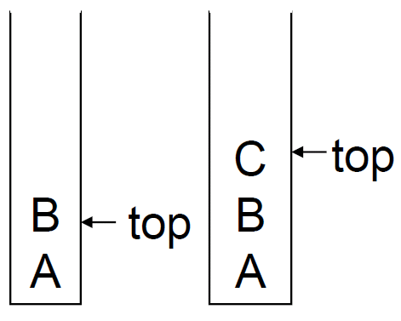
Array Implementation of Stack
3-<number>

Slide 14
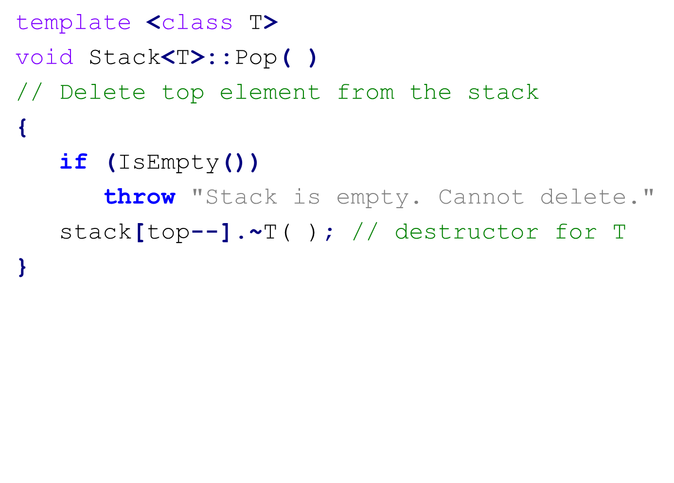
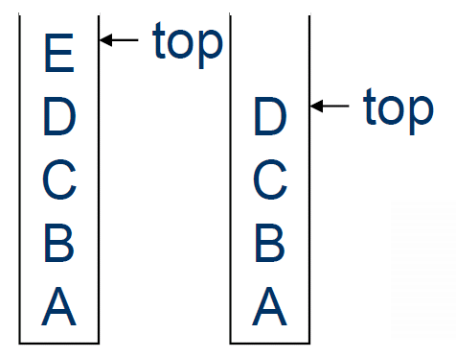
Array Implementation of Stack
3-<number>

Slide 15
Queue
First-in first-out (FIFO)
First come first serve (FCFS)
2 ends: Data are inserted to one end (rear) and deleted from the other end (front).
3-<number>

Slide 16
Linear Queue
initial
insert(A)
insert(B)
A
B
A
rear
rear
rear
front
front
front
delete
Insert(C)
someday
B
C
B
E
D
rear
rear
front
rear
front
front
insert(F): overflow, but there are still some empty locations in the lower part.
3-<number>

Slide 17
Circular Queue
initial
front
Next of the last: 0
empty queue 之條件:
front = = rear
4
3
2
1
0
rear
4 | E
3 | D
2 | C
1
0
rear = 4
4 | E
3 | D
2 | C
1
0 | F
front = 1
front = 1
rear = 0
3-<number>

Slide 18
Full Circular Queue
In this situation, we cannot distinct a full or empty queue.
4 | E
3 | D
2 | C
1 | G
0 | F
front = rear = 1
In a circular queue with n locations, it is full if n-1 locations are used.
If all of n location are used, we cannot distinct a full queue or an empty queue.
3-<number>

Slide 19
Abstract Data Type Queue
template <class T>
class queue
{ // A finite ordered list with zero or more elements
public:
queue (int queueCapacity = 10);
// Create an empty queue whose initial capacity is queueCapacity
bool IsEmpty() const;
// Check whether the queue is empty or not
T& Front() const; // (前面)
// Return the front element of the queue
T& Rear() const; // (後面)
// Return the rea element of the queue
void Push(const T& item);
// Insert item at the rear
void Pop();
// Delete the front element
};
3-<number>

Slide 20
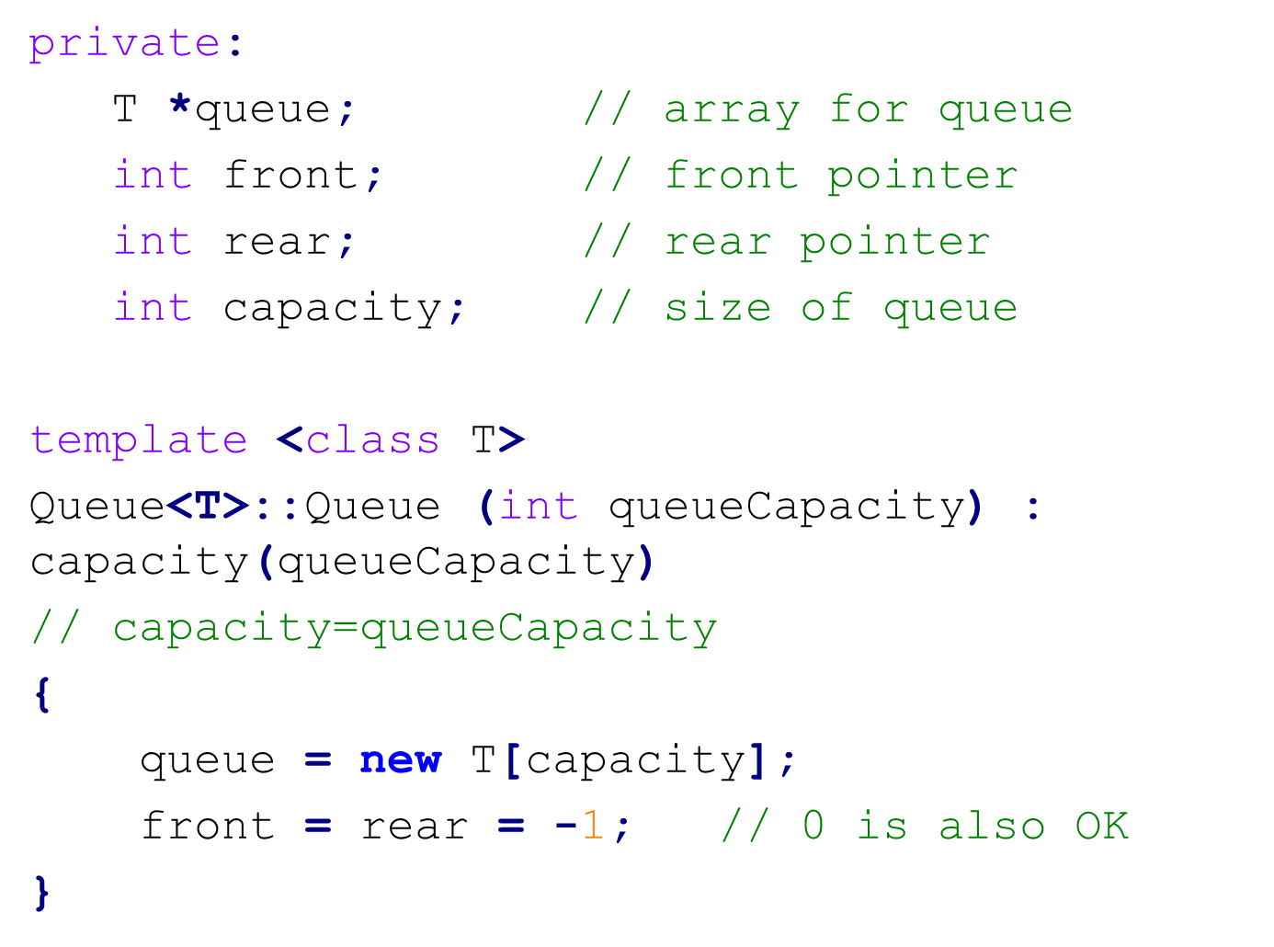
Array Implementation of Queue
3-<number>

Slide 21
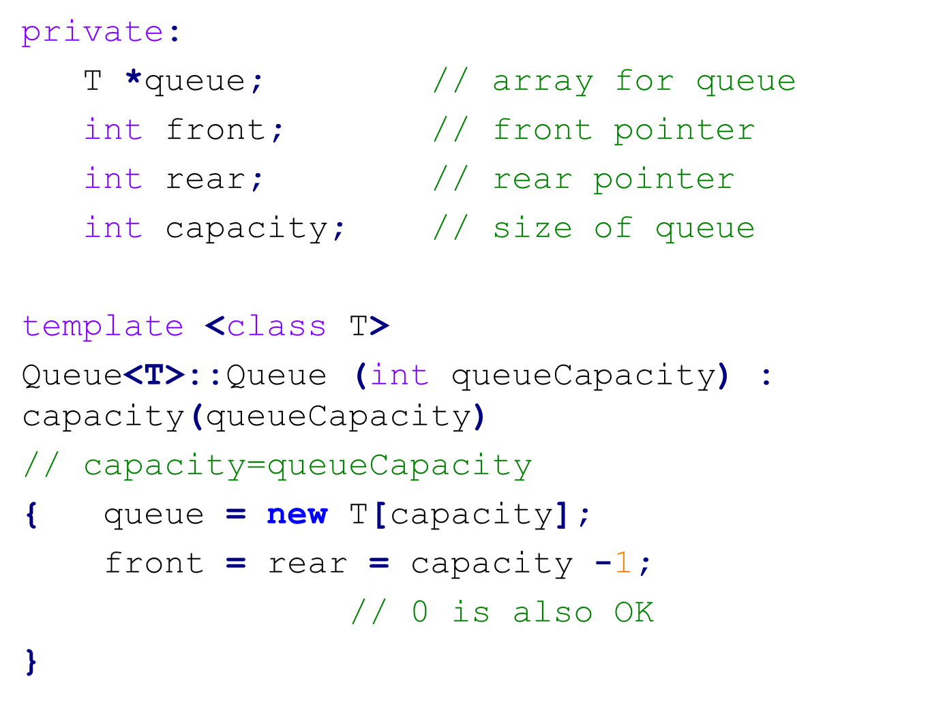
Array Implementation of Queue
3-<number>

Slide 22
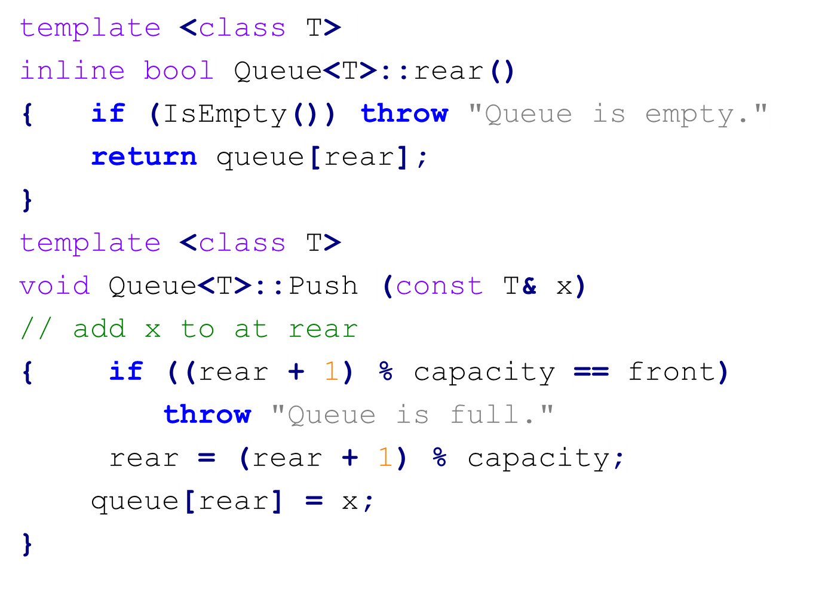
Array Implementation of Queue
3-<number>

Slide 23
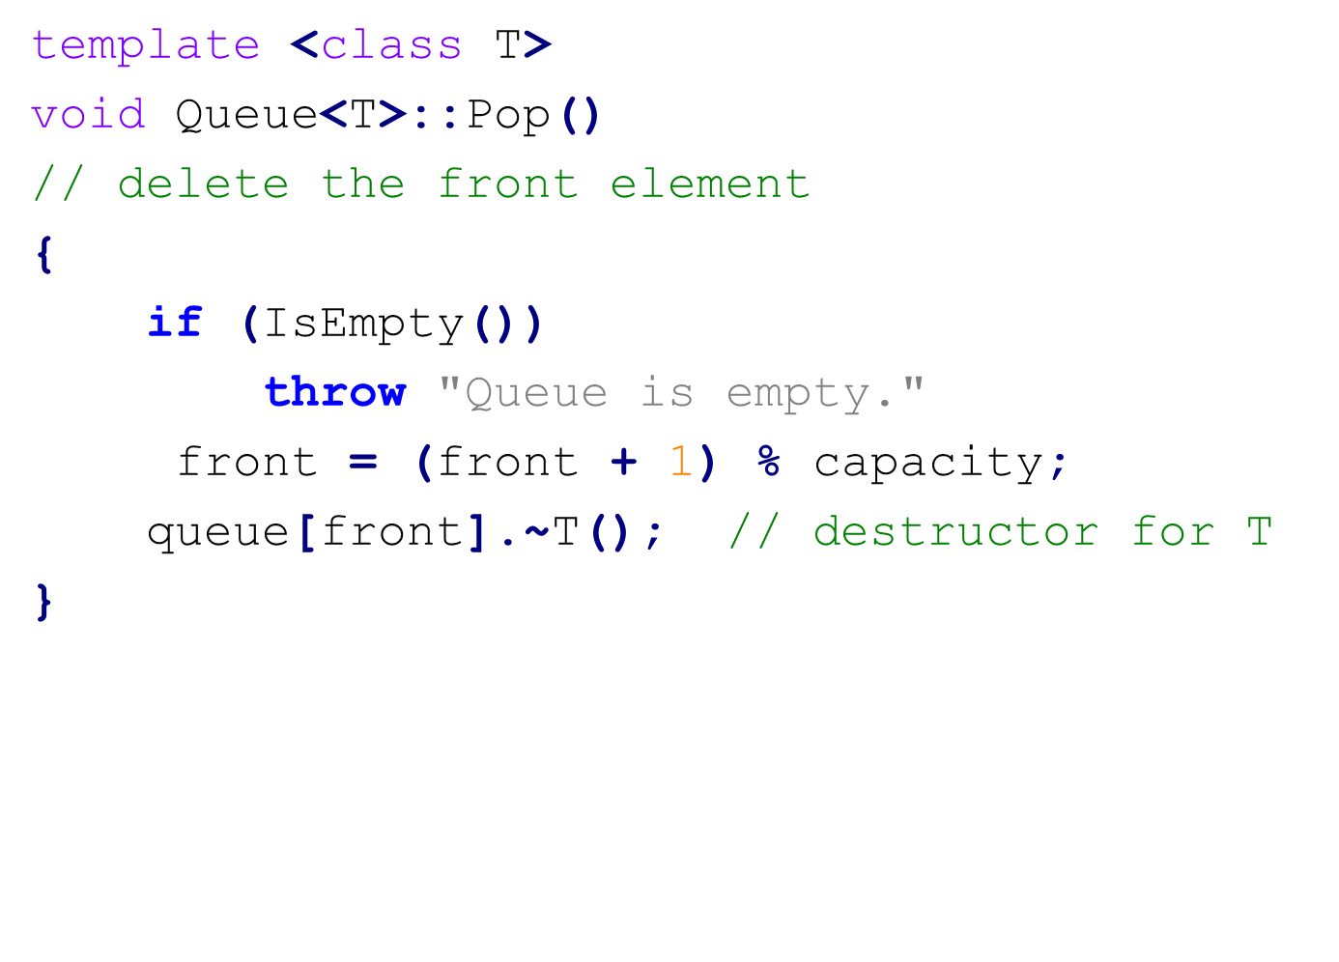
Array Implementation of Queue
3-<number>

Slide 24
Class Inheritance in C++
class Bag {
public:
Bag (int bagCapacity = 10); // constructor
virtual ~Bag(); // destructor
virtual int Size() const; // return #elements in the bag
virtual bool IsEmpty() const; // empty or not
virtual int Element() const; // return an element
virtual void Push(const int); // insert an element
virtual void Pop(); //delete an element
/* 被繼承時，若子類別的有同名函數，欲執行何者視當時指標的實際指向而定 */
protected:
int *array; // array used for storing Bag
int capacity; // size of array
int top; // array index of top element
};
3-<number>

Slide 25
Class Inheritance in C++
class Stack : public Bag
// Stack inherits Bag, Stack 繼承 bag
{
public:
Stack(int stackCapacity = 10);// constructor
~Stack(); // destructor
int Top() const;
void Pop();
};
Stack::Stack(int stackCapacity) : Bag(stackCapacity) { }
// Constructor for Stack calls constructor for Bag
private : class 內部可用
protected: 繼承者內部亦可用
public : 全部可用
3-<number>

Slide 26
Class Inheritance in C++
Stack::~Stack() { }
/* Destructor for Bag is automatically called when Stack is destroyed. This ensures that array is deleted */
int Stack::Top() const
{
if (IsEmpty()) throw "Stack is empty.";
return array[top];
}
void Stack::Pop()
{
if (IsEmpty())
throw "Stack is empty. Cannot delete.";
top--;
}
3-<number>

Slide 27
Class Inheritance in C++
Bag b(3); // uses Bag constructor to create array of capacity 3
Stack s(3);// uses Stack constructor to create array of capacity 3
b.Push(1); b.Push(2); b.Push(3);
// use Bag::Push
s.Push(1); s.Push(2); s.Push(3);
// Stack::Push not defined, so use Bag::Push.
b.Pop(x); // uses Bag::Pop, which calls Bag::IsEmpty
s.Pop(x);
/* uses Stack::Pop, which calls Bag::IsEmtpy because IsEmpty has not been redefined in Stack. */
3-<number>

Slide 28
Inheritance in C++
A derived class (衍生類別, Stack) inherits all the non-private members (data and functions) of the base class (基本類別, Bag).
Inherited public and protected members from public inheritance have the same level of access in the derived class as they did in the base class.
The derived class can reuse the implementation of a function in the base class, except constructor and destructor.
The derived class can implement its own function (override the implementation).
3-<number>

Slide 29
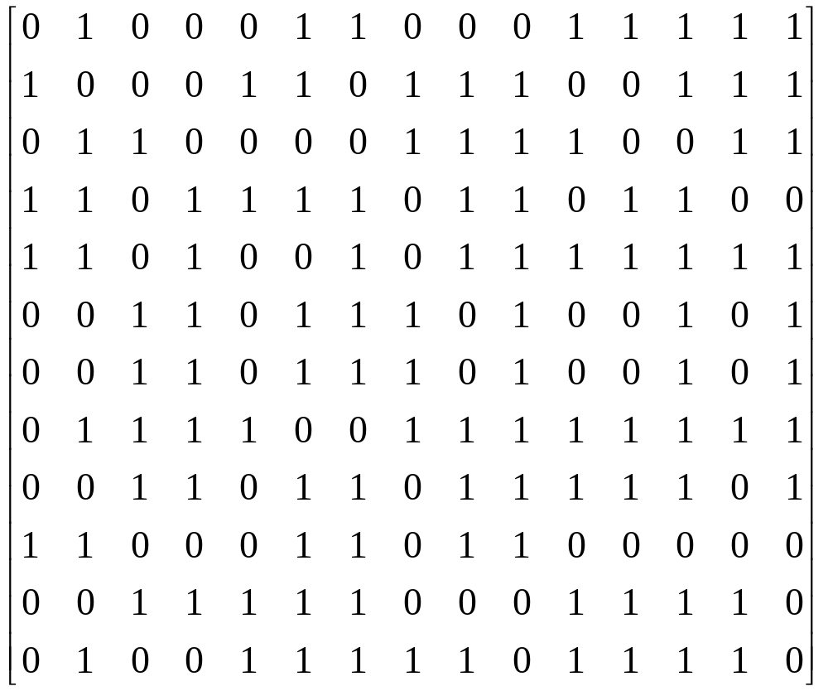
The Mazing Problem (迷宮問題)
Entrance
N
NW
NE
W
E
SW
S
SE
Exit
0:通路 1:障礙物 八方向
3-<number>

Slide 30
Allowable Moves
N
[i-1][j-1]
[i-1][j]
[i-1][j+1]
NW
NE
W
[i][j-1]
X
[i][j+1]
E
[i][j]
[i+1][j-1]
[i+1][j]
[i+1][j+1]
SW
S
SE
3-<number>

Slide 31
Stack
1
2
3
4
5
6
7
8
9
10
11
12
13
14
15
1
0 1 0 0 0 1 1 0 0 0 1 1 1 1 1
1 0 0 0 1 1 0 1 1 1 0 0 1 1 1
0 1 1 0 0 0 0 1 1 1 1 0 0 1 1
1 1 0 1 1 1 1 0 1 1 0 1 1 0 0
1 1 0 1 0 0 1 0 1 1 1 1 1 1 1
0 0 1 1 0 1 1 1 0 1 0 0 1 0 1
0 1 1 1 1 0 0 1 1 1 1 1 1 1 1
0 0 1 1 0 1 1 0 1 1 1 1 1 0 1
1 1 0 0 0 1 1 0 1 1 0 0 0 0 0
0 0 1 1 1 1 1 0 0 0 1 1 1 1 0
0 1 0 0 1 1 1 1 1 0 1 1 1 1 0
2
3
4
9
5
8
6
7
7
6
8
5
9
4
10
1
4
E
3
11
1
3
E
2
**
2
2
NE
1
1
1
SE
0
row
col
dir
3-<number>

Slide 32
Infix, Postfix, Prefix Expressions
infix A+B /* A, B: operands, +: operator */
postfix AB+
(reverse Polish notation)
prefix +AB
(Polish notation)
Conversion from infix to postfix:
e.g. A + (B*C) infix (inorder)
A + (BC*)
A(BC*)+
ABC * + postfix (postorder)
3-<number>

Slide 33
Expression Tree (1)
+
infix : A + (B*C)
prefix : + A * B C
postfix: A B C * +
A
*
B
C
inorder traversal: 1. left subtree
2. root
3. right subtree
preorder traversal: 1. root
2. left subtree
3. right subtree
postorder traversal: 1. left subtree
2. right subtree
3. root
3-<number>

Slide 34
Expression Tree (2)
e.g. (A+B) * C infix
(AB+) * C
(AB+)C *
AB+C * postfix
*
infix : (A+B) * C
prefix : * + A B C
postfix: A B + C *
+
C
A B
3-<number>

Slide 35
Expression Tree (3)
e.g. infix A$B*C-D+E/F/(G+H)
/* $: exponentation, 次方 */
expression tree:
+
-
/
*
D
/
+
$
C E F G H
A B
postfix :
prefix :
**
3-<number>

Slide 36
Evaluating a Postfix Expression
precedence: (, ) > $ > *, / > +, -
left associative: A+B+C = (A+B)+C
right associative: A$B$C = A$(B$C)
e.g. 6 2 3 + - 3 8 2 / + * 2 $ 3 +
infix form:
((6 - (2+3)) * (3 + 8 / 2)) $ 2 + 3 = 52
5 4
1 7
7
49
3-<number>
52

Slide 37
Evaluation with a Stack
symb opnd1 opnd2 value stack
6 6
2 6, 2
3 6, 2, 3
+ 2 3 5 6, 5
- 6 5 1 1
3 6 5 1 1, 3
8 6 5 1 1, 3, 8
2 6 5 1 1, 3, 8, 2
/ 8 2 4 1, 3, 4
+ 3 4 7 1, 7
* 1 7 7 7
2 1 7 7 7, 2
$ 7 2 49 49
3 7 2 49 49, 3
+ 49 3 52 52
3-<number>

Slide 38
Postfix Evaluation with a Stack
Algorithm (演算法)： **
3-<number>

Slide 39
How to Verify a Postfix Expression?
方法一：
方法二：
**
3-<number>

Slide 40
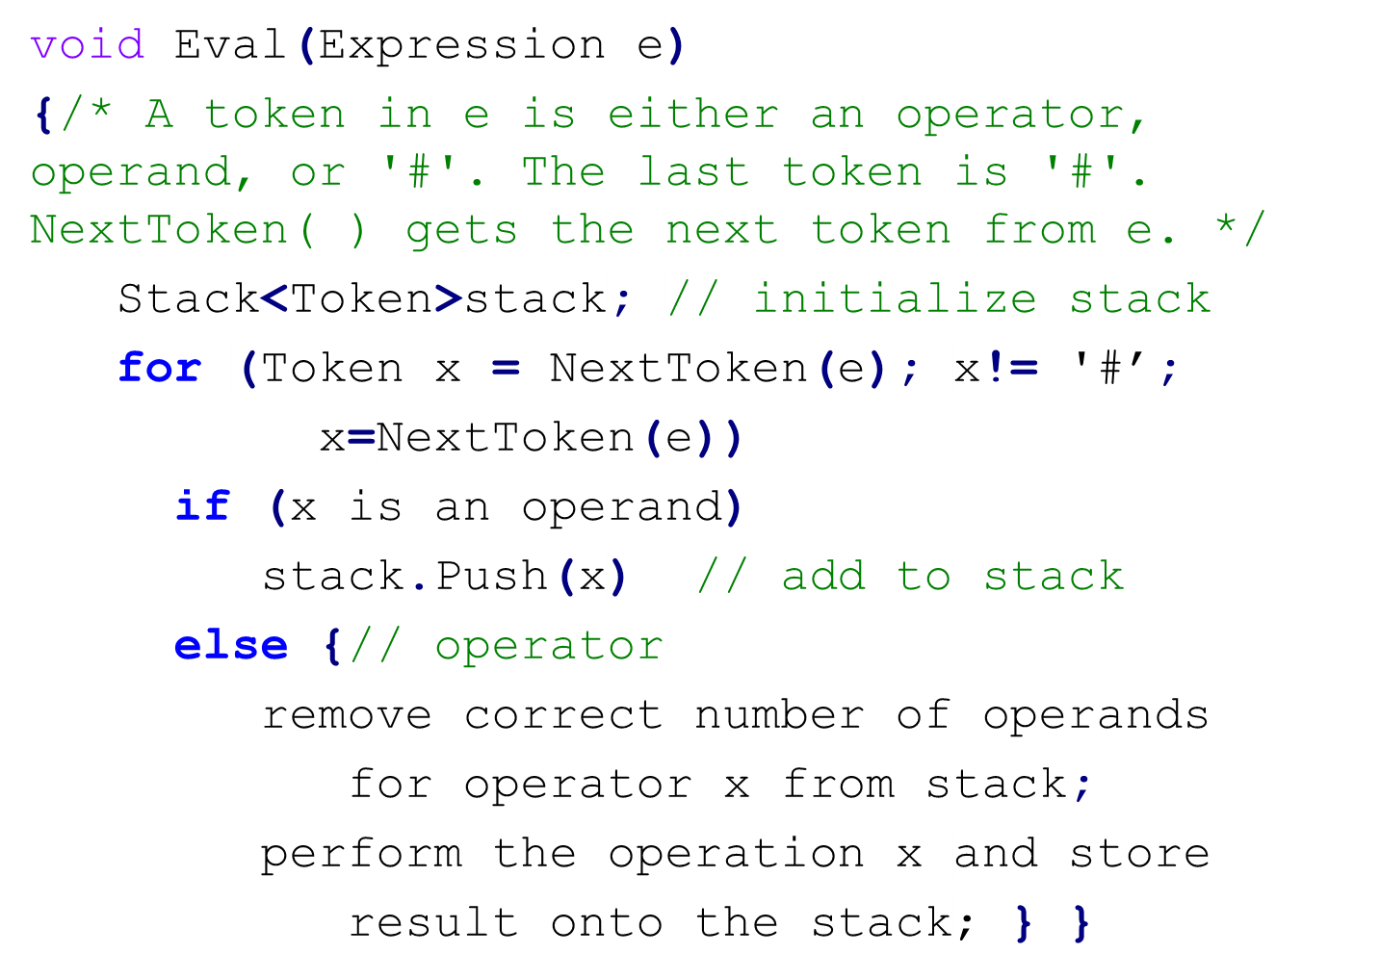
Pseudo Code for Postfix Evaluation
3-<number>

Slide 41
Conversion from Infix to Postfix
e.g. A+B*C ABC*+
symb postfix string stack
1 A A
2 + A +
3 B AB +
4 * AB + *
5 C ABC + *
6 ABC * +
7 ABC * +
e.g. A*B+C AB*C+
3-<number>

Slide 42
e.g. ((A-(B+C))*D)$(E+F) ABC+-D*EF+$
symb postfix string stack
( (
( ((
A A ((
- A ((-
( A ((-(
B AB ((-(
+ AB ((-(+
C ABC ((-(+
) ABC+ ((-
) ABC+- (
* ABC+- (*
D ABC+-D (*
) ABC+-D*
$ ABC+-D* $
( ABC+-D* $(
E ABC+-D*E $(
+ ABC+-D*E $(+
F ABC+-D*EF $(+
) ABC+-D*F+ $
ABC+-D*EF+$
3-<number>

Slide 43
Algorithm for Conversion
1)遇 operand, 直接 output
2)遇 operator
(a) 若此 operator 之 precedence 比 top of
stack 高 ==> 此 operator 放入 stack.
(b) 否則, 將所有比此 operator 之precedence 還
高之 operator 全 pop 並 output, 再將比
operator 放入 stack.
3)
**
4)
5)
3-<number>

Slide 44
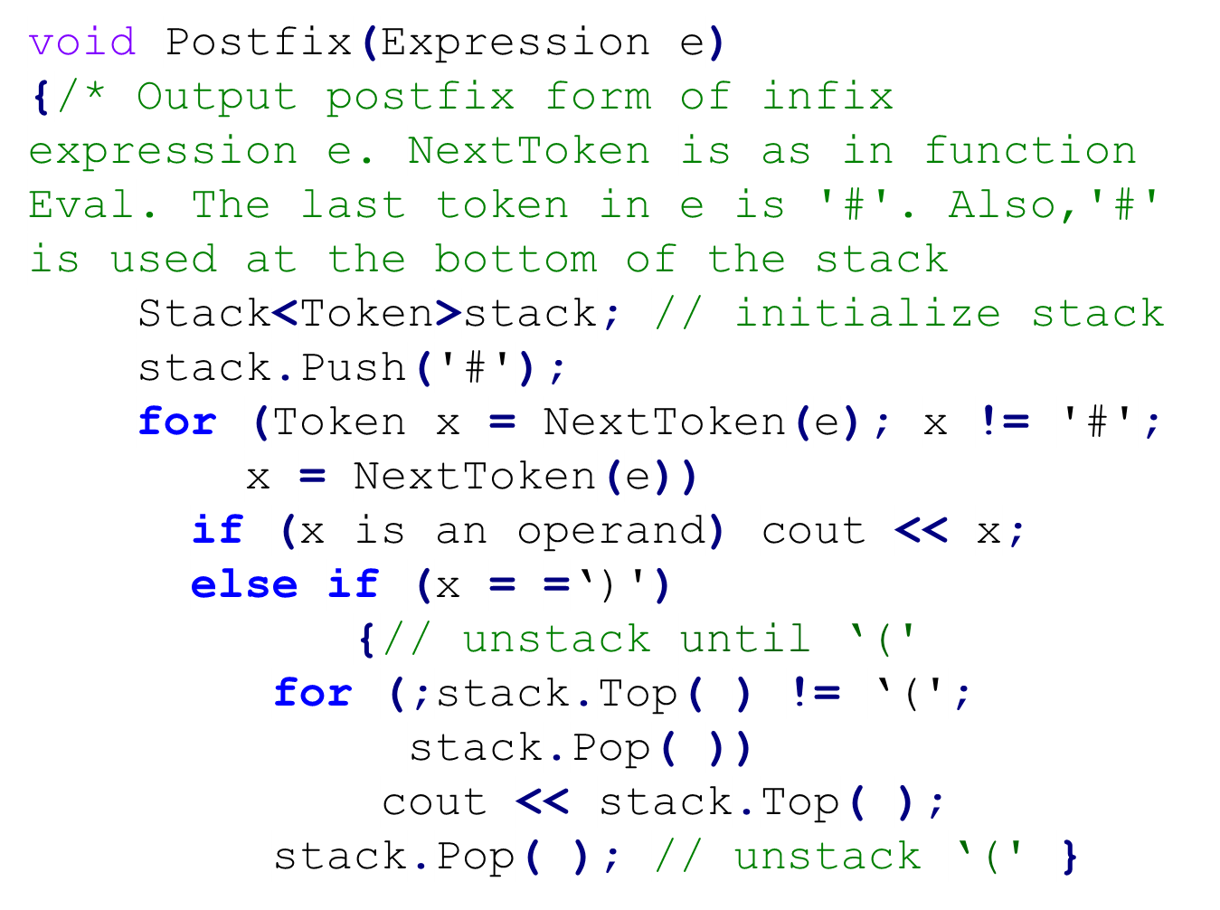
Conversion from Infix to Postfix(1)
3-<number>

Slide 45
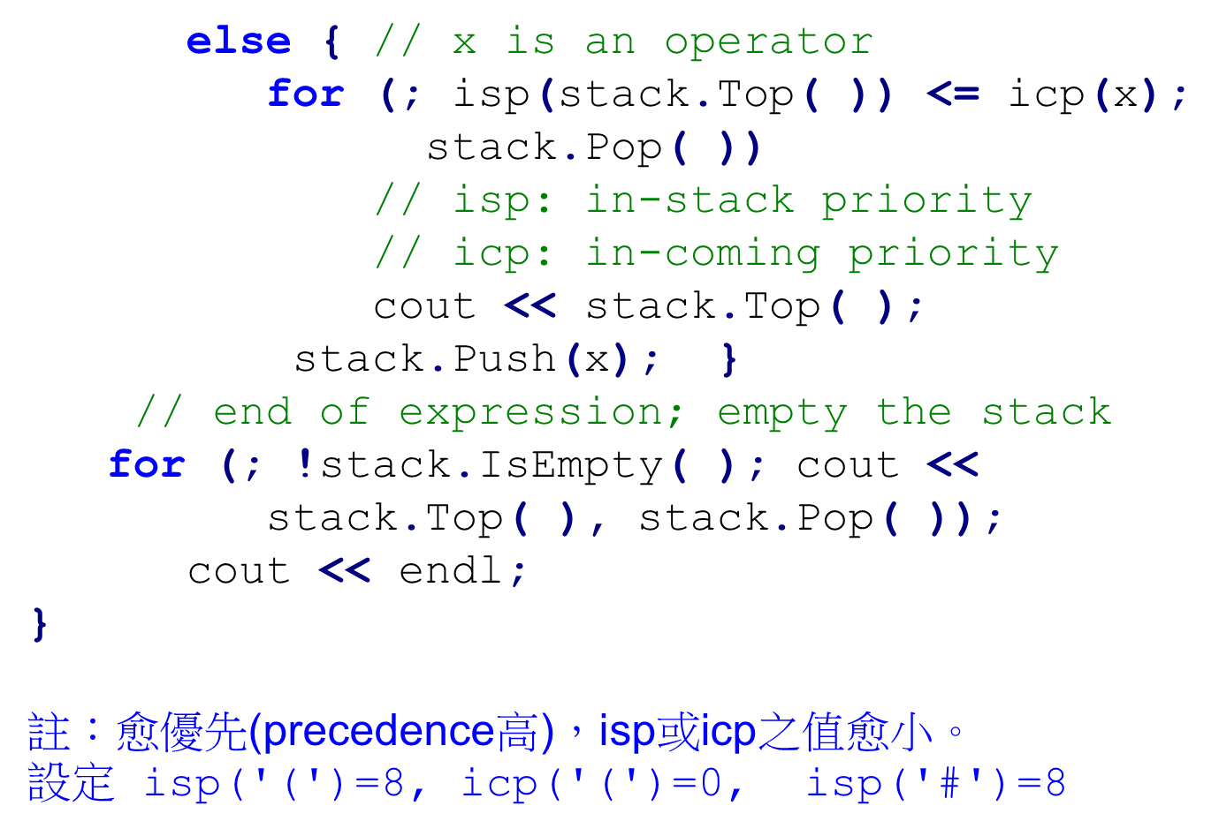
Conversion from Infix to Postfix(2)
3-<number>

Slide 46
Storage Allocation for a C Compiler
dynamic allocation:
  storage for local variables, parameters are allocated when a function is called.
A function call is maintained by using a
stack
3-<number>

Slide 47
j i x return address
temporary b a t s return address
e.g.
int f1(int x)
{
int i, j;
}
int f2(float s,float t)
{
char a, b;
f1(4)
}
int f3()
{
f2(2.4, 7.5);
}
for f1
...
local
variables
...
for f2
parameters
...
...
for f3
...
Stack
Some programming languages do not allow
recursive programs, e.g. FORTRAN, COBAL.
3-<number>

