Slide 1
Data Structures
Chapter 5: Trees
5-<number>

Slide 2
Pedigree Genealogical Chart
血統、家譜 宗譜的、家系的
Cheryl
Kevin
Rosemary
John
Terry
Richard
Kelly
Jack
Mary
Anthony
Karen
Joe
Michelle
Mike
Angela
Ancestors of Cheryl: A binary tree
John and Terry are parents of Kevin.
5-<number>

Slide 3
Lineal Genealogical Chart
直系的、世襲的 宗譜的、家系的
Proto Indo-European
Italic
Hellenic
Germanic
Osco-Umbrian
Latin
Greek
North
West
Osco
Umbrian
Spanish
French
Italian
Icelandic
Norwegian
Swedish
Low
High
Yiddish
Modern European languages
Latin produces Spanish, French and Italian.
5-<number>

Slide 4
A Tree
degree(A) = 3
degree(B) = 2
degree(C) = 1
height = depth = 4
node: A, B, C, …M
parent of E: B
children of B: E, F
ancestors of E: A, B
descendants of B: E, F, K, L
leaf nodes (terminal nodes): K, L, F, G, M, I, J
root
Level
A
1
B
C
D
2
E
F
G
H
I
J
3
K
L
M
4
nonleaf nodes (nonterminal nodes): **
5-<number>

Slide 5
Trees
Definition: A tree is a finite set of one or more nodes such that:
  There is a specially designated node called the root.
  The remaining nodes are partitioned into n ≥ 0 disjoint (無交集的) sets T₁, …, T_{n}, each of which is a subtree.
5-<number>

Slide 6
Tree Terminologies (1)
degree (分支度) of a node:
number of subtrees of the node.
degree of a tree:
maximum degree of the nodes in the tree.
leaf (terminal) node:
a node with degree zero
Siblings (brothers):
the nodes with the same parent
A
B
C
D
E
F
G
H
I
J
K
L
M
5-<number>

Slide 7
Tree Terminologies (2)
ancestors of a node:
all the nodes along the path from
the root to the node.
descendants of a node:
all the nodes of its subtrees.
level of a node:
the level of the node’s parent plus one.
Here, the level of the root is 1.
height (depth) of a tree:
the maximum level of the nodes in the tree.
A
B
C
D
E
F
G
H
I
J
K
L
M
5-<number>

Slide 8
List Representation of a Tree
The tree is represented as a list:
(A (B (E (K, L), F), C(G), D(H (M), I, J)))
A
B
C
D
E
F
G
H
I
J
K
L
M
A
0
B
F
0
C
G
0
D
I
J
0
E
K
L
0
H
M
0
5-<number>

Slide 9
Representation of Trees
Left child-right sibling tree
  two links (or pointers): left child and right sibling
data
A
left child
right sibling
B
C
D
A
B
C
D
E
F
G
H
I
J
E
F
G
H
I
J
K
L
M
K
L
M
5-<number>

Slide 10
Binary Trees
A
A
A
B
C
B
B
C
D
E
F
C
G
H
I
D
E
F
G
D
Binary tree
H
I
E
Skewed binary tree
歪斜二元樹
Complete binary tree
完整二元樹
5-<number>

Slide 11
Binary Tree 二元樹
A binary tree:
  a finite set of nodes that is either empty, or consists of a root and two disjoint binary trees called the left subtree and the right subtree.
In a binary tree, we distinguish between the order of the children; in a tree we do not.
A
A
B
B
Two different binary trees
5-<number>

Slide 12
Full Binary Tree
The maximum number of nodes on level i of a binary tree is 2^{i–1}, i ≥ 1.
The maximum number of nodes in a binary tree of depth k is 2^{k} – 1, k ≥ 1.
A full binary tree of depth k is a binary tree of depth k having 2^{k} – 1 nodes, k ≥ 0.
1
2
3
4
5
6
7
8
9
12
13
5-<number>
10
11
14
15

Slide 13
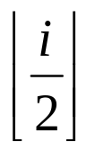
Complete Binary Tree
A complete binary tree with n nodes and depth k is that its nodes correspond to the nodes numbered from 1 to n in the full binary tree of depth k.
It can be represented by an array.
Root is at a[1]. a[0] is not used.
1
2
3
parent(i)=
** left_child(i)=
right_child(i)=
4
5
6
7
8
9
5-<number>

Slide 14
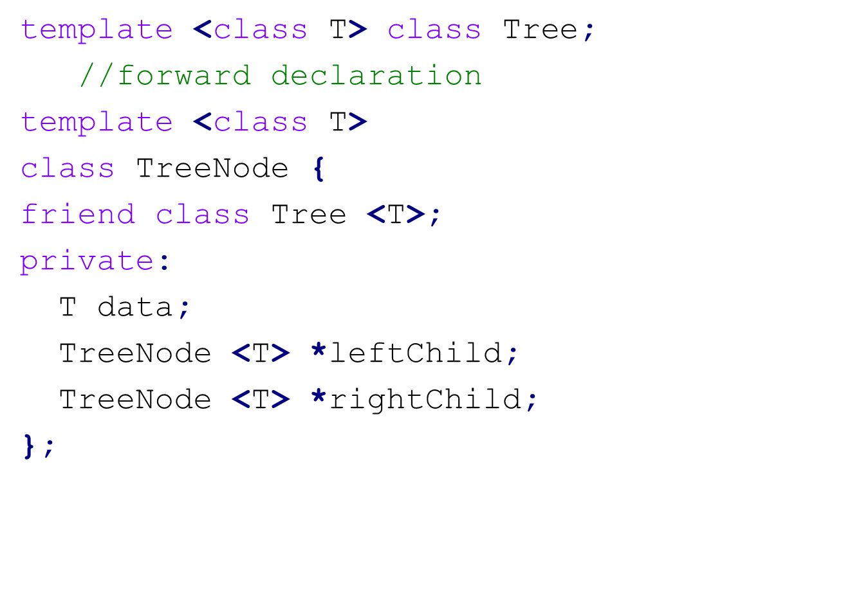
Linked Representation of Binary Trees
data
leftChild
rightChild
leftChild
data
rightChild
5-<number>

Slide 15
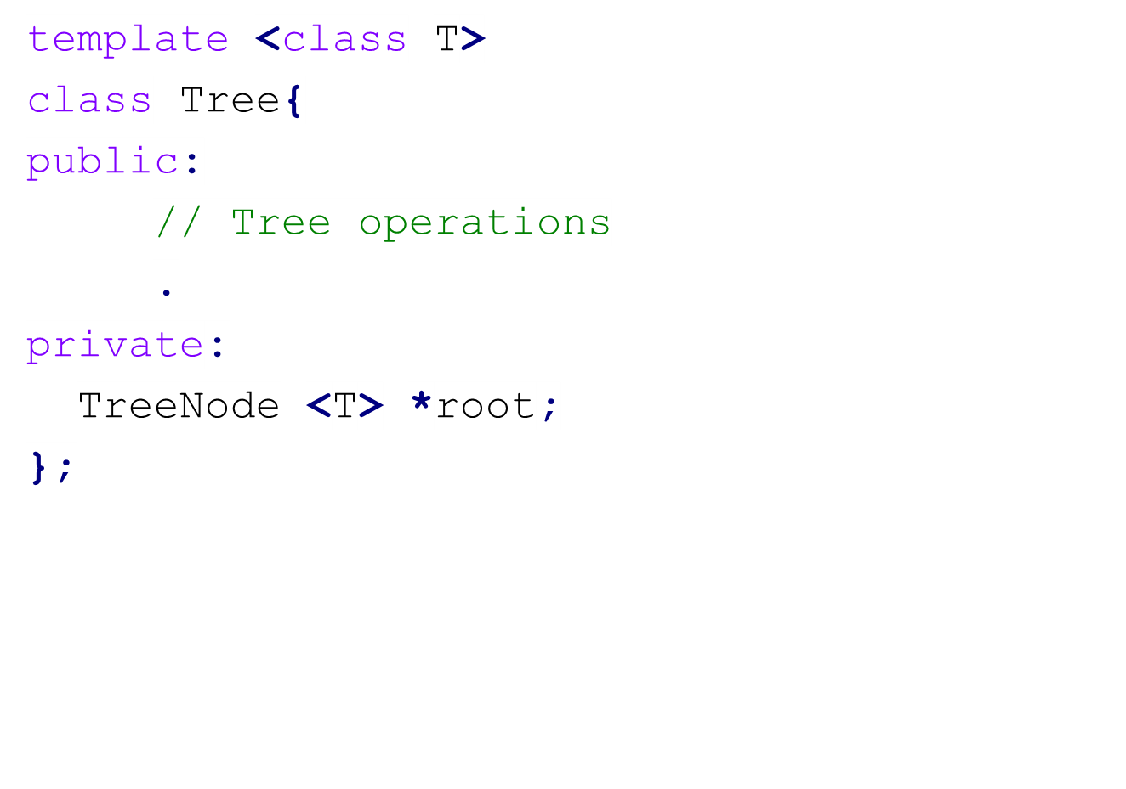
Linked Representation of Binary Trees
5-<number>

Slide 16
Linked Representation of a Binary Tree
A
root
B
C
A
D
E
F
G
C
B
H
I
D
0
E
0
0
F
0
0
G
0
0
H
0
0
I
0
5-<number>

Slide 17
Binary Tree Traversal
Preorder traversal:
  root
  left subtree
  right subtree
Inorder traversal:
  left subtree
  root
  right subtree
Postorder traversal:
  left subtree
  right subtree
  root
5-<number>

Slide 18
Arithmetic Expression Trees
Preorder Traversal: **
  => Prefix expression
Inorder Traversal:
  => Infix expression
Postorder Traversal:
  => Postfix expression
+
*
E
*
D
/
C
A
B
5-<number>

Slide 19
Preorder Traversal
template <class T>
void Tree <T>::Preorder()
{//Driver calls workhorse for traversal of entire tree
Preorder(root);
}
template <class T>
void Tree <T>::Preorder (TreeNode <T> *currentNode)
{//Workhouse traverses the subtree rooted at currentNode
If (currentNode){
Visit(currentNode); //visit root
Preorder(currentNode->leftChild);
Preorder(currentNode->rightChild);
}
}
5-<number>

Slide 20
Inorder Traversal
template <class T>
void Tree <T>::Inorder()
{//Driver calls workhorse for traversal of entire tree
Inorder(root);
}
template <class T>
void Tree <T>::Inorder (TreeNode <T> *currentNode)
{//Workhouse traverses the subtree rooted at currentNode
If (currentNode){
Inorder(currentNode->leftChild);
Visit(currentNode); //visit root
Inorder(currentNode->rightChild);
}
}
5-<number>

Slide 21
Postorder Traversal
template <class T>
void Tree <T>::Postorder()
{//Driver calls workhorse for traversal of entire tree
Postorder(root);
}
template <class T>
void Tree <T>::Postorder (TreeNode <T> *currentNode)
{//Workhouse traverses the subtree rooted at currentNode
If (currentNode){
Postorder(currentNode->leftChild);
Postorder(currentNode->rightChild);
Visit(currentNode); //visit root
}
}
5-<number>

Slide 22
Level-Order Traversal
Preorder, inorder and postorder traversals all require a stack.
Level-order traversal uses a queue.
Level-order traversal:
  root
  left child
  right child.
After All nodes on a level have been
visited, we can move down.
+
*
E
*
D
/
C
A
B
Level-order traversal: **
5-<number>

Slide 23
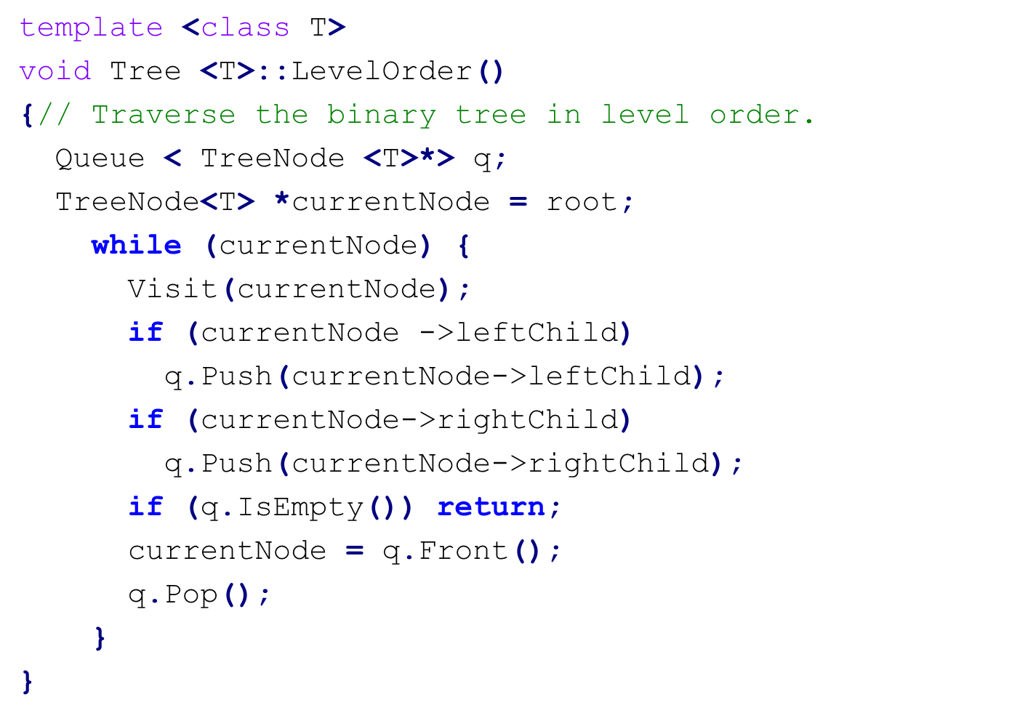
Level-Order Traversal of a Binary Tree
+
*
E
*
D
/
C
+*E*D/CAB
A
B
5-<number>

Slide 24
Threaded Binary Tree 引線二元樹
Threading Rules
  A 0 rightChild field at node p is replaced by a pointer to the node that would be visited after p when traversing the tree in inorder. That is, it is replaced by the inorder successor of p.
  A 0 leftChild link at node p is replaced by a pointer to the node that immediately precedes node p in inorder (i.e., it is replaced by the inorder predecessor of p).
5-<number>

Slide 25
Threaded Binary Tree
A
B
C
A
D
E
F
G
B
C
H
I
D
E
F
G
H
I
Inorder sequence: HDIBEAFCG
5-<number>

Slide 26
Memory Representation of Threaded Tree
A
  x->rightThread == TRUE
  => x->rightChild is a thread
  (pointer to inorder successor)
  x->rightThread == FALSE
  => x->rightChild is a pointer
  to the right child.
B
C
D
E
F
G
H
I
Inorder sequence: H D I B E A F C G
f
-
f
f
A
f
f
B
f
f
B
f
f
D
f
t
E
t
t
D
t
t
E
t
t
H
t
t
I
t
5-<number>

Slide 27
Inorder Successor in Threaded Trees
By using the threads, we can perform an inorder traversal without making use of a stack.
T* ThreadedInorderIterator::Next()
{//Return the inorder successor of currentNode=x
ThreadedNode <T> *temp = currentNode -> rightChild;
if (!currentNode->rightThread) //real rightChild
while (!temp->leftThread) temp = temp -> leftChild;
//a path of leftChild starting from rightChild of x
currentNode = temp;
if (currentNode == root) return 0;
else return &currentNode -> data;
}
A
B
C
Inorder sequence:
H D I B E A F C G
D
E
F
G
H
I
5-<number>

Slide 28
Insertion of r as the Right Child of s in a Threaded Binary Tree (1)
Case 1: The right subtree of s is empty.
u
u
s
s
r
r
before
after
5-<number>

Slide 29
Insertion of r as the Right Child of s in a Threaded Binary Tree (2)
Case 2: The right subtree of s is not empty.
s
s
p
r
r
q
p
q
before
after
5-<number>

Slide 30
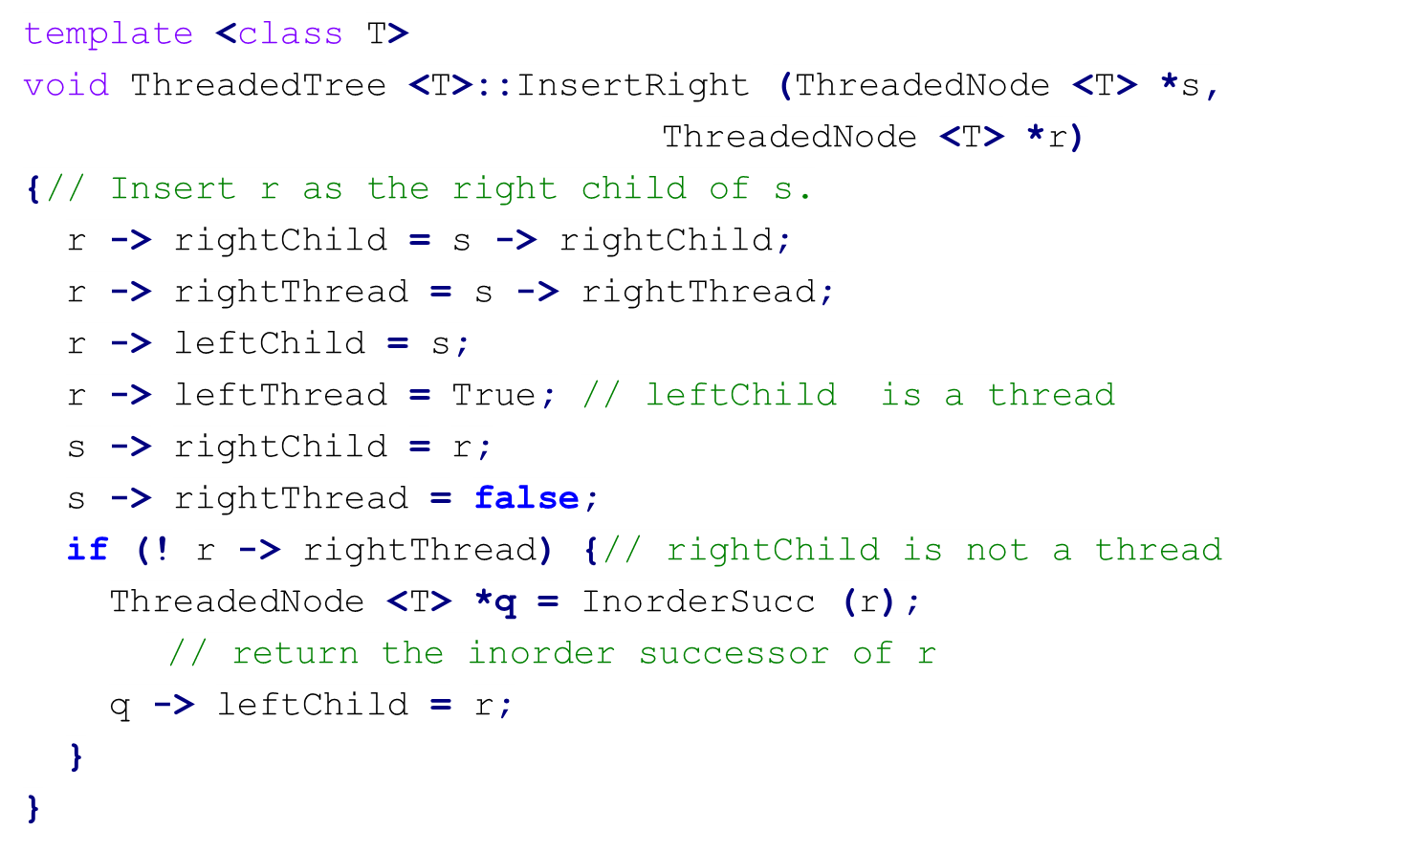
Inserting r as the Right Child of s
5-<number>

Slide 31
Priority Queue
Maximum (minimum) finding: In a priority queue, the element to be deleted is the one with highest (or lowest) priority. It is easy to get the maximum (minimum).
Insertion: An element with arbitrary priority can be inserted into the queue according to its priority.
max (min) priority queue: a data structure supports the above two operations.
5-<number>

Slide 32
14
9
30
12
7
6
3
25
10
8
6
5
Max heaps
2
10
11
7
4
20
83
21
10
8
6
50
Min heaps
5-<number>

Slide 33
Max (Min) Heaps
A max (min) heap is a complete binary tree in which the key value in each node is no smaller (larger) than the key values in its children (if any).
Heaps are frequently used to implement priority queues.
Time complexity of a max (min) heap with n nodes:
  Max (min) finding: O(1)
  Insertion: O(log n)
  Deletion: O(log n)
5-<number>

Slide 34
Insertion into a Max Heap
20
20
(a)
(b)
15
2
15
2
14
10
14
10
(b)→(c1)
Insert 5
20
21
(b)→(c2)
Insert 21
15
20
15
5
5
5
14
10
2
14
10
2
5-<number>

Slide 35
Deletion from a Max Heap
21
2
(a)
(b)
15
20
15
20
14
10
2
14
10
2
2
20
(c)
(d)
15
20
15
2
14
10
14
10
5-<number>

Slide 36
Deletion from a Max Heap (Cont.)
20
10
(e)
(f)
15
2
15
2
14
10
14
10
10
15
(g)
(i)
15
2
14
2
14
10
5-<number>

Slide 37
Binary Search Trees
A binary search tree is a binary tree. It may be empty. If it is not empty, then it satisfies the following properties:
  Every element has a key and no two elements have the same key (i.e., the keys are distinct)
  The keys (if any) in the left subtree are smaller than the key in the root.
  The keys (if any) in the right subtree are larger than the key in the root.
  The left and right subtrees are also binary search trees.
5-<number>

Slide 38
Binary Trees
20
30
60
15
25
5
40
70
14
10
22
65
80
2
Not binary search tree
Binary search trees
5-<number>

Slide 39
Searching a Binary Search Tree
Search for an element with key value k.
If the root is 0, then this is an empty tree, and the search is unsuccessful.
Otherwise, compare k with the key in the root.
  k==root: successful search.
  k < root: search the left subtree.
  k > root: search the right subtree.
30
5
40
2
35
80
5-<number>

Slide 40
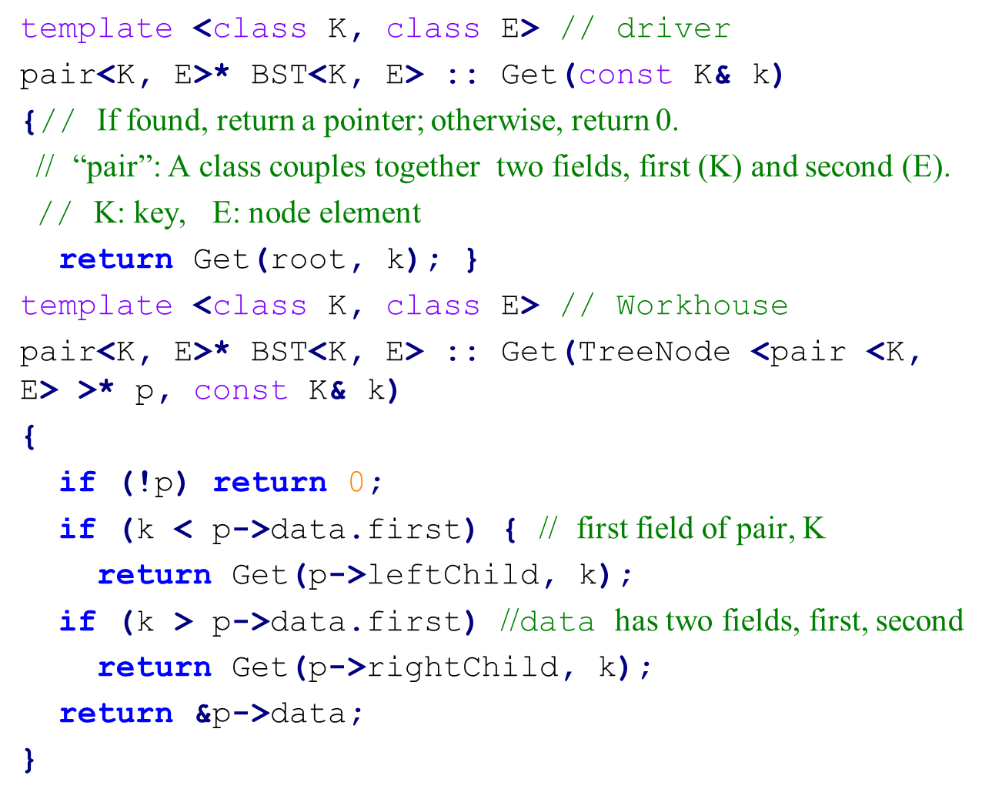
Searching a Binary Search Tree
5-<number>

Slide 41
Insertion into a Binary Search Tree
30
30
5
40
5
40
2
(1) Insert 80
2
80
30
(2) Insert 35
5
40
Time complexity: O(h)
h: tree height
2
35
80
5-<number>

Slide 42
Deletion from a Binary Search Tree
30
30
5
40
Delete 35
5
40
2
35
80
2
80
30
5
Delete 30
5
40
5
40
2
40
2
80
2
80
80
5-<number>

Slide 43
Deletion from a Binary Search Tree
Deletion of a node x:
  x is a leaf node: delete x directly.
  x has one child: move up the position of child to x.
  x has two children: replace x with either inorder successor (smallest in the right subtree, no left child) or inorder predecessor (largest in the left subtree, no right child).
Time complexity: O(h), h:tree height
5-<number>

Slide 44
Selection Trees
Goal: merge (合併) k ordered sequences (called runs) in nondecreasing into a single ordered sequence.
Straightforward method: perform k – 1 comparisons each time to select the smallest one among the first number of each of the k ordered sequences.
Better method: winner tree
k = 8
10
9
20
6
8
9
90
17
15
20
20
15
15
11
95
18
16
38
30
25
50
16
99
20
28
run1
run2
run3
run4
run5
run6
run7
run8
5-<number>

Slide 45
Winner Tree for k = 8
1
6
2
3
6
8
4
5
6
7
9
6
8
17
8
9
10
11
12
13
14
15
10
9
20
6
8
9
90
17
15
20
20
15
15
11
95
18
16
38
30
25
50
16
99
20
28
run1
run2
run3
run4
run5
run6
run7
run8
5-<number>

Slide 46
Winner Tree for k = 8
1
8
2
3
9
8
4
5
6
7
9
15
8
17
8
9
10
11
12
13
14
15
10
9
20
15
8
9
90
17
15
20
20
25
15
11
95
18
16
38
30
28
50
16
99
20
run1
run2
run3
run4
run5
run6
run7
run8
5-<number>

Slide 47
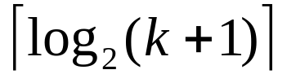
Winner Tree
A winner tree is a complete binary tree in which each node represents the smaller of its two children. Thus, the root represents the smallest.
Each leaf node represents the first record in the corresponding run.
Each nonleaf node represents the winner of a tournament.
Number of levels:
Total time for merging k runs: O(n log₂k)
5-<number>

Slide 48
Loser Tree
1
Winner Tree
6
2
3
6
8
4
5
6
7
9
6
8
17
8
9
10
11
12
13
14
15
10
9
20
6
8
9
90
17
6
Overall winner
0
(6,8)
1
(6,9)
8
(8,17)
2
3
9
17
(9,10)
(6,20)
(8,9)
(17,90)
4
5
6
7
10
20
9
90
9
10
11
12
13
14
15
10
9
20
6
8
9
90
17
1
2
3
4
5
6
5-<number>
run
7
8

Slide 49
Loser Tree
Loser tree: A selection tree in which each nonleaf node retains a pointer to the loser.
Each leaf node represents the first record of each run.
An additional node, node 0, has been added to represent the overall winner of the tournament.
5-<number>

Slide 50
Forests
Forest: a set of n ≥ 0 disjoint trees.
If we remove the root of a tree, we obtain a forest.
  E.g., removing the root of a binary tree produces a forest of two trees.
A
E
G
B
C
D
F
H
I
5-<number>

Slide 51
Representing a Forest with a Binary Tree
leftChild=first child
rightChild=next sibling
A forest of
3 trees
A
E
G
B
C
D
F
H
I
A
A forest is represented by a binary tree.
B
E
C
F
G
D
H
I
5-<number>

Slide 52
Constructing a Binary Tree from Its Inorder Sequence and Preorder Sequence
Inorder sequence: BCAEDGHFI
Preorder sequence: ABCDEFGHI
Step 1: Find the root
Step 2: Do recursively
A
A
B, C
D, E, F, G, H, I
B
D, E, F, G, H, I
C
5-<number>

Slide 53
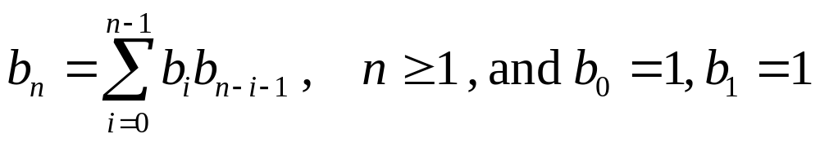
Number of Distinct Binary Trees
n = 2, b₂=2
n = 3, b₃=5
Number of distinct binary trees with n nodes:
b_{n}
b_{i}
b_{n-i-1}
5-<number>

Slide 54
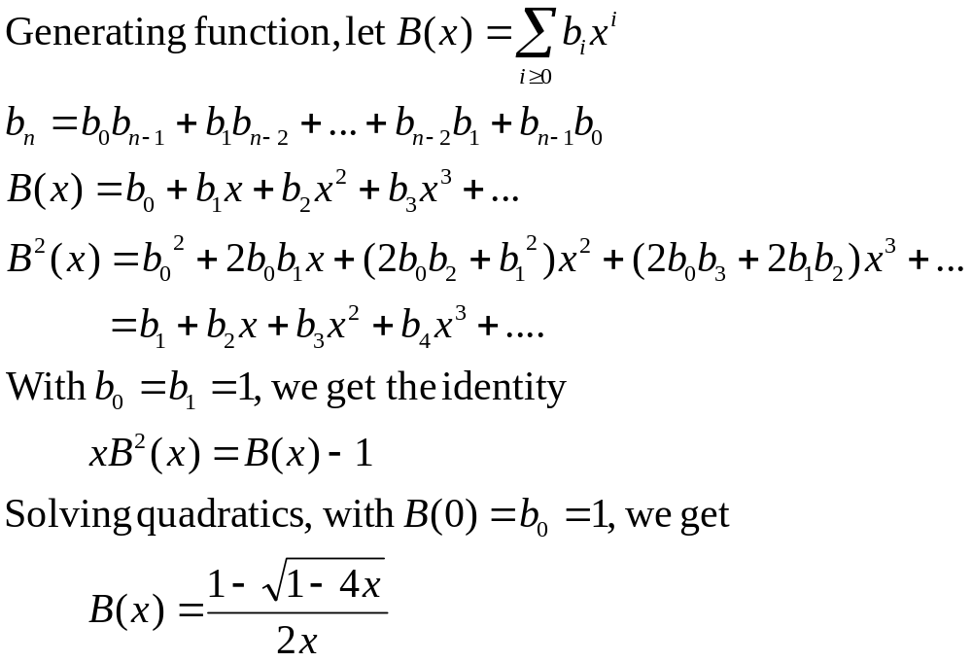
5-<number>

Slide 55
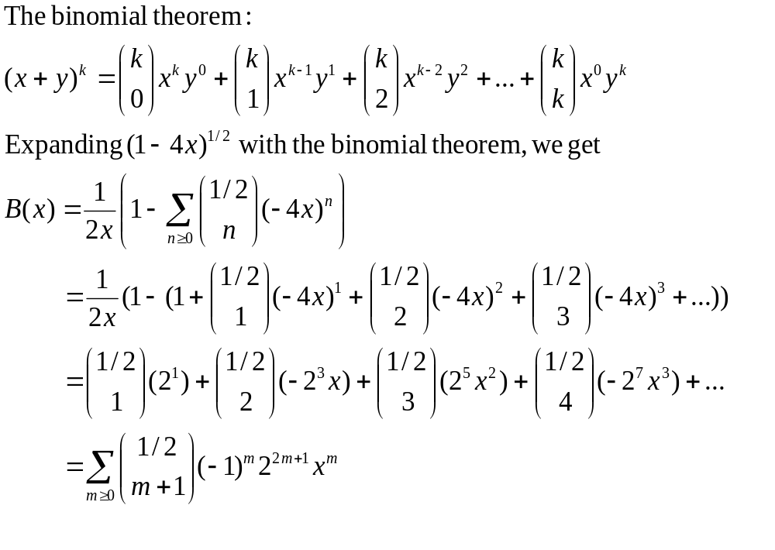
5-<number>

Slide 56
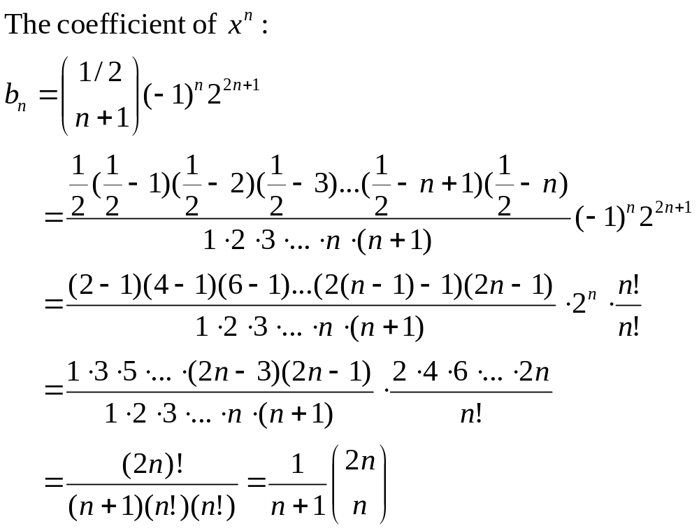
5-<number>

Slide 57
Number of Distinct Binary Trees
b_{n} are Catalan numbers:1, 1, 2, 5, 14, 42, 132, 429, 1430, 4862, 16796, 58786, 208012, 742900, 2674440, 9694845, 35357670, 129644790, 477638700, 1767263190, 6564120420, …
Number of distinct binary trees with n nodes= b_{n}
  b₀=1, b₁=1, b₂=2, b₃=5, b₄=14, b₅=42, …
http://en.wikipedia.org/wiki/Catalan_number
5-<number>

