Slide 1
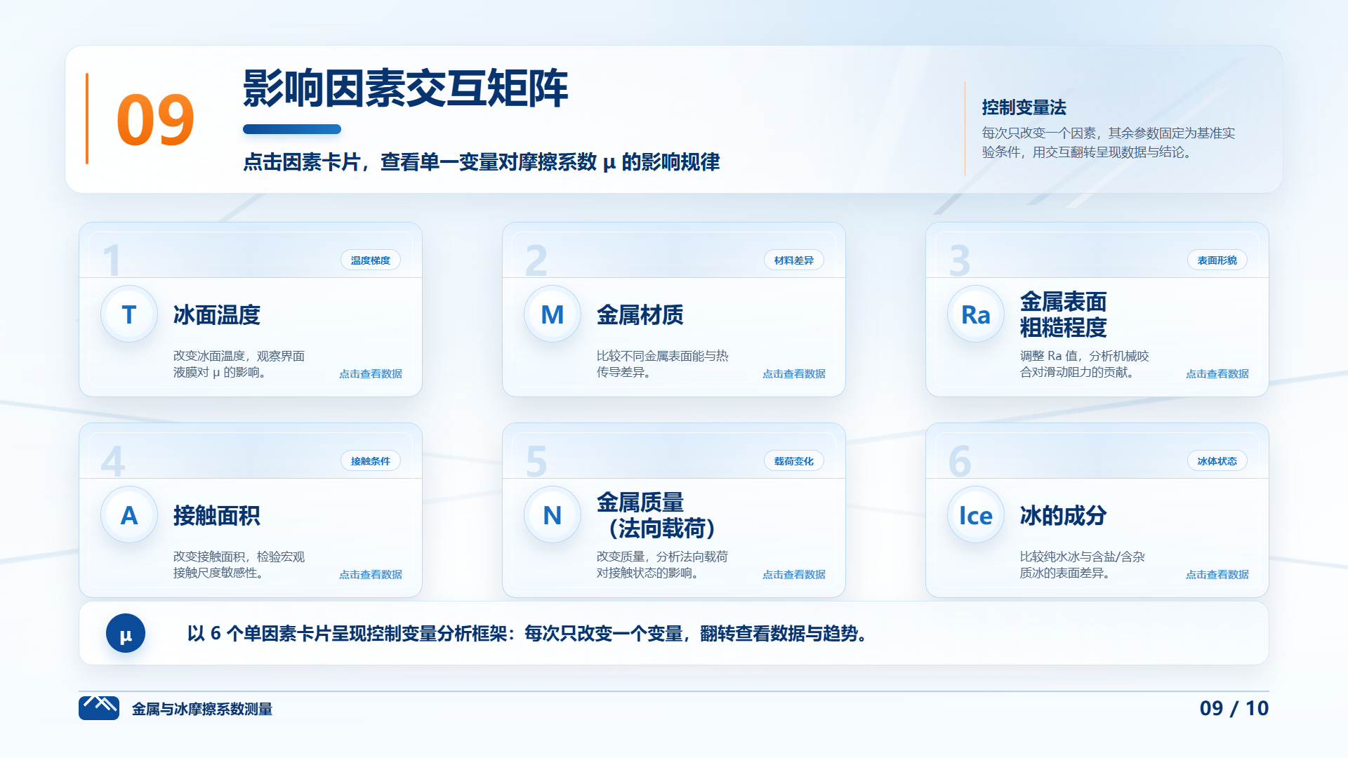
WPS????? HTML???????

