Slide 1
LESS
CSS Pre-processor
Extends the CSS
1
What is the CSS?
2
What are the disadvantages of CSS?
Variables
Mixin
Inheritance
Function
Mathematical
No inheritance
No algorithm
Browser compatibility

Slide 2
The Two Way to Use Less
1
客户端使用
<link rel="stylesheet/less" type="text/css" href="style.less">
<script src="less.js" type="text/javascript"></script>
2
服务器端使用

Slide 3

Variables (变量)
Less
@btn-bg-color:#efefef;
.btn1{
background-color: @btn-bg-color;
}
CSS
.btn1 {
background-color: #efefef;
}

Slide 4

Mixin (混合)
Less
.border{
border: solid 1px #efefef;
border-radius: 5px;
}
a{
.border;
display: block;
width: 200px;
height: 40px;
color: #666666;
line-height: 40px;
text-align: center;
cursor: pointer;
}
CSS
.border {
border: solid 1px #efefef;
border-radius: 5px;
}
a {
border: solid 1px #efefef;
border-radius: 5px;
display: block;
width: 200px;
height: 40px;
color: #666666;
line-height: 40px;
text-align: center;
cursor: pointer;}
带参数的Mixin
.border(@border:5px){
border: solid 1px #efefef;
border-radius: @border;
}
.border(10px);
.border(red,10px)
两个参数
.border(@color:#efefef;@border:5px;){
border: solid 1px @color;
border-radius: @border;
}

Slide 5
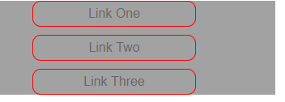
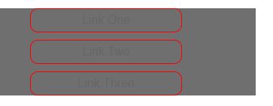
Mixin (混合-模式匹配和导引表达式)
.mixin (@switch, @color)
.mixin (dark, @color) {
background-color: darken(@color, 10%);
}
.mixin (light, @color) {
background-color: lighten(@color, 10%);
}
.mixin (@_, @color) {
display: block;
}
@switch: light;
.class {
width: 300px;
.mixin(@switch, #888);
}
@switch：light；
@switch：dark；

Slide 6
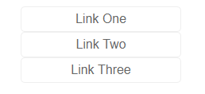
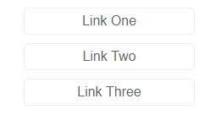
Inheritance(继承)
Less
.top-linker{
list-style: none;
a{
height: 30px;
line-height: 30px;
text-decoration: none;
}}
.top-linker{
list-style: none;
a{
height: 30px;
line-height: 30px;
text-decoration: none;
}
>li + li{
margin-top: 10px;
}
}
CSS
.top-linker {
list-style: none;}
.top-linker a {
height: 30px;
line-height: 30px;
text-decoration: none;
}
.top-linker > li + li {
margin-top: 10px;
}

Slide 7

Inheritance(&用法)
Less
a{
.border;
display: block;
width: 200px;
height: 40px;
color: #666666;
line-height: 40px;
text-align: center;
cursor: pointer;
&:hover{
background-color: #5e5e5e;
color: #ffffff;
}
}
CSS
a:hover {
background-color: #5e5e5e;
color: #ffffff;
}
1.伪类：hover、focus、
visited、linked；
2.串连选择器（一定要
区别于后代选择器；）

Slide 8
The Two Way to Use Less
1
客户端使用
<link rel="stylesheet/less" type="text/css" href="style.less">
<script src="less.js" type="text/javascript"></script>
2
服务器端使用

Slide 9
The Two Way to Use Less

