Slide 1
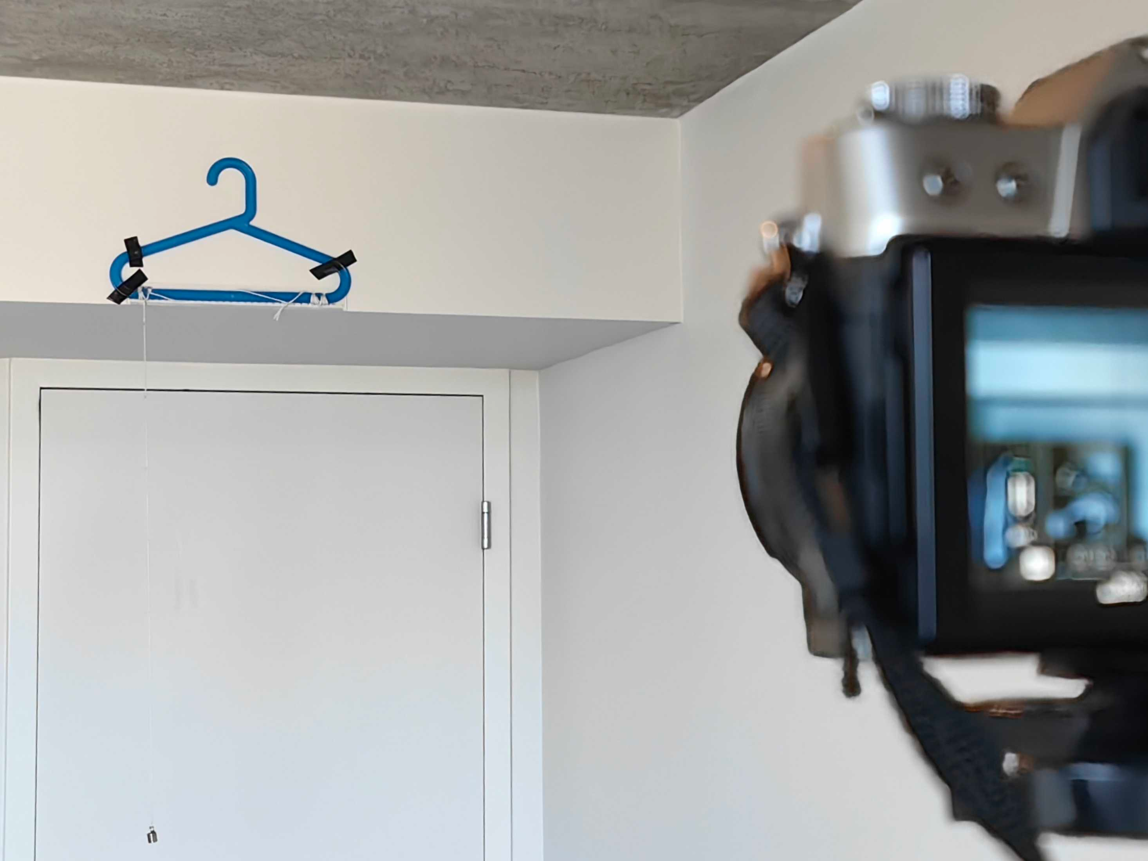
DSLR Camera
Pendulum Hanger

