Slide 1







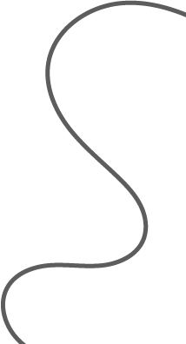


Cornell Notes
Key points
Notes
Summary

