Slide 1

Introduction to Sourcetree
Sourcetree 소개
A Visual Git Client for Web Development
Presented by: ZHANG LUYUE
장로월
Notes:
Hello everyone. My name is [Your Name]. Today, I'm going to introduce a very useful tool for our web development course: Sourcetree. It's a visual Git client that makes managing our code much easier. Let's get started.

Slide 2

Table of Contents
목차
1
What is Sourcetree?
Sourcetree란 무엇인가요?
2
Why Use Sourcetree?
Sourcetree를 왜 사용해야 할까요?
Core Features
핵심 기능
4
Standard Workflow
표준 작업 흐름
3
5
Pros and Cons
장단점
6
Summary
요약
Notes:
Now I will show my presentation outline. I will introduce what Sourcetree is, why we use it, its core functions, standard workflow, pros and cons, and a simple summary.

Slide 3





What is Sourcetree?
소스트리란 무엇인가?
Sourcetree is a free Git client that provides a clean, visual interface for managing your Git repositories. It eliminates the need for complex terminal commands, allowing you to easily see changes, commit history, branches, and merges through an intuitive graphical layout.
Git Client
사용자 친화적인 도구로 Git 저장소와 연동하며, 버전 관리를 쉽게 사용할 수 있게 해줍니다.
Visual Interface
코드 기록, 브랜치, 병합 내용을 그래프로 보여주어 이해하기 쉽습니다.
Simplify Git Workflow
An intuitive GUI to visualize
and manage your Git repositories.
100% Free
개인 및 상업적 사용 모두 무료이며, 숨겨진 비용이나 유료 등급이 없습니다.
Cross-Platform
윈도우와 맥OS 모두 지원하여 개발 환경에 제약이 없습니다.
Notes:
So, what exactly is Sourcetree? Simply put, it's a free tool that gives you a graphical interface for Git. Instead of typing complicated commands in the terminal, you can see everything visually. It's like having a map for your code. It's free to use, and works on both Windows and Mac computers.

Slide 4
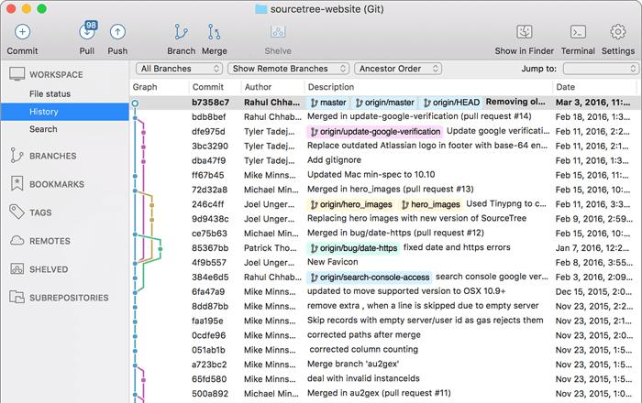



Why Use Sourcetree?
소스트리를 왜 사용할까요?
Simpler Learning
배우기 쉬움
No CLI Needed
명령줄 불필요
Visual diagrams demystify Git's branching and merging, helping beginners grasp core concepts faster than command-line alone.
Execute commits, pushes, pulls, and merges with intuitive point-and-click actions—no need to memorize complex commands.
Visual History
시각적 작업 기록
Advanced Tools
고급 내장 도구
소스트리는 윈도우와 맥용 무료 Git GUI 클라이언트입니다.
명령어를 외울 필요 없이 시각적 인터페이스로 Git을 다룰 수 있어 초보자가 배우기 쉽습니다.
커밋 기록과 브랜치 관계를 그래프로 확인할 수 있고, Git Flow, 리베이스 등 고급 기능도 지원해 복잡한 작업도 쉽게 처리할 수 있습니다.
See your project's commit history and branch relationships in a clear, interactive graph view for easy navigation.
Built-in support for Git Flow, LFS, stashing, cherry-picking, and rebasing to handle complex workflows easily.
Notes:
Why should we use Sourcetree? The main reason is that it makes Git much easier, especially for those of us who are new to it. You don't need to remember difficult commands. You can just click buttons to do everything. The visual history shows you exactly what's happening with your code branches, which is very helpful.

Slide 5
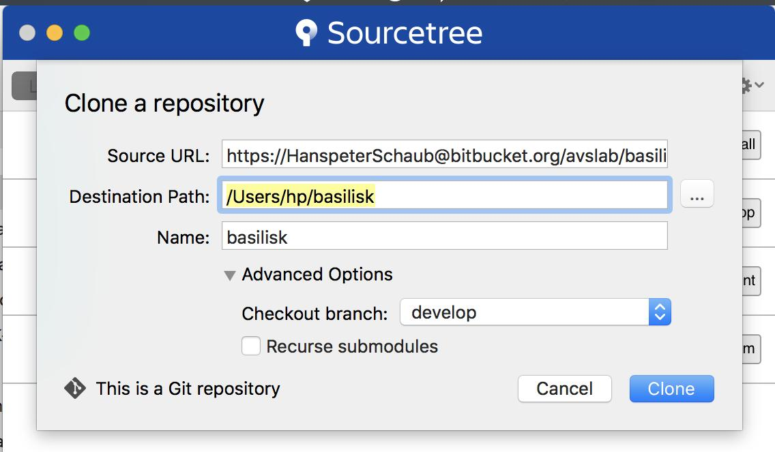
Core Feature 1: Clone
핵심 기능 1: 클론 (Clone)
Clone: Download a remote repository to our local computer
01. Click the "Clone" button in Sourcetree to initiate the process.
02. Paste the repository URL (copied from GitHub, GitLab, or Bitbucket).
03. Choose a local folder to save the files.
04. Click "Clone" to download the repository and create a local copy.
핵심 기능 1: 클론 (Clone)
원격 저장소의 프로젝트를 로컬 컴퓨터에 복사해오는 기본적인 작업으로, GitHub/GitLab 등에서 프로젝트를 가져올 때 사용합니다.
1. Sourcetree에서 [Clone] 버튼 클릭 → 2. 저장소 URL 붙여넣기
3. 로컬 저장 경로 선택 → 4. [Clone]으로 다운로드 완료
Notes:
Let's look at the first core feature: Clone. Cloning means downloading a copy of a project from an online server, like GitHub, to your own computer. It's very simple. Just click Clone, paste the project's URL, choose where to save it, and click Clone again. Now you have the project on your PC and can start working on it.

Slide 6
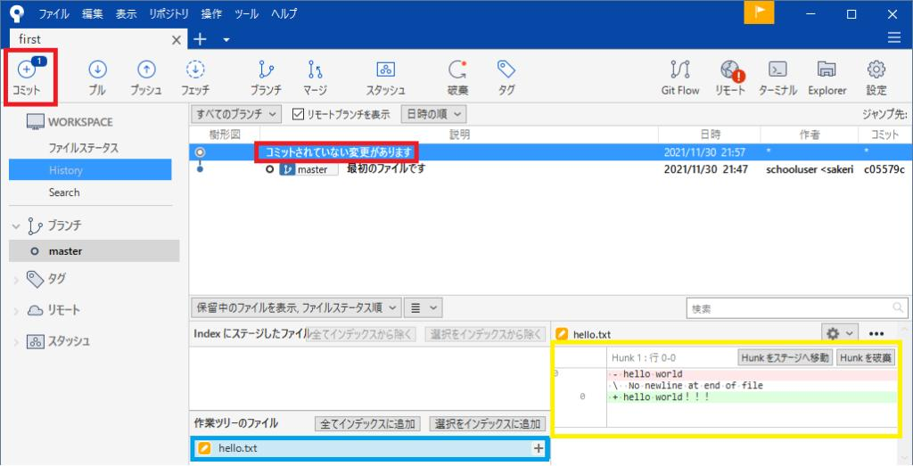
Core Feature 2: Commit
핵심 기능 2: 커밋(Commit)
Commit: Save our changes to the local repository
1. Make edits to your code files in your preferred editor.
2. Check the "File Status" panel to see modified files.
3. Stage specific files to prepare them for commit.
4. Write a concise message explaining what you changed.
5. Click "Commit" to save this local version.
Sourcetree provides a visual interface to manage your Git workflow. The "File Status" panel clearly shows which files have been modified, making it easy to review changes before committing.
핵심 기능 2: 커밋 (Commit)
1. 코드 편집기에서 파일에 변경 사항을 적용합니다.
2. Sourcetree의 "File Status" 패널에서 수정된 파일을 확인합니다.
3. 커밋할 파일을 스테이징 (Unstaged → Staged)합니다.
4. 변경 내용을 설명하는 간결한 메시지를 작성합니다.
5. "Commit"을 클릭하여 로컬 저장소에 변경 사항을 저장합니다.
Notes:
The second important feature is Commit. When you finish editing your code, you need to save those changes. That's what Commit does. You select the files you've changed, write a short note about what you did, and click Commit. This saves a snapshot of your work on your computer.

Slide 7
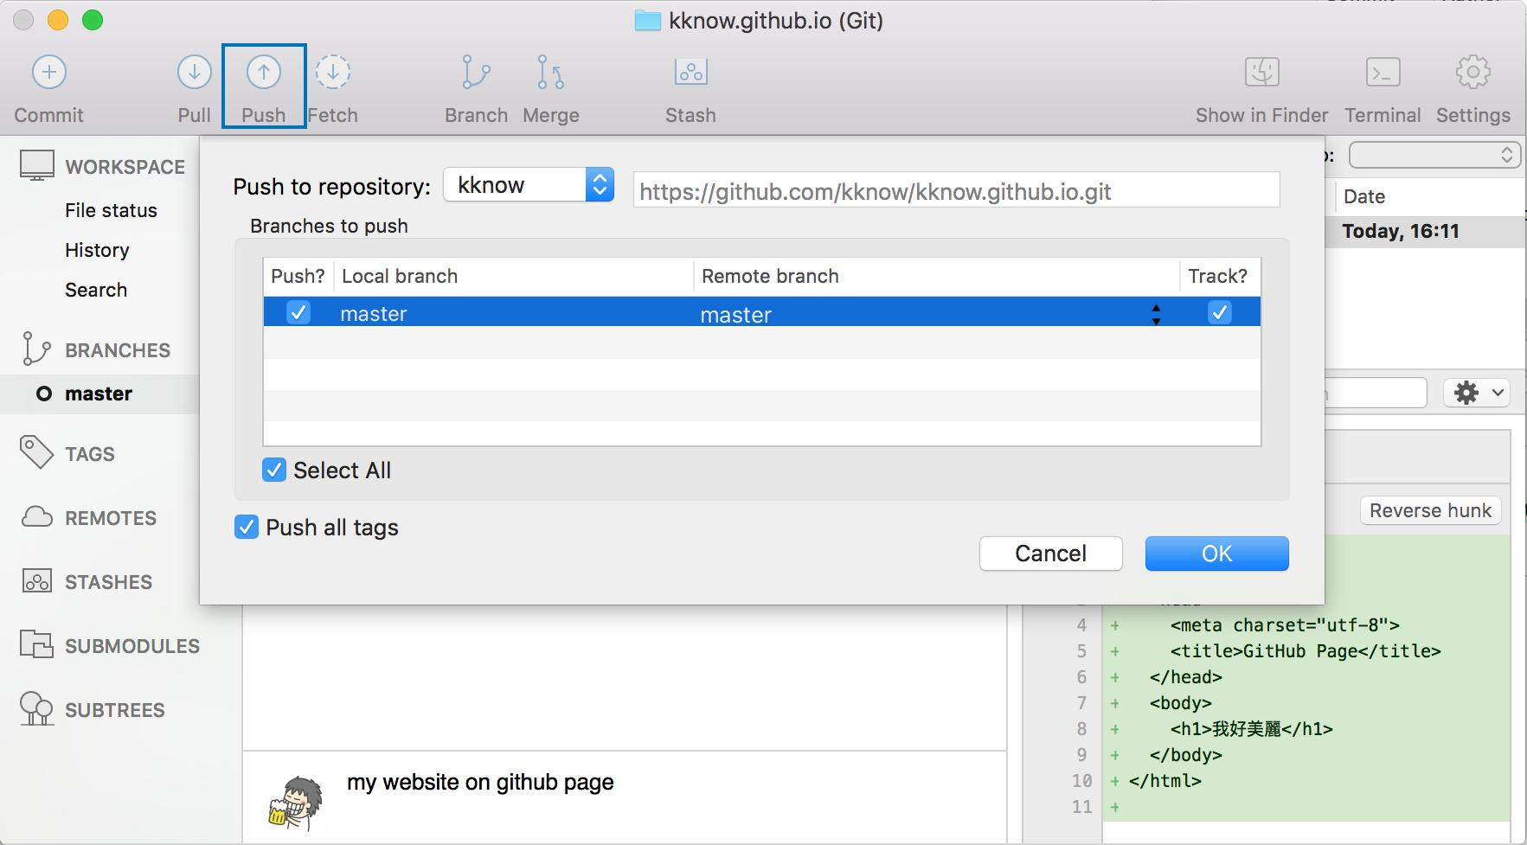
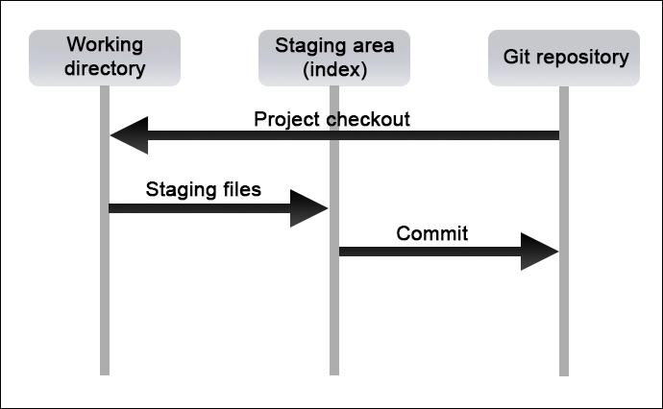
Core Feature 3: Push & Pull
핵심 기능 3: 푸시 & 풀(Push & Pull)
01. Push: Upload Your Work
02. Pull: Sync with the Remote
Send your local commits to the remote repository. Click the "Push" button, select your branch, and confirm to upload your changes.
로컬 커밋을 원격 저장소로 보내는 작업입니다. 툴바의 "Push" 버튼을 클릭하고 브랜치를 선택한 후 변경 사항을 업로드하세요.
Download the latest changes from the remote server. This fetches new commits and merges them into your local branch to keep your code up-to-date.
원격 서버에서 최신 변경 사항을 다운로드합니다. 이 작업은 새 커밋을 가져와 로컬 브랜치에 병합하여 코드를 최신 상태로 유지합니다.
Notes:
Next, we have Push and Pull. Push is how you upload your committed changes back to the online server, like GitHub. This is how you submit your homework. Pull is the opposite: it downloads the latest code from the server to your computer, so you have the newest version. Always remember to Pull before you Push!

Slide 8
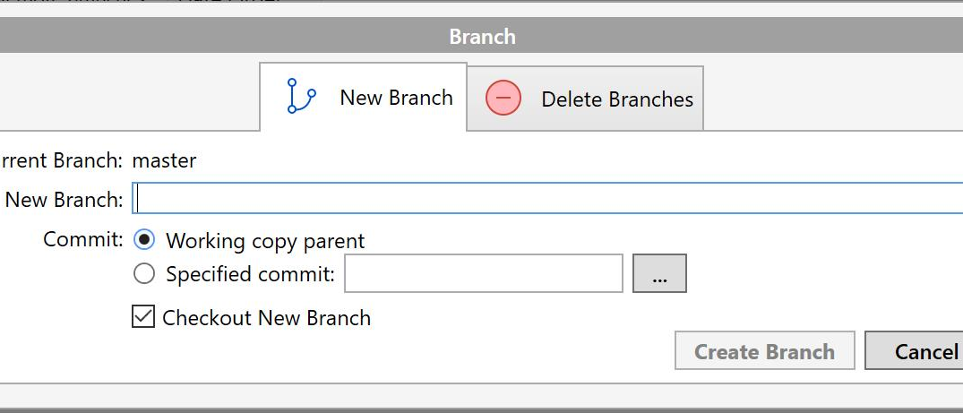






Core Feature 4: Branch
핵심 기능 4: 브랜치 (Branch)
Why Use Branches?
Isolate Work: Develop new features without risking the main codebase.
Bug Fixes: Fix issues in a dedicated, risk-free environment.
Safe Experimentation: Test ideas without breaking production.
3 Steps to Create a Branch
Pro Tip: Naming Conventions
이름 짓기 규칙
feature/, bugfix/, hotfix/ 와 같은 일관된 접두사를 사용하면 팀원에게 브랜치의 목적을 바로 알릴 수 있습니다.
1. Click the “Branch” button in the Sourcetree toolbar.
2. Enter a clear name (e.g., “feature/payment-gateway”).
3. Click “Create Branch” to start your isolated line.
Notes:
Branches are a very powerful feature in Git. A branch is like a separate copy of your project where you can work on new features or fix bugs without messing up the main code. Creating a branch in Sourcetree is easy. Just click the Branch button, give it a name, and you're ready to work in your own safe space.

Slide 9





Standard Workflow for Web Homework
웹 과제 표준 작업 흐름
01. Clone the Repo
Copy the project from the course server to your local machine to start working.
02. Create a Branch
Create a new branch (e.g., "hw-1") to isolate your assignment work.
03. Commit Changes
Save your work frequently with clear, descriptive commit messages.
04. Push to Remote
Upload your branch to the server to submit your completed assignment.
05. Pull Request (Team Projects)
Propose merging your branch into the main project for code review and integration with your team's work.
Git 생명주기 시각화: 로컬 작업 디렉토리에서 중앙 저장소까지
한국어 요약: 과제 서버에서 저장소를 클론하고, 'assignment-1'과 같은 새 브랜치를 생성합니다. 작업 내용을 자주 커밋하고 완료되면 원격 서버로 푸시합니다. 팀 프로젝트의 경우, Pull Request를 통해 브랜치를 메인 브랜치에 병합 요청하세요.
Notes:
This is the standard workflow you will use for our web homework. First, clone the project. Then create a new branch for your work. Commit your changes often. When you're done, push your branch to submit. For group projects, you'll create a Pull Request to share your work with the team. This is a very important process to learn.

Slide 10




Pros and Cons
Pros (장점)
Cons (단점)
👁️ Visual Interface: Provides an intuitive, graphical overview of Git history, branches, and merges.
🎓 Beginner-friendly: Significantly lowers the learning curve for new Git users.
⚡ Free & Integrated: 100% free to use, with seamless integration with Atlassian tools like Bitbucket and Jira.
직관적인 시각 인터페이스로 초보자 학습이 쉽고, 무료이며 Bitbucket·Jira와 원활하게 연동된다.
🐢 Performance: It may become slow for very‑large code projects or complex commit
💻 Limited Compatibility: It has limited support for Linux system, and uses more computer resources..
🔑 Account Requirement: Full functionality (e.g., remote repo management) requires a free Atlassian account.
대형 프로젝트에서 성능이 저하되고 리눅스 지원이 제한적이며, 전체 기능 사용에 애틀라시안 계정이 요구된다.
Notes:
Like any tool, Sourcetree has its pros and cons. The biggest advantages are its visual interface, which is great for beginners, and it's completely free. It also works well with other tools from Atlassian, like Bitbucket. The main disadvantages are that it can be slow with very big projects and it's not available for Linux. But for our course, the pros definitely outweigh the cons.

Slide 11
SUMMARY 요약
1. Sourcetree is a free Git GUI
Sourcetree는 무료 Git GUI 툴입니다
2. No complex command lines, visual‑based operation
복잡한 명령어 없이 시각적으로 조작
3. Key operations: Clone, Commit, Push, Pull, Branch
주요 기능：Clone, Commit, Push, Pull, Branch
4. Great for beginners for web‑coding homework
웹 코딩 과제를 하는 초보자에게 적합
5. Has limits on large projects and Linux support
대형 프로젝트, 리눅스 환경에서 제약 존재
Notes:
Like any tool, Sourcetree has its pros and cons. The biggest advantages are its visual interface, which is great for beginners, and it's completely free. It also works well with other tools from Atlassian, like Bitbucket. The main disadvantages are that it can be slow with very big projects and it's not available for Linux. But for our course, the pros definitely outweigh the cons.

Slide 12

Thank You For Listening!
감사합니다! 모두 즐거운 추석 보내세요!
Wish everyone a happy Mid-Autumn Festival!
预祝大家中秋节快乐
Notes:
That's the end of my presentation. Thank you for listening. I hope this introduction to Sourcetree was helpful. Now, I'd be happy to answer any questions you might have about Sourcetree or Git workflows.

