Slide 1
Realizable Accessibility
Luyu Liu
2021/11/17

Slide 2
What is accessibility?
Accessibility determines your ability to reach different opportunities
Example: How far can you go in 30 minutes?
Example: How many jobs you can commute to by bus?
Accessibility is your freedom to move, which public transit usually lacks

Slide 3
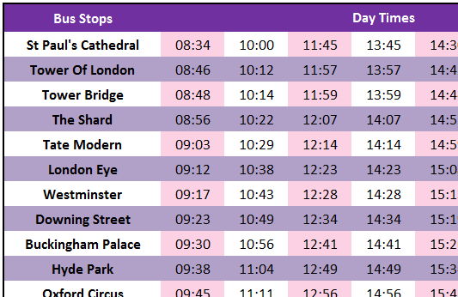
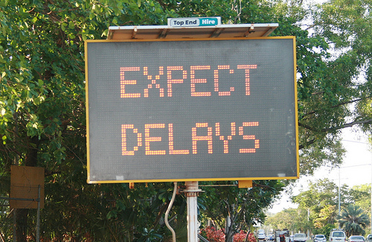
Why is transit accessibility not working?
In short, we do not measure it right.
Traditional studies used scheduled data.
Scheduled data is not reality
Delay or early arrival can happen (a lot!)
Source Source

Slide 4
So just measure the actual time!
Why don’t we just change the scheduled time to the actual real-time time?
Yes, people did:
Wessel, Allen, Farber (2017) and Wessel and Farber (2019) retrospectively calculate the real-time accessibility
They found that the retrospective real-time accessibility are significantly different from the scheduled accessibility
Is it the end of the discussion?

Slide 5
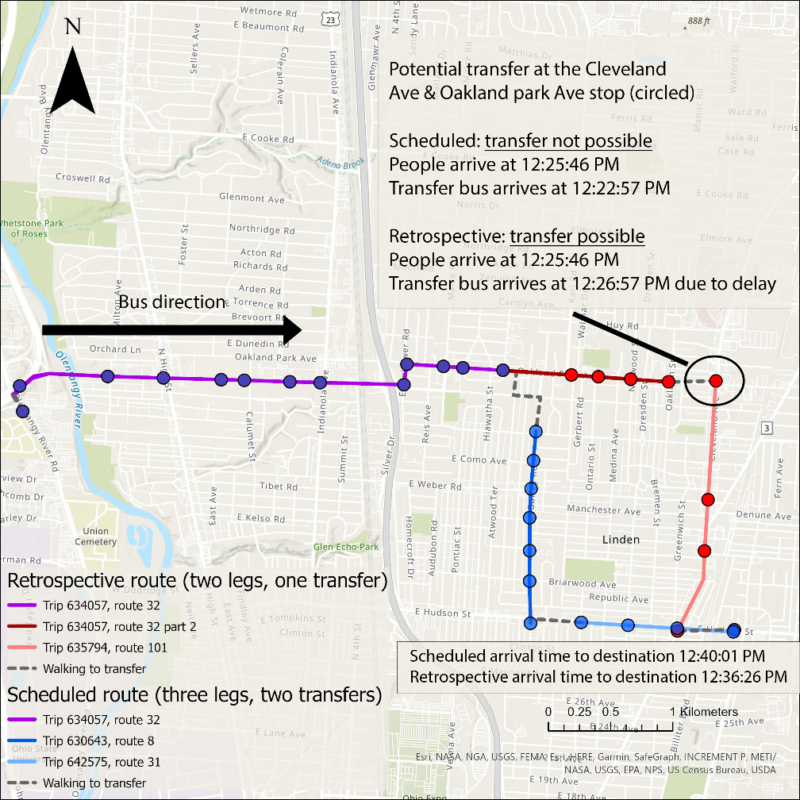
But can you actually do it?
Short answer: you cannot. Because you must predict the future.
No one can tell buses’ actual arrival time before taking the bus.
You need to make a trip plan before taking any buses.
What you planned can be different from what you take.

Slide 6
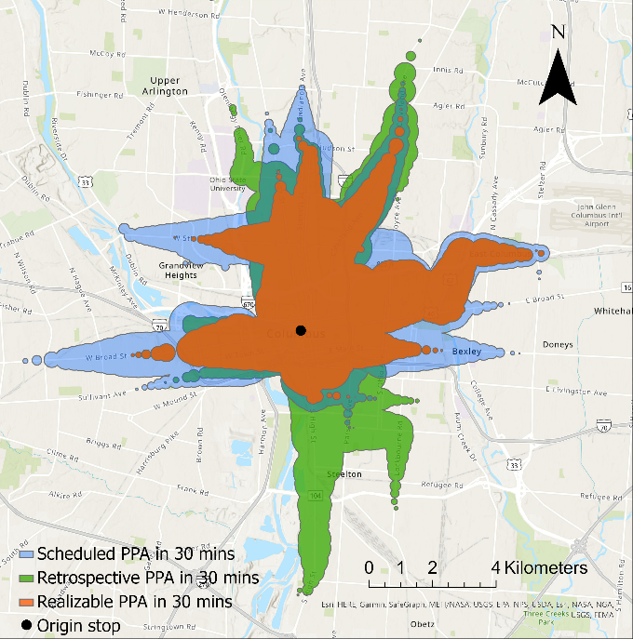
Realizable accessibility
It is two-step.
First plan with scheduled times, which are available beforehand.
Then implement with actual times.
Just like what human does.
It is more conservative.
Realizable accessibility has smallest reachable area in 30 minutes

Slide 7
How it changes

