Slide 1
A Solution to Time-dependent Routing Problem
Luyu Liu
8/11/2021

Slide 2
What is time-dependent routing problem?
Let’s break it down:
It’s essentially a routing problem
Find the shortest path and travel cost from start to end
Time-dependent? What is time-dependent?

Slide 3
Time-dependent
The travel time on a link depends on when the user arrives at the start of the link
For example:
The bus arrives at 9:00 am
Net bus time on the road segment is 5 minutes
When arriving at 9:00 am, the travel time is 5 minutes (net bus time)
When arriving at 8:55 am, the travel time is 5 min (net bus time) + 5 min (wait time)

Slide 4
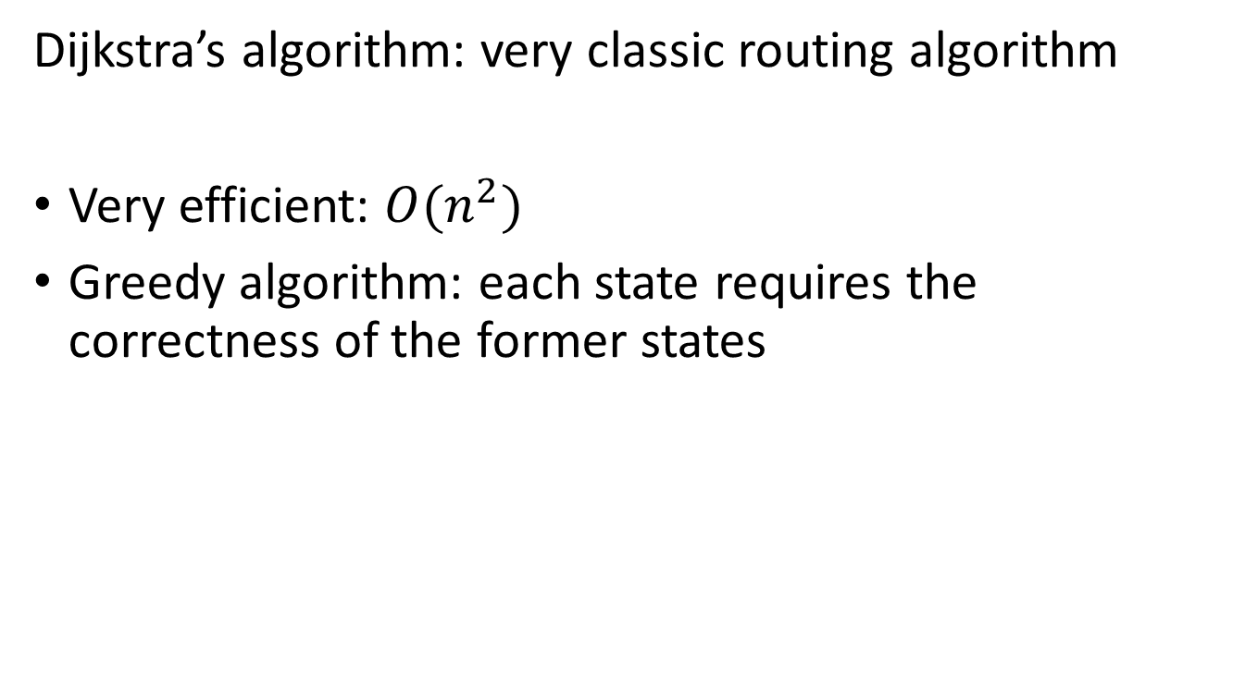
Solution?
Dijkstra’s algorithm: very classic routing algorithm
Very efficient: $O(n^{2})$
Greedy algorithm: each state requires the correctness of the former states
Or is it?
May only apply to static network
Source

Slide 5
Passing and FIFO
Due to passing, the assumption made by Dijkstra may not always hold
A later bus passes an earlier bus in a transit queue
In that sense, you can travel faster by arriving later
Then what?
We just don’t care about passing
FIFO (first-in-first-out) rule: there is no passing happening
Empirical data show there is indeed very few passing in COTA system

Slide 6
Python Implementation
I am working on a Python implementation with GTFS scheduled and real-time data. But why?
Mainstream algorithm is a black box to me
If they do support time-dependent routing, please tell me, e.g. open trip planner
Much more flexible for scientific calculation
Support for achieved real-time data

