Slide 1

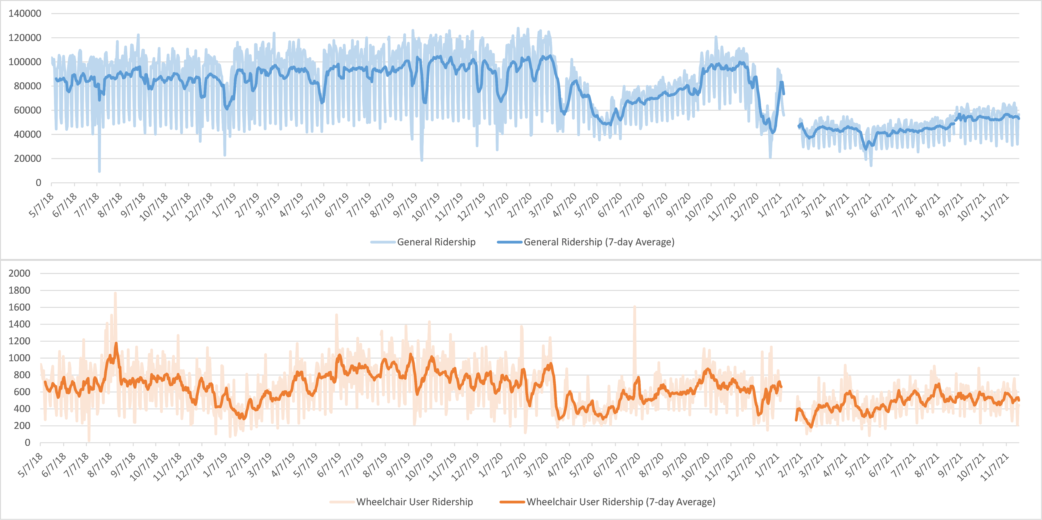
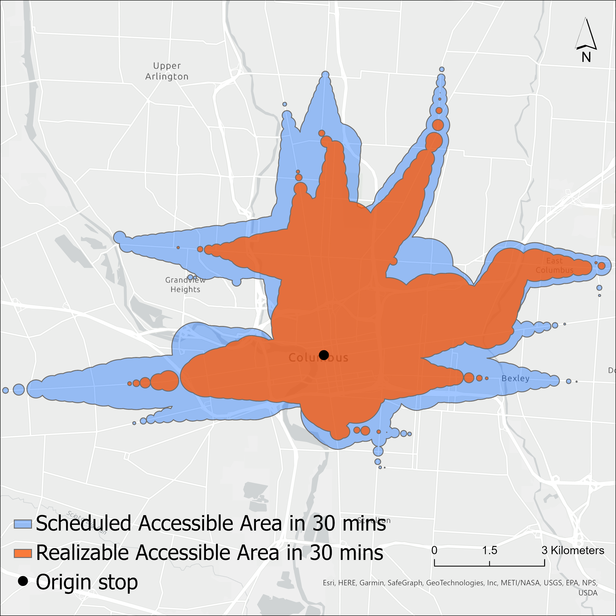
Measuring the Impacts of Disruptions on Public Transit Accessibility and Reliability
Luyu Liu, Adam Porr, Harvey J. Miller
Department of Geography, The Ohio State University
Background
Short-term Case: Ohio State Football Game
Long-term Case: COVID-19 Pandemic
Public transit systems are at higher risk of system degradation and decreased reliability due to external disruptions, making resilience (maintaining functions during a disruption) a crucial assessment.
Significant Disruption: With a 30-minute time budget, powered and manual wheelchair users’ accessible stops are 59% and 95% less than people without disabilities.
About 200 – 1800 disabled people used fixed-route public transit every day throughout the four years, which accounted for about 1% of all ridership. Wheelchair users’ behavior is also different:
More sensitive to low temperature and precipitation
Favor the middle of the day, rather than the rush hours
Stops with high ridership are more dispersed
Free fare policy helped to maintain high transit usage in 2020
Wheelchair users’ trips are more destination-driven, especially around shopping centers and medical centers
Data & Method
The city center, which also has highest accessibility and ridership, also has largest disparity in accessibility.
We calculate two space-time prism-based measures using GTFS-RT data: realizable real-time accessibility (achievable by users with delays) and scheduled accessibility.
We also calculate accessibility unreliability as the deviation between realizable and scheduled accessibility to measure the reliability of delivered accessibility.
Spatial pattern of wheelchair users’ access disparity
Sidewalks matter: Sidewalk infrastructure impacts transit accessibility significantly. Different infrastructure levels decreases all three groups’ accessible stops by about 50%.
Daily ridership (blue: general; orange: wheelchair users)
Transit usage during COVID: Wheelchair users have lower ridership than people without disabilities during 2020 but have disproportionately higher usage during 2021. But disparities in accessibility became larger during the pandemic. This suggests the lack of alternatives for fixed-route transit users in wheelchair.
Conclusions
Large accessibility disparities exist for wheelchair users in fixed-route public transit services
Wheelchair users’ usage patterns are also very different
The pandemic widened the disparity in both useability and usage of transit services for wheelchair users
Paratransit services are important as a complement
Unreliability: difference between scheduled and realizable accessible area
Three groups’ accessible stops count with different sidewalks

