Slide 1
Measuring the impact of COVID-19 on the Ridership in the US transit systems
Luyu Liu, Harvey Miller
The Ohio State University
Center for Urban and Regional Analysis

Slide 2
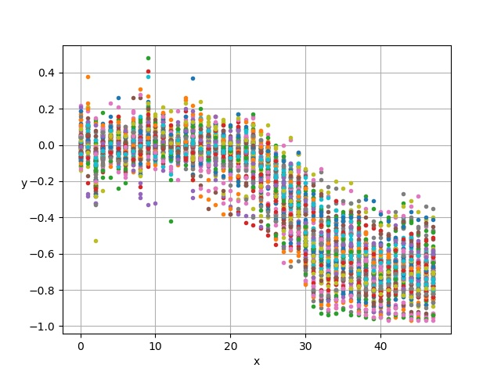
All systems

Slide 3
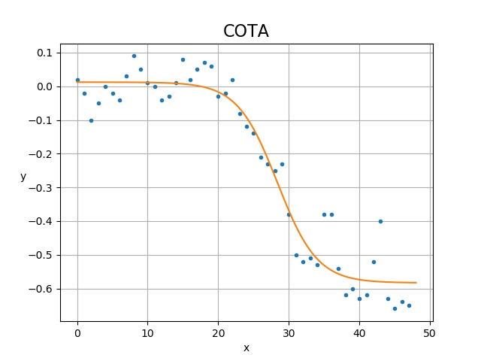
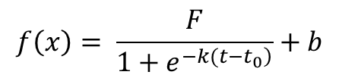
An example of logistic curve
$$f\left(x\right)= \frac{F}{1+e^{\left.−k(t−t_{0}\right)}}+b$$
F: Floor value
How far can the system reach?
How many users rely on the transit system?
How many transit users cannot working from home?
How aware are the local people?
F

Slide 4
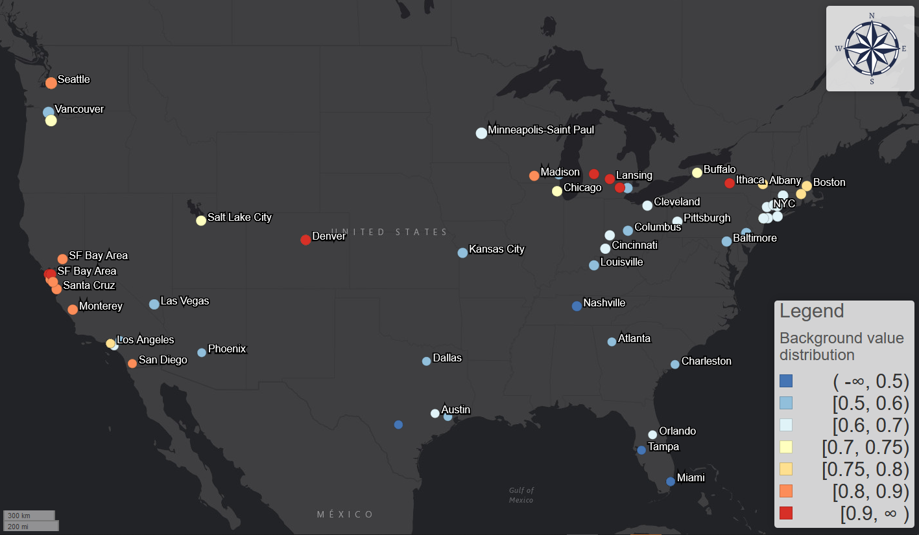
Red:
Care a lot about the coronavirus;
Can switch to other transportation anytime;
Can work from home
Floor
Blue:
Don’t care about the coronavirus;
Rely on transit system
Cannot work from home

Slide 5
Floor
Every city may have very different platform value:
Columbus: 50% ~
New York: 70% ~
Seattle and Bay area: 80%~
UCB: 90%+

Slide 6
Response interval
The interval between actual case increase and demand decrease
Demand decrease is usually (but not always) earlier than actual case increase.
Goal: to see whether people started to avoid transit trips when the local community spread began.

Slide 7
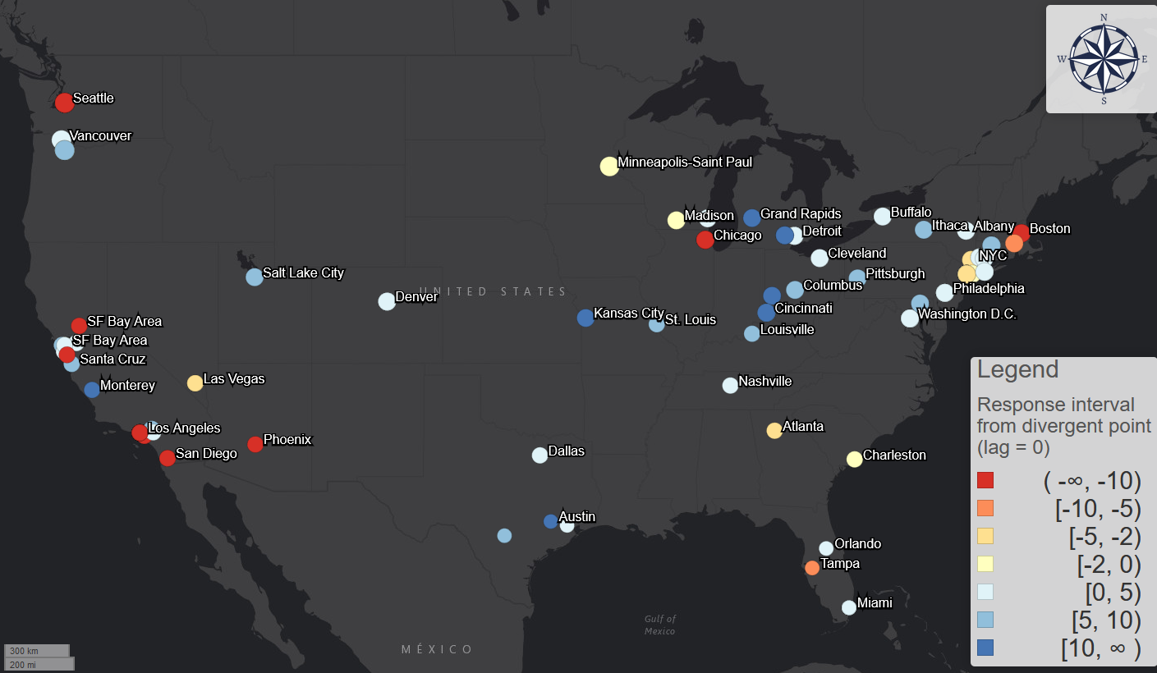
Red: responded late
Blue: responded early

Slide 8
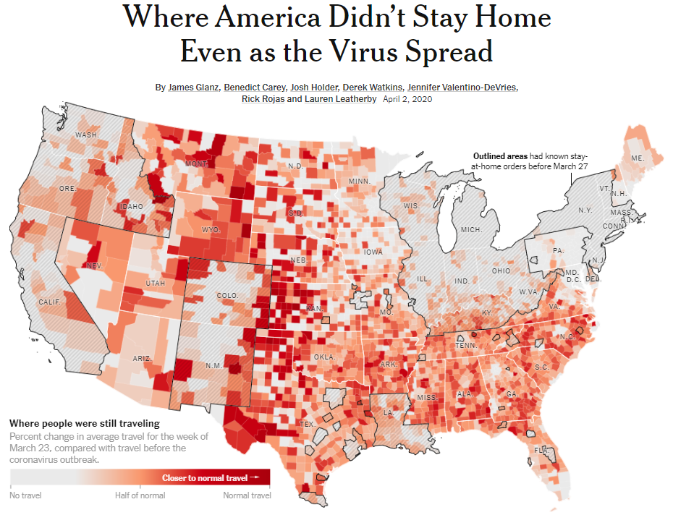

Slide 9
Some questions for Transit app

Slide 10
Need raw ridership/demand data for averaging purposes
Cannot aggregate different systems/days with percentages.
If raw data is sensitive, we can also work with normalized/adjusted value.
For example, the percentage version of everyday’s demand based on the highest day.
 | 4/2/2020 | 4/3/2020 | 4/4/2020 | 4/5/2020
Raw demand | 10000 | 20000 | 10000 | 15000
Percentage version | 50% | 100% | 50% | 75%

Slide 11
Further hourly data?
Current at 3/7/2020.
Seattle already witness decrease from 2/18/2020.

Slide 12
More data on local scale
Concentrate on Columbus, Ohio;
Higher resolution on local geographies;
Parcels? Census tracts?
Data type: app activity; trips; OD matrix?

Slide 13
Representativeness of transit app data?
We collect 40 systems official ridership declining figures;
Local news and reports;
No bias for T-Test.
Average bias = 3.7%, Standard deviation = 15.96% (still large)
Any survey on this?

Slide 14
Future: more data, more analyses
Hourly analysis
Shape similarity before and after: different city types.
Distance between curves before and after.
Weekday analysis.

