Slide 1
Measuring the impact of COVID-19 on the Ridership in the US transit systems

Slide 2
SFMTA – San Francisco

Slide 3
Seattle

Slide 4
MTA buses Manhattan – New York City

Slide 5
Miami

Slide 6
COTA – Franklin OH

Slide 8
Parameters
Slope: the speed of declining;
Platform: the proportion that cannot WFH.
Delay: the offset between case increase and demand decrease

Slide 9
Slope
The speed of declining
It may represent the response of a city/state

Slide 10
Platform
Every city may have very different platform value:
Columbus: 50% ~
New York: 70% ~
Seattle and Bay area: 80%~
UCB: 90%+

Slide 11
Delay
the offset between case increase and demand decrease
Demand decrease is always earlier than actual case increase.
Could be because of:
Test case release date is late;
Awareness is good;
How to tell delay from slope:
Some system is just late
And some systems are just slow
Statistic test

Slide 12
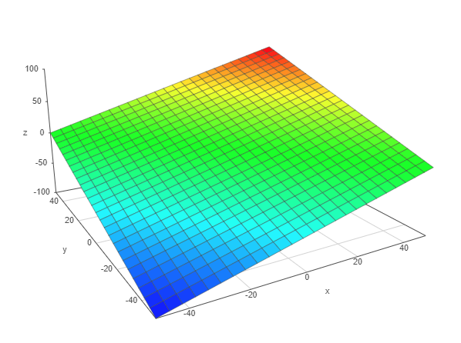
Two polar: Urban rate and white-collar rate
Urban rate OR sustainability score: how many (portion) people rely on public transit to work;
White-collar rate or collar whiteness: how many (portion) people can actually WFH.
Platform value
Service/manufacture
Car- dominating
University;
Office/white collar dominating
transit- dominating

Slide 13
Top 20 declining systems
University of California Berkeley (Bear Transit) | SF Bay Area
PresidiGo | SF Bay Area
Via Mobility Services (Boulder) | Denver
TCAT | Ithaca
U-M Transit | Ann Arbor
Golden Gate Transit | SF Bay Area
The Ride | Ann Arbor
Glendale Beeline | Los Angeles
MUNI (SFMTA) | SF Bay Area
City of Seattle | Seattle
AC Transit | SF Bay Area
BART | SF Bay Area
Capitol Corridor | SF Bay Area
Santa Cruz Metro | Santa Cruz
Madison Metro | Madison
SamTrans | SF Bay Area
West Hollywood (WeHo) | Los Angeles
Caltrain | SF Bay Area
Monterey-Salinas Transit | Monterey
Santa Clarita Transit | Los Angeles
CTA | Chicago
Las Vegas Monorail | Las Vegas

Slide 14
Those who didn’t actually decline
CTTransit New Britain | New Britain | Hartford | Connecticut
Fairfax Connector | Washington D.C. | D.C | D.C
SMART | Detroit | Wayne | Michigan
KCATA | Kansas City | Jackson | Missouri
CTTransit New Haven | New Haven | New Haven | Connecticut
Montgomery County Transit | Washington D.C. | D.C | D.C
MTA | Baltimore | Baltimore | Maryland
VIA | San Antonio | Bexar | Texas
Tri-Rail | Miami | Miami-Dade | Florida
Shore Line East | New Haven | New Haven | Connecticut
Palm Tran | Miami | Miami-Dade | Florida
CTTransit Hartford | Hartford | Hartford | Connecticut
Hartford Line | Hartford | Hartford | Connecticut
Greater Dayton RTA | Dayton | Montgomery | Ohio
PSTA | Tampa | Hillsborough | Florida
HRT | Hampton | Hampton city | Virginia
Or just not severe… Or hasn’t reach the platform

Slide 15
Another theory: why Columbus is so low
Columbus is still engaging.
Hasn’t reached the platform.

Slide 16
To-do
Calculate Slope,

