Slide 1
The impacts of COVID-19 pandemic on public transit demand in the United States
Luyu Liu
2020.11.19
Notes:
Hello everyone, my name is Luyu Liu. Today I would like to see the measure the real-time information’s impact on public transit user’s waiting time using high-resolution real-time data

Slide 2
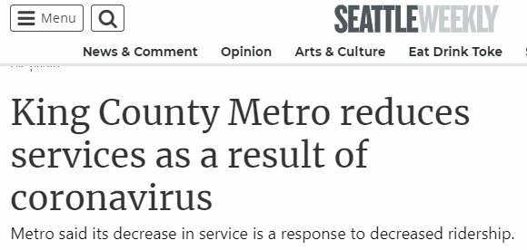
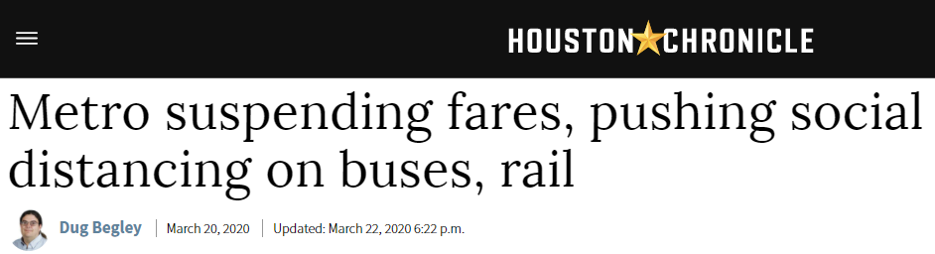
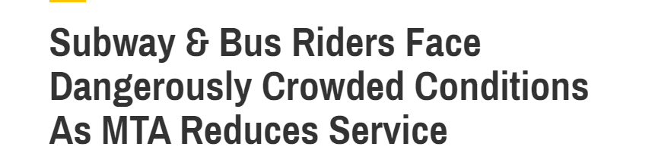
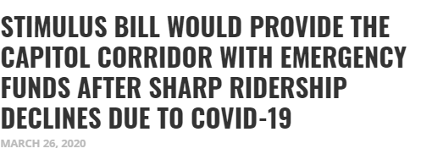
Transit in a crisis
Seattle: decreased for 60% of ridership
Houston: decreased for 29% of ridership
NYC: decreased for 70% of ridership
Sacramento: decreased for 90% - 95% of ridership

Slide 3
Research questions
How many people continue to transit during the lockdown?
Who are these people?
What can we learn from the crisis?
Notes:
You probably didn’t want to use transit back during the lockdown back in April - May.

Slide 4
Data – Transit demand
Cell phone activity data from Transit app.
How many people plan their transit trips on their cell phone every day in a transit system?
Demand; not accurate ridership.
113 county-level transit systems
63 metro areas
28 states

Slide 5
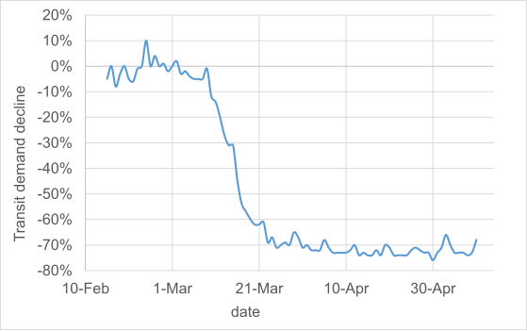
Transit Demand decrease – US average

Slide 6
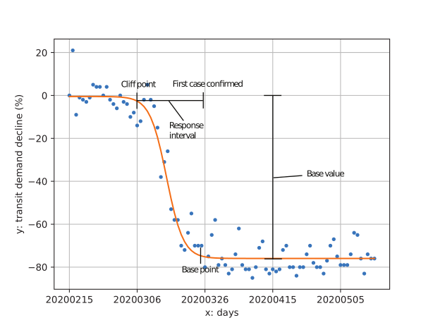
Analyze a transit decline process
Logistic function modeling
Base value: how many people were still using transit during the lockdown
Transit demand decrease in Capital metro, Austin, Texas

Slide 7
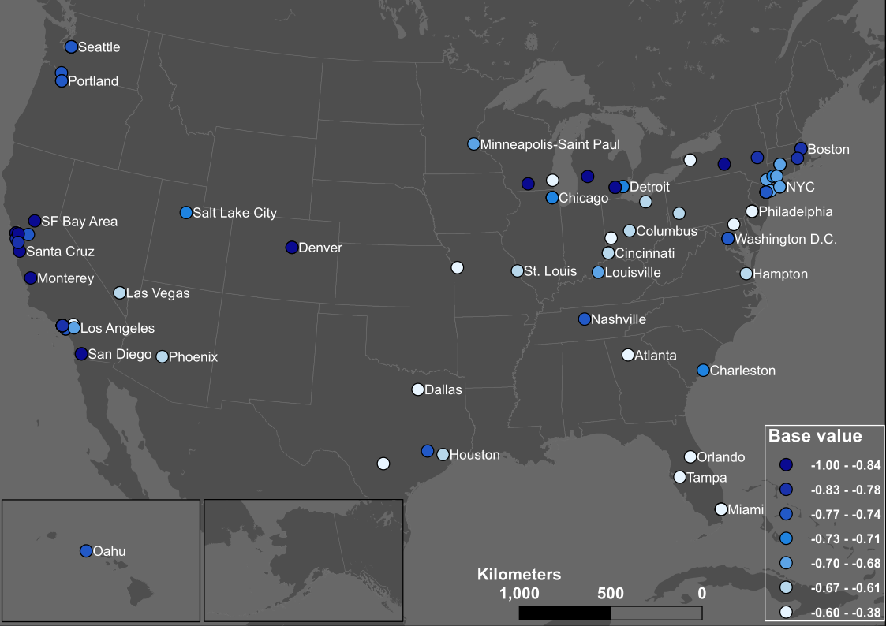
More people using transit
Less people using transit

Slide 8
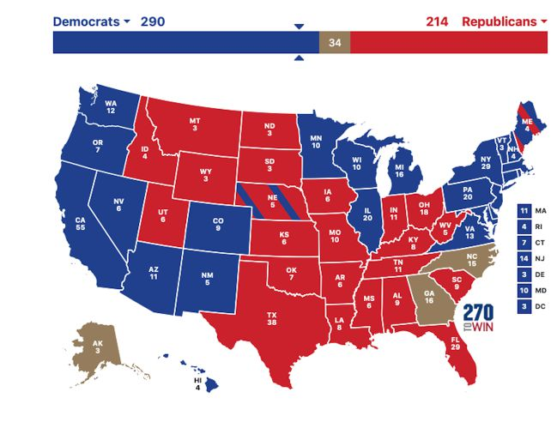

Slide 9
Who are still using transit - a regression analysis
Four significant factors contribute to the base value – how many people were using transit during the lockdown in a city.
From most significant factors to less ones:
African-American and women;
Occupation (non-physical jobs) and Hispanic;
Age (>45 y/o)
Awareness of the pandemic (Google search index)

Slide 10
Who is using transit – African-American and women
If a city has higher ratio of African-American people and women, more people will use transit during the lockdown.
Survey shows:
African-American: 24% => 37%
Caucasian: 41% => 23%
Gender ratio: 50 (F) / 50 (M) => 56 (F) / 40 (M)
In some cities like Philadelphia, more than 68% of riders are women.

Slide 11
Who is using transit – Occupation/Hispanic
More people cannot work remotely (necessary workers), more people sticked to the transit.
More Hispanic people, more people used transit.
Simple fact (maybe even stereotypical)
Hispanic people have the highest percentage of physical occupations.

Slide 12
Who is using transit – age and awareness
More senior people over 45 years old, more people using transit.
More people searching “Coronavirus” on Google, less people using transit.
During this crisis, your preference/awareness is hardly a factor.
Your race, your gender, your job, and your age matter more.

Slide 13






Peasants deal with it
Aight Imma head out
Who’s here to stay?

Slide 14
What do we learn
Despite an unknown deadly virus and lockdown, people still need transit systems.
These people are the vulnerable, the minorities, the poor, and the ones who have no choice.
Your preference hardly matters during this crisis.
We may want to think twice before complaining about zoom calls.
Public transit should not be a business, but a social-welfare.

Slide 15
Thanks!
liu.6544@osu.edu

